Slide 1

BANK LOAN CASE STUDY
(Final Project-2)
https://1drv.ms/x/c/e1641d3ba3ec422b/Efy1pc8Ae8FDunC4JB83J70B9UOfG1GKAqhlH0-gt6bNUg?e=qw0V2W

Slide 2
Project Description:
This case study attempts to demonstrate the application of EDA in a real-world business environment. In this case study, in addition to using the techniques learned in the EDA module, it will help in gaining a basic grasp of risk analytics in banking and financial services, as well as how data is utilized to reduce the risk of losing money when lending to consumers.
The company wants to understand the driving factors (or driver variables) behind loan default, i.e. the variables which are strong indicators of default.
When a customer applies for a loan, your company faces two risks:
1. If the applicant can repay the loan but is not approved, the company loses business.
2. If the applicant cannot repay the loan and is approved, the company faces a financial loss
The dataset you'll be working with contains information about loan applications. It includes two types of scenarios:

Slide 3
Description:
1. Customers with payment difficulties: These are customers who had a late payment of more than X days on at least one of the first Y installments of the loan.
2. All other cases: These are cases where the payment was made on time.
When a customer applies for a loan, there are four possible outcomes:
1. Approved: The company has approved the loan application.
2. Cancelled: The customer cancelled the application during the approval process.
3. Refused: The company rejected the loan.
4. Unused Offer: The loan was approved but the customer did not use it.

Slide 4
APPROACH
This case study has two enormous data sets: the current application and the previous application. Each included several unneeded columns that would be useless for risk assessments, as well as many blank data. So, first step is cleaning the data.
To evaluate his enormous set of data, I first cleaned the data, located some outliers and deleted them, and then began performing univariate and bivariate analysis using pivot tables and charts.

Slide 5
TECH-STACK USED
Software And The Version Used While Making The Project :
1. MS Excel (For working, analysing and reporting insights)
2. Microsoft Power Point (For presenting the detailed analysis)

Slide 6
Task 1 : Present the overall approach of the analysis. Mention the problem statement and the analysis approach briefly
Both the CSV files will be checked for any unnecessary data and unwanted columns/rows, and will be cleaned/removed if necessary. Then they will be checked for outliers, if any, to find if there is skewness in the given columns which would affect the final visualization and insight. Data Imbalance will be checked. Different types of analysis will be done to understand the relationships between different variable to find the Driving Factors. Different visualizations will be observed to understand the relationships
Notes:
Both the CSV files will be checked for any unnecessary data and unwanted columns/rows, and will be cleaned/removed if necessary. Then they will be checked for outliers, if any, to find if there is skewness in the given columns which would affect the final visualization and insight. Data Imbalance will be checked. Different types of analysis will be done to understand the relationships between different variable to find the Driving Factors. Different visualizations will be observed to understand the relationships

Slide 7
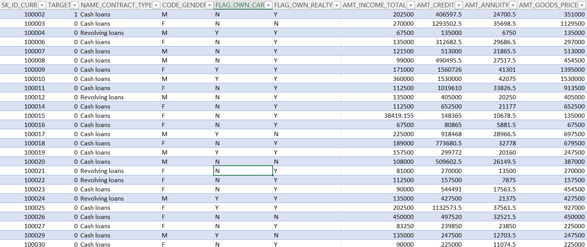
After Cleaning the Table

Slide 8
Task 2 : Identify the missing data and use appropriate method to deal with it. (Remove columns/or replace it with an appropriate value)
In Applicant_data.csv
Before Cleaning, the number of Columns and rows are 122 and 3075124 respectively. Items removed from the original dataset are :
There are columns having more than 40% null data.
There are more than 50 unwanted columns or columns not desirable for our analysis. (Hint: Note that in EDA, since it is not necessary to replace the missing value, but if you have to replace the missing value, what should be the approach. Clearly mention the approach.)
There are columns with null values less than 40%. They can be treated in 2 ways. I can delete those columns but then I might lose some important information required for my analysis. I can retain it but then I will have to do treatment. If I impute them, I will introduce bias. The decision to delete or retain basically depends on the Understanding of the problem statement, the usefulness of the variable, total size of available data. Here it seems that those columns can be removed So, I have removed them. There are still some columns will very little missing values which will be treated if necessary or left as it is.

Slide 9
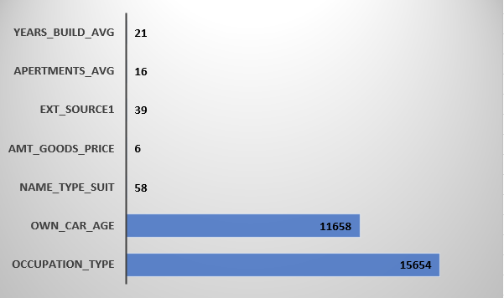
Identify Missing Data and Deal with it Appropriately

Slide 10
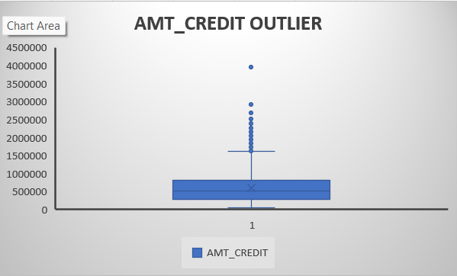
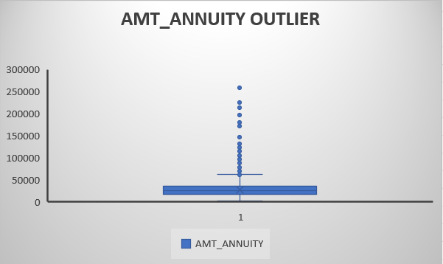
Task 3: Detect and identify outliers in the dataset using Excel statistical functions and features, focusing on numerical variables.

Slide 11
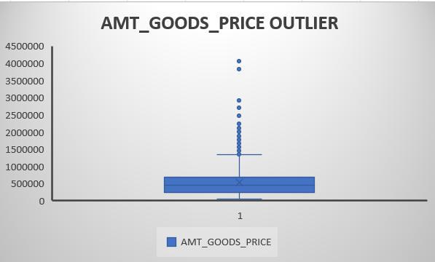
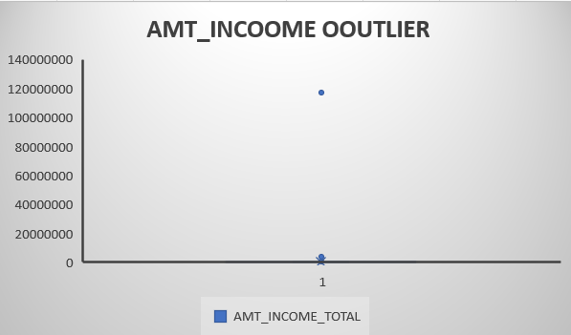
Outlier Analysis:

Slide 12
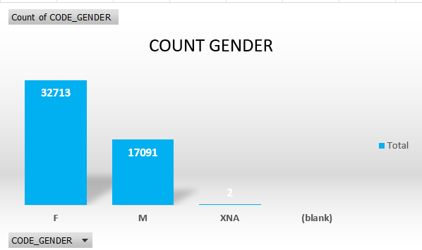
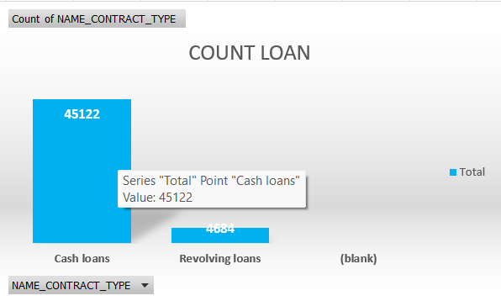
Task 4 : Identify if there is data imbalance in the data. Find the ratio of data imbalance.

Slide 13
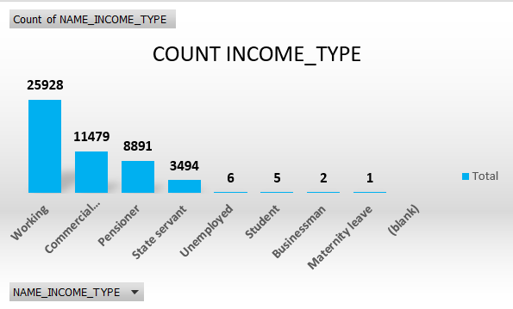
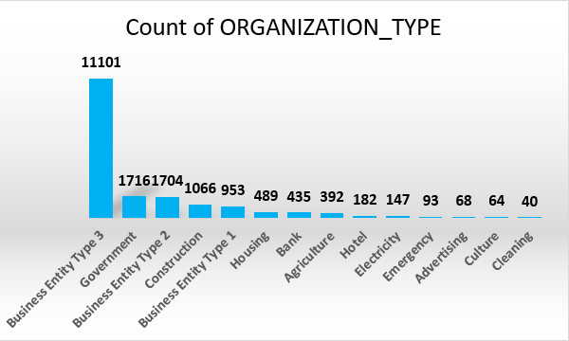
Imbalanced Data:

Slide 14
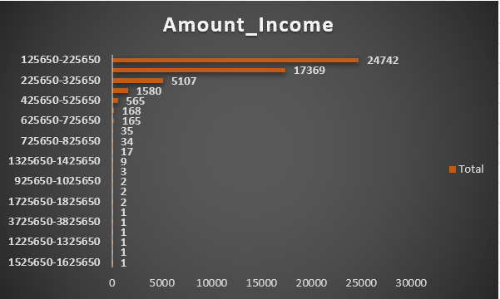
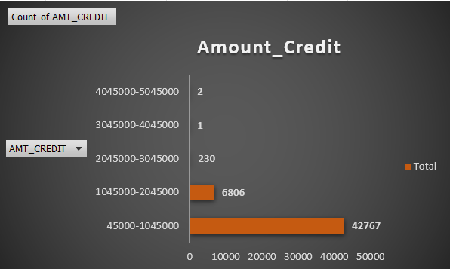
Task 5: Explain the results of univariate, segmented univariate, bivariate analysis, etc. in business terms.
Univariate:

Slide 15
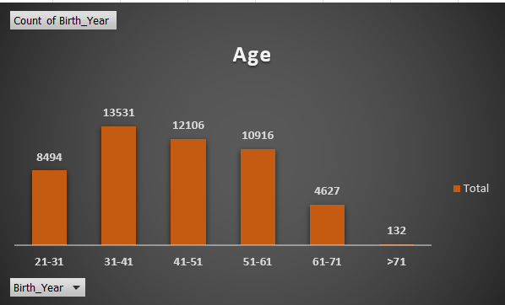
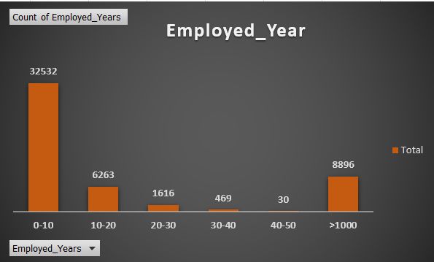
Group Chart:

Slide 16
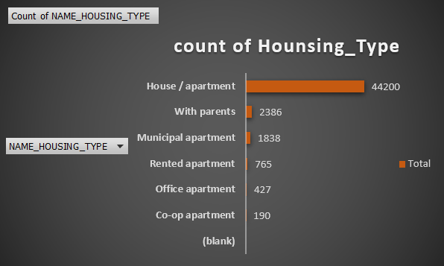
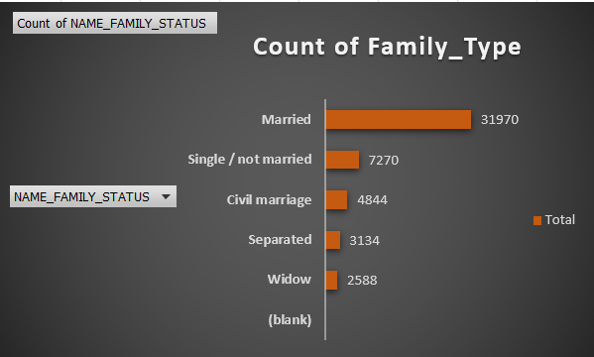
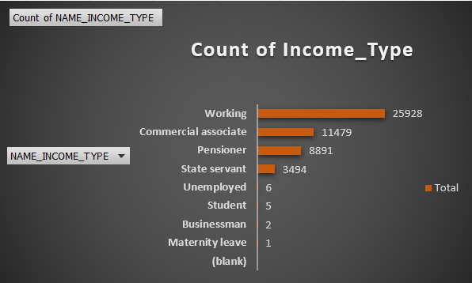
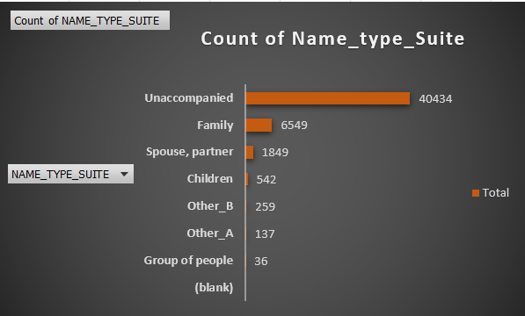
Count Variables:

Slide 17
Analysis:
Individuals with higher incomes are less likely to apply for loans.
The credit amount of a bank loan is typically in the range of 45000 to 545000.
Individuals whose house/apartment are more likely to apply for loans than others.
More loans have been requested by working people.
Those who are married have taken out more loans.
Unaccompanied minors have requested for extra loans.
Those with 0 to 10 years of work experience are the most likely to seek for loans.
The majority of loan applications have come from people between the ages of 31 and 41.

Slide 18
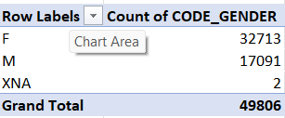
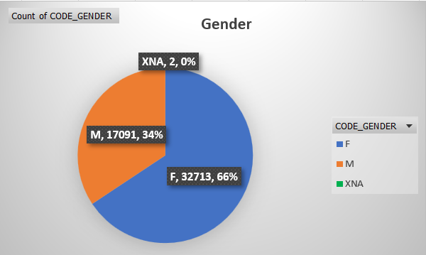
SEGMENTED UNIVARIATE ANALYSIS

Slide 19
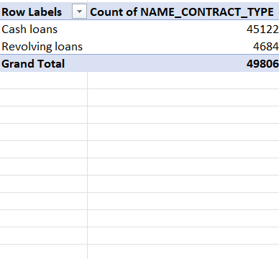
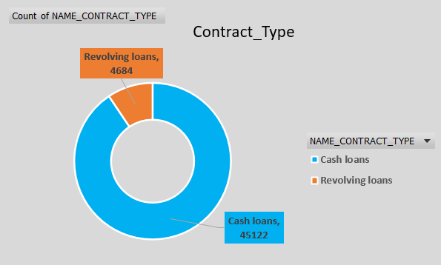
Pie Chart:

Slide 20
BIVARIATE ANALYSIS :
Customers who live in low-rating areas will have higher defaults.
Individuals with lower incomes are more likely to default.
Young people are more likely to default, and the trend of defaulters declines with age.
Ladies are less inclined than males to have defaults.
More defaults are predicted due to maternity leave and unemployment.
Customers with more than five family members are more likely to default on their bank loan.
Customers with fewer educational qualifications are more likely to fail on a bank loan.
Customers with hardly work experience are more likely to have defaults.

Slide 21
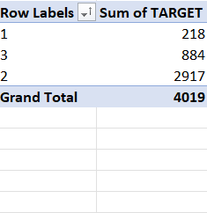
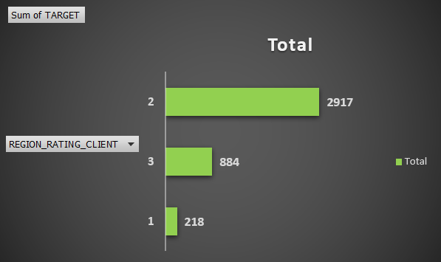
Chart:

Slide 22
Task 6 : Find the top 10 correlation for the Client with payment difficulties and all other cases (Target variable).
Top 10 driving factors in current application.csv
1.Income type
2. Count of Family Members
3. Birth Year
4. External source
5. Region rating of client
6. Age
7. Years Employed
8. Amount credit
9. Amount Goods Price
10. Amount total income

Slide 23
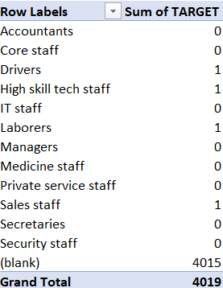
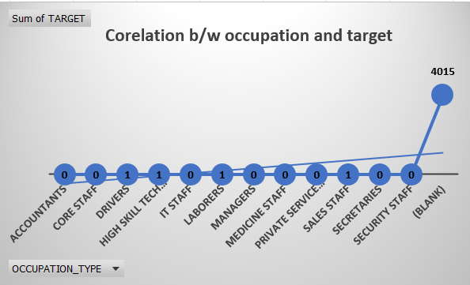
Corelation:

Slide 24
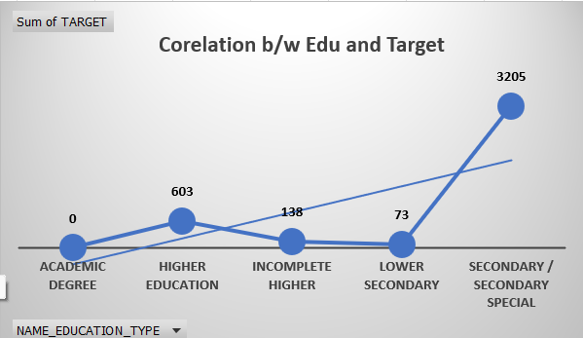
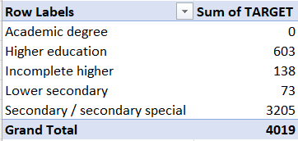
Corelation:

Slide 25
Insights
NAME_EDUCATION_TYPE: Academic degree has less defaults.
NAME_INCOME_TYPE: Student and Businessmen have no defaults.
REGION_RATING_CLIENT: RATING 1 is safer.
ORGANIZATION_TYPE: Clients with Trade Type 4 and 5 and Industry type 8 have defaulted less than 3%.
DAYS_BIRTH: People above age of 61-71 have low probability of defaulting
DAYS_EMPLOYED: Clients with 50+ year experience having less than 1% default rate.
AMT_INCOME_TOTAL: Applicant with Income more than 30-40 lakh are less likely to default.
NAME_CASH_LOAN_PURPOSE: Loans bought for Hobby, buying garage are being repaid mostly.
CNT_CHILDREN: People with zero to two children tend to repay the loans.
CODE_GENDER: Men are at relatively higher default rate
NAME_FAMILY_STATUS: People who have civil marriage or who are single default a lot.
NAME_EDUCATION_TYPE: People with Lower Secondary & Secondary education
NAME_INCOME_TYPE: Clients who are either at Maternity leave OR Unemployed default a lot.
REGION_RATING_CLIENT: People who live in Rating 3 has highest defaults.
OCCUPATION_TYPE: Avoid Low-skill Laborers, Drivers and Waiters/barmen staff, Security staff, Laborers and Cooking staff as their default rate is huge

Slide 26
Loan-Highly Recommended Loan-High Risk Group Groups
Loan-Highly Recommended Groups Previous application approved clients Married clients Senior client More Educated clients Customer with high income Clients with greater external source Females Customer with strong work experience | Loan-High Risk Groups Clients that are unemployed Youth clients Customer whose prior application denied Low income clients Clients with insufficient external sources Customer with little work experience Customer on maternity leave Clients with large number of family members
Previous application approved clients
Married clients
Senior client
More Educated clients
Customer with high income
Clients with greater external source
Females
Customer with strong work experience

Slide 27
Results
After performing the analysis, we can rectify whether a client will repay the loan or not.
The people who are likely to face problem in loan repayment are labourers.
People with Secondary /secondary special education might face problem in loan repayment.
Moreover, those who are living in house/apartment are facing difficulty in loan repayment (may be because of extra home loan, EMIs and so on).

Slide 28
END OF REPORT
THANK YOU

