Slide 1

2023.03.31
Neural Prophet 사용하여 참외거래량 예측하기
Prepared By KHOEURN Saksonita

Slide 2
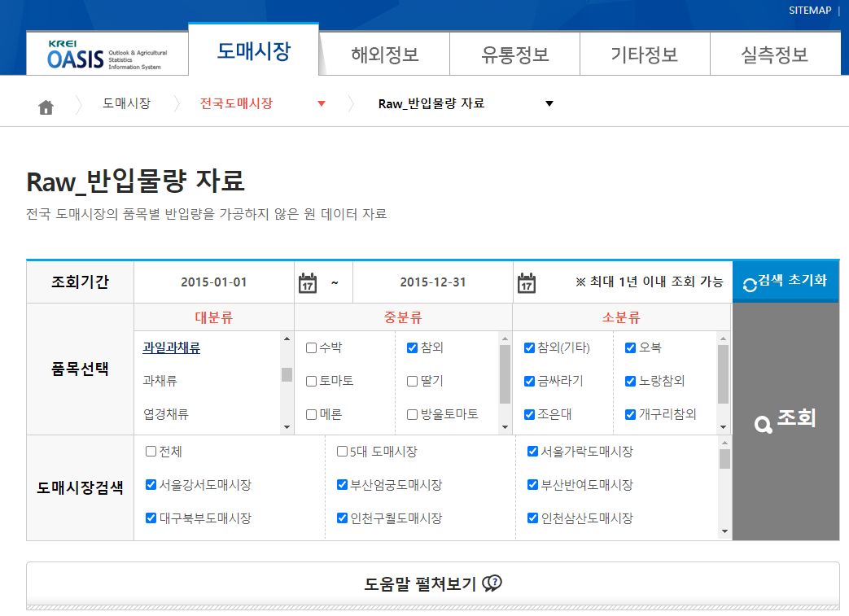
DATA SOURCES
Korean |  | English |  | Description
거래년월일 |  | Trade Date |  | The date on which the transaction took place (e.g., purchase, sale, or exchange of items).
품목명 |  | Item Name |  | The name of the product being traded.
시장코드 |  | Market Code |  | A unique identifier for the market where the transaction took place.
시장명 |  | Market Name |  | The name of the market where the transaction took place.
출하지코드 |  | Departure Code |  | A unique identifier for the location from which the items were shipped or dispatched.
출하지명 |  | Departure Name |  | The name of the location from which the items were shipped or dispatched.
거래량 |  | Transaction Volume |  | The quantity of items traded during the transaction (Kg).
품목코드 |  | Item Code |  | A unique identifier for the specific item being traded.
235,428 Entries
2015-2022
Sources: https://oasis.krei.re.kr/basicInfo/wholesale/qty.do

Slide 3
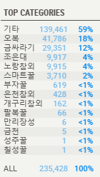
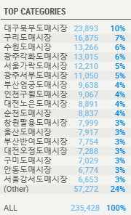
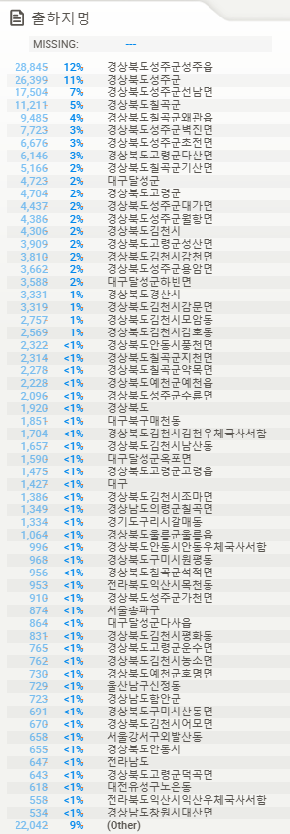
EDA & DATA PREPROCESSING
품목명
시장명
출하지명
Mostly the sources are from 성주
The top transaction is from 대구

Slide 4
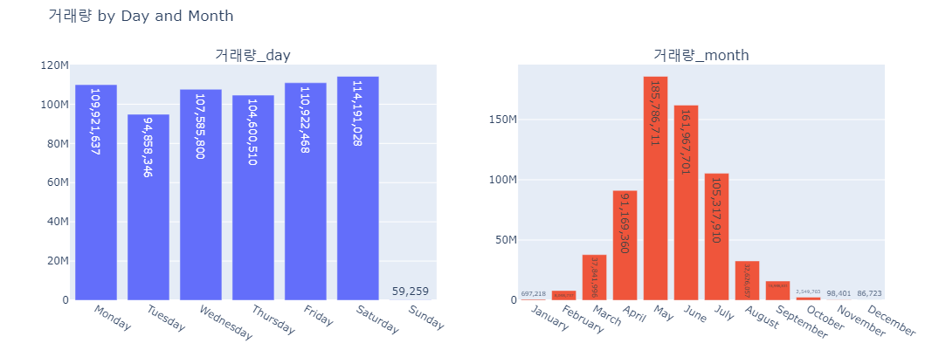
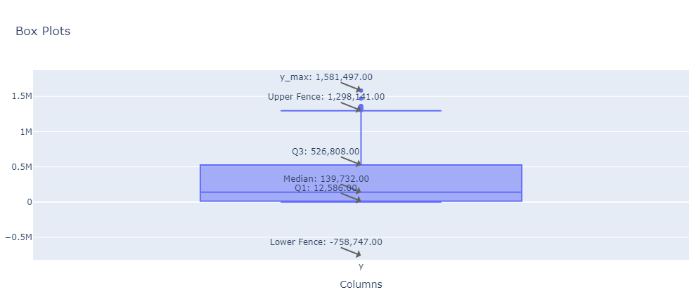
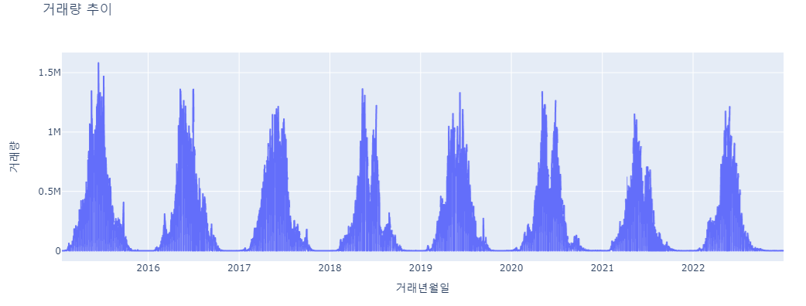
EDA & DATA PREPROCESSING
Sum up all the 거래량 day by day
Fill missing values with 0
Final Dataset: 2,904 entries, 2015-01-19 to 2022-12-31
Flatten Outliers

Slide 5
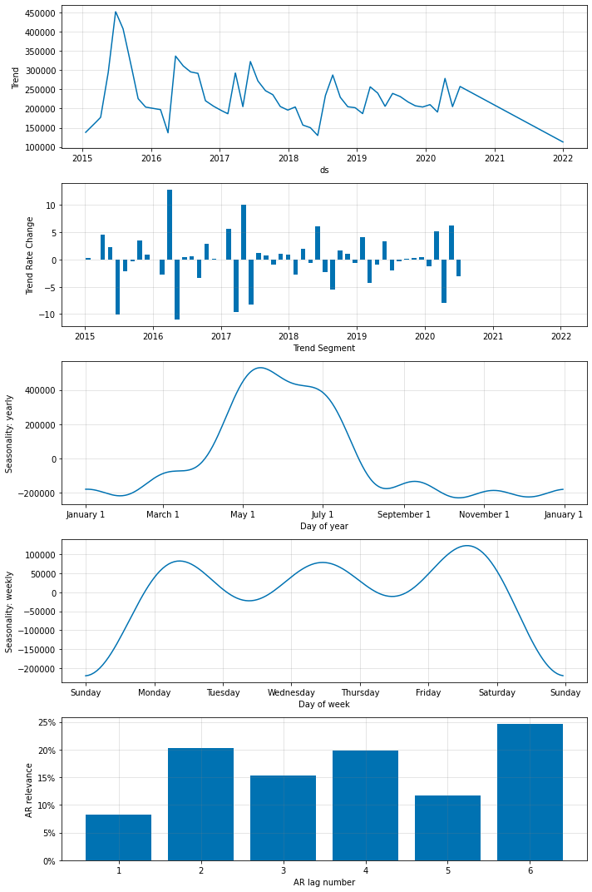
MODEL CREATION
Parameter
Value
Parameter | Value
growth | linear
n_lags | 6
n_forecasts | 360
seasonality_mode | additive
n_changepoints | 50
num_hidden_layers | 3
weekly_seasonality | auto
yearly_seasonality | TRUE
daily_seasonality | FALSE
normalize | minmax
d_hidden | 64
learning_rate | 0.03
batch_size | 45
epochs | 200
Train: 2015-2021
Test: 2022

Slide 6
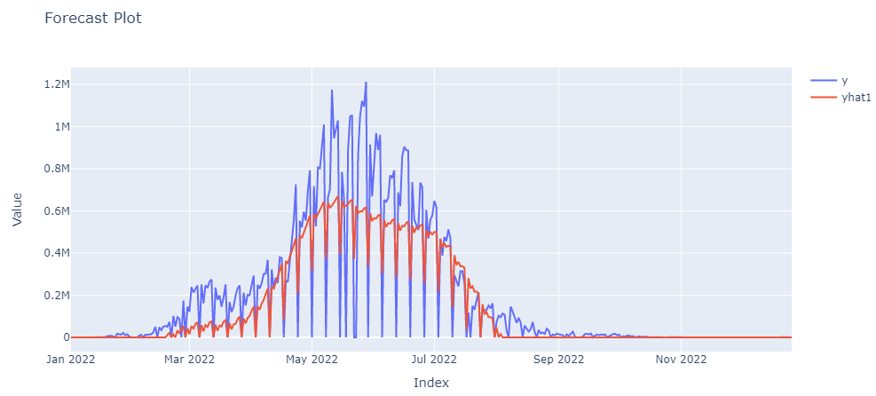
MODEL VALIDATION
MAE : 76833.11666666667
RMSE: 140426.97845183135

Slide 7
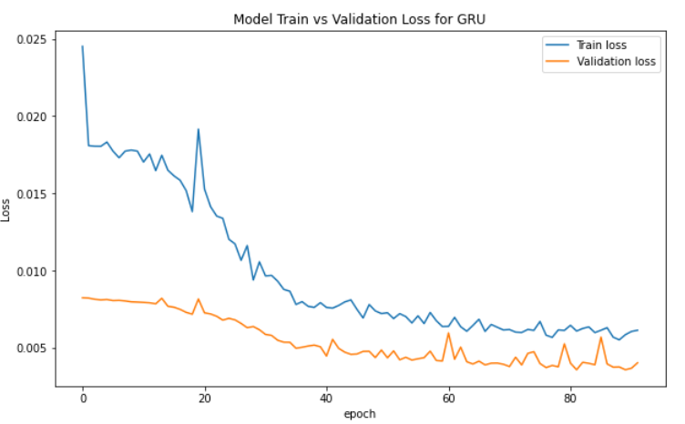
GRU
Layer | Type | Output Shape | Param #
gru_2 | GRU | (None, 30, 64) | 12,864
dropout_2 | Dropout | (None, 30, 64) | 0
gru_3 | GRU | (None, 64) | 24,960
dropout_3 | Dropout | (None, 64) | 0
dense_2 | Dense | (None, 1) | 65
Total params: |  | 37,889
Trainable params: |  | 37,889
Non-trainable params: |  | 0

Slide 8
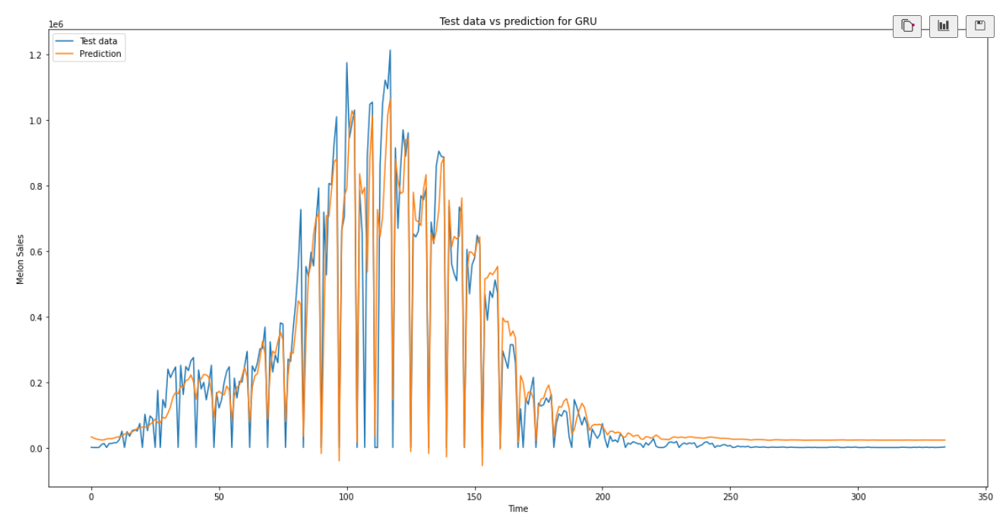
GRU MODEL EVALUATION
MAE : 50249.6049
RMSE: 92620.4026

Slide 9
Model 1
Data Preprocessing
Linear growth trend assumption
Additive seasonality
Min-max normalization
Model Architecture
Input Layer: n_lags (8)
Hidden Layer 1: d_hidden (64)
Hidden Layer 2: d_hidden (64)
Hidden Layer 3: d_hidden (64)
Output Layer: n_forecasts (30 * 12)
Seasonality Components
Weekly seasonality: auto
Yearly seasonality: True
Training Configuration
Learning rate: 0.03
Batch size: 45
Epochs: 200
n_changepoints: 50

Slide 10
Initialize
Model 1: Primary configuration
Model 2-5: Alternate configurations with varying n_lags and learning_rate values
Train
Train each model for 200 epochs
Calculate
For each model:
Predict on validation data
Handle missing values
Compute mean squared error
Store errors in a list
Compute
Determine ensemble weights based on inverse errors
Normalize weights
Ensemble Forecast
Generate weighted forecast using ensemble approach

Slide 11
Initialize
Model 1: same as the first model
Model 2: n_lags=10, learning_rate=0.001
Model 3: n_lags=20, learning_rate=0.001
Model 4: n_lags=10, learning_rate=0.01
Model 5: n_lags=20, learning_rate=0.01
Train
Train 200 epochs each model
Calculate
For each models:
Predict on validation data
Combine
Calculate weights based on inverse errors
Normalize weights
Ensemble Forecast
Fill NaN values with 0
Calculate mean squared error
Append error to errors list

Slide 12




First Model
Data Preprocessing
Model Architecture
Seasonality Components
Training Configuration
Linear growth trend assumption
Input Layer: n_lags (8)
Weekly seasonality: auto
Learning rate: 0.03
Output 1
Hidden Layer 1: d_hidden (64)
Batch size: 45
Additive seasonality
Hidden Layer 2: d_hidden (64)
Yearly seasonality: True
Epochs: 200
Min-max normalization
Hidden Layer 3: d_hidden (64)
Input
Output Layer: n_forecasts (30 * 12)
n_changepoints: 50
Ensemble Model
Initialize
Train
Calculate
Combine
Model 1: same as the first model
Train 200 epochs each model
For each models:
Predict on validation data
Fill NaN values with 0
Calculate mean squared error
Append error to errors list
Calculate weights based on inverse errors
Ensemble Output
Model 2: n_lags=10, learning_rate=0.001
Model 3: n_lags=20, learning_rate=0.001
Normalize weights
Model 4: n_lags=10, learning_rate=0.01
Model 5: n_lags=20, learning_rate=0.01

Slide 13
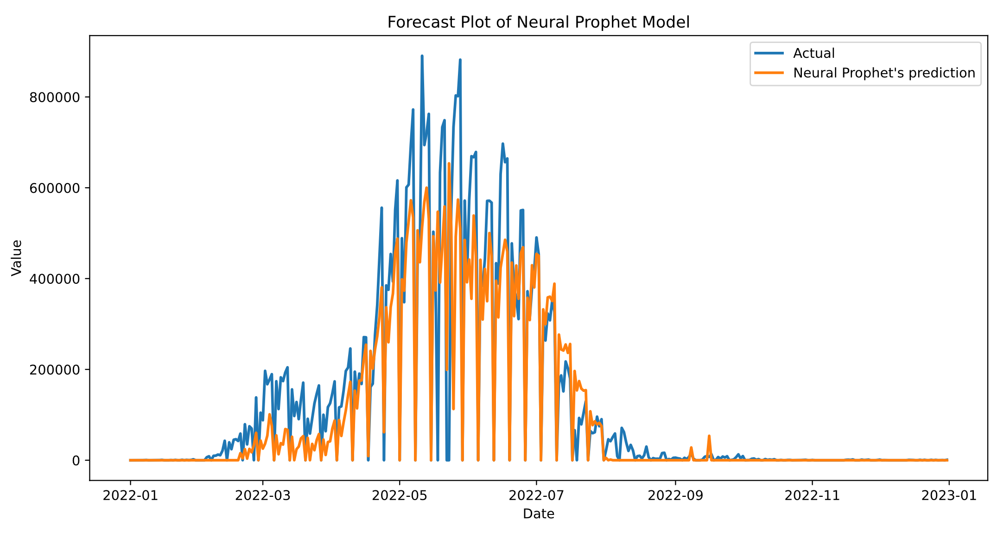
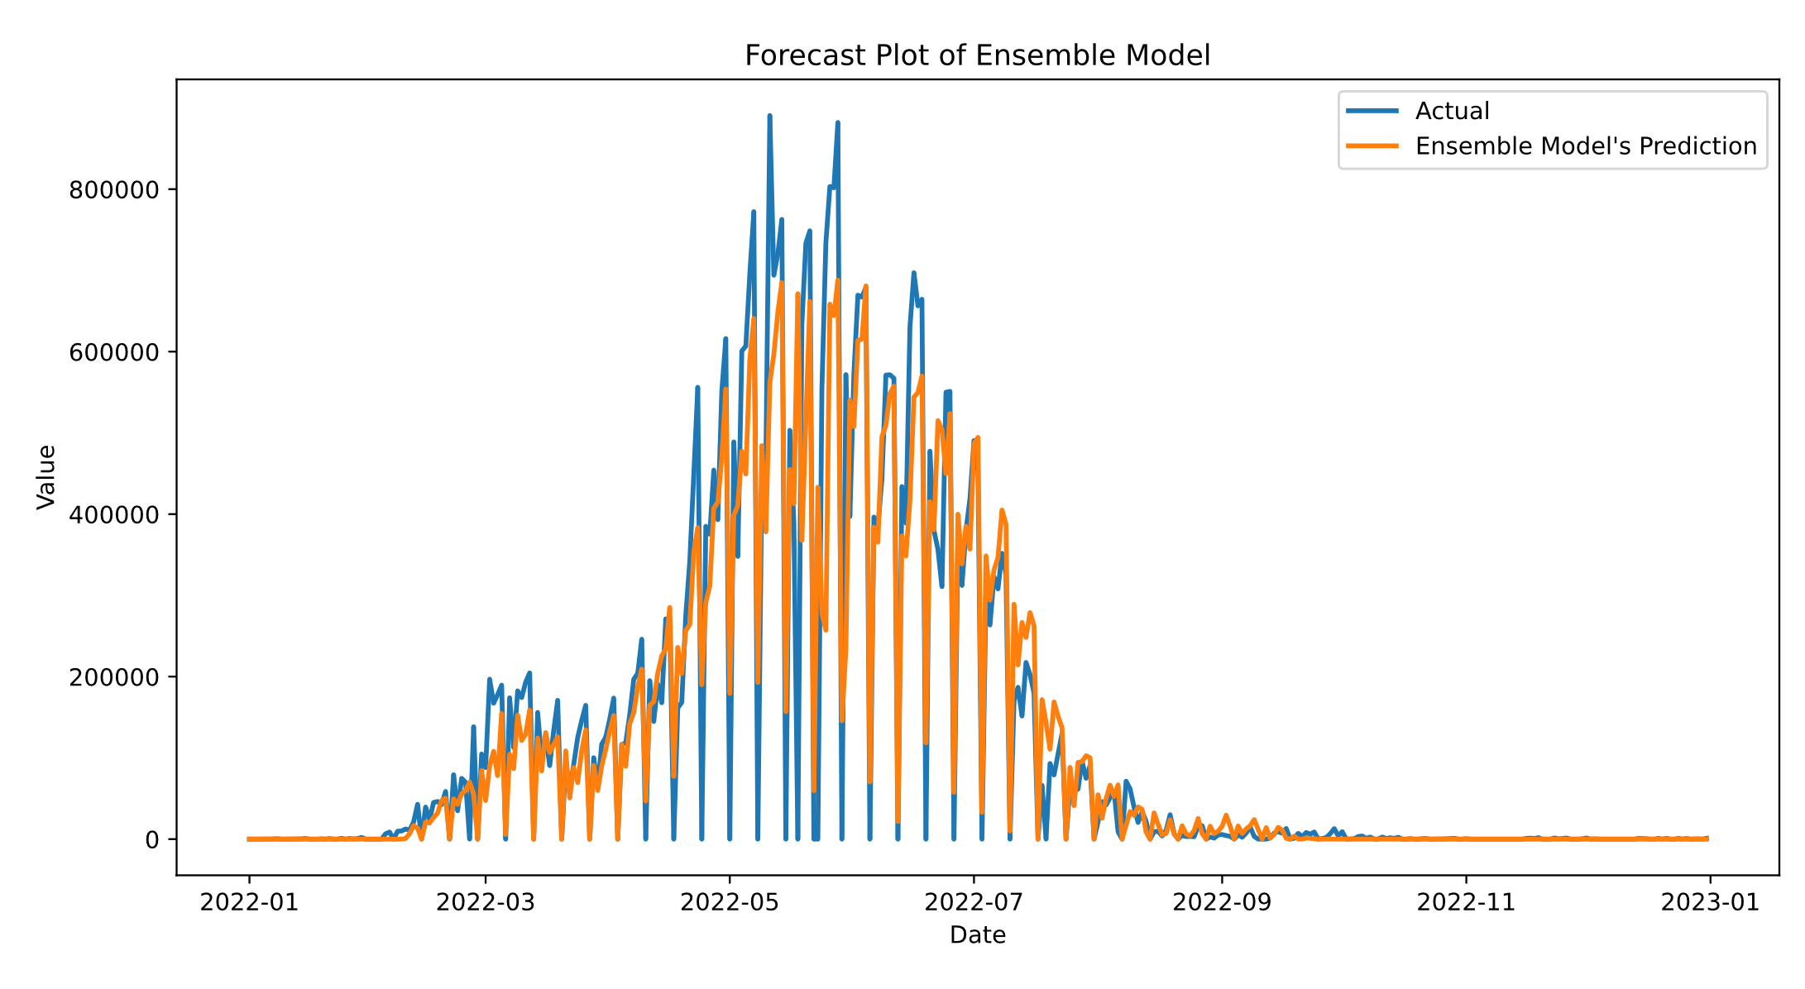

Slide 14

Thank you

