Slide 1
Analysis of the Mathematics and Implications of Bernstein-Vazirani Algorithm
Abu Bucker Siddik
Shamminuj Aktar

Slide 2
Presentation Outline
Definition of Bernstein-Vazirani (BV) problem
Classical Solution of BV Problem & Query Complexity
Quantum Solution of BV problem
Mathematical overview of BV algorithm
Implementation of BV algorithm on IBM Quantum Machines
Result Analysis & Discussion
Conclusion

Slide 3
Bernstein-Vazirani Algorithm
A quantum algorithm which solves the Bernstein - Vazirani problem
BV algorithm invented by Ethan Bernstein and Umesh Vazirani in 1992
BV algorithm allows Quantum Computers to outperform Classical Computers
An extension of the Deutsch-Josza algorithm (DJ) algorithm

Slide 4

Bernstein-Vazirani Problem
A black-box function f with n bit strings as input and one bit output
The function f is of the form:
Problem: Find the n bit secret string a ﻿by querying f as few times as possible
The oracle returns f(x) = x ∙ a [dot denotes the inner product modulo 2]
Example: Let, x = 100 and a = 101
So, x ∙ a= (1) (1) + (0) (0) + (0) (1) (mod 2) = 1

Slide 5



Classical Implementation & Query Complexity
Classically we can solve the hidden string problem using n queries.
Consider ﻿bit string x = 100 · · · 0, where and
The oracle will send us back
f(x) = x ∙ a = , where ﻿where is the first bit of a
Similarly, with bit string x = 010 · · · 0, we will get second bit of a
Classically for n bit hidden string, it requires n queries
n classical queries is a lower bound for classical solution

Slide 6
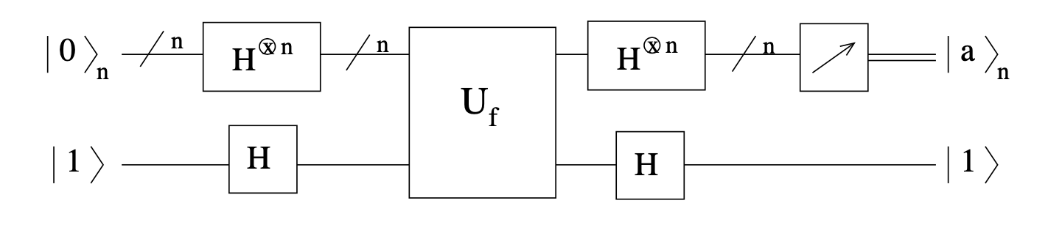
Quantum Solution of BV problem
BV algorithm can solve the BV problem with just one query for any n bit secret string - ﻿a linear speedup!
Fig: Quantum circuit for Bernstein-Vazirani algorithm
Source: https://young.physics.ucsc.edu/150/bv.pdf

Slide 7
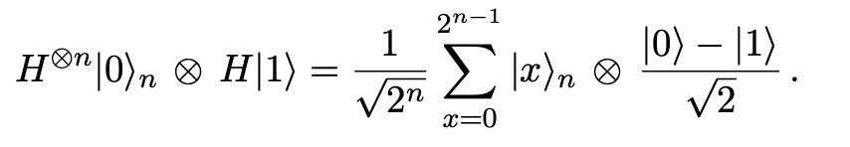

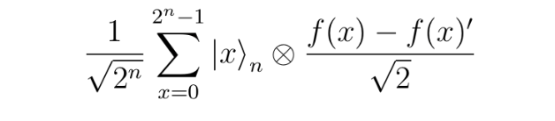
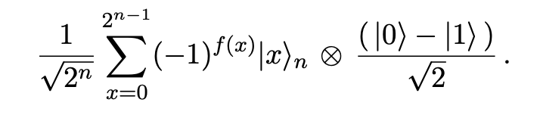
Mathematical overview of BV algorithm
First, we apply Walsh-Hadamard transformation to input qubits and Hadamard gate to target qubit :
Then applying gives us:
⇒
Source: https://young.physics.ucsc.edu/150/bv.pdf

Slide 8
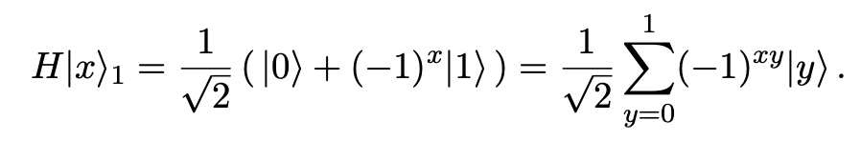

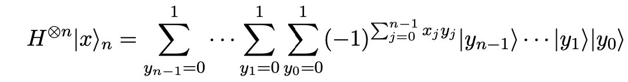
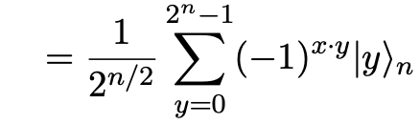
Mathematical overview of BV algorithm
We then again apply Walsh-Hadamard transformation to first register.
Applying Hadamard to one qubit gives us:
So, will generate:
Source: https://young.physics.ucsc.edu/150/bv.pdf

Slide 9
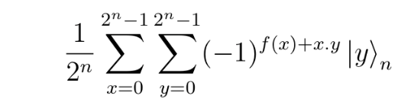
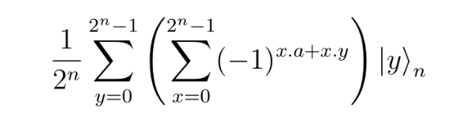


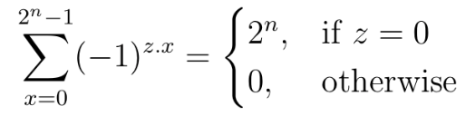

Mathematical overview of BV algorithm
Finally we get,
⇒
⇒
We can write:
We also know that
Since we are also applying Hadamard transformation on target qubit, finally we will get,
Source: https://young.physics.ucsc.edu/150/bv.pdf

Slide 10

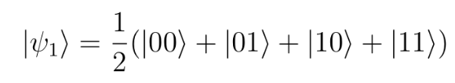
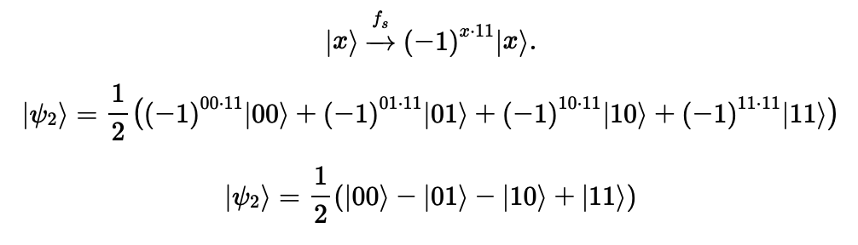

Example: Quantum Solution of BV problem
Let n = 2 qubits and a secret string s = 11
The register of two qubits is initialized to zero:
After applying Hadamard gate, we get:
For the string s = 11, the quantum oracle performs following operation:
Applying Hadamard gate to both qubits we get :
Source: https://qiskit.org/textbook/ch-algorithms/bernstein-vazirani.html

Slide 11
Implementation on IBM Quantum Machines
We implemented BV algorithm using Qiskit
We used the following IBM Quantum Machines for our analysis:
IBM Machine | Qubit | T1 (μs) | T2 (μs) | Avg. CNOT Error | Avg. Readout Error
IBMQ Toronto | 27 | 104.7 | 127.88 | 1.26E-02 | 4.31E-02
IBMQ Sydney | 27 | 102.67 | 118.27 | 9.78E-03 | 3.63E-02
IBMQ Casablanca | 7 | 86.39 | 80.94 | 1.60E-02 | 1.86E-02
IBMQ Santiago | 5 | 125.07 | 142.27 | 6.58E-03 | 1.53E-02
IBMQ Rome | 5 | 72.31 | 86.44 | 1.45E-02 | 2.45E-02
Source: https://quantum-computing.ibm.com/services?skip=0&systems=all

Slide 12
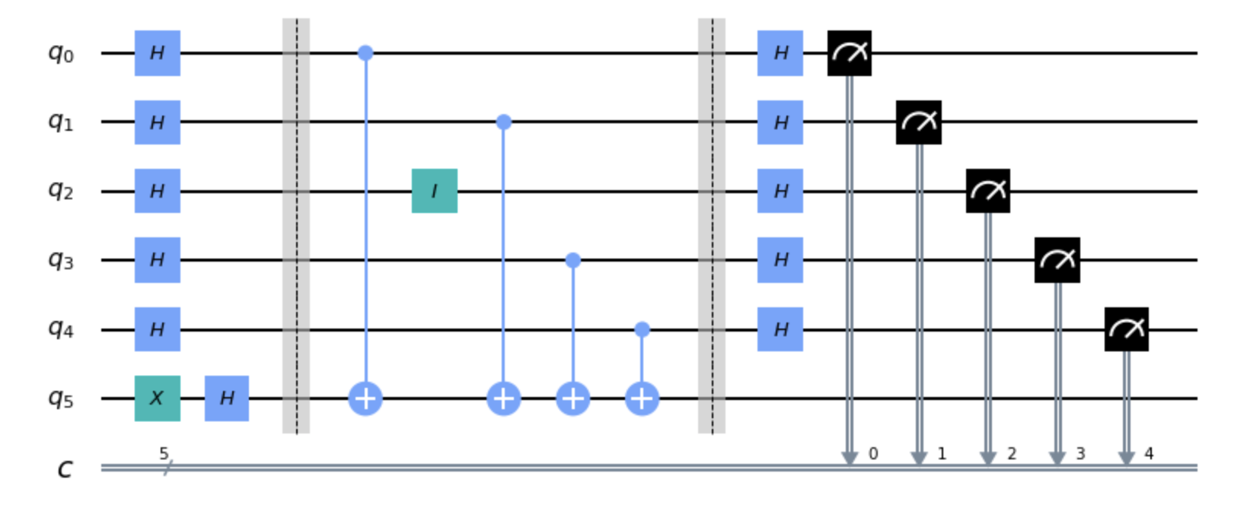
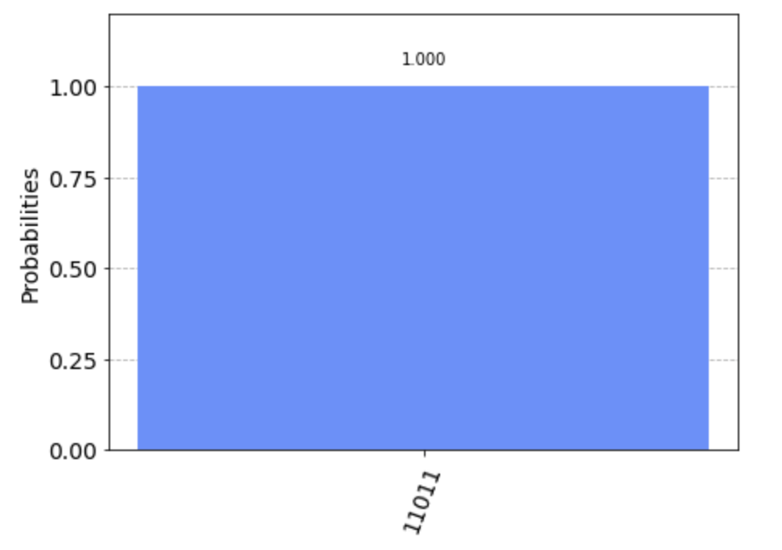
Implementation on IBM Quantum Machines
For Hidden String 11011, we get following circuit of Fig (a)
Then we run the circuit on IBM QASM Simulator to verify.
Fig (a) : Qiskit implementation of Bernstein-Vazirani algorithm
Fig (b) : Measured success rate for string 11011

Slide 13
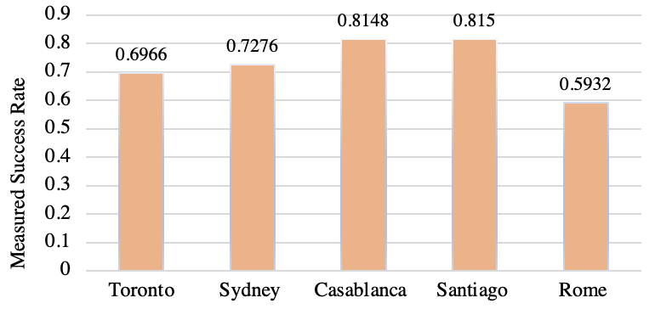
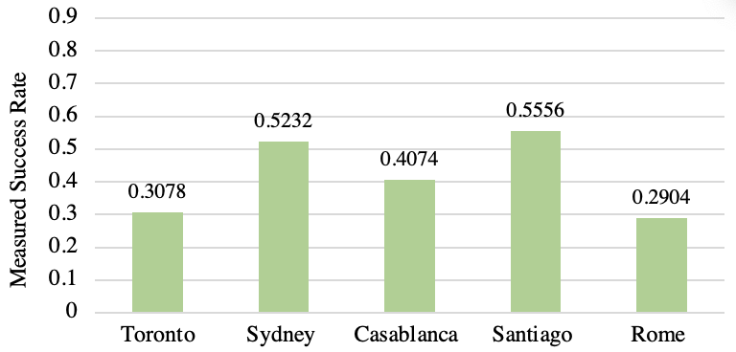
Result Analysis & Discussion
Here, we observed performance of measured success rate when secret string length l = 3 & l = 4
Fig (a) : Measured success rate of different quantum machine when string length l = 3
Fig (b) : Measured success rate of different quantum machine when string length l = 4

Slide 14
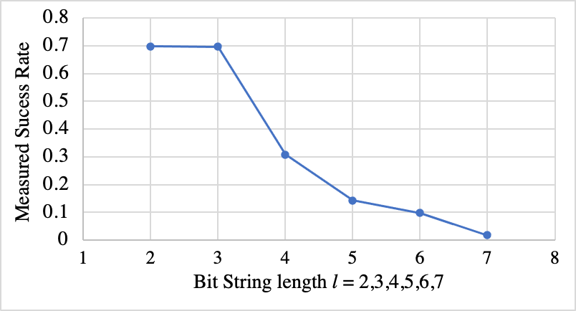
Result Analysis & Discussion
Now, we want to see performance of IBM Toronto machine when we query for secret string with length l = 2, 3, 4, 5, 6, 7
Fig: Measured success rate on IBM Toronto Quantum Processor for secret string with length l = 2, 3, 4, 5, 6, 7

Slide 15
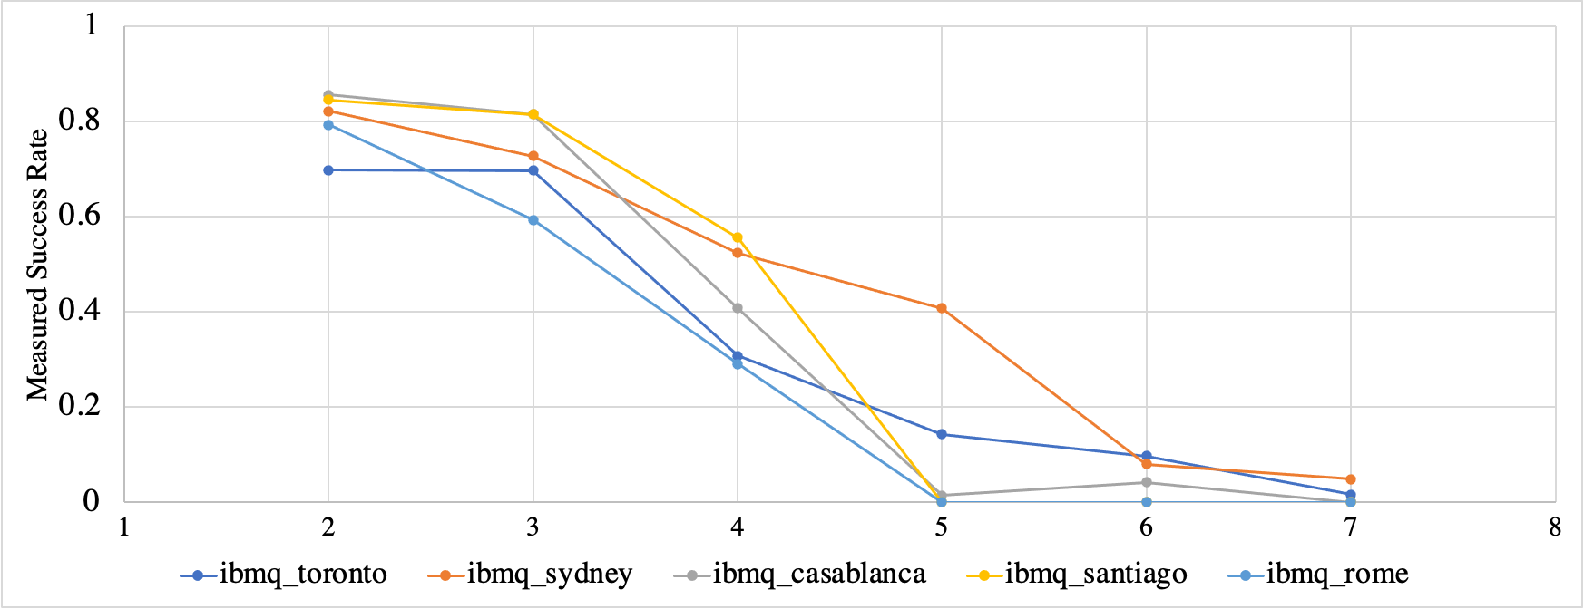
Result Analysis & Discussion
We ran the circuit on all the quantum machines varying secret string length l = 2,3,4,5,6 & 7
Fig: Measured success rate on different Quantum Processor for secret string with length l = 2,3,4,5,6,7

Slide 16
Conclusion
Bernstein-Vazirani (BV) algorithm allows to solve hidden string problem with single query
BV provides linear speedup over classical counterpart
Implementation of IBM Quantum machine shows
Measured success rate decreases with increased bit string length
Machine’s T1 & T2 time has significant importance on circuit execution
Recent research showed application of BV algorithm in Quantum multiplication, cryptography etc.

