Slide 1
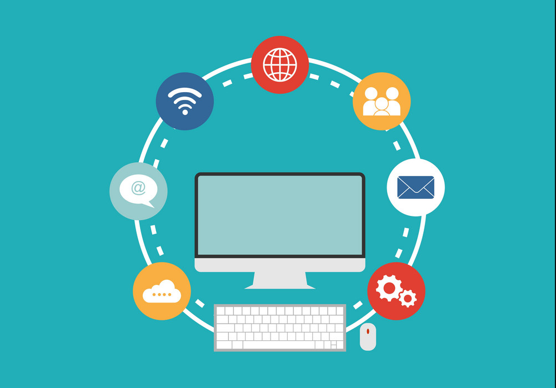
Internet Technology
Workshop on Web Technologies
Mar 02th, 2023

Slide 2
Highlights:
What is Internet
Evolution and History of Internet
Growth Of Internet-Owners of Internet
Internet Services
How does the Internet Works ?
Anatomy Of Internet
Internet Addressing Internet Vs Intranet-Impact of Internet
Governance Of Internet

Slide 3
What is Internet
The Internet is the global system of interconnected computer networks that use the Internet protocol suite (TCP/IP) to link devices worldwide.
It is a network of networks that consists of private, public, academic, business, and government networks of local to global scope, linked by a broad array of electronic, wireless, and optical networking technologies. The Internet carries a vast range of information resources and services.

Slide 4
What is Internet ? + Short history
It was originally created by the U.S. government during the Cold War. In 1958, President Eisenhower founded the Advanced Research Projects Agency (ARPA) to give a boost to the country’s military technology, according to the Journal of Cyber Policy. Scientists and engineers developed a network of linked computers called ARPANET.
The Internet was developed by Bob Kahn and Vint Cerf in the 1970s. They began the design of what we today know as the ‘internet.’ It was the result of another research experiment which was called ARPANET, which stands for Advanced Research Projects Agency Network.

Slide 5
Evolution & History Of Internet
1960:
The U.S. Department of Defense initiates the creation of ARPANET, a decentralized network intended to allow researchers at different universities to share resources and communicate with one another.
1970:
The first email is sent in 1971.
The TCP/IP protocol is developed, which would become the basis for the modern internet.
The first message is sent between two computers connected via ARPANET in 1972.

Slide 6
Evolution & History Of Internet
1990:
The World Wide Web is created in 1990 by Tim Berners-Lee.
The first web browser, called WorldWideWeb, is developed in 1991.
The first search engine, called Archie, is created in 1990.
The first online marketplace, eBay, is launched in 1995.
The first social networking site, SixDegrees, is launched in 1997.
2000:
Broadband internet becomes widely available, enabling faster speeds and making it easier to access media-rich websites.
The first smartphones are introduced, allowing people to access the internet from their mobile devices.
The rise of web 2.0 technologies allows for greater interactivity and user-generated content on websites.
The launch of social media platforms like Facebook and Twitter in the mid-2000s leads to a significant increase in online social interaction.

Slide 7
Evolution & History Of Internet
2010:
The rise of mobile internet usage leads to a shift in how people access the internet, with mobile devices becoming the primary means of online access for many people.
The increasing use of cloud computing allows for more data storage and processing to be done remotely.
The Internet of Things (IoT) emerges, with more and more devices becoming connected to the internet.
The use of artificial intelligence (AI) and machine learning (ML) technologies become more prevalent, allowing for more sophisticated automation and data analysis.

Slide 8
Evolution & History Of Internet
2020:
The COVID-19 pandemic leads to a significant increase in remote work and online activity, highlighting the importance of the internet in daily life.
The development of 5G networks promises even faster internet speeds and greater connectivity.
The debate over internet privacy and regulation continues, with ongoing discussions around topics like net neutrality and data privacy.

Slide 9
Evolution & History Of Internet
Users | 2005 | 2010 | 2017 | 2019 | 2021
World Population | 6.5 Billion | 6.9 Billion | 7.4 Billion | 7.75 Billion | 7.9 Billion
World Wide | 16 % | 30 % | 48 % | 53.6 % | 63 %
In Developing World | 8 % | 21 % | 41.3 % | 47 % | 57 %
In Developed World | 51 % | 67 % | 81 % | 81.6 % | 30 %

Slide 10
Growth Of Internet-Owners of Internet
Increased Connectivity: The Internet has connected people from all over the world, allowing them to communicate, collaborate, and access a wealth of information quickly and conveniently.
Increased Productivity: By providing access to a wide range of resources, the Internet has enabled businesses to become more productive and efficient. This has allowed businesses to save time and money in the long run.
Increased Innovation: The Internet has enabled people to come up with new ideas and solutions to problems, allowing businesses to stay ahead of the competition.
Increased Accessibility: By making information more available, the Internet has made it easier for people to access the resources they need, no matter where they are.

Slide 11
Growth Of Internet-Owners of Internet
Increased Opportunities: Thanks to the Internet, people are now able to find and take advantage of new opportunities they may not have been aware of otherwise.
Increased Communication: As the Internet has enabled people to communicate with each other more quickly and easily, relationships have been strengthened and businesses have been able to better serve their customers.
Increased Security: The Internet has enabled businesses to protect their information and resources more securely, reducing the risk of data breaches and other security threats.

Slide 12
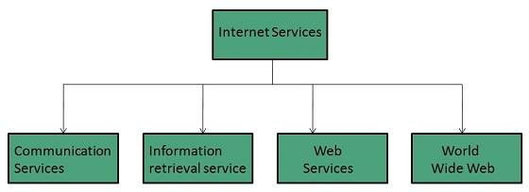
Internet Services
Internet Services allows us to access huge amount of information such as text, graphics, sound and software over the internet. Following diagram shows the four different categories of Internet Services.

Slide 13
Internet Services
Communication Services:
There are various Communication Services available that offer exchange of information with individuals or groups. The following table gives a brief introduction to these services

Slide 14
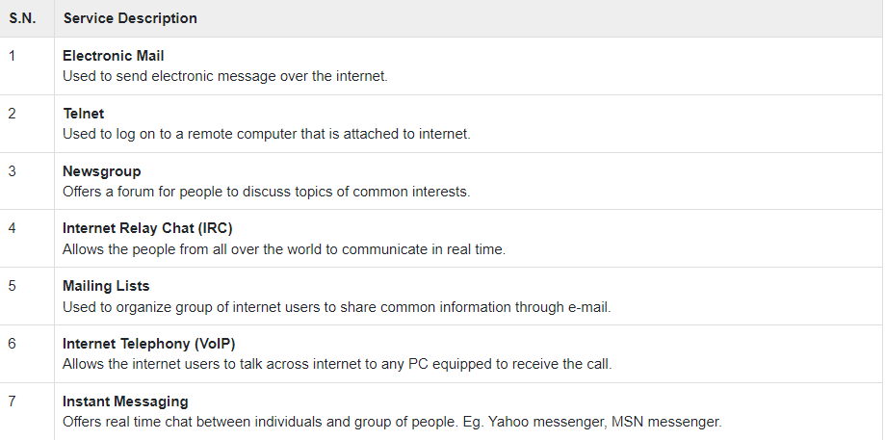
Internet Services

Slide 15
Internet Services
Information Retrieval Services :
There exist several Information retrieval services offering easy access to information present on the internet. The following table gives a brief introduction to these services:

Slide 16
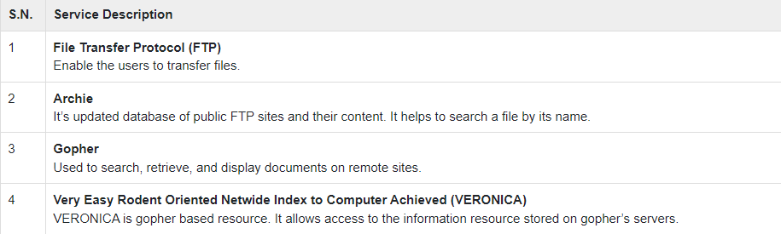
Internet Services

Slide 17
Internet Services
Web Services :
Web services allow exchange of information between applications on the web. Using web services, applications can easily interact with each other.
The web services are offered using concept of Utility Computing.

Slide 18
Internet Services
World Wide Web (WWW) :
WWW is also known as W3. It offers a way to access documents spread over the several servers over the internet. These documents may contain texts, graphics, audio, video, hyperlinks. The hyperlinks allow the users to navigate between the documents.

Slide 19
Internet Services
Video Conferencing :
Video conferencing or Video teleconferencing is a method of communicating by two-way video and audio transmission with help of telecommunication technologies.
Modes of Video Conferencing :
Point-to-Point
Multi-point

Slide 20
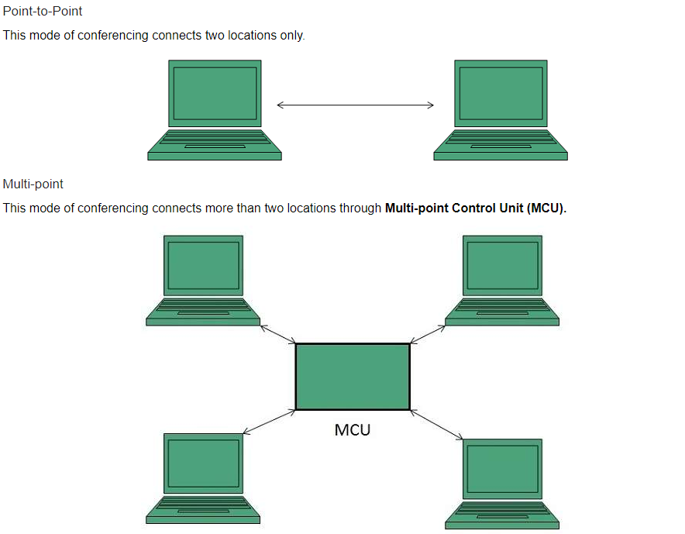
Internet Services
Modes of Video
Conferencing :

Slide 21
How does the Internet Works
The internet is a vast network of interconnected computers and servers that allows people to communicate and share information.
Two main components uphold the functionality of the Internet, they are:
Packets
Protocols

Slide 22
How does the Internet Works
what are Packets and Protocols ?
In networking, the data which is being transmitted through the internet is sent via small segments which are later translated into bits and the packets get routed to their endpoint (destination) through different networking devices i.e. routers or switches. Later, once the packet arrives at the receiver’s end, that small chunks of data get reassembled in order to utilize or check the data that he/she requested. That’s why they are used to push ease in networking and large data can be easily sent by sending small units and this whole process of sending/receiving small bits is known as Packet Switching.

Slide 23
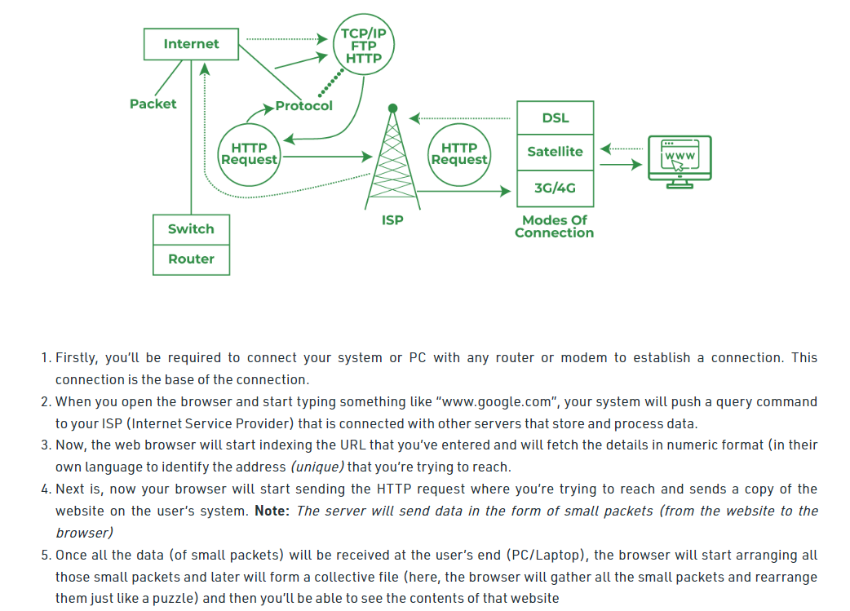
How does the Internet Works

Slide 24
How does the Internet Works
It is a standardized method of performing certain tasks and data formatting so that two or more devices can communicate with each other.
Internet Protocol (IP)
Transmission Control Protocol (TCP)
World Wide Web (WWW)
Domain Name System (DNS)
Internet Service Providers (ISPs)
Content Delivery Networks (CDNs)
Cloud Computing

Slide 25
How does the Internet Works
Internet Protocol (IP): The Internet uses a protocol called IP to transfer data between devices. IP assigns each device a unique address that identifies it on the Internet.
Transmission Control Protocol (TCP): TCP is a protocol that enables reliable communication between devices. It breaks data into small packets and reassembles them at the destination to ensure that data is not lost or corrupted during transmission.

Slide 26
How does the Internet Works
World Wide Web (WWW): The WWW is a collection of interconnected documents and other resources, linked by hyperlinks and URLs. It uses a protocol called Hypertext Transfer Protocol (HTTP) to transfer data between devices.
Domain Name System (DNS): The DNS is a hierarchical naming system that translates human-readable domain names into IP addresses. This makes it easier for people to remember and access websites.

Slide 27
How does the Internet Works
Internet Service Providers (ISPs): ISPs are companies that provide Internet connectivity to individuals and organizations. They connect their customers to the Internet using a variety of technologies, such as DSL, cable, and fiber-optic networks.
Content Delivery Networks (CDNs): CDNs are networks of servers located around the world that deliver content to users more quickly and reliably by storing copies of popular content in multiple locations.

Slide 28
How does the Internet Works
Cloud Computing: Cloud computing refers to the delivery of computing services over the Internet. Instead of running software and storing data on local computers, individuals and organizations can access these resources remotely through the Internet.
Modes of Connecting Through the Internet
Digital Subscriber Line - DSL (Broadband connection) , Dial-Up (Telephone connection) , Cable TV Connection (Cable TV wire / Broadband technology) , Satellite, 3G/4G/5G
https://www.tutorialspoint.com/internet_technologies/internet_connectivity.htm

Slide 29
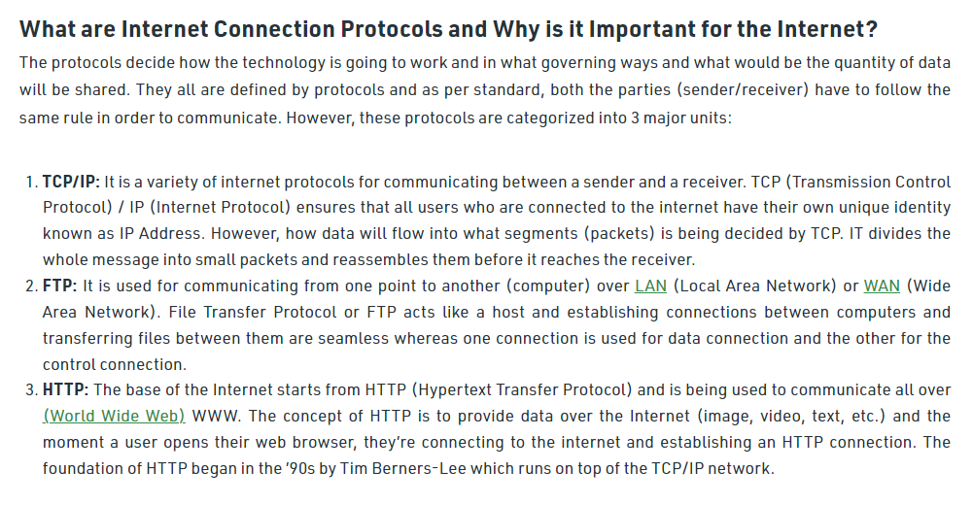
How does the Internet Works

Slide 30
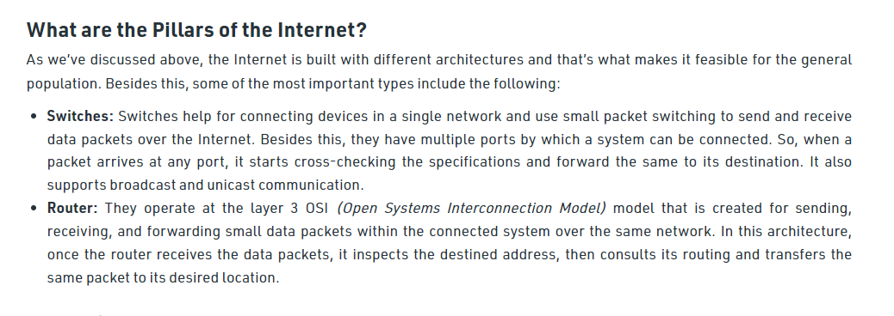
How does the Internet Works

Slide 31
Anatomy Of Internet
The Internet is a global network of interconnected computers, servers, and other devices.
It was first created in the 1960s as a way to share information among researchers.
It is made up of millions of computers and other devices connected by cables, wireless connections, and other forms of communication.
These devices can communicate with each other to send data, such as emails, webpages, and files.
The Internet is used for a variety of activities, including browsing the web, emailing, streaming video and music, online shopping, and more.
It is also used for research, communication, and collaboration between people around the world.
Many businesses rely on the Internet for daily operations and to reach customers.
The Internet is also used to share information, ideas, and resources between people, organizations, and governments.

Slide 32
Anatomy Of Internet
The internet is a vast network of interconnected computers and servers that allows people to communicate and share information. It consists of three main components: the access network, the core network, and the content network.
Access network : This refers to the physical infrastructure that allows users to connect to the internet. It includes devices such as computers, mobile phones, routers, and modems, as well as the cables, fiber-optic lines, and wireless networks that transmit data.
Core network : This is the backbone of the internet and consists of high-speed data transmission lines, routers, and switches that allow data to travel across the network. The core network is maintained by large telecommunications companies and internet service providers (ISPs).
Content network : This is the part of the internet where content is created, stored, and shared. It includes websites, online applications, and databases.

Slide 33
Anatomy Of Internet
In addition to these three main components, there are also various protocols and technologies that allow the internet to function. These include the Transmission Control Protocol/Internet Protocol (TCP/IP), Domain Name System (DNS), hypertext transfer protocol (HTTP), and secure socket layer (SSL), among others.
Overall, the anatomy of the internet is a complex and interconnected system that allows people around the world to communicate, collaborate, and access information.

Slide 34
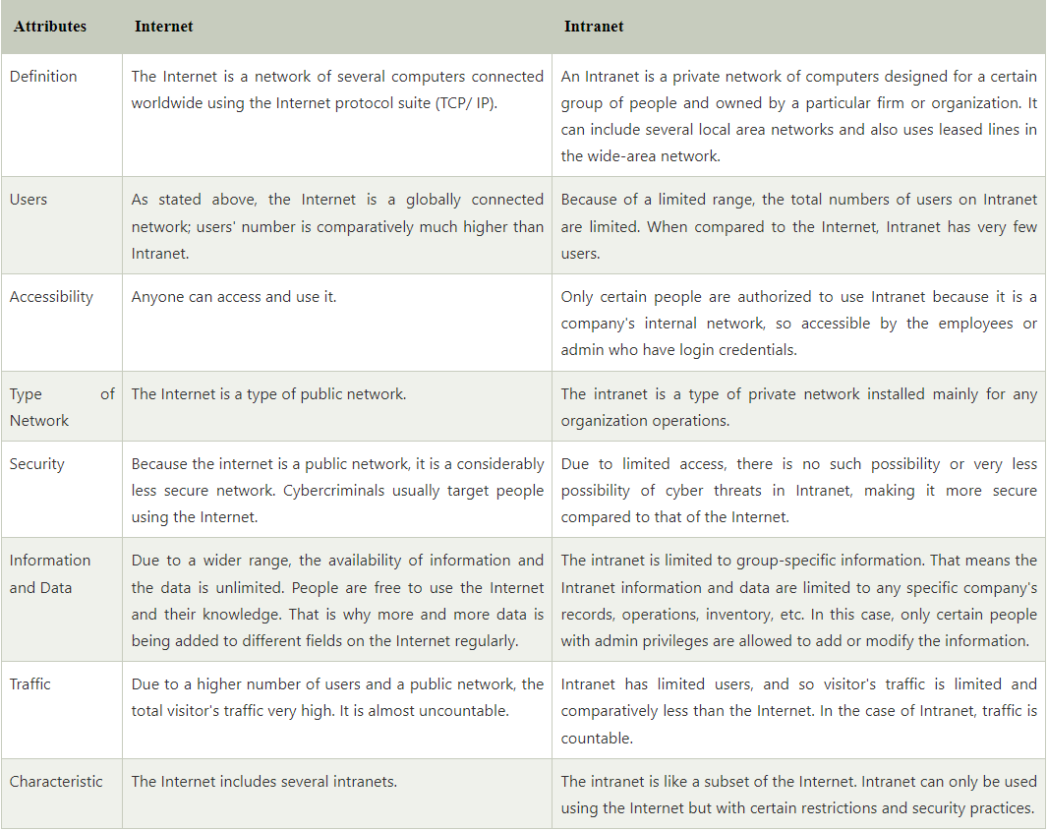
Internet Addressing Internet Vs Intranet-Impact of Internet

Slide 35
Governance Of Internet
Internet governance refers to the rules, policies, standards and practices that coordinate and shape global cyberspace.
The definition of Internet governance has been contested by differing groups across political and ideological lines. One of the main debates concerns the authority and participation of certain actors, such as national governments, corporate entities and civil society, to play a role in the Internet's governance.

Slide 36
Thank you!

