Slide 1

Computational Models using
Peptide-Antibody Interactions
M. Sakthi Balan
and
Kamala Krithivasan
Theoretical Computer Science Lab
Department of Computer Science and Engineering
Indian Institute of Technology Madras
Chennai – 600036.

Slide 2
Organization
Peptide Computing
Objective of the Work
Solving NP-Complete problems
Modeling gate operations
Modeling arithmetic operations
Binding-Blocking Automata (BBA)
Normal-forms, Complexity measures of BBA
String Binding-Blocking Automata
Rewriting Binding-Blocking Automata
Conclusion

Slide 3
Peptide Computing
Introduced by Hubert Hug and Rainer Schuler in 2000.
Solved satisfiability problem using peptide-antibody interactions.

Slide 4
Peptide Computing
Uses peptides and antibodies
Operation – binding of antibodies to epitopes in peptides
Epitope – The site in peptide recognized by antibody
Highly non-deterministic
Massive parallelism

Slide 5
Peptide Computing
Contd..
Peptides – sequence of amino acids
Twenty amino acids.
Example – Glycine, Valine
Connected by covalent bonds

Slide 6
Peptide Computing
Contd..
Antibodies recognizes epitopes by binding to it
Binding of antibodies to epitopes has associated power called affinity
Higher priority to the antibody with larger affinity power

Slide 7
Objectives
Using peptide computing for solving NP-Complete problems.
To show this model is universal.
Modeling switching operations, arithmetical operations.
Defining automata model inspired by interactions between peptides and antibodies – Binding-Blocking Automata.

Slide 8
Objectives (Contd..)
Analyze the power of Binding-Blocking Automata (BBA).
Define and study some complexity measures for BBA.
Define several variants of the model and study the acceptance power.

Slide 9
Solving NP-Complete Problems

Slide 10
Hamiltonian Path Problem
G = (V,E) is a directed graph
V = {v₁,v₂,…,v_{n}} is the vertex set
E = {e_{ij} | v_{i} is adjacent to v_{j}} is the edge set
v₁ - source vertex, v_{n} – end vertex
Problem – Test whether there exists a Hamiltonian path between v₁ and v_{n}

Slide 11
1
2
3
4
5
6

Slide 12
1
2
3
4
5
6

Slide 13
Peptides Formation
For each possible solution there is a peptide sequence formed.
Each of the pair of epitopes present in the peptide sequence denote a possible edge of the graph.

Slide 14
Antibody Formation
Three sets of antibodies are formed.
One set to recognize all the legal edges.
One set to recognize all edges not present in the graph.
Last one to recognize the Hamiltonian path of the graph.

Slide 15
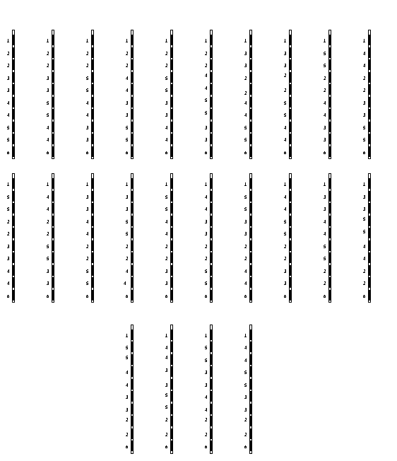
Peptide Solution Space

Slide 16
Algorithm
Take all the peptides in an aqueous solution
Add antibodies Aij
Add antibodies Bij
Add labeled antibody C
If fluorescence is detected answer is yes or else the answer is no

Slide 17
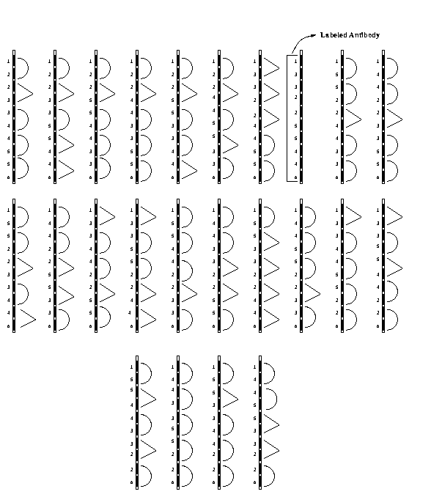
Peptides with Antibodies

Slide 18
Peptide with Antibodies

Slide 19
labeled antibody

Slide 20
Complexity
Number of peptides = (n-2)!
Length of peptides = O(n)
Number of antibodies = O(n²)
Number of Bio-steps is constant

Slide 21
Exact Cover by 3-Sets Problem
Instance A finite set X = {x₁,x₂,…,x_{n}}, n = 3q and a collection C of 3-elements subsets of X
Question: Does C contain an Exact Cover for X

Slide 22
Peptide Computing is Computationally Complete
A Turing Machine can be
simulated by a Peptide System

Slide 23
Universality Result
Turing machine, M = (Q, Σ, δ, s₀, F)
Q = {q₁,q₂, … ,q_{m}}
Σ = {a₁,a₂, …,a_{l}}
B is the blank symbol

Slide 24
Universality Result
Contd..
Peptide without antibodies

Slide 25
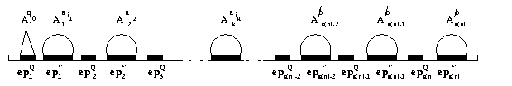
Initial Configuration of Peptide

Slide 26
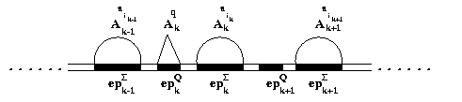
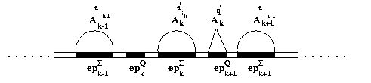
Simulating the Right Move
Contd..

Slide 27
Complexity
Peptide system takes O(t(n)) time
Length of the peptide is O(s(n))
Amount of antibodies is
O(m.s(n)+l.(s(n))

Slide 28
Switching Operations - OR, AND & NOT gates

Slide 29
Why modeling gate operations?
Peptide and antibody formation is dependent on the problem.
Defining basic operations makes the model independent of the problem.

Slide 30
Proposed Model
Consists of a peptide sequence and some set of antibodies.
Peptide sequence consists of five epitopes,
Six antibodies denoted by A₁, A₂, B₁, B₂, C_{init} and C_{f}.
Antibodies A₁, A₂, B₁ and B₂ denote the inputs.
C_{init} denote the initial value of the result of the operation.
C_{init} and C_{f} denote the output of the operation.

Slide 31
Proposed Model
Epitopes for the antibodies denoting the input to bind.
Epitope for the antibody representing the initial output to bind.
Epitopes for the antibodies denoting the output to bind.

Slide 32
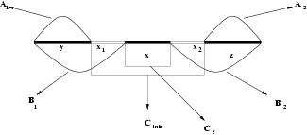
Peptide sequence
Peptide Sequence with Antibodies

Slide 33
OR Gate
Input bits 0 and 1 are represented by the antibodies A_{i} and B_{i} respectively where 1 ≤ i ≤ 2.
The antibody C_{init} denotes the bit 0.
The antibody C_{f} (labeled antibody) denotes the bit 1.
epitope(A₁) = {y}, epitope(A₂) = {z},
epitope(B₁) = {yx₁}, epitope(B₂) = {x₂z},
epitope(C_{init}) = {x₁xx₂}, epitope(C_{f}) = {x},
aff(B_{i}) > aff(C_{init}) > aff(C_{f}), 1 ≤ i ≤ 2.

Slide 34
OR Gate
The output 1 occurs if at least one of the inputs is 1.
Start with an initial output of 0 - antibody C_{init} binds to its epitope.
C_{init} is toggled if at least one 1 comes as an input. For this to be carried out the epitopes for the antibody C_{init} and the antibody B_{i}, 1 ≤ i ≤ 2 are taken as overlapping ones.
aff(B_{i}) > aff(C_{init}) > aff(C_{f}), 1 ≤ i ≤ 2.
This facilitates toggle of output bit to 1 - antibody C_{f} binds to its epitope.

Slide 35
Algorithm
Take the peptide sequence P in an aqueous solution.
Add the antibody C.
Add antibodies corresponding to the input bits. For example if the first bit is 1 and the second bit is 0 then add antibodies B₁ and A₂.
Add antibody C_{f}.
If the output has to be seen the antibody C_{f} can be gives some color so that at the end of the algorithm if fluorescence is detected the output will be 1 or else it will be 0.

Slide 36
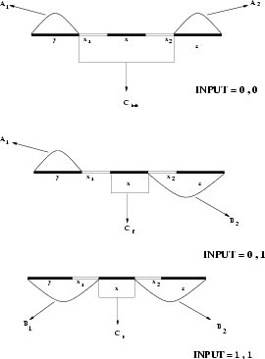

Slide 37
Other Gates
This model has been extended to other gates – AND, NOT, NAND, NOR and XOR
We also extend this model to simulate Boolean circuits.

Slide 38
Modeling Arithmetic Operations

Slide 39
Arithmetic Operations
Proposed Model
Consists of a peptide and set of antibodies
Peptide sequence has n position specific epitopes
Epitopes ep_{i} = y_{i} x_{i} z_{i}, y_{i} and z_{i} are switching epitopes for the i^{th} bit.

Slide 40
y₄
x₄
z₄
y₀
x₀
z₀
Peptide Sequence for a 5-bit number

Slide 41
Antibodies
A = {A₀, A₁, …, A_{n-1}}
B = {B₀, B₁, …, B_{n-1}}
T_{AB} = {T_{AB0}, T_{AB1}, …, T_{AB(n-1)}}
T_{BA} = {T_{BA0}, T_{BA1}, …, T_{BA(n-1)}}

Slide 42
Binding Sites
x_{i}z_{i}
y_{i}x_{i}
For A_{i}
For B_{i}
x_{i}
x_{i}
y_{i}x_{i} > x_{i}
x_{i}z_{i} > x_{i}
T_{ABi}
Z_{i}
T_{BAi}
y_{i}

Slide 43
Affinity
aff(T_{ABi}) > aff(A_{i})
aff(T_{BAi}) > aff(B_{i})
aff(T_{ABi}) = aff(T_{BAi})

Slide 44
What it denotes?
A_{i} – denotes i^{th} bit is zero
B_{i} – denotes i^{th} bit is one
T_{ABi} – used to switch i^{th} bit from zero to one
T_{BAi} – used to switch i^{th} bit from one to zero

Slide 45
Representation of Binary Numbers
If the i^{th} bit is 0 then the antibody A_{i} is bounded to the epitope y_{i}x_{i}
If the i^{th} bit is 1 then the antibody B_{i} is bounded to the epitope x_{i}z_{i}

Slide 46
Example
B₄
A₃
B₂
A₁
B₀
10101

Slide 47
Addition of Two Binary Numbers
A = a_{n-1}a_{n-2} …a₀
B = b_{n-1}b_{n-2} …b₀
C = c_{n} c_{n-1}c_{n-2} …c₀

Slide 48
XOR
a_{i}
b_{i}
C_{i}
1
0
0
0
2
0
1
1
3
1
0
1
4
1
1
0

Slide 49
Addition (Contd..)
First step – guessing equivalent to XOR gate.
The bit c_{n} is initialized to zero.
Carry propagation.

Slide 50
Addition (Contd..)
Carry occurs only when both the bits a_{i} and b_{i} are 1.
Carry is propagated to the left until both the bits a_{j} and b_{j} (j > i) are 0.
If no such j exists then propagation stops making n^{th} bit 1.
j.j-1….i+1 is called the carry block.
For each carry block j.j-1….i+1 invert the digits c_{k}
(i+1 ≤ k ≤ j)

Slide 51
Algorithm
Add antibodies A_{i} where a_{i} = 0 and b_{i} = 0 or a_{i} = 1 and b_{i} = 1.
Add antibodies B_{i} where a_{i} = 0 and b_{i} = 1 or a_{i} = 1 and b_{i} = 0.
For all carry block j_{k}j_{k}-1…i_{k}+1 do the following in parallel. For i_{k} +1 ≤ s ≤ j_{k}
  Add antibodies T_{ABs},
  Add antibodies B_{s},
  Add antibodies T_{BAs}, and
  Add antibodies A_{s}.

Slide 52
Example
10110
10011
+
000101
A₅
A₄
A₃
B₂
A₁
B₀

Slide 53
Example (Contd..)
101101
B₅
A₄
B₃
B₂
A₁
B₀

Slide 54
Example (Contd..)
101001
B₅
A₄
B₃
A₂
A₁
B₀

Slide 55
Algorithm
ADD(A,B,C)
XOR(A,B,C)
BlockInversion(I₁,I₂,…I_{k},C) where I_{j} are carry blocks and k is the number of carry blocks.

Slide 56
Binding-Blocking Automata

Slide 57
Binding-Blocking Automata
finite control
finite tape
tape head
finite tape symbols
transition function
partial order relation
blocking and unblocking functions

Slide 58
BBA Formal Definition
P = (Q,V,E,δ,q₀,R,β_{b},β_{ub},Q_{accept},Q_{reject})
where Q = Q_{block} ∪ Q_{unblock} ∪ Q_{general},
q₀ ∈ Q (start state),
V is a finite set of symbols,
E is the finite subset of V*,
δ is the transition function from Q × E → Q,
R ⊆ E × E is the partial order relation,
β_{b} is the blocking function from Q_{block} → 2^{V},
β_{ub} is the unblocking function from Q_{unblock} → 2^{V},
Q_{accept} ∪ Q_{reject} ⊆ Q_{general} where Q_{accept} is the set of accepting states and Q_{reject} is the set of rejecting states.

Slide 59
BBA (Contd..)
The symbols read by the head are called marked symbols.
The symbols blocked are called as blocked symbols.
The head can read a sequence of symbols from its present position.
Only those symbols which are not marked and not blocked can be read by the head.

Slide 60
Four kinds of Transition
(l,b)-transition
(l,f)-transition
(ll,b)-transition
(ll,f)-transition
l – leftmost, ll – locally leftmost,
b – blocked, f - free

Slide 61
BBA - Results
BBA_{(l,b)} ⊂ BBA_{(l,f)}
BBA_{(ll,b)} ⊆ BBA_{(ll,f)}
BBA_{p,(l,x)} = BBA_{np,(l,x)}, x = b or f,
BBA_{(l,x)} = SBBA_{(l,x)}, x = b or f,
For every language L ∈ k-SNFA there is a language
L' ∈ BBA_{(ll,b)} such that L can be written in the form
h⁻¹(L') where h is a homomorphism from L to L'.
For every L ∈ BBA_{(l,x)} there exists BBA_{(ll,x)} P such
that L(P) = L where x ∈{b,f}.
BBA_{(l,b)} ⊂ BBA_{(ll,b)}.

Slide 62
Complexity Issues
Blocking number is the total number of sets of symbols blocked by the system at any point of time. Lies between 1 and 2^{V}.
Blocking instant is defined as the maximum number of symbols blocked at any point of time.

Slide 63
Complexity Issues (Contd..)
Blocking quotient of a subset X of alphabet is the length of the longest run from the blocking of X to the unblocking of X.
Blocking quotient of a BBA system is defined as the maximum of blocking quotient over all the subsets of alphabet.
P(k,m,n) denote a BBA P with k the blocking
number, m the blocking instant and n blocking quotient.

Slide 64
Complexity Issues of BBA
Results
REG ⊆ BBA_{D}(*,1,*) ⊆ BBA_{D}(*,2,*) ⊆ BBA_{D}(*,3,*) ⊆ … …
where D ∈ {(ll,b),(ll,f),(l,b),(l,f)}.
REG ⊆ BBA_{D}(1,*,*) ⊆ BBA_{D}(2,*,*) ⊆ BBA_{D}(l,*,*) ⊆ … …
BBA_{D}(*,*,1) = BBA_{D}(*,*,k), k ≤ 2,
D ∈ {(l,b),(l,f),(ll,b),(ll,f)}

Slide 65
String Binding-Blocking Automata
String of symbols (starting from the head's position) can be blocked from being read by the head.
Only those symbols which are not marked and not blocked can be read by the head.
Blocking is maximal.

Slide 66
Results in StrBBA
The power of StrBBA in l transition is strictly more than BBA in l transition.
The power of StrBBA in ll transition is strictly more than languages not accepted by BBA in ll.
For every L ∈ StrBBA_{l} there exists a random-context grammar RC with Context-free rules such that
L(RC) = L.
The set of all languages accepted by strbba_{l}(Fin) is equal to the set of all regular languages.

Slide 67
Rewriting BBA
A 2-way tape head which scans a cell to its right at a time.
Marking is done with help of a particular set called Marker set
There is a set of poset relations, where each poset is defined on the marker set.
This poset relation, depending on the state, helps to replace the markers.

Slide 68
RBBA - Result
RBBA is Universally Complete
Simulate a Turing machine using a RBBA
Rewriting of Turing machine is taken care by the markers
The states of the RBBA system is taken as 3-tuple [q,a,p]
where
  p denotes the system is in,
  q states the previous state of the system,
  a is the symbol read last.
If a symbol a is rewritten by A when in the state p, which is got from the state q then the state-affinity has the pair (A,a) which gives more affinity to A than a.

Slide 69
Summary
Solved two NP-Complete problems using peptide-antibody interactions.
Modeled switching operations and simple arithmetical operations using peptide-antibody interactions.
Proposed an automata model – binding-blocking automata.
Studied normal-forms and complexity measures for binding-blocking automata
Extended the definition of binding-blocking to some more variants
  string binding-blocking automata > BBA
  rewriting binding-blocking automata = Turing Machine

Slide 70
Conclusion
The peptide computational model has the potential to solve difficult combinatorial problems (Note: it hides pre-processing time)
Will it be a complete computational model or a hybrid version with silicon computers or a model used to solve some subset of problems?
Defining basic operations for the model.
Solving hard problems using these basic operations.
Preprocessing time – time for building peptides and antibodies is more.
Implementation difficulties (cross-reactivity, structure of peptides)
Can exhaustive search be replaced by other efficient methods (step-by-step elimination method)
Turing machine simulation in which the transition is automatically taken over by the interactions between peptides and antibodies.
Can we bound the number of antibodies in the Turning machine simulation.

