Slide 1

Computational Models using Peptide-Antibody Interactions
M. Sakthi Balan
Department of Computer Science and Engineering
Indian Institute of Technology Madras
Chennai – 600036.
Email: sakthi@cs.iitm.ernet.in
Homepage: theory.cs.iitm.ernet.in/~sakthi

Slide 2
Organization
Motivation of the work
Background
Objective of the work
Peptide computing
Solving NP-Complete problems
Modeling gate operations
Modeling arithmetic operations
Automata motivated by peptide model
Conclusion

Slide 3
Motivation
Solving intractable problems
Current technology is reaching a physical limit
Search on for defining new computational models
  DNA Computing
  Quantum Computing
  Peptide Computing (very recent model)
The idea of using living cells and molecular complexes as potential computing components was given by Richard Feynman

Slide 4
Background
L. Adleman in 1994 solved an instance of Hamiltonian Path Problem using DNA strands. (Nature 1994)
H. Hug and R. Schuler proposed a model using interactions between peptides and antibodies to solve SAT problem. (Bioinformatics 2001)

Slide 5
Objectives
Using peptide computing for solving NP-Complete problems.
To show this model is universal.
Modeling switching operations, arithmetical operations.
Defining automata model inspired by interactions between peptides and antibodies – Binding-Blocking Automata and study its power and complexity.

Slide 6
Peptide Computing
Uses peptides and antibodies
Operation – binding of antibodies to epitopes in peptides
Epitope – The site in peptide recognized by antibody
Highly non-deterministic
Massive parallelism

Slide 7
Peptide Computing
Contd..
Peptides – sequence of amino acids
Twenty amino acids.
Example – Glycine, Valine
Connected by covalent bonds

Slide 8
Peptide Computing
Contd..
Antibodies recognizes epitopes by binding to it
Binding of antibodies to epitopes has associated power called affinity
Higher priority to the antibody with larger affinity power

Slide 9
Solving NP-Complete Problems

Slide 10
Definition
For finite sequence M = m₁,m₂,…,m_{n} the doubly duplicated sequence is
MM = m₁,m₁,m₂,m₂,…,m_{n},m_{n}
Doubly duplicated permutation of a finite set S is
{mm | m is a permutation of the set S}

Slide 11
Hamiltonian Path Problem
G = (V,E) is a directed graph
V = {v₁,v₂,…,v_{n}} is the vertex set
E = {e_{ij} | v_{i} is adjacent to v_{j}} is the edge set
v₁ - source vertex, v_{n} – end vertex
Problem – Test whether there exists a Hamiltonian path between v₁ and v_{n}

Slide 12
1
2
3
4
5
6

Slide 13
1
2
3
4
5
6

Slide 14
Peptides Formation
Each vertex v_{i} has a corresponding epitope ep_{i}
Each peptide has ep₁ on one extreme and ep_{n} on the other extreme
All doubly duplicated permutations of
{ep₂, … ,ep_{n-1}} are formed in each of the peptide in between ep₁ and ep_{n}

Slide 15
Antibody Formation
Form antibodies A_{ij} – site = ep_{i}ep_{j} s.t. v_{j} is adj. to v_{i}
Form antibodies B_{ij} – site = ep_{i}ep_{j} s.t. v_{j} is not adj. to v_{i}
Form antibody C – site is whole of peptide
Affinity(B_{ij}) > Affinity(C)
Affinity(C) > Affinity(A_{ij})

Slide 16

Peptide Solution Space

Slide 17
Algorithm
Take all the peptides in an aqueous solution
Add antibodies Aij
Add antibodies Bij
Add labeled antibody C
If fluorescence is detected answer is yes or else the answer is no

Slide 18
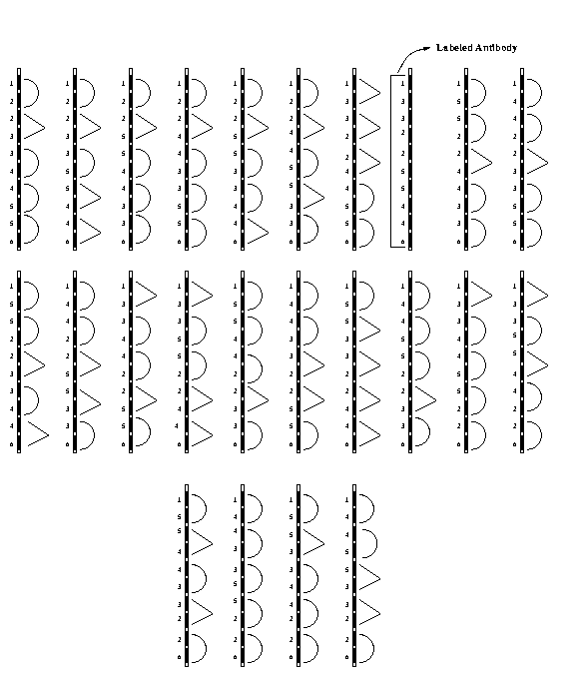
Peptides with Antibodies

Slide 19
Peptide with Antibodies

Slide 20
labeled antibody

Slide 21
Complexity
Number of peptides = (n-2)!
Length of peptides = O(n)
Number of antibodies = O(n²)
Number of Bio-steps is constant

Slide 22
Exact Cover by 3-Sets Problem
Instance A finite set X = {x₁,x₂,…,x_{n}}, n = 3q and a collection C of 3-elements subsets of X
Question: Does C contain an Exact Cover for X

Slide 23
Peptide Computing is Computationally Complete
A Turing Machine can be
simulated by a Peptide System

Slide 24
Universality Result
Contd..
Peptide without antibodies

Slide 25
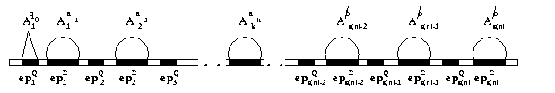
Initial Configuration of Peptide

Slide 26
Simulating the Right Move
M moves from a_{i} q a_{j} a_{j’} to a_{i} a_{j’’} q’ a_{j’}
Add excess of free epitopes ep_{k}^{Σ} and ep_{k}^{Q}
Add antibodies A_{k}ª_{j’’} and A_{k+1}^{q’}
k is the position of the head prior to the right move

Slide 27
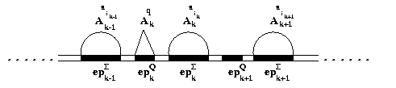
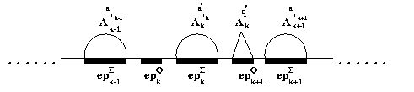
Simulating the Right Move
Contd..

Slide 28
Simulating the Left Move
M moves from a_{i} q a_{j} a_{j’} to q’a_{i} a_{j’’} a_{j’}
Add excess of free epitopes ep_{k}^{Σ} and ep_{k}^{Q}
Add antibodies A_{k}ª_{j’’} and A_{k-1}^{q’}
k is the position of the head prior to the right move

Slide 29
Complexity
Peptide system takes O(t(n)) time
Length of the peptide is O(s(n))
Number of peptide is one
Amount of antibodies is
O(m.s(n)+l.(s(n))

Slide 30
Switching Operations - OR, AND & NOT gates

Slide 31
Why modeling gate operations?
Peptide and antibody formation is dependent on the problem.
Defining basic operations makes the model independent of the problem.

Slide 32
For DNA Computing
Ogihara et al, Martyn Amos et al have done the simulation of Boolean circuits for DNA computing.
H.Hug et al have proposed a model to do parallel arithmetical operations using DNA operations on DNA strands.

Slide 33
Proposed Model
Consists of a peptide sequence and some set of antibodies.
Peptide sequence consists of five epitopes,
P = y x₁xx₂z
where each y, x₁,x, x₂ and z are epitopes.
Six antibodies denoted by A₁, A₂, B₁, B₂, C_{init} and C_{f}.
Antibodies A₁, A₂, B₁ and B₂ denote the inputs.
C_{init} denote the initial value of the result of the operation.
C_{init} and C_{f} denote the output of the operation.

Slide 34
Proposed Model
Epitopes x and y are the binding places for the antibodies denoting the input.
Epitope x₁xx₂is the place where the antibody representing the initial output binds.
Epitopes x₁x, xx₂ and x are the binding places for the antibodies denoting the output.

Slide 35
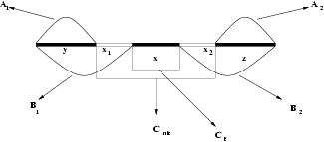
Peptide sequence
Peptide Sequence with Antibodies

Slide 36
OR Gate
Input bits 0 and 1 are represented by the antibodies A_{i} and B_{i} respectively where 1 ≤ i ≤ 2.
The antibody C_{init} denotes the bit 0.
The antibody C_{f} (labeled antibody) denotes the bit 1.
epitope(A₁) = {y}, epitope(A₂) = {z},
epitope(B₁) = {yx₁}, epitope(B₂) = {x₂z},
epitope(C_{init}) = {x₁xx₂}, epitope(C_{f}) = {x},
aff(B_{i}) > aff(C_{init}) > aff(C_{f}), 1 ≤ i ≤ 2.

Slide 37
OR Gate
The output 1 occurs if at least one of the inputs is 1.
Start with an initial output of 0 - antibody C_{init} binds to its epitope.
C_{init} is toggled if at least one 1 comes as an input. For this to be carried out the epitopes for the antibody C_{init} and the antibody B_{i}, 1 ≤ i ≤ 2 are taken as overlapping ones.
aff(B_{i}) > aff(C_{init}) > aff(C_{f}), 1 ≤ i ≤ 2.
This facilitates toggle of output bit to 1 - antibody C_{f} binds to its epitope.

Slide 38
Algorithm
Take the peptide sequence P in an aqueous solution.
Add the antibody C.
Add antibodies corresponding to the input bits. For example if the first bit is 1 and the second bit is 0 then add antibodies B₁ and A₂.
Add antibody C_{f}.
If the output has to be seen the antibody C_{f} can be gives some color so that at the end of the algorithm if fluorescence is detected the output will be 1 or else it will be 0.

Slide 39
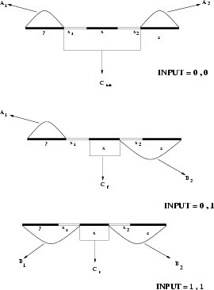

Slide 40
Other Gates
This model has been extended to other gates – AND, NOT, NAND, NOR and XOR
We also extend this model to simulate Boolean circuits.

Slide 41
Boolean Circuit
An n-input m-output Boolean circuit is modeled as a directed acyclic graph G=(V,E).
V consists of two disjoint sets X_{n} and G
X_{n} denotes the n-inputs and G denotes all the gates, of which m are output gates.
Each input vertex has in-degree 0 and is associated with a single Boolean variable x_{i}
Every vertex denoting gate has in-degree 2 and is associated with NAND operation
The m vertices denoting the output vertices have 0 out-degree

Slide 42
Boolean Circuit (Contd..)
An assignment of Boolean variables from {0,1}^{n} to X_{n} induces Boolean values at the output gates
The Boolean network is said to construct the function,
f(x_{n}) : {0,1}^{n} {0,1}^{m} = <f^{(i)}(X_{n}) : {0,1}^{n} {0,1}>,
where i = 1 to m
if ∀α ∈ {0,1}^{n}, t_{i}(α) = f^{(i)}(α) for all i = 1 to m
t₁,t₂,…,t_{m} are output gates

Slide 43
Boolean Circuit (Contd..)
The size of the network C(S), S – Boolean network
The depth of circuit D(S)
The breadth of the circuit B(S)
We denote j^{th} gate at k level by g_{k,j}
For every gate g_{k,j} we form peptide sequence p_{k,j}

Slide 44
Formation of Peptide Sequence
At level k=0, the j^{th} gate is denoted by the sequence
p_{0,j} = y_{0,j}x_{0,j,1}x_{0,j}x_{0,j,2}z_{0,j}
For level k>0 if k=m, j=p then
p_{m,p} = x_{m-1,n,1}w_{m-1,n}x_{m-1,n,2}w_{m,p}x_{m-1,s,1}w_{m-1,s}x_{m-1,s,2} if the gate g_{m,p} gets inputs from the gates g_{m-1,n} and g_{m-1,s}
w_{0,i} = x_{0,i} for all i and w_{m,n} unique for all m,n where m>0.

Slide 45
Formation of Antibodies
At level k=0, there are seven antibodies for each gates, (A₁)^{0,j}, (A₂)^{0,j}, (B₁)^{0,j}, (B₂)^{0,j}, (C_{init})^{0,j}, (C_{f})^{0,j} and (R)^{0,j}
epi((A₁)^{0,j}) = y_{0,j}x_{0,j,1} epi((A₂)^{0,j}) = x_{0,j,2}z_{0,j}
epi((B₁)^{0,j}) = y_{0,j} epi((B₂)^{0,j}) = z_{0,j}
epi((C_{init})^{0,j}) = x_{0,j,1}x_{0,j}x_{0,j,2}
epi((C_{f})^{m,j}, (R)^{m,j}) = w_{m,j}

Slide 46
Formation of Antibodies
At level k>0, epi((C_{init})^{k,j})=x_{k-1,n,2}w_{k,j}x_{k-1,s,1}
provided the gate g_{k,j} get inputs from gates
g_{k-1,n} and g_{k-1,s}
The peptide sequence g_{k,j} get antibodies out(g_{k-1,n}) and out(g_{k-1,s}) as inputs
out(g_{k-1,n}) ∈ {(C_{init})^{k-1,n},(C_{f})^{k-1,n}}
out(g_{k-1,s}) ∈ {(C_{init})^{k-1,s},(C_{f})^{k-1,s}}

Slide 47
Formation of Antibodies
affinity((R)^{m,j}) > affinity((C_{init})^{m,j})
affinity((C_{init})^{m,j}) > affinity((C_{f})^{m,j})
affinity((C_{init})^{m-1,j}) > affinity((C_{init})^{m,i})

Slide 48
Simulating Boolean Circuit
Antibodies denoting the inputs are put into the solution containing peptide sequences p_{0,j}
All the peptides p_{m-1,i} are initialized with antibody (C_{init})^{m-1,i}

Slide 49
Simulating Boolean Circuit
Suppose gate g_{k,j} gets inputs from g_{k-1,n} and
g_{k-1,s}
Put (R)^{m-1,n} and (R)^{m-1,s} are put into the solution to get the outputs of the gates g_{m-1,n} and g_{m-1,s}
Put the antibody (C_{f})^{k,i}

Slide 50
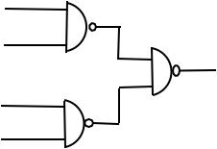
Example
4-input and 1-output

Slide 51
Example (Contd..)
y_{0,1}
x_{0,1,1}
x_{0,1}
x_{0,1,2}
z_{0,1}
y_{0,2}
x_{0,2,1}
x_{0,2}
x_{0,2,2}
z_{0,2}
Peptide sequences representing the first two gates at level 0

Slide 52
Example (Contd..)
y_{0,1}
x_{0,1,1}
x_{0,1}
x_{0,1,2}
z_{0,1}
(C_{init})^{0,1}
(C_{init})^{0,2}
y_{0,2}
x_{0,2,1}
x_{0,2}
x_{0,2,2}
z_{0,2}
Gates initialized at level 0

Slide 53
Output in the first two gates
(B₁)^{0,1}
(B₂)^{0,1}
y_{0,1}
x_{0,1,1}
x_{0,1}
x_{0,1,2}
z_{0,1}
(B₁)^{0,2}
(A₂)^{0,2}
y_{0,2}
x_{0,2,1}
x_{0,2}
x_{0,2,2}
z_{0,2}
x_{0,1,1}
x_{0,1}
x_{0,1,2}
w_{1,1}
x_{0,1,1}
x_{0,1}
x_{0,1,2}
(C_{init})^{1,1}
When the input is 1,1 and 1,0

Slide 54
Outputs removed
(B₁)^{0,1}
(B₂)^{0,1}
y_{0,1}
x_{0,1,1}
x_{0,1}
x_{0,1,2}
z_{0,1}
(R)^{0,1}
(B₁)^{0,2}
(A₂)^{0,2}
y_{0,2}
x_{0,2,1}
x_{0,2}
x_{0,2,2}
z_{0,2}
(R)^{0,2}
x_{0,1,1}
x_{0,1}
x_{0,1,2}
w_{1,1}
x_{0,1,1}
x_{0,1}
x_{0,1,2}
(C_{init})^{1,1}

Slide 55
Output getting as input andoutput at the third gate
(B₂)^{0,1}
(B₁)^{0,2}
y_{0,1}
x_{0,1,1}
x_{0,1}
x_{0,1,2}
z_{0,1}
(R)^{0,1}
(B₁)^{0,2}
(A₂)^{0,2}
y_{0,2}
x_{0,2,1}
x_{0,2}
x_{0,2,2}
z_{0,2}
(R)^{0,2}
x_{0,1,1}
x_{0,1}
x_{0,1,2}
w_{1,1}
x_{0,2,1}
x_{0,2}
x_{0,2,2}
(C_{f})^{0,2}
(C_{init})^{0,1}
(C_{f})^{1,1}

Slide 56
Modeling Arithmetic Operations

Slide 57
Arithmetic Operations
Proposed Model
Consists of a peptide and set of antibodies
Peptide sequence has n position specific epitopes
Epitopes ep_{i} = y_{i} x_{i} z_{i}, y_{i} and z_{i} are switching epitopes for the i^{th} bit.

Slide 58
y₄
x₄
z₄
y₀
x₀
z₀
Peptide Sequence for a 5-bit number

Slide 59
Antibodies
A = {A₀, A₁, …, A_{n-1}}
B = {B₀, B₁, …, B_{n-1}}
T_{AB} = {T_{AB0}, T_{AB1}, …, T_{AB(n-1)}}
T_{BA} = {T_{BA0}, T_{BA1}, …, T_{BA(n-1)}}

Slide 60
Binding Sites
x_{i}z_{i}
y_{i}x_{i}
For A_{i}
For B_{i}
x_{i}
x_{i}
y_{i}x_{i} > x_{i}
x_{i}z_{i} > x_{i}
T_{ABi}
Z_{i}
T_{BAi}
y_{i}

Slide 61
Affinity
aff(T_{ABi}) > aff(A_{i})
aff(T_{BAi}) > aff(B_{i})
aff(T_{ABi}) = aff(T_{BAi})

Slide 62
What it denotes?
A_{i} – denotes i^{th} bit is zero
B_{i} – denotes i^{th} bit is one
T_{ABi} – used to switch i^{th} bit from zero to one
T_{BAi} – used to switch i^{th} bit from one to zero

Slide 63
Representation of Binary Numbers
If the i^{th} bit is 0 then the antibody A_{i} is bounded to the epitope y_{i}x_{i}
If the i^{th} bit is 1 then the antibody B_{i} is bounded to the epitope x_{i}z_{i}

Slide 64
Example
B₄
A₃
B₂
A₁
B₀
10101

Slide 65
Addition of Two Binary Numbers
A = a_{n-1}a_{n-2} …a₀
B = b_{n-1}b_{n-2} …b₀
C = c_{n} c_{n-1}c_{n-2} …c₀

Slide 66
XOR
 | a_{i} | b_{i} | C_{i}
1 | 0 | 0 | 0
2 | 0 | 1 | 1
3 | 1 | 0 | 1
4 | 1 | 1 | 0

Slide 67
Addition (Contd..)
First step – guessing equivalent to XOR gate.
The bit c_{n} is initialized to zero.
Carry propagation.

Slide 68
Addition (Contd..)
Carry occurs only when both the bits a_{i} and b_{i} are 1.
Carry is propagated to the left until both the bits a_{j} and b_{j} (j > i) are 0.
If no such j exists then propagation stops making n^{th} bit 1.
j.j-1….i+1 is called the carry block.
For each carry block j.j-1….i+1 invert the digits c_{k}
(i+1 ≤ k ≤ j)

Slide 69
Algorithm
Add antibodies A_{i} where a_{i} = 0 and b_{i} = 0 or a_{i} = 1 and b_{i} = 1.
Add antibodies B_{i} where a_{i} = 0 and b_{i} = 1 or a_{i} = 1 and b_{i} = 0.
For all carry block j_{k}j_{k}-1…i_{k}+1 do the following in parallel. For i_{k} +1 ≤ s ≤ j_{k}
  Add antibodies T_{ABs},
  Add antibodies B_{s},
  Add antibodies T_{BAs}, and
  Add antibodies A_{s}.

Slide 70
Example
10110
10011
+
000101
A₅
A₄
A₃
B₂
A₁
B₀

Slide 71
Example (Contd..)
101101
B₅
A₄
B₃
B₂
A₁
B₀

Slide 72
Example (Contd..)
101001
B₅
A₄
B₃
A₂
A₁
B₀

Slide 73
Algorithm
ADD(A,B,C)
XOR(A,B,C)
BlockInversion(I₁,I₂,…I_{k},C) where I_{j} are carry blocks and k is the number of carry blocks.

Slide 74
Binding-Blocking Automata

Slide 75
Binding-Blocking Automata
finite control
finite tape
tape head
finite tape symbols
transition function
partial order relation
blocking and unblocking functions

Slide 76
BBA Formal Definition
P = (Q,V,E,δ,q₀,R,β_{b},β_{ub},Q_{accept},Q_{reject})
where Q = Q_{block} ∪ Q_{unblock} ∪ Q_{general},
q₀ ∈ Q (start state),
V is a finite set of symbols,
E is the finite subset of V*,
δ is the transition function from Q × E → Q,
R ⊆ E × E is the partial order relation,
β_{b} is the blocking function from Q_{block} → 2^{V},
β_{ub} is the unblocking function from Q_{unblock} → 2^{V},
Q_{accept} ∪ Q_{reject} ⊆ Q_{general} where Q_{accept} is the set of accepting states and Q_{reject} is the set of rejecting states.

Slide 77
Results in BBA
Power of the system is analyzed in four variants,
({leftmost, locally leftmost} X {blocked and free transitions})
Locally leftmost is more powerful.
The acceptance power of k-NFA is in between the power of BBA in leftmost and locally leftmost.

Slide 78
Complexity Issues
Blocking number
Blocking instant
Blocking quotient
Infinite hierarchy
Hierarchy collapses

Slide 79
String Binding-Blocking Automata
String of symbols (starting form the head's position) can be blocked from being read by the head.
Only those symbols which are not marked and not blocked can be read by the head.
Blocking is maximal.

Slide 80
Results in StrBBA
The power of StrBBA in l transition is strictly more than BBA in l transition.
The power of StrBBA in ll transition is strictly more than languages not accepted by BBA in ll.
For every L ∈ StrBBA_{l} there exists a random-context grammar RC with Context-free rules such that
L(RC) = L.
The set of all languages accepted by strbba_{l}(Fin) is equal to the set of all regular languages.

Slide 81
Rewriting BBA
A 2-way tape head which scans a cell to its right at a time.
Marking is done with help of a particular set called Marker set
There is a set of poset relations, where each poset is defined on the marker set.
This poset relation, depending on the state, helps to replace the markers.

Slide 82
RBBA - Result
RBBA is Universally Complete
Simulate a Turing machine using a RBBA
Rewriting of Turing machine is taken care by the markers.

Slide 83
Conclusion
The peptide computational model has the potential to solve difficult combinatorial problems.
Will it be a complete computational model or a hybrid version with silicon computers or a model used to solve some subset of problems?
Defining basic operations for the model.
Solving hard problems using these basic operations.
Preprocessing time – time for building peptides and antibodies is more.
Implementation difficulties.
Can exhaustive search be replaced by other efficient methods.

Slide 84
“Sciences reach a point where they become mathematized..... It occurred in physics about the time of the Renaissance; it began in chemistry after John Dalton developed atomic theory; and it is just now happening in biology”
“They were built by 3 billion years of evolution, and we’re just beginning to tap their potential to serve non-biological purposes. Nature has given us an incredible toolbox, and we’re starting to explore what we might build.”
Leonard Adleman
Thank You

