Slide 1

Peptide Computing and Binding-Blocking Automata
M. Sakthi Balan
Theoretical Computer Science Lab
Department of Computer Science and Engg.
Indian Institute of Technology
Chennai – 600036.
Email: sakthi@cs.iitm.ernet.in
URL: www.cs.iitm.ernet.in/theory/sakthi

Slide 2
Organization
DNA Computing
Peptide Computing
Solving Hamiltonian Path Problem
Solving Exact 3-Cover Set Problem
Solving Satisfiability Problem
Binding-Blocking Automata (BBA)
Normal Forms of BBA
Conclusion

Slide 3
“.…It seems that progress in electronic hardware (and the corresponding software engineering) is not enough; for instance, the miniaturization is approaching the quantum boundary, where physical processes obey laws based on probabilities and non-determinism, something almost completely absent in the operation of “classical” computers. So, new breakthrough is needed….”
Computing with Cells and Atoms –
Cristian S. Calude and Gh. Paun

Slide 4
Natural Computing
Biological Computing
Quantum Computing

Slide 5
Biological Computing
DNA Computing
Peptide Computing

Slide 6
DNA Computing
Uses DNA strands and Watson-Crick Complementarity as operation
Highly non-deterministic
Massive parallelism
Solves NP-Complete Problems quite efficiently

Slide 7
Peptide Computing
Uses peptides and antibodies
Operation – binding of antibodies to epitopes in peptides
Epitope – The site in peptide recognized by antibody
Highly non-deterministic
Massive parallelism

Slide 8
Peptide Computing
Contd..
Peptides – sequence of amino acids
Twenty amino acids. Example – Glycine, Valine
Connected by covalent bonds

Slide 9
Peptide Computing
Contd..
Antibodies recognizes epitopes by binding to it
Binding of antibodies to epitopes has associated power called affinity
Higher priority to the antibody with larger affinity power

Slide 10
Computing
DNA Vs Peptide
Twenty building blocks (20 amino acids)
Example: Glycine, Valine
Different antibodies can recognize different epitopes
Binding affinity of antibodies can be different
Four building blocks
Adenine (A), Guanine(G), Cytosine (C), Thiamine (T)
Only one reverse complement – Watson-Crick Complement
Complement (A) = T and Complement (G) = C

Slide 11
Peptide Computing Model
Peptides represent sample space of the problem
Antibodies are used to select the correct solution of the problem (i.e. peptides)

Slide 12
Definition
For finite sequence M = m₁,m₂,…,m_{n} the doubly duplicated sequence is
MM = m₁,m₁,m₂,m₂,…,m_{n},m_{n}
Doubly duplicated permutation of a finite set S is
{mm | m is a permutation of the set S}

Slide 13
Hamiltonian Path Problem
G = (V,E) is a directed graph
V = {v₁,v₂,…,v_{n}} is the vertex set
E = {e_{ij} | v_{i} is adjacent to v_{j}} is the edge set
v₁ - source vertex, v_{n} – end vertex
Problem – Test whether there exists a Hamiltonian path between v₁ and v_{n}

Slide 14
1
2
3
4
5
6

Slide 15
1
2
3
4
5
6

Slide 16
Peptides Formation
Each vertex v_{i} has a corresponding epitope ep_{i}
Each peptide has ep₁ on one extreme and ep_{n} on the other extreme
All doubly duplicated permutations of
{ep₂, … ,ep_{n-1}} are formed in each of the peptide in between ep₁ and ep_{n}

Slide 17
Antibody Formation
Form antibodies A_{ij} – site = ep_{i}ep_{j} s.t. v_{j} is adj. to v_{i}
Form antibodies B_{ij} – site = ep_{i}ep_{j} s.t. v_{j} is not adj. to v_{i}
Form antibody C – site is whole of peptide
Affinity(B_{ij}) > Affinity(C)
Affinity(C) > Affinity(A_{ij})

Slide 18

Peptide Solution Space

Slide 19
Algorithm
Take all the peptides in an aqueous solution
Add antibodies Aij
Add antibodies Bij
Add labeled antibody C
If fluorescence is detected answer is yes or else the answer is no

Slide 20
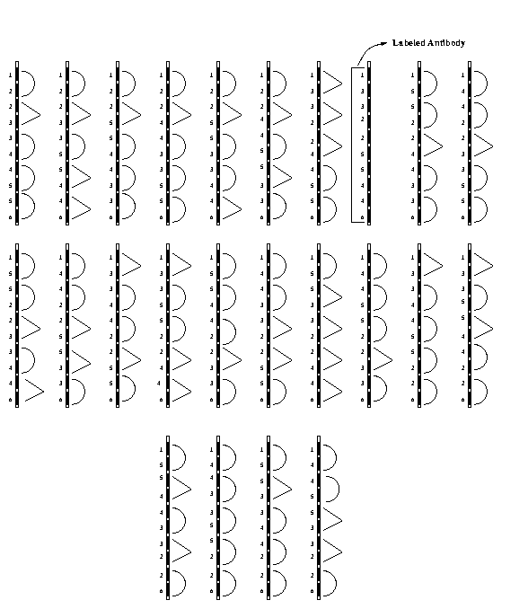
Peptides with Antibodies

Slide 21
Peptide with Antibodies

Slide 22
labeled antibody

Slide 23
Complexity
Number of peptides = (n-2)!
Length of peptides = O(n)
Number of antibodies = O(n²)
Number of Bio-steps is constant

Slide 24
Exact Cover by 3-Sets Problem
Instance: A finite set X = {x₁,x₂,…,x_{n}},
n = 3q and a collection C of 3-elements subsets of X
Question: Does C contain an Exact Cover for X

Slide 25
Peptide Formation
For each xi a specific epitope ep_{i} is chosen
For every permutation of the set {ep_{i}} a peptide is chosen s.t. every subsequence of ep_{i} ep_{j} ep_{k} is followed by the epitope ep_{ijk}

Slide 26
Example
X = {x₁,x₂,…,x₉}
For permutation
x₁, x₇, x₉, x₂, x₆, x₄ , x₃, x₅, x₈

Slide 27
Antibody Formation
Form antibodies A_{ijk}, site = ep_{i} ep_{j} ep_{k} if
{x_{i},x_{j},x_{k}} is in C
Form antibodies B_{ijk}, site = ep_{i} ep_{j} ep_{k} if
{x_{i},x_{j},x_{k}} is not in C
Form colored antibody C, site is whole of peptide
Affinity(B_{ijk}) > Affinity(C)
Affinity(C) > Affinity(A_{ijk})

Slide 28
Algorithm
Take all the antibodies in an aqueous solution.
Add antibodies Aijk
Add antibodies Bijk
Add antibody C
If fluorescence is detected the answer is yes otherwise no

Slide 29
Complexity
Number of peptides = n!
Length of peptides = O(n)
Number of Antibodies = O(n³)
Number of Bio-steps is constant

Slide 30
Satisfiability Problem
Problem: Let F be a formula over n variables. Does there exists an assignment of truth value to every variable in F such that F becomes true.

Slide 31
Satisfiability Problem (Contd..)
Let F be a formula in conjunctive normal form.
There are n variables in F.
To find an assignment such that F is true.
N = 2^{n} assignments possible.

Slide 32
Example
Let F = (v₁ or ¬v₂) and ¬v₂ and (v₁ or v₂)
Assignments are (F,F), (F,T), (T,F), and (T,T)
(T,F) satisfies F

Slide 33
Peptide Formation
For each assignment prepare a peptide and different antibodies binding to overlapping epitopes.
Binding affinities are C > A >B.
C
A
B

Slide 34
Peptide Formation (Contd..)
Prepare partial solutions G₁,G₂,…,G_{k} where G_{i} contains antibody A if C_{i} is true under corresponding assignment X
G₁ = {A₁,A₃,A₄}, G₂ = {A₁,A₃}, G₃ = {A₂,A₃,A₄}

Slide 35
Algorithm
Let m = k
The antibody set G_{k} is added. The antibodies A of G_{k} bind to their epitopes.
Antibodies B are added. Antibodies B bind to all free binding sites for B.
Antibodies C are added.
Antibodies C are removed by adding epitope C in excess
All remaining anitbodies are covalently attached to their epitopes.
Let m = m-1. If m > 0 go to (2)
Add labeled antibodies A or B
Fluorescence is detected.

Slide 36
(F,F)
(F,T)
A
B
V1 and ¬V2
(T,F)
(T,T)
A
A

Slide 37
(F,F)
(F,T)
C
B
(T,F)
(T,T)
C
C

Slide 38
(F,F)
(F,T)
A
B
¬V2
(T,F)
(T,T)
A
B

Slide 39
(F,F)
(F,T)
C
B
(T,F)
(T,T)
C
B

Slide 40
(F,F)
(F,T)
B
B
V1 and V2
(T,F)
(T,T)
A
B

Slide 41
(F,F)
(F,T)
B
B
(T,F)
(T,T)
C
B

Slide 42
(F,F)
(F,T)
B
B
(T,F)
(T,T)
A
B

Slide 43
Peptide Computing is Computationally Complete
A Turing Machine can be
simulated by a Peptide System

Slide 44
Assumptions
Turing Machine halts when it reaches a final state
Let s(n) be the space complexity of the Turing Machine
Assume that s(n) is apriori known

Slide 45
Universality Result
Turing machine, M = (Q, Σ, δ, s₀, F)
Q = {q₁,q₂, … ,q_{m}}
Σ = {a₁,a₂, …,a_{l}}
B is the blank symbol

Slide 46
Universality Result
Contd..
Form s(n) epitopes,
E_{Q} = {ep_{i}^{Q} | 1 < i < s(n)}
Form s(n) epitopes,
E_{Σ} = {ep_{i}^{Σ}| 1 < i < s(n)}

Slide 47
Universality Result
Contd..
Form s(n)*m antibodies,
A_{Q} = {A_{i}^{q} | 1 < i < s(n), q Є Q}
Form s(n)*l antibodies,
A_{Σ} = {A_{i}ª | 1 < i < s(n), a Є Σ U {b}}
The antibodies A_{i}^{q}_{f} are labeled

Slide 48
Universality Result
Contd..
Peptide without antibodies

Slide 49
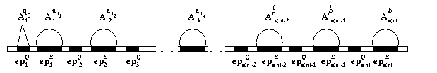
Initial Configuration of Peptide

Slide 50
Simulating the Right Move
M moves from a_{i} q a_{j} a_{j’} to a_{i} a_{j’’} q’ a_{j’}
Add excess of free epitopes ep_{k}^{Σ} and ep_{k}^{Q}
Add antibodies A_{k}ª_{j’’} and A_{k+1}^{q’}
k is the position of the head prior to the right move

Slide 51
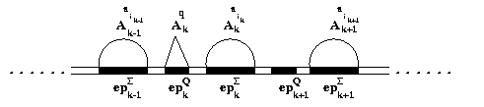
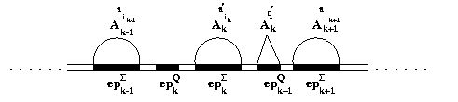
Simulating the Right Move
Contd..

Slide 52
Simulating the Left Move
M moves from a_{i} q a_{j} a_{j’} to q’a_{i} a_{j’’} a_{j’}
Add excess of free epitopes ep_{k}^{Σ} and ep_{k}^{Q}
Add antibodies A_{k}ª_{j’’} and A_{k-1}^{q’}
k is the position of the head prior to the right move

Slide 53
Complexity
Peptide system takes O(t(n)) time
Length of the peptide is O(s(n))
Number of peptide is one
Amount of antibodies is
O(m.s(n)+l.(s(n))

Slide 54
Binding-Blocking Automata

