Slide 1
Credit Risk Model Evaluation
SHAP and ROC analysis for best-performing model selection

Slide 2
Project Overview
Objective: Predict credit outcomes using bureau and risk features.
Data source: combined credit report and additional customer information.
Approach: clean data, compare feature sets, train supervised models, explain selected model with SHAP and ROC.

Slide 3
Models Trained and Evaluated
Logistic Regression
Random Forest
HistGradientBoosting
Each model trained on multiple feature combinations for comparison.

Slide 4
Feature Combinations Used
Credit Scores: RISK_SCORE, NO_SCORE, SCORE_CR22
Risk Features: RISK_SCORE, RISK_RELATIVE_ODDS_CR21
Risk Relative Index: RISK_RELATIVE_CR21
Selected Features: top predictive features from RandomForest importance
SFM Selected: features chosen via SelectFromModel using RandomForest
Credit + Risk: combined credit scores and risk indices

Slide 5
Best Performing Model
Selected model: HistGradientBoosting with feature set 'SFM Selected'
AUC = 0.758268
Accuracy = 0.918946
Selection justified by highest AUC and strong accuracy among evaluated candidates.

Slide 6
Evaluation Comparison Summary
SFM Selected + HistGradientBoosting achieved the highest AUC.
Selected Features + HistGradientBoosting is a close second, demonstrating robust feature selection.
Risk Features and Credit + Risk models show lower but stable performance, validating feature engineering choices.

Slide 7
ROC and AUC Analysis
ROC curve measures trade-off between true positive rate and false positive rate.
AUC of 0.7583 indicates good discriminative power for the selected model.
The ROC plot confirms the model separates classes better than random guessing.

Slide 8
SHAP Interpretation
SHAP explains how each feature contributes to predictions.
Top contributors: ENQUIRIES_12M, RISK_SCORE, NO_MONTHS_VCR228, ENQUIRIES_6M.
High ENQUIRIES_12M increases predicted risk, while higher RISK_SCORE reduces risk.

Slide 9
Dataset Splitting and Strategy
Train/test split: 75% training, 25% test.
Stratified split preserves target class balance across sets.
Feature subsets evaluated separately to identify the strongest predictors.

Slide 10
Recommendations
Use SFM-selected features with HistGradientBoosting for production scoring.
Consider collecting more risk-related features to improve AUC further.
Use SHAP insights for monitoring feature drift and model explainability.

Slide 11
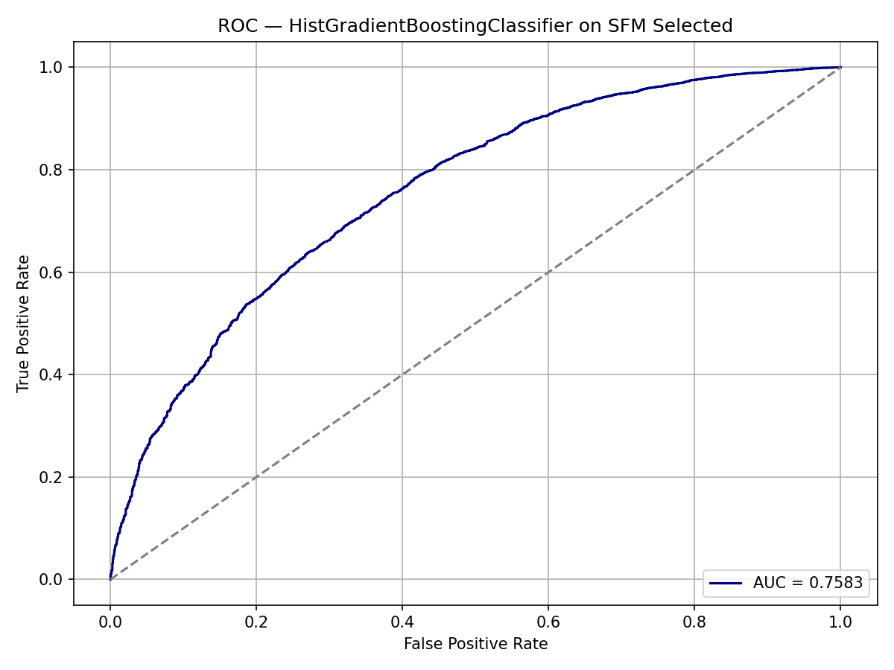
ROC Curve for Selected Model

Slide 12
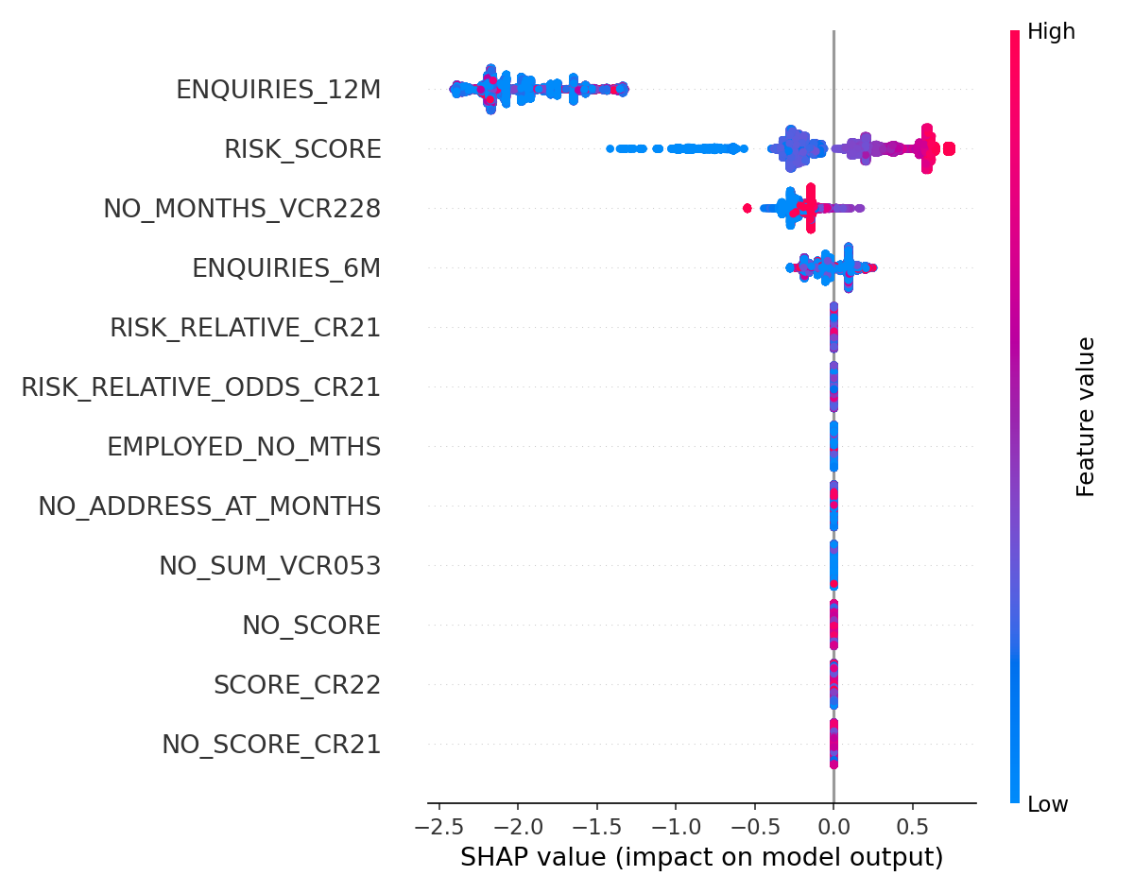
SHAP Summary Plot

