Slide 1
Credit Risk Model Evaluation
A polished report with model selection, ROC/AUC results, and SHAP insights.

Slide 2
Agenda
• Problem definition and dataset strategy
• Models trained and evaluated
• Comparison of model metrics
• Best model ROC/AUC analysis
• SHAP interpretation and insights
• Conclusions and recommendations

Slide 3
Models Trained and Evaluated
Three classifier types were trained across feature combinations:
Logistic Regression
Random Forest
HistGradientBoosting
Each model was evaluated on AUC and accuracy

Slide 4
Top Model Candidates
Feature Set | Model | AUC | Accuracy
SFM Selected | HistGradientBoosting | 0.758268 | 0.918946
Selected Features | HistGradientBoosting | 0.757469 | 0.919246
Risk Features | HistGradientBoosting | 0.741956 | 0.917892
Selected Features | Logistic Regression | 0.741161 | 0.918896
Credit + Risk | HistGradientBoosting | 0.740653 | 0.917375

Slide 5
Feature Combinations Evaluated
Feature groups created for comparative modeling:
Credit Scores: RISK_SCORE, NO_SCORE, SCORE_CR22
Risk Features: RISK_SCORE, RISK_RELATIVE_ODDS_CR21
Risk Relative Index: RISK_RELATIVE_CR21
Selected Features: RandomForest importance-based selection
SFM Selected: SelectFromModel feature selection
Credit + Risk: combined score and risk index variables

Slide 6
Best Model Selection
Best model: HistGradientBoosting with 'SFM Selected'
AUC = 0.758268
Accuracy = 0.918946
Selected because it achieved the highest AUC and strong accuracy.
HistGradientBoosting handles nonlinear relationships and interactions effectively.

Slide 7
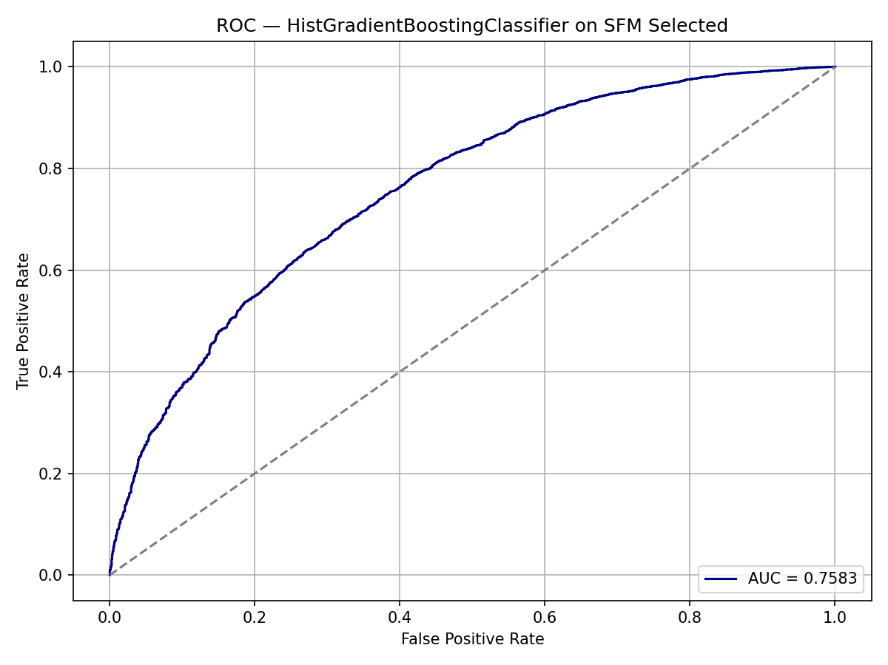
ROC Curve & AUC
The ROC plot shows model discrimination between classes. A higher AUC indicates better separation of good vs bad outcomes.

Slide 8
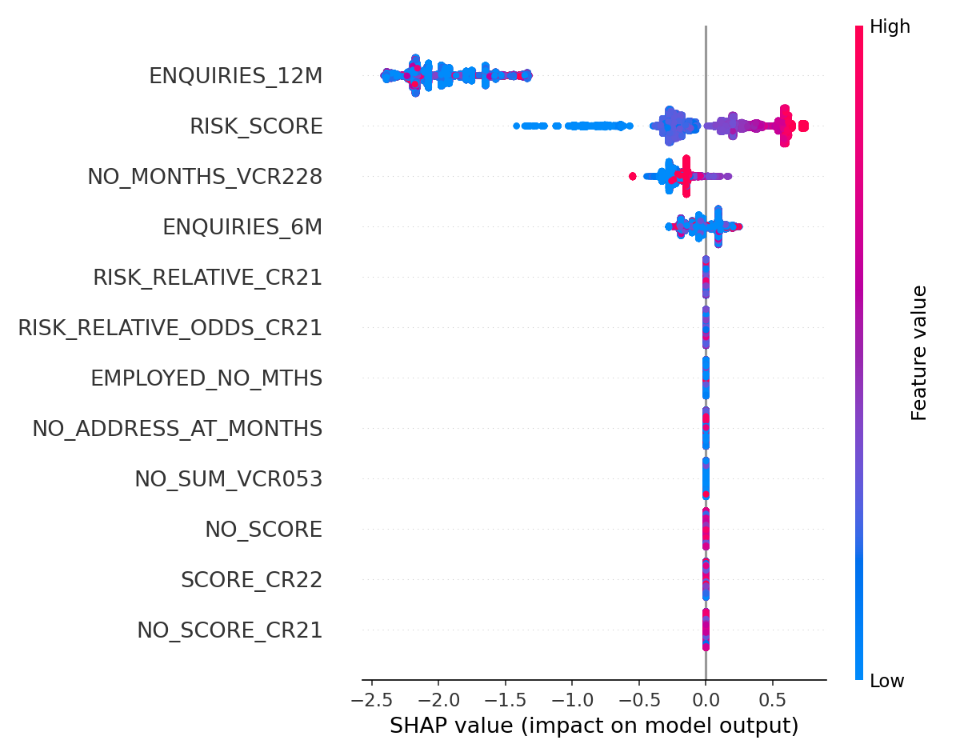
SHAP Summary and Feature Impact
SHAP highlights the most influential predictors. ENQUIRIES_12M and RISK_SCORE are the strongest drivers of model predictions.

Slide 9
Data Splitting and Strategy
Data split was performed with a 75/25 train/test ratio and stratified by outcome class to preserve balance.
This ensures a representative test set for unbiased evaluation.
Feature subsets were evaluated separately to identify the best predictive combination.
Duplicate records were removed and policy-decline cases excluded.

Slide 10
Conclusions & Next Steps
The recommended production approach is HistGradientBoosting with SFM-selected features.
Monitor feature drift using SHAP insights.
Collect more risk-related variables to potentially increase AUC further.
Next step: validate on an external holdout set before deployment.

