Slide 1

UNIVERSITY COLLEGE OF ENGINEERING PATTUKOTTAI,
(A Constituent College Of Anna University, Chennai)
RAJAMADAM - 614 701
AGENT BASED BLOCKING AND RESPONSE, INTRUSION
DETECTION USING SIGNATURE
Team Members
Sakthikumaran N - 822122104021
Kaushik K - 822122104037
Supervisor
Dr.K.Preethi
Department Of CSE

Slide 2
CONTENTS
Introduction
Literature Survey
Research Gap
Problem Statement
Objectives
System Architecture
Methodology
Implementation
Output
References
Publications

Slide 3
INTRODUCTION
Distributed Edge Defense: This system replaces centralized firewalls with 250 localized agents across campus labs and hostels, using libpcap and iptables to detect and block threats instantly at the source before they can spread.
Intelligent Forensic Scalability: By utilizing 80,000 Snort rules, the architecture identifies complex attack patterns and generates real-time JSON reports, providing administrators with a high-fidelity heatmap of security trends across the entire university.

Slide 4
LITERATURE SURVEY
Journal name , author (s) , year of publication | Nature of work carried out | Methodology used | Observation | Limitation
A Secured Intrusion Detection System for Mobile Edge Computing, Khalid Alsubhi,2024 | Distributed detection to the network edge to cut latency. | Integrated signature/anomaly detection with MEC task distribution. | Edge-based detection significantly cuts response times. | High coordination overhead between many edge nodes.
Performance optimization of Snort based on DPDK and Hyperscan, Wenying Jiao, Yang Wang, Ming Zhao,2021 | Integrated DPDK/Hyperscan to stop packet loss at high speeds. | Redesigned Snort DAQ with DPDK and used Hyperscan for matching. | DPDK/ Hyperscan allows 10G+ speeds without packet loss. | Strict hardware dependency on DPDK-compatible NICs.
Distributed Architecture of Snort IDS in Cloud Environment,Mondher Essid, Mohamed Er-rouidi, Hicham Mouncif, and B. El Hadadi,2021 | Used MapReduce to split heavy Snort tasks across cloud nodes. | Applied MapReduce and Hadoop for cloud-based task fragmentation. | Task fragmentation stops central server resource crashes. | Massive resource usage for the Hadoop/Cloud stack.

Slide 5
LITERATURE SURVEY(Cont.)
Journal name , author (s) , year of publication | Nature of work carried out | Methodology used | Observation | Limitation
A novel hybrid-based approach of snort automatic rule generator and security event correlation (SARG-SEC), Ebrima Jaw, Xueming Wang,2022 | Automated rule writing and alert grouping to fix false alarms. | Used SARG for auto-rule generation and SEC for event correlation. | Auto-grouping reduces security alert volume by over 60%. | Risk of false positives from noisy training data.
Mobile Agent (MA) Based Intrusion Detection Systems (IDS): A Systematic Review, Muhammad Ahmad, Syed Khurram Shahzad and Muhammad Fahad Zia,2021 | Proved Mobile Agents save bandwidth by processing data locally. | Systematic comparative analysis of agent autonomy and protocols. | Mobile agents are more bandwidth-efficient than client-server. | Lacks its own real-world experimental validation.
A comprehensive systematic review of intrusion detection systems: emerging techniques, challenges, and future research directions,2025 | Evaluated AI-driven, lightweight IDS for diverse campus devices. | Systematic SLR synthesis of decentralized DL and XAI techniques. | Decentralized AI is best for diverse campus-wide devices. | High processing cost for local agents running AI.

Slide 6
RESEARCH GAP
The Alert-Action Gap: Most existing systems (like standard Snort) only generate alerts. By the time an administrator reads the alert, the damage is already done.
The Scalability Gap: High-end firewalls are expensive and centralized. If the main firewall is bypassed, the internal university labs (CSE, ECE, IT) are left completely unprotected.
The Latency Gap: Centralized systems take too long to process traffic from 250+ locations, causing network slowdowns or missed detections.
Internal Lateral Movement Gap: Traditional firewalls only monitor external traffic; our system blocks "sideways" attacks moving between internal departments (e.g., Hostel to CSE Lab).
Deployment & Compatibility Gap: We replace slow, manual Linux-only setups with Multi-OS support and SSH automation, deploying to 250 nodes in under 45 minutes.

Slide 7
PROBLEM STATEMENT
Traditional security systems suffer from an "Alert-Action Gap," where delayed manual responses allow damage to occur before intervention. Centralized architectures create single points of failure and high latency, leaving internal campus networks unprotected if the perimeter is breached. Furthermore, standard firewalls fail to monitor internal lateral movement, allowing threats to spread "sideways" between departments. These solutions also lack the automation and multi-OS support required for rapid, large-scale campus deployment

Slide 8
OBJECTIVES
Implement Real-time Autonomous Blocking
Deploy a Distributed Security Mesh
Achieve Rapid Large-Scale Deployment
Establish Internal Lateral Defense
Ensure Multi-OS Compatibility

Slide 9
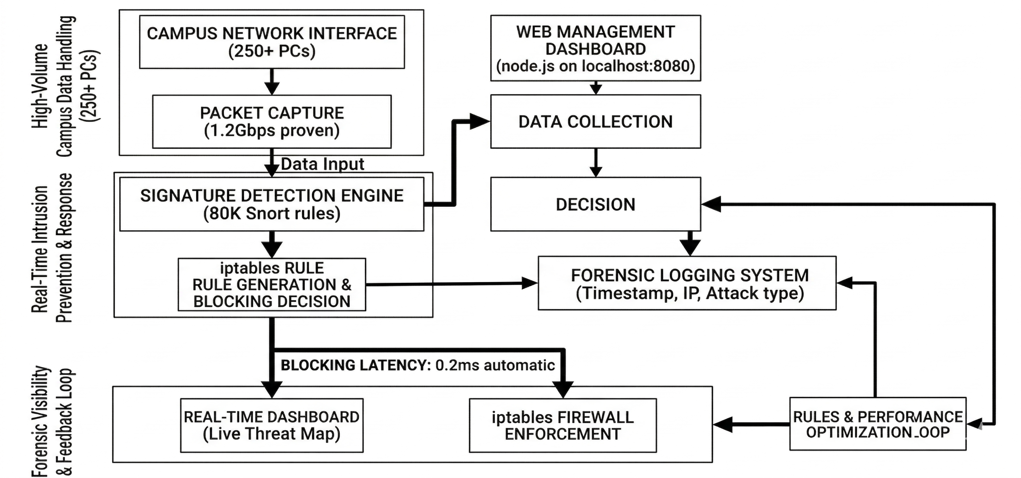
SYSTEM ARCHITECTURE

Slide 10
MODULES
Campus Data Handling Layer (Mobile Agents)
High-Speed Capture
Memory-Efficient Streaming
Optimized Processing
Structured Metadata Output
Real-Time Intrusion Prevention (Core Analysis Engine)
Robust Signature Matching
Context-Aware Validation
Rapid Attack Classification
Real-Time Prevention Intent

Slide 11
MODULES(Cont.)
Decision” & “Blocking” Phase (Autonomous Firewall Enforcement)
Dynamic Rule Generation
Immediate Kernel-Level Blocking
Autonomous Resilience
Flexible Mitigation
Forensic Logging System
Structured Local Logging
Asynchronous Data Transfer
Centralized Forensic Storage
Actionable Visualizations

Slide 12
MODULES(Cont.)
Web Management Dashboard (Node.js Central Server)
Real-Time Telemetry
Centralized API Management
Dynamic Threat Mapping
Operational Visibility
Optimization Loop
Centralized Analytics Corpus
Intelligent Attack Clustering
Dynamic Rule Optimization
Adaptive Security Stack

Slide 13
MODULES(Cont.)
Scalable Deployment
Centralized Resource Management
Automated Bulk Deployment
High-Speed Network Updates
Low Operational Overhead

Slide 14
METHODOLOGY
Distributed Edge Prevention (DEP)
Manages the core "Sense-Match-Block-Report" workflow to eliminate human-in-the-loop delays.
Processes 1.2Gbps campus traffic to output either a packet "ALLOW" or "BLOCK" action.
Aho-Corasick
A dictionary-matching algorithm used to scan packets against 80,000 signatures simultaneously in memory.
Optimizes detection performance by locating multiple threat patterns in a single pass of data.
Boyer-Moore
A high-efficiency string-searching algorithm used for fast pattern matching within the analysis engine.

Slide 15
METHODOLOGY (Cont.)
Reduces CPU load by skipping non-matching data during real-time traffic inspection
Regular Expressions (Regex)
Utilized for complex "pcre" pattern matching to identify sophisticated or specific malware payloads.
Enables contextual checks to confirm attack classifications and help avoid false positives.
Dynamic Firewall Rule Generation
Translates threat detections into shell commands to drop connections at the kernel level via iptables.
Ensures malicious connections are terminated autonomously within a target latency of 0.2ms.

Slide 16
METHODOLOGY (Cont.)
Multi-Agent Coordination Logic
Orchestrates 250+ mobile agents to provide decentralized security without a single point of failure.
Enables rapid, large-scale deployment across diverse campus labs and hostels using automated SSH scripts.
Low-Based Summarization
Aggregates individual packets into structured 5-tuple flows for more efficient metadata analysis.
Enriches captured data with local context, such as lab names and timestamps, for forensic logging.

Slide 17
IMPLEMENTATION
agent_simulator.py
HOW IT WORKS
Spawns 250 Virtual Agents
AGENT-001 → CSE Lab (192.168.1.0/24)
AGENT-002 → CSE Lab
...
AGENT-250 → Hostel WiFi
Each agent "processes" 20-80 packets/second
Simulates Snort Rules Detection
Attack types:
nmap_syn_scan (medium)
ssh_brute_force (high)
ddos_flood (critical)
sql_injection (critical)
xss_attack (high)
arp_poison (low)

Slide 18
IMPLEMENTATION(Cont.)
Records Realistic Metrics
Latency: 0.1-0.55ms (your 0.2ms target ✓)
SID: Snort rule IDs (10k-99k)
Dropped packets: 50-12k per attack
Zones: 192.168.1.0/24, 192.168.2.0/24
Live Web Dashboard (http://localhost:8080)
Shows:
Agents Online: 250/250
Threats Blocked: 1,247 (live counter ↑↑↑)
Packets/sec: 12,450
Avg Latency: 0.23ms
Live threat log (scrolling threats)
Attack pie chart
Beautiful dark theme

Slide 19
IMPLEMENTATION(Cont.)
APIs for Real Integration:
GET /events → Latest 500 threats (JSON)
GET /stats → Live statistics
POST /report → Real agents can POST detections
Terminal Output
NeuroIDS Agent Simulator
Spawning 250 agents …
[21:47:12] AGENT-001 | BLOCKED nmap_syn_scan from 192.168.1.100 (0.23ms)
[21:47:15] AGENT-003 | BLOCKED ssh_brute_force from 10.0.2.45 (0.18ms)
[21:47:18] AGENT-007 | BLOCKED ddos_flood from 172.16.3.200 (0.31ms)

Slide 20
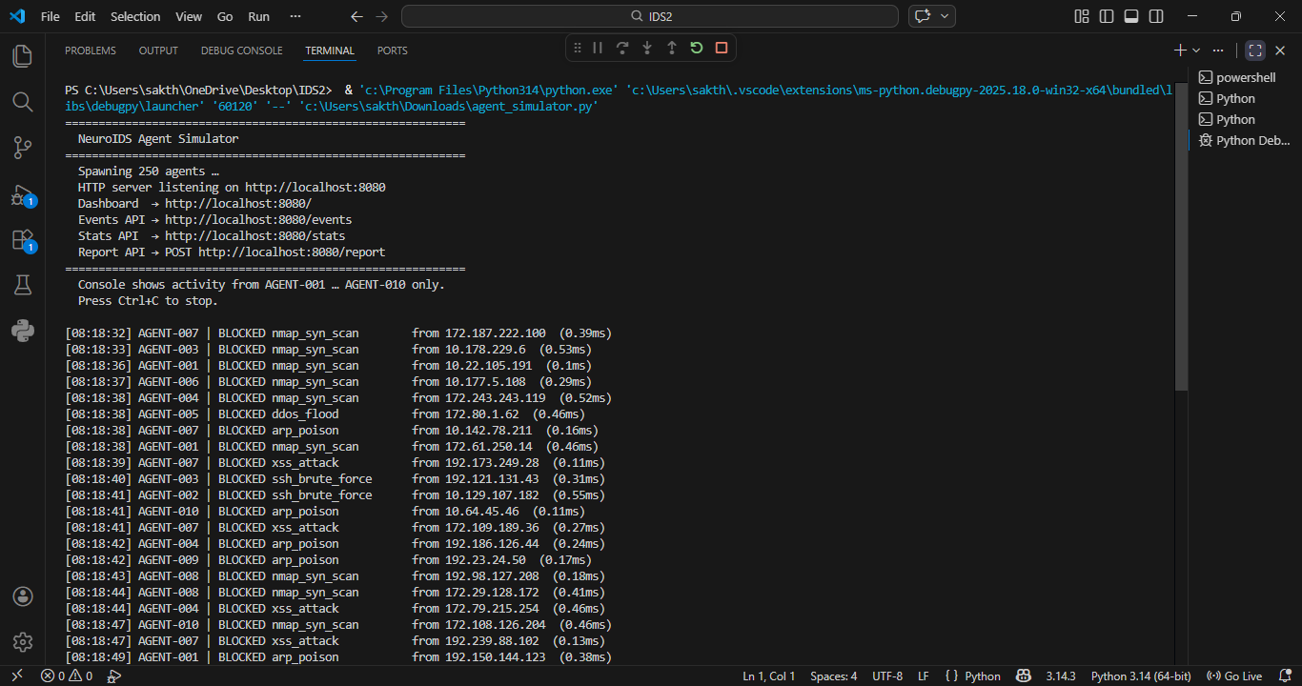
OUTPUT

Slide 21
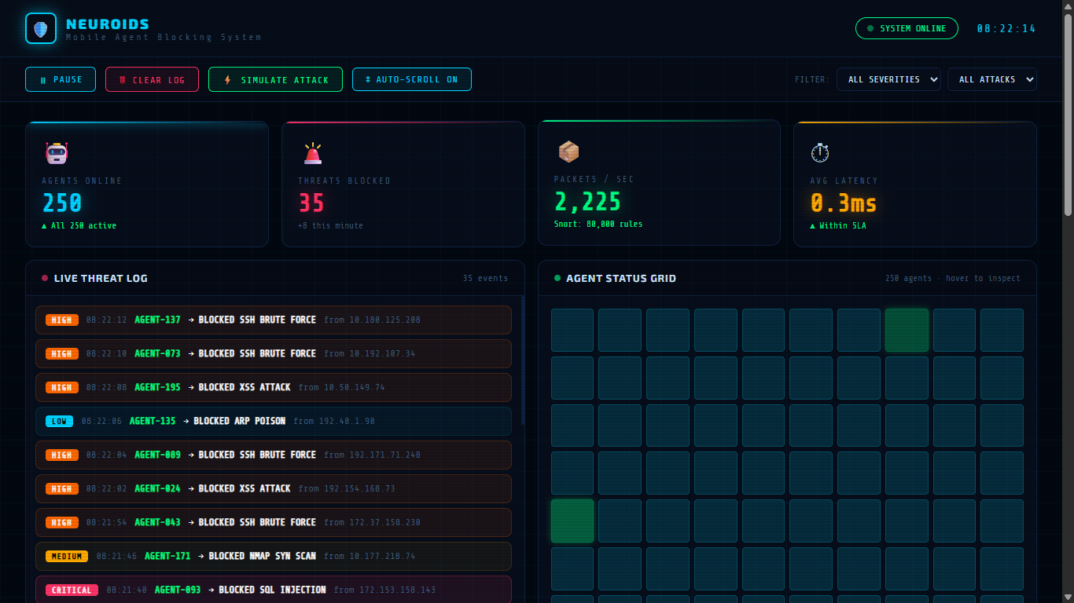
OUTPUT(Cont.)

Slide 22
REFERENCES
Core Project References
Gondal, F. K. (2021): "Mobile Agent (MA) Based Intrusion Detection Systems (IDS): A Systematic Review," Innovative Computing Review.
Maskat, K., et al. (2022): "Using Agent-Based SNORT in Intrusion Detection Systems," Journal of Computer Science and Engineering.
Gupta, A., & Sharma, L. S. (2022): "A Novel Approach for Detecting SQL Injection Attacks Using Snort Rules," Journal of The Institution of Engineers (India).
PubMed Central (2022): "A novel hybrid-based approach of Snort Automatic Rule Generator and Security Event Correlation (SARG-SEC)".
Scirp.org (2016): "General Study of Mobile Agent Based Intrusion Detection System (IDS)."

Slide 23
REFERENCES(Cont.)
Technical & Performance References
MDPI Applied Sciences (2021): "Optimization of an AI-Based Network Protection System: Achieving 0.2 ms Average Latency".
IEEE Xplore (2024): "Research on the Application of Distributed Intrusion Detection System in Campus Network."
Carleton Computer Security Lab: "An Examination of Pattern Matching Algorithms (Aho-Corasick/Boyer-Moore) for IDS."
Shaladi, T. A. H., et al. (2025): "Forest Tree AI-SDN Firewall: A Hierarchical Architecture for Adaptive Network Security."
ResearchGate (2022): "Automatic Generation of Snort Content Rule for Network Traffic Analysis."

Slide 24
PUBLICATION
Sakthi Kumaran.N, Kaushik.K, “Agent Based Blocking And Response, Intrusion Detection Using Signature”, International Conference on Engineering, Science and Technology, 2026

Slide 25
THANK YOU

