Slide 1
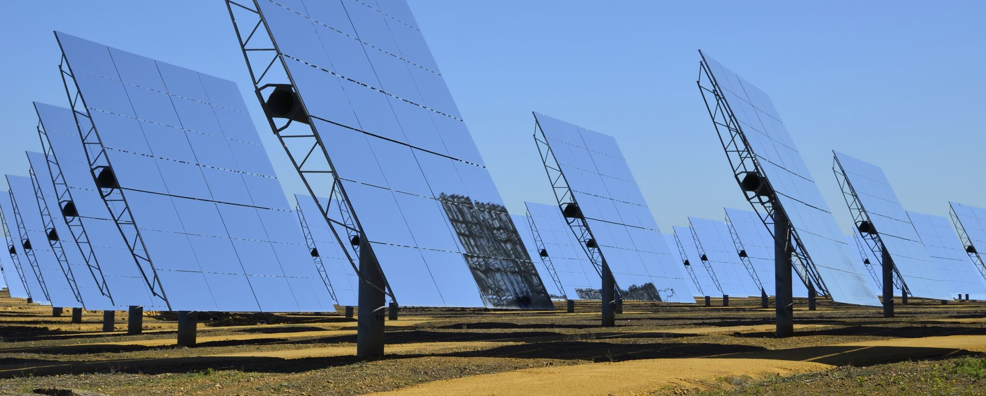
Solar Power Systems
1.Predictive Maintenance in Solar Power Systems. 2. Waste Sorting Using Computer Vision. 3.Energy Efficiency in Smart Building. 4.Air Quality Prediction in Urban Areas . 5.Sustainable Agriculture with AI for Crop Yield Prediction.

Slide 2
Predictive Maintenance in Solar Power Systems.
Problem Statement : Solar power plants play a crucial role in the transition toward clean energy.
However , maintaining large solar forms is challenging, as breakdowns inefficiencies can significantly reduce power output and cause financial losses.
Dataset: You are provided with sensor data from solar panels, including temperature, voltage, current,and historical maintenance records.

Slide 3
Waste Sorting Using Computer Vision
Problem Statement : Waste management is a critical aspect of sustainability.
A major problem faced by recycling facilities is the incorrect sorting of waste, which reduces recycling efficiency.
Dataset : You are provided with a dataset condaiting images of different types of waste (plastic, class , metal, paper).

Slide 4
Energy Efficiency in Smart Buildings
Problem Statement : Buildings account for nearly 40% of global energy consumption.
Improving energy efficiency in building is essential for meeting sustainablity torgets.
Dataset : you are provided with building energy usage data, occupancy data , and weather conditions over a two- year period.

Slide 5

Air Quality Prediction in Urban Areas
Problem Statement : Air polution is a severe challenge in urban areas, impacting public health and the environment.
Accurately predicting air quality levels can help city officials take timely action to reduce emissions or warn the public.
Dataset : You are provided with air quality data (PM 2.5 , PM 10, NO 2 , CO), traffic data, andbweather conditions over three years.

Slide 6
Sustainable Agriculture with AI for Crop yield Prediction
Problem Statement: Agriculture is highly sensitive to environmental conditions such as temperature, rainfall, and soil quality.
In the context of climate change, it is bital for farmers to have accurate predictions about crop yields to optimise resource usage and reduce waste.
Dataset: You are provided with crop yield data, soil quality data, rainfall, and temperature reading over a five year period.

