Slide 1

AI Powered Banking Chatbot
Sakthipraba M
Machine Learning Internship
Duration: 15th Jan – 15th May

Slide 2
Abstract
This project involves developing an AI-powered chatbot specifically for handling banking-related queries using Generative AI and Retrieval-Augmented Generation (RAG). A pretrained BERT model is used for intent prediction, which first classifies whether the user query is banking-related. Only if the intent is valid, the query is passed to the RAG pipeline. The system retrieves relevant information from a Vector Database storing document embeddings. The retrieved context is then fed into a Large Language Model (LLM) to generate accurate, context-aware responses. This setup ensures the chatbot delivers precise and domain-specific answers efficiently.

Slide 3
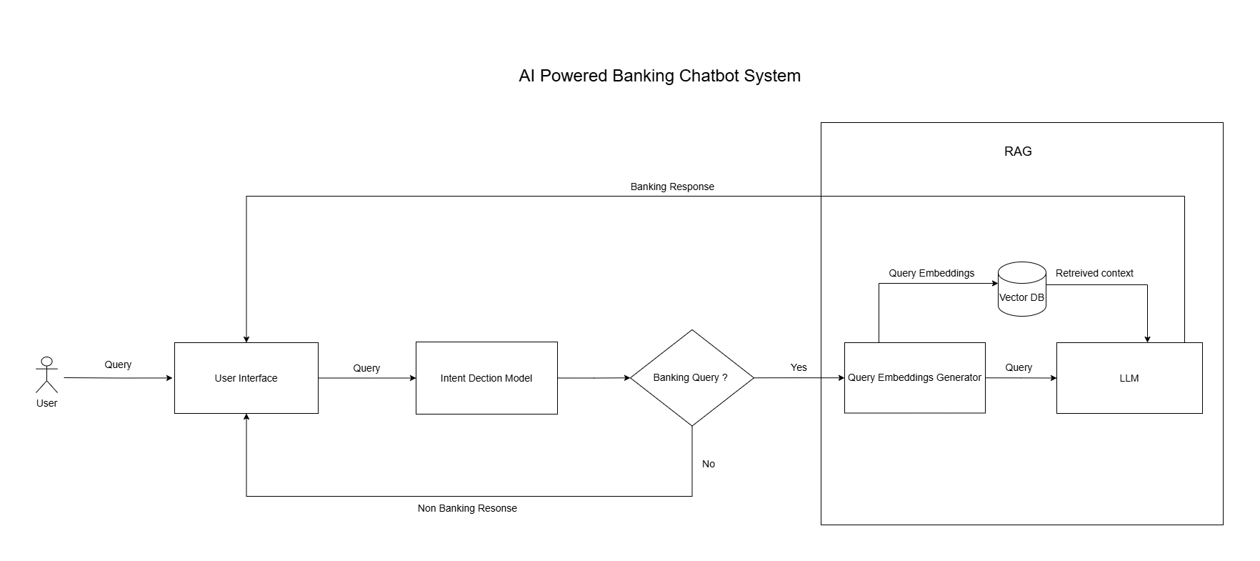
Architecture and Workflow

Slide 4
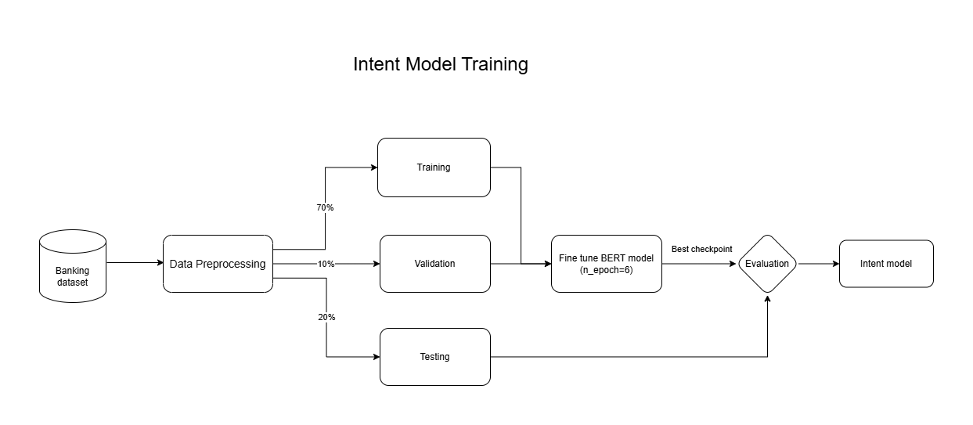
Workflow showing data collection, data preprocessing, BERT model training, evaluation, and deployment for intent classification

Slide 5
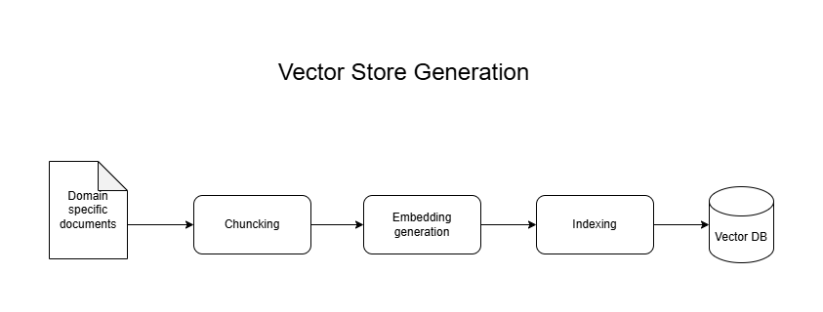
Pipeline for document ingestion, embedding generation, and storing vectors in the Vector DB for RAG-based retrieval.

Slide 6
Data Collection
Banking Data Collected from HuggingFace’s dataset with 5000 samples along with 78 banking-related intent classes.
e.g., can you give me information about what to do when my card expires?
Non-Banking Data
The non-banking data were collected from multiple public sources including GitHub and Papers with Code.
Dataset 1 contains domain-specific queries like flight bookings.
e.g., Can you show me flights from Dallas to Atlanta on Tuesday night?
Dataset 2 covers general-purpose questions.
e.g., How do I update my profile picture?
Dataset 3 includes casual conversational queries.
e.g., Turn off typing, speak instead. Hi, need some help with this.

Slide 7
Data Augmentation
To enhance the model's ability to handle edge cases, performed data augmentation by adding 100 ambiguous queries containing both banking and non-banking intents. These queries were crafted to mimic real-world uncertainties, helping the model generalize better when similar mixed-intent queries appear. This enriched the dataset and improved the robustness of intent classification.
Banking: I want to open a fixed deposit under the name ‘Blood Relief Fund’.
Non Banking: Is the blood bank open on Sundays?
All these datasets were cleaned and reformatted into a consistent structure with two columns such as Query and Intent. Each entry was labelled as non-banking and later merged with the banking data.
The feature used for model training was the user query (Query), and the target was the corresponding Intent.
In total,
Banking Data: 5040
Non Banking Data: 5060

Slide 8
Data Preprocessing
Performed duplicate and missing value checks to clean the dataset.
Removed duplicate queries, especially from banking intent classes where overlaps occurred.
Analyzed the unique classes in the banking intent and filtered out irrelevant ones, which are not useful for this task.
Each and every classes of the banking data were relabeled as banking
After cleaning, finalized the dataset with 10,100 samples for training intent classification model.

Slide 9
BERT Fine-Tuning for Banking Intent Classification
Dataset: Used 10,100 queries, split into 70% training, 10% validation, and 20% test data, with labels for banking and non-banking intents.
Model: Fine tuned the “bert-base-uncased” model to classify queries as banking related or not, leveraging its pretrained knowledge for efficient learning.
Training: Trained for 6 epochs with a batch size of 8 and a learning rate of 2e-5, optimizing the model’s performance on the validation set.
Best Checkpoint: The best model checkpoint was selected based on highest validation accuracy, ensuring optimal performance for inference.
Results: Achieved 99% accuracy on the test set, demonstrating the model's strong ability to classify banking-related queries accurately.

Slide 10
Building Vector DB for Retrieval Mechanism (RAG)
Collecting documents: Collected banking-related documents from official websites and uploaded them in PDF format.
Loading PDF’s: Each PDF was uploaded using Streamlit’s file uploader, then used “PDFPlumberLoader” to extract text from the PDFs.
Chunking: Extracted content was chunked using “SemanticChunker”, which ensures chunks are not just arbitrary splits but are semantically coherent, making downstream retrieval more accurate.
Embedding Creation: Each chuck then converted into a high dimensional vector using “HuggingFaceEmbeddings”, representing the chunk’s semantic meaning numerically.
Vector Index Creation: Once each text chunk is embedded, a FAISS index is created to store these vectors. FAISS helps in fast similarity search, allowing the system to retrieve relevant chunks quickly during question answering.
Saving The Vector Store: The updated or newly created index is saved to disk. This ensures that future queries can directly load the saved vector database without repeating embedding or chunking steps.

Slide 11
RAG Workflow
Load Saved Vector Store: The saved FAISS vector store is loaded locally and used to retrieve the top 5 relevant chunks for a user query.
Initialized Retriever: A retriever fetches the matching content based on semantic similarity using precomputed HugginFace embeddings
Load Local LLM: The DeepSeek-R1 LLM is loaded locally using Ollama, It has total 7 billion parameters model. This model will generate the final answer using retrieved context.
Design a custom prompt: A strict instruction based prompt is used to control the LLM’s behaviour.
Create a QA pipeline: The RetrievalQA pipeline connects the retriever and LLM. The “Retriever” fetches relevant context,
“LLM chain” will generates the answer based on the prompt and retrieved context and “stuffDocumentsChain” formats the retrieved documents before feeding them to LLM.
Generating Response: The system retrieves contextually relevant information from the documents and generates an accurate answer using LLM.

Slide 12
Implementation
Finally, integrated the intent classification model with the Retrieval-Augmented Generation (RAG) system into one cohesive application. When a user submits a query, the system first determines if the intent is related to banking. If so, the query is forwarded to the RAG component, which retrieves relevant information from a pre-built vector database and leverages a language model to generate a concise, context-aware response. For non-banking queries, the system notifies the user that only banking-related queries are supported.

Slide 13
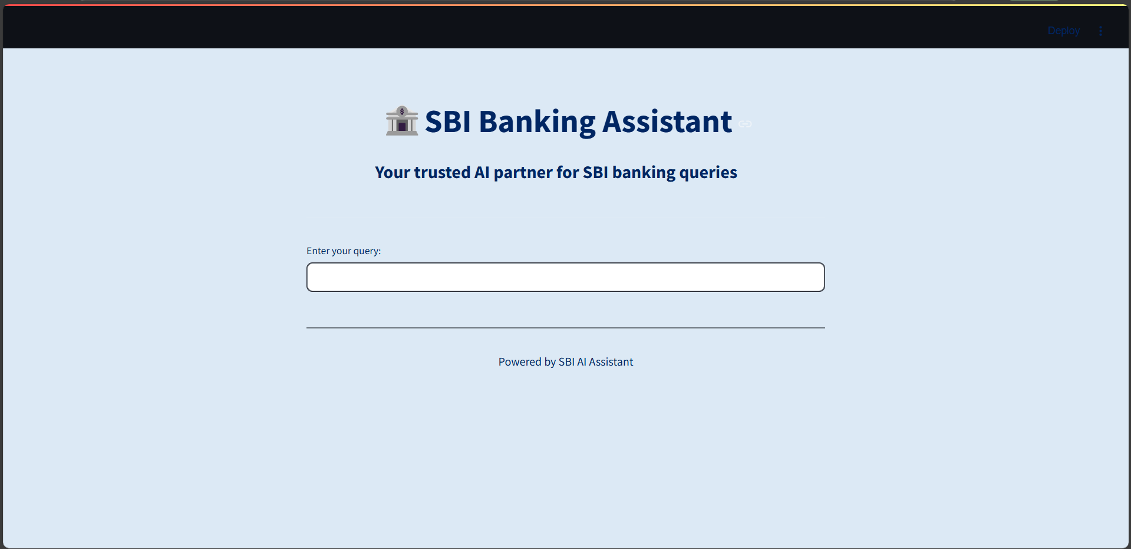
Homepage

Slide 14
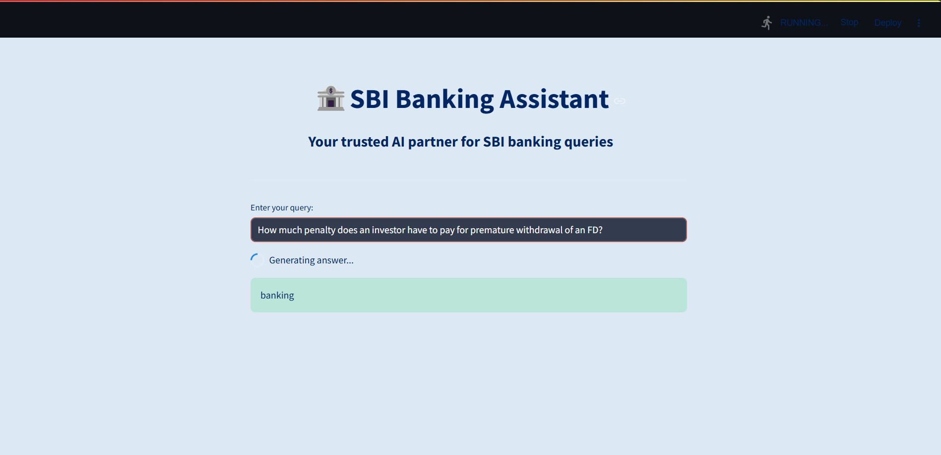
Intent Response

Slide 15
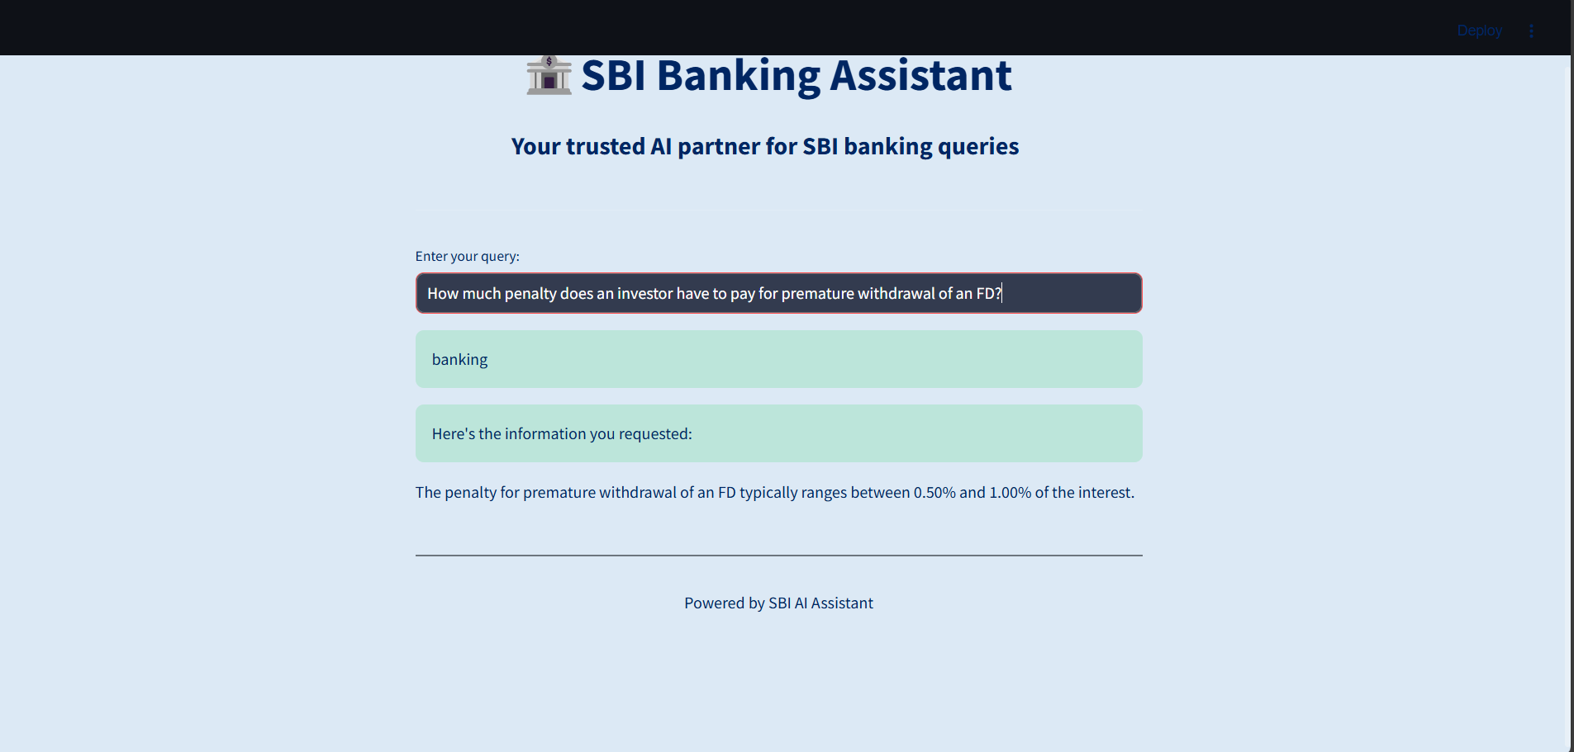
Banking Response

Slide 16
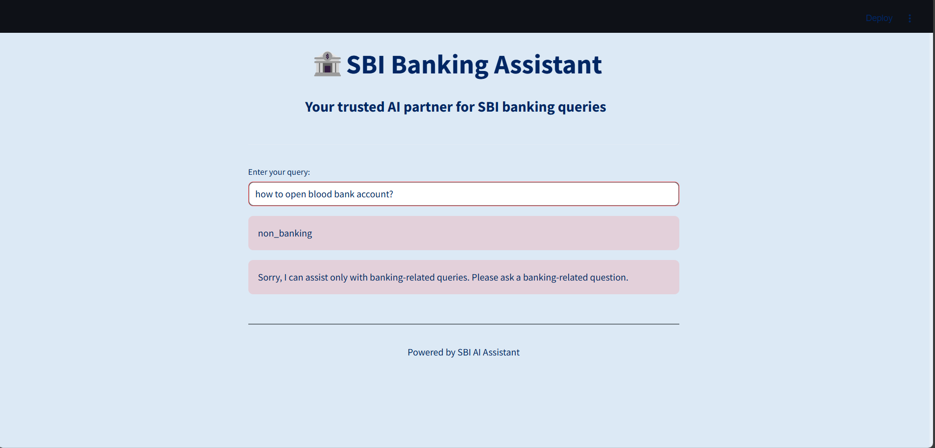
Non-Banking Response

Slide 17
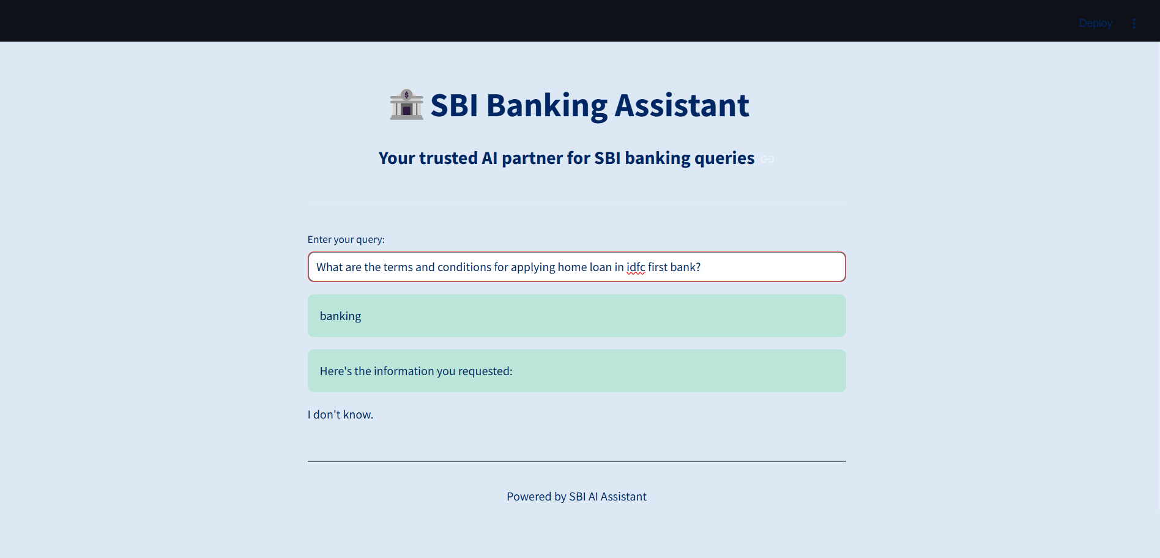
Out of Scope

Slide 18
Thank you

