Slide 1
DATA ANALYTICS MAIN PROJECT USING PYTHON
Submitted by Sakthiraj R Nair

Slide 2
Project Title:
Black Friday Sales Analysis
Using Python

Slide 3
1. Data Loading and Initial Overview
2. Data Pre-processing
3. Exploratory Data Analysis (EDA)
4. Visualizations
5. Insight Generation and Report
Project Scope:

Slide 4
Project Domain : Sales and E-commerce
Data Source : Kaggle

Slide 5
What is Black Friday Sales?
Black Friday is a major shopping event that takes place every year, mainly in the United States, on the Friday after Thanksgiving.It is known for large discounts, special offers, and increased customer purchases.
What is a Black Friday Sales Dataset?
A Black Friday sales dataset contains information about customers and the products they purchased during a Black Friday shopping event.

Slide 6
Project Objective
The objective of this project is to analyze Black Friday sales data using Python.
The analysis focuses on customer purchasing behavior, product categories, demographic patterns, and sales performance.

Slide 7
I. Data Loading and Initial Overview

Slide 8
Step 1: Importing Libraries
CODE
import pandas as pd
import numpy as np
import matplotlib.pyplot as plt
import seaborn as sns
import warnings
warnings.filterwarnings('ignore')
print("Libraries imported successfully")
OUTPUT / RESULT
Libraries imported successfully
The message confirms that pandas, NumPy, Matplotlib, and Seaborn were imported successfully.
Warnings were also configured to be hidden, so routine warning messages will not clutter the notebook.
1/85

Slide 9
Step 2: loading Dataset
CODE
df = pd.read_csv("Black-Friday-OriginalDataSet.csv")
OUTPUT / RESULT
No printed/table output is stored for this cell. A successful run without an exception is the expected result.
If the cell runs without an error, the CSV has been read successfully into the DataFrame named df.
2/85

Slide 10
Step 3: Display First 5 Records
CODE
df.head()
OUTPUT / RESULT
User_ID Product_ID Gender Age Occupation City_Category \
0 1000001 P00069042 F 0-17 10 A
1 1000001 P00248942 F 0-17 10 A
2 1000001 P00087842 F 0-17 10 A
3 1000001 P00085442 F 0-17 10 A
4 1000002 P00285442 M 55+ 16 C
Stay_In_Current_City_Years Marital_Status Product_Category_1 \
0 2 0 3
1 2 0 1
2 2 0 12
3 2 0 12
4 4+ 0 8
Product_Category_2 Product_Category_3 Purchase
0 NaN NaN 8370
1 6.0 14.0 15200
2 NaN NaN 1422
3 14.0 NaN 1057
4 NaN NaN 7969
INTERPRETATION
The first five records are displayed. This confirms the dataset structure and shows examples of customer, product, demographic, category, and Purchase fields. NaN values are visible in Product_Category_2 and Product_Category_3, indicating missing data.
3/85

Slide 11
Step 4: Display Last 5 Records
OUTPUT / RESULT
User_ID Product_ ID Gender Age Occupation City_Category \
550063 1006033 P00372445 M 51-55 13 B
550064 1006035 P00375436 F 26-35 1 C
550065 1006036 P00375436 F 26-35 15 B
550066 1006038 P00375436 F 55+ 1 C
550067 1006039 P00371644 F 46-50 0 B
Stay_In_Current_City_Years Marital_Status Product_Category_1 \
550063 1 1 20
550064 3 0 20
550065 4+ 1 20
550066 2 0 20
550067 4+ 1 20
Product_Category_2 Product_Category_3 Purchase
550063 NaN NaN 368
550064 NaN NaN 371
550065 NaN NaN 137
550066 NaN NaN 365
550067 NaN NaN 490
CODE
df.tail()
INTERPRETATION
The last five records are displayed. This checks the end of the loaded dataset and confirms that the DataFrame contains records through index 550067.
4/85

Slide 12
Step 5: Find Number of Rows and Columns
Step 6: Display All Column Names
CODE
print("Number of Rows:", df.shape[0])
print("Number of Columns:", df.shape[1])
CODE
print("Columns in the dataset:")
for column in df.columns:
print(column)
OUTPUT / RESULT
Columns in the dataset:
User_ID
Product_ID
Gender
Age
Occupation
City_Category
Stay_In_Current_City_Years
Marital_Status
Product_Category_1
Product_Category_2
Product_Category_3
Purchase
OUTPUT / RESULT
Number of Rows: 550068
Number of Columns: 12
INTERPRETATION
The dataset contains 550,068 rows and 12 columns. In other words, the original dataset has 550,068 transaction records and 12 variables.
INTERPRETATION
The output lists all 12 column names:
User_ID, Product_ID, Gender, Age, Occupation, City_Category, Stay_In_Current_City_Years, Marital_Status, Product_Category_1, Product_Category_2, Product_Category_3, and Purchase.

Slide 13
Step 7: Check Data Types
Step 8: Complete Dataset Information
CODE
df.info()
CODE
df.dtypes
OUTPUT / RESULT
User_ID int64
Product_ID object
Gender object
Age object
Occupation int64
City_Category object
Stay_In_Current_City_Years object
Marital_Status int64
Product_Category_1 int64
Product_Category_2 float64
Product_Category_3 float64
Purchase int64
dtype: object
OUTPUT / RESULT
<class 'pandas.core.frame.DataFrame'>
RangeIndex: 550068 entries, 0 to 550067
Data columns (total 12 columns):
# Column Non-Null Count Dtype
--- ------ -------------- -----
0 User_ID 550068 non-null int64
1 Product_ID 550068 non-null object
2 Gender 550068 non-null object
3 Age 550068 non-null object
4 Occupation 550068 non-null int64
5 City_Category 550068 non-null object
6 Stay_In_Current_City_Years 550068 non-null object
7 Marital_Status 550068 non-null int64
8 Product_Category_1 550068 non-null int64
9 Product_Category_2 376430 non-null float64
10 Product_Category_3 166821 non-null float64
11 Purchase 550068 non-null int64
dtypes: float64(2), int64(5), object(5)
memory usage: 50.4+ MB
INTERPRETATION
The output shows the data type of every column. User_ID, Occupation, Marital_Status, Product_Category_1 and Purchase are int64; Product_Category_2 and Product_Category_3 are float64; the remaining fields are stored as object/text.
INTERPRETATION
The DataFrame has 550,068 rows and 12 columns. Product_Category_2 has 376,430 non-null values and Product_Category_3 has 166,821 non-null values, so these two columns contain missing values. The dataset uses about 50.4 MB of memory.

Slide 14
Step 9: Statistical Summary
Step 10: Categorical Summary
CODE
df.describe()
CODE
df.describe(include='object')
OUTPUT / RESULT
User_ID Occupation Marital_Status Product_Category_1
count 5.500680e+05 550068.000000 550068.000000 550068.000000
mean 1.003029e+06 8.076707 0.409653 5.404270
std 1.727592e+03 6.522660 0.491770 3.936211
min 1.000001e+06 0.000000 0.000000 1.000000
25% 1.001516e+06 2.000000 0.000000 1.000000
50% 1.003077e+06 7.000000 0.000000 5.000000
75% 1.004478e+06 14.000000 1.000000 8.000000
max 1.006040e+06 20.000000 1.000000 20.000000
Product_Category_2 Product_Category_3 Purchase
count 376430.000000 166821.000000 550068.000000
mean 9.842329 12.668243 9263.968713
std 5.086590 4.125338 5023.065394
min 2.000000 3.000000 12.000000
25% 5.000000 9.000000 5823.000000
50% 9.000000 14.000000 8047.000000
75% 15.000000 16.000000 12054.000000
max 18.000000 18.000000 23961.000000
OUTPUT / RESULT
Product_ID Gender Age City_Category Stay_In_Current_City_Years
count 550068 550068 550068 550068 550068
unique 3631 2 7 3 5
top P00265242 M 26-35 B 1
freq 1880 414259 219587 231173 193821
INTERPRETATION
The categorical summary describes text columns such as Product_ID, Gender, Age, City_Category and Stay_In_Current_City_Years. It helps identify the number of unique categories and the most frequent category in each field.
INTERPRETATION
The numerical summary shows, among other values, an average Purchase of about 9,263.97, a median Purchase of 8,047, a minimum of 12, and a maximum of 23,961. Purchase therefore varies substantially across transactions.
10/85

Slide 15
II. Data Pre-processing

Slide 16
Step 11: Check Missing Values
Step 12: Missing Values Percentage
CODE
missing_percentage = (df.isnull().sum() / len(df)) * 100
missing_percentage.sort_values(ascending=False)
CODE
df.isnull().sum()
OUTPUT / RESULT
User_ID 0
Product_ID 0
Gender 0
Age 0
Occupation 0
City_Category 0
Stay_In_Current_City_Years 0
Marital_Status 0
Product_Category_1 0
Product_Category_2 173638
Product_Category_3 383247
Purchase 0
dtype: int64
OUTPUT / RESULT
Product_Category_3 69.672659
Product_Category_2 31.566643
User_ID 0.000000
Product_ID 0.000000
Gender 0.000000
Age 0.000000
Occupation 0.000000
City_Category 0.000000
Stay_In_Current_City_Years 0.000000
Marital_Status 0.000000
Product_Category_1 0.000000
Purchase 0.000000
dtype: float64
INTERPRETATION
The missing-value count identifies missing entries. Product_Category_2 has 173,638 missing values and Product_Category_3 has 383,247 missing values; the other columns have no missing values.
INTERPRETATION
The missing-value percentages rank the columns by the proportion of missing data. Product_Category_3 has the largest missing proportion, followed by Product_Category_2; the other columns have 0% missing values.

Slide 17
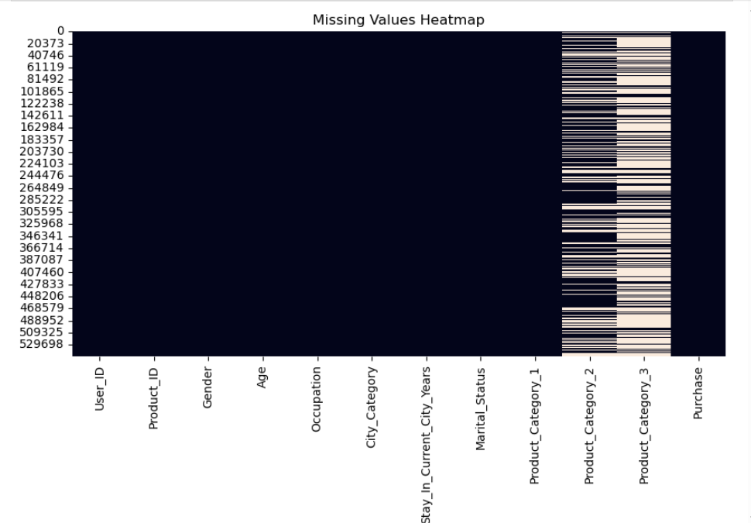
Step 13: Visualize Missing Values
OUTPUT / RESULT
CODE
plt.figure(figsize=(10,5))
sns.heatmap(df.isnull(), cbar=False)
plt.title("Missing Values Heatmap")
plt.show()
INTERPRETATION
The heatmap visualizes where missing values occur across the dataset. It is used to see the concentration of missing data, especially in Product_Category_2 and Product_Category_3.
13/85

Slide 18
Step 14: Check Duplicate Records
Step 15: Handle Missing Values
CODE
duplicate_count = df.duplicated().sum()
print("Number of duplicate records:", duplicate_count)
CODE
df['Product_Category_2'] = df['Product_Category_2'].fillna(0)
df['Product_Category_3'] = df['Product_Category_3'].fillna(0)
OUTPUT / RESULT
Number of duplicate records: 0
INTERPRETATION
The output reports the number of completely duplicated rows.
A result of 0 means no exact duplicate records were found.
INTERPRETATION
Missing values in Product_Category_2 and Product_Category_3 are replaced with 0. This is the notebook's chosen cleaning approach; 0 acts as the replacement value for previously missing category entries.
14/85
15/85

Slide 19
Step 16: Verify null values Again
Step 17: Check Data Types Again
CODE
df.isnull().sum()
CODE
df.dtypes
OUTPUT / RESULT
User_ID int64
Product_ID object
Gender object
Age object
Occupation int64
City_Category object
Stay_In_Current_City_Years object
Marital_Status int64
Product_Category_1 int64
Product_Category_2 float64
Product_Category_3 float64
Purchase int64
dtype: object
OUTPUT / RESULT
User_ID 0
Product_ID 0
Gender 0
Age 0
Occupation 0
City_Category 0
Stay_In_Current_City_Years 0
Marital_Status 0
Product_Category_1 0
Product_Category_2 0
Product_Category_3 0
Purchase 0
dtype: int64
INTERPRETATION
The data types remain consistent after the missing-value replacement. Product_Category_2 and Product_Category_3 remain numeric float columns because they now contain zeros as well as category values.
INTERPRETATION
After the replacement, the missing-value check shows no missing values in the DataFrame. The cleaning step therefore removed the NaN values from the two product-category columns.
17/85

Slide 20
Step 18: Check Unique Values
Step 19: Unique Customers Analysis
CODE
for column in df.columns:
print(column, ":", df[column].nunique())
CODE
unique_customers = df['User_ID'].nunique()
print("Number of Unique Customers:", unique_customers)
OUTPUT / RESULT
User_ID : 5891
Product_ID : 3631
Gender : 2
Age : 7
Occupation : 21
City_Category : 3
Stay_In_Current_City_Years : 5
Marital_Status : 2
Product_Category_1 : 20
Product_Category_2 : 18
Product_Category_3 : 16
Purchase : 18105
OUTPUT / RESULT
Number of Unique Customers: 5891
INTERPRETATION
The code counts distinct values in every column. This helps understand the number of customers, products, demographic categories, occupations, city categories, product categories and other unique values available.
INTERPRETATION
There are 5,891 unique customers identified by User_ID. This means the 550,068 transaction rows come from 5,891 distinct customer IDs.

Slide 21
Step 20: Unique Products Analysis
Step 21: Create purchase_level (Derived column)
CODE
unique_products = df['Product_ID'].nunique()
print("Number of Unique Products:", unique_products)
CODE
def purchase_level(value):
if value < 5000:
return 'Low'
elif value < 10000:
return 'Medium'
else:
return 'High'
df['Purchase_Level'] = df['Purchase'].apply(purchase_level)
df[['Purchase', 'Purchase_Level']].head()
OUTPUT / RESULT
Purchase Purchase_Level
0 8370 Medium
1 15200 High
2 1422 Low
3 1057 Low
4 7969 Medium
OUTPUT / RESULT
Number of Unique Products: 3631
INTERPRETATION
A new Purchase_Level column is created using the rules: below 5,000 = Low; 5,000 to below 10,000 = Medium; 10,000 or more = High. The first five rows show the resulting labels alongside Purchase values.
INTERPRETATION
There are 3,631 unique products identified by Product_ID. The dataset therefore contains many transactions across 3,631 distinct products.

Slide 22
Step 22: Overall Sales Analysis
CODE
total_sales = df['Purchase'].sum()
average_purchase = df['Purchase'].mean()
minimum_purchase = df['Purchase'].min()
maximum_purchase = df['Purchase'].max()
print("Total Sales:", total_sales)
print("Average Purchase:", average_purchase)
print("Minimum Purchase:", minimum_purchase)
print("Maximum Purchase:", maximum_purchase)
OUTPUT / RESULT
Total Sales: 5095812742
Average Purchase: 9263.968712959126
Minimum Purchase: 12
Maximum Purchase: 23961
INTERPRETATION
Total sales are 5,095,812,742. The average transaction is about 9,263.97, with a minimum of 12 and a maximum of 23,961. These four measures provide the overall sales baseline.

Slide 23
III.
Exploratory Data Analysis (EDA)

Slide 24
Step 23: Check Age Distribution
OUTPUT / RESULT
Age
26-35 219587
36-45 110013
18-25 99660
46-50 45701
51-55 38501
55+ 21504
0-17 15102
Name: count, dtype: int64
CODE
df['Age'].value_counts()
INTERPRETATION
The 26-35 age group has the most transaction records (219,587), while 0-17 has the fewest (15,102). This describes transaction frequency by age group, not unique-customer count.

Slide 25
Step 24: Gender Analysis
Step 25: Age Group - Purchase Analysis
CODE
gender_count = df['Gender'].value_counts()
gender_count
CODE
age_purchase = df.groupby('Age')['Purchase'].sum().sort_values(ascending=False)
age_purchase
OUTPUT / RESULT
Age
26-35 2031770578
36-45 1026569884
18-25 913848675
46-50 420843403
51-55 367099644
55+ 200767375
0-17 134913183
Name: Purchase, dtype: int64
OUTPUT / RESULT
Gender
M 414259
F 135809
Name: count, dtype: int64
INTERPRETATION
There are 414,259 male transaction records and 135,809 female transaction records. The dataset therefore contains more male than female transaction rows.
INTERPRETATION
The 26-35 age group contributes the largest total Purchase amount, 2,031,770,578. The 0-17 group contributes the smallest total, 134,913,183.
24/85
25/85

Slide 26
Step 26: Average Purchase by Age
Step 27: Total Purchase by Gender
CODE
age_avg_purchase = df.groupby('Age')['Purchase'].mean()
age_avg_purchase
CODE
gender_purchase = df.groupby('Gender')['Purchase'].sum()
gender_purchase
OUTPUT / RESULT
Age
0-17 8933.464640
18-25 9169.663606
26-35 9252.690633
36-45 9331.350695
46-50 9208.625697
51-55 9534.808031
55+ 9336.280459
Name: Purchase, dtype: float64
OUTPUT / RESULT
Gender
F 1186232642
M 3909580100
Name: Purchase, dtype: int64
INTERPRETATION
Average purchase differs by age group. The highest average is for 51-55 at about 9,534.81, while 0-17 has the lowest at about 8,933.46.
INTERPRETATION
Male transaction records account for 3,909,580,100 in total Purchase, compared with 1,186,232,642 for female records. This is total transaction value, not per-customer spending.

Slide 27
Step 28: Average Purchase by Gender
Step 29: City Category Analysis
CODE
df.groupby('Gender')['Purchase'].mean()
CODE
df['City_Category'].value_counts()
OUTPUT / RESULT
City_Category
B 231173
C 171175
A 147720
Name: count, dtype: int64
OUTPUT / RESULT
Gender
F 8734.565765
M 9437.526040
Name: Purchase, dtype: float64
INTERPRETATION
Average Purchase is about 9,437.53 for male transactions and 8,734.57 for female transactions. This compares the average transaction amount by gender.
INTERPRETATION
City category B has the most transaction records (231,173), followed by C (171,175) and A (147,720).

Slide 28
Step 30: City-wise Sales
Step 31: Average Purchase by City
CODE
city_sales = df.groupby('City_Category')['Purchase'].sum()
city_sales
CODE
df.groupby('City_Category')['Purchase'].mean()
OUTPUT / RESULT
City_Category
A 8911.939216
B 9151.300563
C 9719.920993
Name: Purchase, dtype: float64
OUTPUT / RESULT
City_Category
A 1316471661
B 2115533605
C 1663807476
Name: Purchase, dtype: int64
INTERPRETATION
Average Purchase is highest in city category C at about 9,719.92 and lowest in A at about 8,911.94. This is an average transaction comparison, not a total-sales comparison.
INTERPRETATION
City category B has the largest total Purchase, 2,115,533,605. Category A has 1,316,471,661 and category C has 1,663,807,476.
31/85
30/85

Slide 29
Step 32: Marital Status Analysis
Step 33: Product Category 1 Analysis
CODE
marital_sales = df.groupby('Marital_Status')['Purchase'].sum()
marital_sales
CODE
category1_sales = df.groupby('Product_Category_1')['Purchase'].sum()
category1_sales = category1_sales.sort_values(ascending=False)
category1_sales.head(10)
OUTPUT / RESULT
Product_Category_1
1 1910013754
5 941835229
8 854318799
6 324150302
2 268516186
3 204084713
16 145120612
11 113791115
10 100837301
15 92969042
Name: Purchase, dtype: int64
OUTPUT / RESULT
Marital_Status
0 3008927447
1 2086885295
Name: Purchase, dtype: int64
INTERPRETATION
Marital status 0 has total Purchase of 3,008,927,447, while status 1 has 2,086,885,295. The code uses the dataset's numeric status values without assigning labels to them.
INTERPRETATION
The top 10 Product_Category_1 values by total Purchase are listed. Category 1 has the largest total at 1,910,013,754, followed by category 5 and category 8.

Slide 30
Step 34: Purchase by Product Category
Step 35: Average Purchase by Product Category
CODE
category1_purchase = df.groupby('Product_Category_1')['Purchase'].sum()
category1_purchase.sort_values(ascending=False).head(10)
CODE
avg_category_purchase = df.groupby('Product_Category_1')['Purchase'].mean()
avg_category_purchase.sort_values(ascending=False).head(15)
OUTPUT / RESULT
Product_Category_1
1 1910013754
5 941835229
8 854318799
6 324150302
2 268516186
3 204084713
16 145120612
11 113791115
10 100837301
15 92969042
Name: Purchase, dtype: int64
OUTPUT / RESULT
Product_Category_1
10 19675.570927
7 16365.689600
6 15838.478550
9 15537.375610
15 14780.451828
16 14766.037037
1 13606.218596
14 13141.625739
2 11251.935384
17 10170.759516
3 10096.705734
8 7498.958078
5 6240.088178
11 4685.268456
18 2972.864320
Name: Purchase, dtype: float64
INTERPRETATION
This repeats the same total-sales ranking as cell 33 using a second variable name. It confirms the same top 10 Product_Category_1 categories by total Purchase.
INTERPRETATION
The ranking is based on average Purchase rather than total Purchase. Category 10 has the highest average transaction value, about 19,675.57, among the displayed categories.

Slide 31
Step 36: Occupation Analysis
Step 37: Total Purchase by Occupation
CODE
occupation_purchase = df.groupby('Occupation')['Purchase'].sum()
occupation_purchase.sort_values(ascending=False)
CODE
occupation_count = df['Occupation'].value_counts()
occupation_count
OUTPUT / RESULT
Occupation
4 72308
0 69638
7 59133
1 47426
17 40043
20 33562
12 31179
14 27309
2 26588
16 25371
6 20355
3 17650
10 12930
5 12177
15 12165
11 11586
19 8461
13 7728
18 6622
9 6291
8 1546
Name: count, dtype: int64
OUTPUT / RESULT
Occupation
4 666244484
0 635406958
7 557371587
1 424614144
17 393281453
12 305449446
20 296570442
14 259454692
16 238346955
2 238028583
6 188416784
3 162002168
15 118960211
10 115844465
5 113649759
11 106751618
19 73700617
13 71919481
18 60721461
9 54340046
8 14737388
Name: Purchase, dtype: int64
INTERPRETATION
Occupation 4 has the most transaction records (72,308), while occupation 8 has the fewest (1,546). These are transaction counts by occupation code.
INTERPRETATION
Occupation 4 has the highest total Purchase, 666,244,484, followed by occupation 0 and occupation 7. The result compares total transaction value across occupation codes.
37/85

Slide 32
Step 38: Stay in Current City Analysis
Step 39: Purchase by City Stay Duration
CODE
df['Stay_In_Current_City_Years'].value_counts()
CODE
stay_sales = df.groupby('Stay_In_Current_City_Years')['Purchase'].sum()
stay_sales
OUTPUT / RESULT
Stay_In_Current_City_Years
1 193821
2 101838
3 95285
4+ 84726
0 74398
Name: count, dtype: int64
OUTPUT / RESULT
Stay_In_Current_City_Years
0 682979229
1 1792872533
2 949173931
3 884902659
4+ 785884390
Name: Purchase, dtype: int64
INTERPRETATION
Customers/transactions with 1 year in the current city are most frequent (193,821 records). The least frequent group is 0 years (74,398 records).
INTERPRETATION
The largest total Purchase is for 1 year in the current city, 1,792,872,533. The smallest is for 0 years, 682,979,229.
38/85
39/85

Slide 33
Step 40: Top 10 Customers by Total Purchase
Step 41: Top 10 Products by Sales Amount
CODE
top_products = (
df.groupby('Product_ID')['Purchase']
.sum()
.sort_values(ascending=False)
.head(10)
)
top_products
CODE
top_customers = (
df.groupby('User_ID')['Purchase']
.sum()
.sort_values(ascending=False)
.head(10)
)
top_customers
OUTPUT / RESULT
User_ID
1004277 10536909
1001680 8699596
1002909 7577756
1001941 6817493
1000424 6573609
1004448 6566245
1005831 6512433
1001015 6511314
1003391 6477160
1001181 6387961
Name: Purchase, dtype: int64
OUTPUT / RESULT
Product_ID
P00025442 27995166
P00110742 26722309
P00255842 25168963
P00059442 24338343
P00184942 24334887
P00112142 24216006
P00110942 23639564
P00237542 23425576
P00057642 23102780
P00010742 22164153
Name: Purchase, dtype: int64
INTERPRETATION
The ten customer IDs with the highest summed Purchase are shown. Customer 1004277 has the highest total at 10,536,909 among the listed customers.
INTERPRETATION
The ten products with the highest summed Purchase are shown. Product P00025442 has the highest total at 27,995,166 among the listed products.
40/85
41/85

Slide 34
Step 42: Overall Purchase Statistics
Step 43: Pivot Table
CODE
print("Total Sales:", df['Purchase'].sum())
print("Average Purchase:", df['Purchase'].mean())
print("Minimum Purchase:", df['Purchase'].min())
print("Maximum Purchase:", df['Purchase'].max())
CODE
pivot_table = pd.pivot_table(
df,
values='Purchase',
index='Age',
columns='Gender',
aggfunc='sum'
)
pivot_table
OUTPUT / RESULT
Gender F M
Age
0-17 42385978 92527205
18-25 205475842 708372833
26-35 442976233 1588794345
36-45 243438963 783130921
46-50 116706864 304136539
51-55 89465997 277633647
55+ 45782765 154984610
OUTPUT / RESULT
Total Sales: 5095812742
Average Purchase: 9263.968712959126
Minimum Purchase: 12
Maximum Purchase: 23961
INTERPRETATION
The pivot table breaks total Purchase into Age × Gender. For example, the 26-35 male group has 1,588,794,345 in total Purchase, while 26-35 female has 442,976,233.
INTERPRETATION
This is another calculation of the overall sales baseline: total sales 5,095,812,742, average Purchase about 9,263.97, minimum 12 and maximum 23,961.
42/85
43/85

Slide 35
Step 44: Correlation Analysis
Step 45: Gender and Age Analysis
CODE
numeric_columns = df.select_dtypes(include=np.number)
correlation = numeric_columns.corr()
correlation
CODE
gender_age_sales = df.groupby(['Age', 'Gender'])['Purchase'].sum().reset_index()
gender_age_sales.head()
OUTPUT / RESULT
User_ID Occupation Marital_Status Product_Category_1 \
User_ID 1.000000 -0.023971 0.020443 0.003825
Occupation -0.023971 1.000000 0.024280 -0.007618
Marital_Status 0.020443 0.024280 1.000000 0.019888
Product_Category_1 0.003825 -0.007618 0.019888 1.000000
Product_Category_2 0.003896 0.006712 0.001099 -0.067877
Product_Category_3 0.003605 0.012269 -0.004629 -0.385534
Purchase 0.004716 0.020833 -0.000463 -0.343703
Product_Category_2 Product_Category_3 Purchase
User_ID 0.003896 0.003605 0.004716
Occupation 0.006712 0.012269 0.020833
Marital_Status 0.001099 -0.004629 -0.000463
Product_Category_1 -0.067877 -0.385534 -0.343703
Product_Category_2 1.000000 0.094750 0.052288
Product_Category_3 0.094750 1.000000 0.288501
Purchase 0.052288 0.288501 1.000000
OUTPUT / RESULT
Age Gender Purchase
0 0-17 F 42385978
1 0-17 M 92527205
2 18-25 F 205475842
3 18-25 M 708372833
4 26-35 F 442976233
INTERPRETATION
The correlation matrix measures linear association among numeric variables. Purchase has a correlation of -0.3437 with Product_Category_1, 0.2885 with Product_Category_3, and 0.0523 with Product_Category_2. Correlation indicates association, not causation.
INTERPRETATION
The grouped table combines Age and Gender and calculates total Purchase for each combination. The first rows show that 0-17 male transactions total 92,527,205 versus 42,385,978 for females in that age group.
44/85
45/85

Slide 36
Step 46: City and Gender Analysis
Step 47: Age and City Analysis
CODE
city_gender_sales = df.groupby(
['City_Category', 'Gender']
)['Purchase'].sum().reset_index()
city_gender_sales
CODE
age_city = (
df.groupby(['Age', 'City_Category'])['Purchase']
.sum()
.reset_index()
)
age_city
OUTPUT / RESULT
Age City_Category Purchase
0 0-17 A 21916841
1 0-17 B 48465500
2 0-17 C 64530842
3 18-25 A 243236868
4 18-25 B 390594232
5 18-25 C 280017575
6 26-35 A 660202334
7 26-35 B 837919708
8 26-35 C 533648536
9 36-45 A 239295720
10 36-45 B 433517875
11 36-45 C 353756289
12 46-50 A 63507243
13 46-50 B 188713201
14 46-50 C 168622959
15 51-55 A 57992372
16 51-55 B 165717109
17 51-55 C 143390163
18 55+ A 30320283
19 55+ B 50605980
20 55+ C 119841112
OUTPUT / RESULT
City_Category Gender Purchase
0 A F 306329915
1 A M 1010141746
2 B F 493617008
3 B M 1621916597
4 C F 386285719
5 C M 1277521757
INTERPRETATION
The grouped table combines City_Category and Gender. For example, male transactions total 1,621,916,597 in city category B, while female transactions total 493,617,008 there.
INTERPRETATION
The table combines Age and City_Category to show total Purchase for every age/city combination. It can be used to compare demographic sales across city categories.

Slide 37
Step 48: Find Highest Purchase Transaction
Step 49: Find Lowest Purchase Transaction
CODE
df.loc[df['Purchase'].idxmax()]
CODE
df.loc[df['Purchase'].idxmin()]
OUTPUT / RESULT
User_ID 1001474
Product_ID P00052842
Gender M
Age 26-35
Occupation 4
City_Category A
Stay_In_Current_City_Years 2
Marital_Status 1
Product_Category_1 10
Product_Category_2 15.0
Product_Category_3 0.0
Purchase 23961
Purchase_Level High
Name: 87440, dtype: object
OUTPUT / RESULT
User_ID 1000050
Product_ID P00370293
Gender F
Age 26-35
Occupation 2
City_Category A
Stay_In_Current_City_Years 1
Marital_Status 1
Product_Category_1 19
Product_Category_2 0.0
Product_Category_3 0.0
Purchase 12
Purchase_Level Low
Name: 545946, dtype: object
INTERPRETATION
The row with the maximum Purchase is identified. The maximum transaction is 23,961 for User_ID 1001474, Product_ID P00052842, age 26-35, gender M, city A.
INTERPRETATION
The row with the minimum Purchase is identified. The minimum transaction is 12 for User_ID 1000050, Product_ID P00370293, age 26-35, gender F, city A.
48/85
49/85

Slide 38
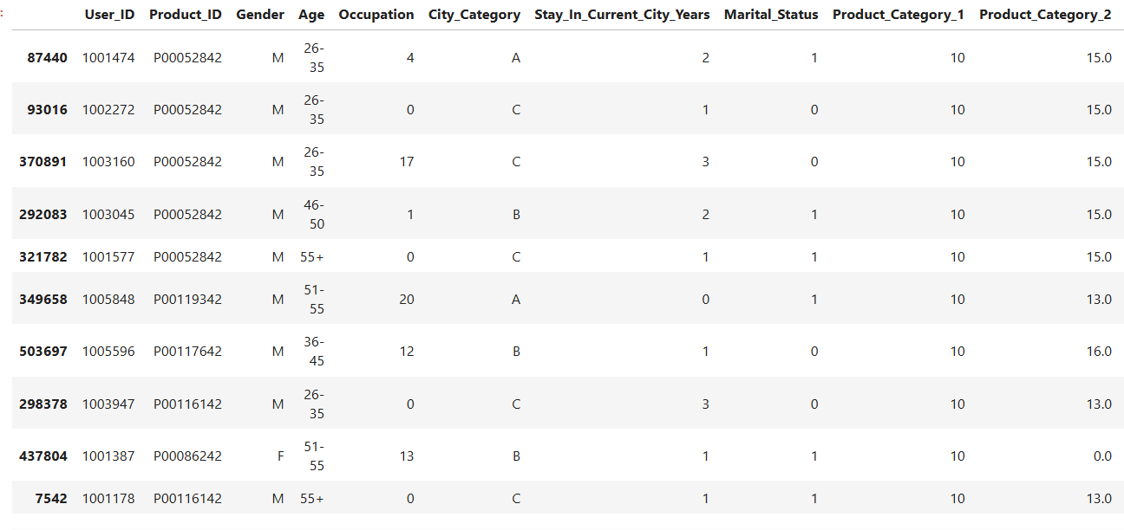
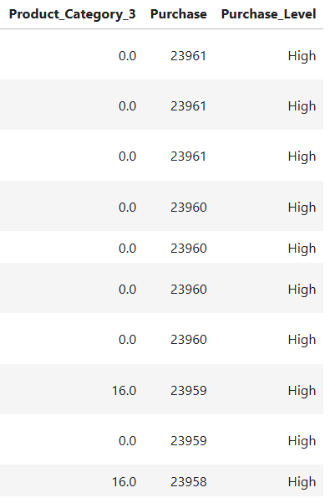
Step 51: Top 10 Highest Purchase Transactions
CODE
df.nlargest(10, 'Purchase')
Output / Result
INTERPRETATION
The ten individual transactions with the highest Purchase amounts are displayed. This identifies high-value transactions, which are different from customers ranked by their total across many transactions.

Slide 39
Step 52: Top 10 Customers by purchase
Step 53: Top 10 Products
CODE
top_products = (
df.groupby('Product_ID')['Purchase']
.sum()
.sort_values(ascending=False)
.head(10)
)
top_products
CODE
top_customers = (
df.groupby('User_ID')['Purchase']
.sum()
.sort_values(ascending=False)
.head(10)
)
top_customers
OUTPUT / RESULT
Product_ID
P00025442 27995166
P00110742 26722309
P00255842 25168963
P00059442 24338343
P00184942 24334887
P00112142 24216006
P00110942 23639564
P00237542 23425576
P00057642 23102780
P00010742 22164153
Name: Purchase, dtype: int64
OUTPUT / RESULT
User_ID
1004277 10536909
1001680 8699596
1002909 7577756
1001941 6817493
1000424 6573609
1004448 6566245
1005831 6512433
1001015 6511314
1003391 6477160
1001181 6387961
Name: Purchase, dtype: int64
INTERPRETATION
The ten customers with the highest total Purchase are recalculated. Customer 1004277 remains the highest with 10,536,909 in total Purchase.
INTERPRETATION
The ten products with the highest total Purchase are recalculated. Product P00025442 remains the highest with 27,995,166.
53/85
52/85

Slide 40
Step 54: Customer Purchase Summary
Step 55: Top Customers Based on Average Purchase
CODE
customer_summary = df.groupby('User_ID').agg(
Total_Purchase=('Purchase', 'sum'),
Average_Purchase=('Purchase', 'mean'),
Number_of_Transactions=('Purchase', 'count')
).reset_index()
customer_summary.head()
CODE
customer_summary.sort_values(
by='Average_Purchase',
ascending=False
).head(10)
OUTPUT / RESULT
User_ID Total_Purchase Average_Purchase Number_of_Transactions
0 1000001 334093 9545.514286 35
1 1000002 810472 10525.610390 77
2 1000003 341635 11780.517241 29
3 1000004 206468 14747.714286 14
4 1000005 821001 7745.292453 106
OUTPUT / RESULT
User_ID Total_Purchase Average_Purchase Number_of_Transactions
3801 1003902 1746322 18577.893617 94
4943 1005069 332823 18490.166667 18
5849 1005999 330227 18345.944444 18
1307 1001349 417743 18162.739130 23
3367 1003461 350174 17508.700000 20
98 1000101 1138265 17246.439394 66
2902 1002983 520509 16790.612903 31
5844 1005994 705057 16787.071429 42
576 1000592 234872 16776.571429 14
4361 1004474 282879 16639.941176 17
INTERPRETATION
A customer-level summary is created with total spending, average transaction value and transaction count for each User_ID. The first customer has total Purchase 334,093 across 35 transactions, with an average of about 9,545.51.
INTERPRETATION
Customers are sorted by average transaction value. User 1003902 has the highest displayed average, about 18,577.89, across 94 transactions.

Slide 41
Step 56: Create Age-wise Summary Table
Step 57: Create City-wise Summary
CODE
age_summary = df.groupby('Age').agg(
Total_Purchase=('Purchase', 'sum'),
Average_Purchase=('Purchase', 'mean'),
Transactions=('Purchase', 'count')
).reset_index()
age_summary
CODE
city_summary = df.groupby('City_Category').agg(
Total_Purchase=('Purchase', 'sum'),
Average_Purchase=('Purchase', 'mean'),
Transactions=('Purchase', 'count')
).reset_index()
city_summary
OUTPUT / RESULT
Age Total_Purchase Average_Purchase Transactions
0 0-17 134913183 8933.464640 15102
1 18-25 913848675 9169.663606 99660
2 26-35 2031770578 9252.690633 219587
3 36-45 1026569884 9331.350695 110013
4 46-50 420843403 9208.625697 45701
5 51-55 367099644 9534.808031 38501
6 55+ 200767375 9336.280459 21504
OUTPUT / RESULT
City_Category Total_Purchase Average_Purchase Transactions
0 A 1316471661 8911.939216 147720
1 B 2115533605 9151.300563 231173
2 C 1663807476 9719.920993 171175
INTERPRETATION
An age-level summary combines total Purchase, average Purchase and transaction count. The 26-35 group has the largest total and transaction count, while 51-55 has the highest average Purchase.
INTERPRETATION
A city-level summary combines total Purchase, average Purchase and transaction count. City B has the largest total and transaction count, while city C has the highest average Purchase.
56/85
57/85

Slide 42
Step 58: Create Gender-wise Summary
Step 59: Create Product Category Summary
CODE
gender_summary = df.groupby('Gender').agg(
Total_Purchase=('Purchase', 'sum'),
Average_Purchase=('Purchase', 'mean'),
Transactions=('Purchase', 'count')
).reset_index()
gender_summary
CODE
product_summary = df.groupby('Product_ID').agg(
Total_Purchase=('Purchase', 'sum'),
Average_Purchase=('Purchase', 'mean'),
Number_of_Transactions=('Purchase', 'count')
).reset_index()
product_summary.head()
OUTPUT / RESULT
Gender Total_Purchase Average_Purchase Transactions
0 F 1186232642 8734.565765 135809
1 M 3909580100 9437.526040 414259
OUTPUT / RESULT
Product_ID Total_Purchase Average_Purchase Number_of_Transactions
0 P00000142 12837476 11143.642361 1152
1 P00000242 3967496 10551.851064 376
2 P00000342 1296475 5313.422131 244
3 P00000442 441173 4795.358696 92
4 P00000542 807212 5417.530201 149
INTERPRETATION
A gender-level summary shows total Purchase, average Purchase and transaction count. Male transactions have higher total and average Purchase and more transaction records in this dataset.
INTERPRETATION
A product-level summary combines total Purchase, average Purchase and transaction count for each product. The first rows illustrate the metrics for individual Product_ID values.

Slide 43
Step 60: Filter High Purchases
OUTPUT / RESULT
User_ID Product_ID Gender Age Occupation City_Category \
1 1000001 P00248942 F 0-17 10 A
5 1000003 P00193542 M 26-35 15 A
6 1000004 P00184942 M 46-50 7 B
7 1000004 P00346142 M 46-50 7 B
8 1000004 P0097242 M 46-50 7 B
Stay_In_Current_City_Years Marital_Status Product_Category_1 \
1 2 0 1
5 3 0 1
6 2 1 1
7 2 1 1
8 2 1 1
Product_Category_2 Product_Category_3 Purchase Purchase_Level
1 6.0 14.0 15200 High
5 2.0 0.0 15227 High
6 8.0 17.0 19215 High
7 15.0 0.0 15854 High
8 16.0 0.0 15686 High
CODE
high_purchase = df[df['Purchase'] >= 10000]
high_purchase.head()
INTERPRETATION
The code filters transactions with Purchase >= 10,000 and displays the first matching records. The displayed rows are labeled High because they meet the Purchase_Level rule.

Slide 44
IV.
Visualizations

Slide 45
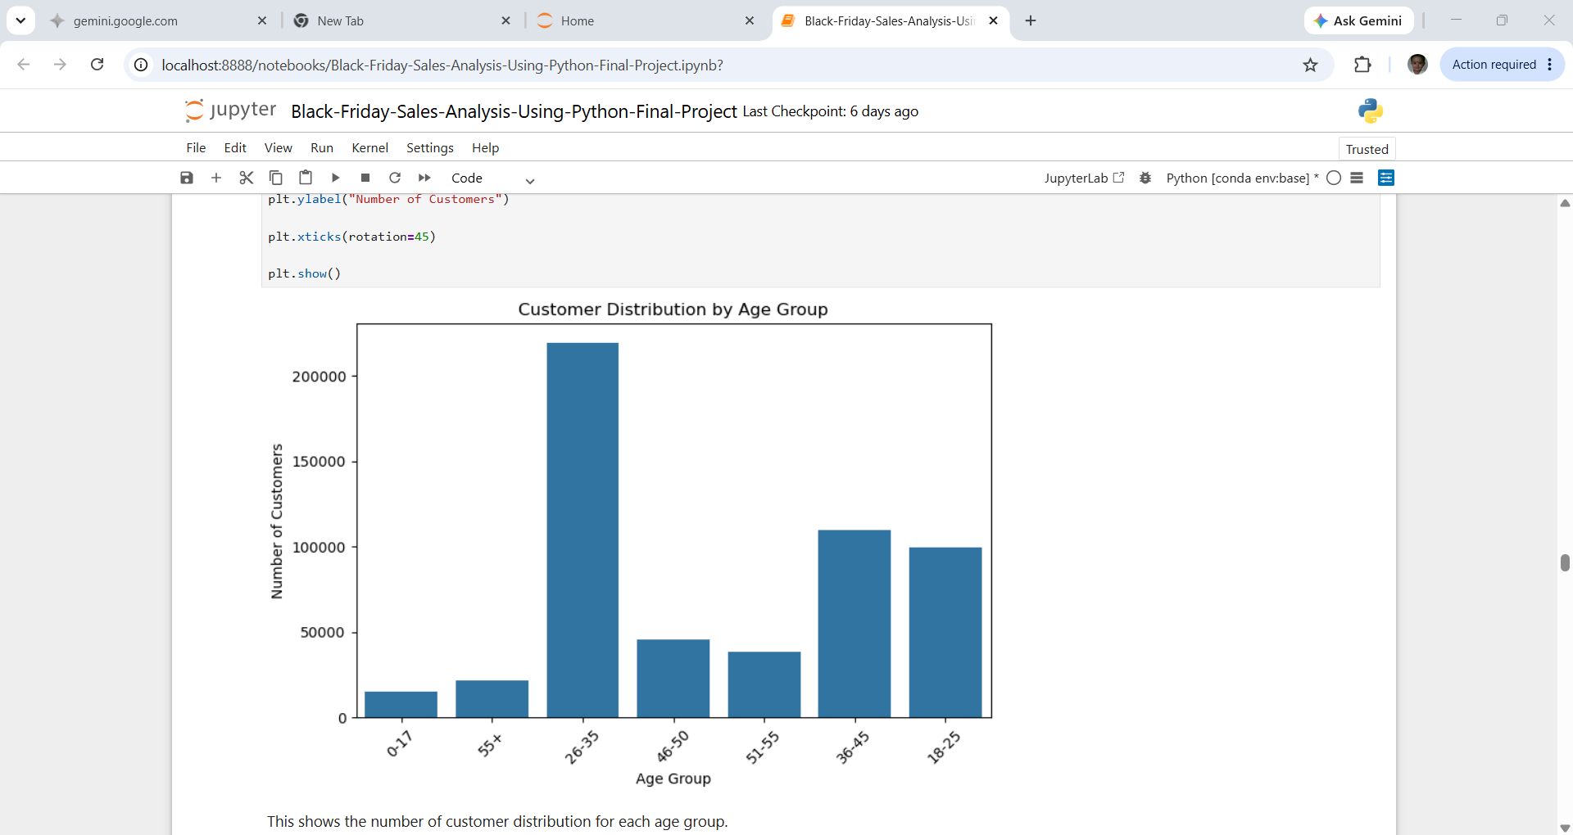
Step 61: 1. Customer Distribution by Age Group
OUTPUT / RESULT
CODE
plt.figure(figsize=(8,5))
sns.countplot(data=df, x='Age')
plt.title("Customer Distribution by Age Group")
plt.xlabel("Age Group")
plt.ylabel("Number of Customers")
plt.xticks(rotation=45)
plt.show()
INTERPRETATION
The count plot visualizes the number of transaction records in each age group. The chart shows the age group 26-35 contribute the most, the age group 0-17 contribute the least records.

Slide 46
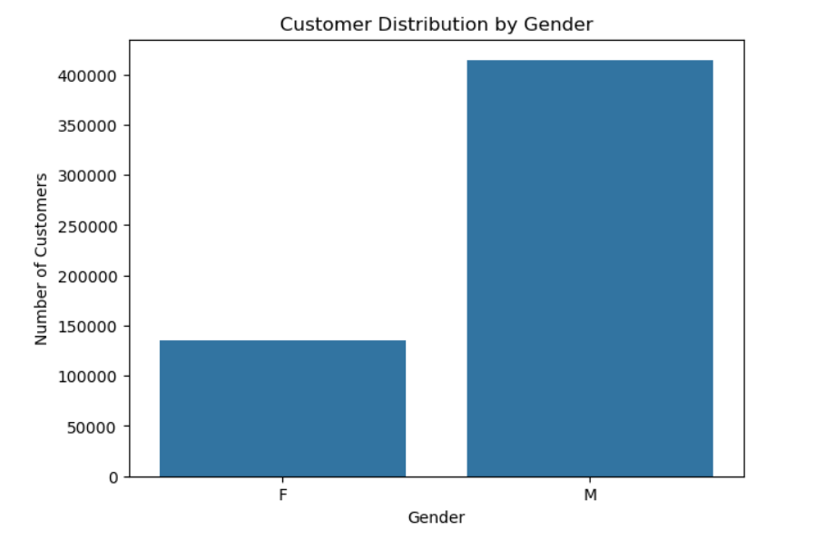
Step 62: 2. Gender Visualization
CODE
plt.figure(figsize=(7,5))
sns.countplot(data=df, x='Gender')
plt.title("Customer Distribution by Gender")
plt.xlabel("Gender")
plt.ylabel("Number of Customers")
plt.show()
OUTPUT / RESULT
INTERPRETATION
The count plot visualizes transaction-record counts by gender. It provides a direct visual comparison of male and female transaction frequencies.

Slide 47
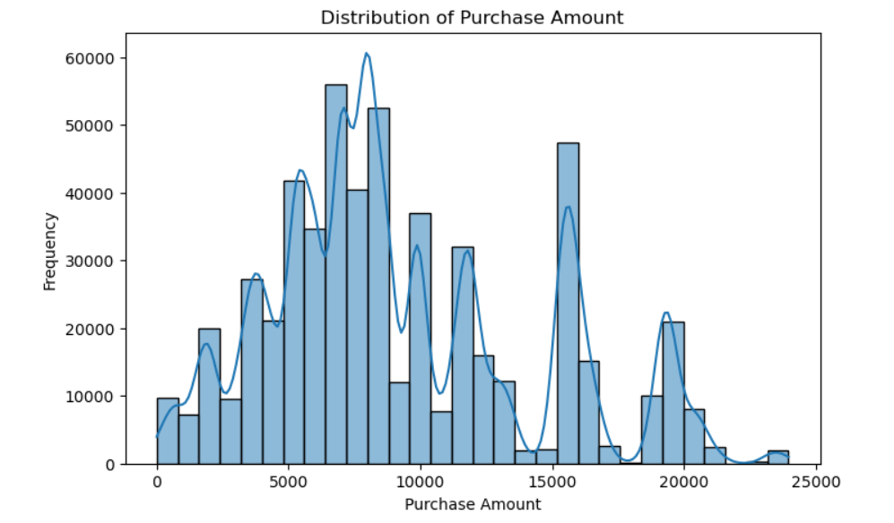
Step 63: 3. Purchase Distribution
OUTPUT / RESULT
CODE
plt.figure(figsize=(8,5))
sns.histplot(df['Purchase'], bins=30, kde=True)
plt.title("Distribution of Purchase Amount")
plt.xlabel("Purchase Amount")
plt.ylabel("Frequency")
plt.show()
INTERPRETATION
The histogram shows how Purchase amounts are distributed across 30 bins, with a KDE curve to indicate the smoothed distribution curve. It helps inspect concentration and spread of transaction values.
Highest Frequency Peak : The most prominent peak occurs around a purchase amount of 8,000 to 9,000, where the frequency approaches nearly 60,000 occurrences.
Sharp Drop-Off : The frequency falls off drastically after 21,000.

Slide 48
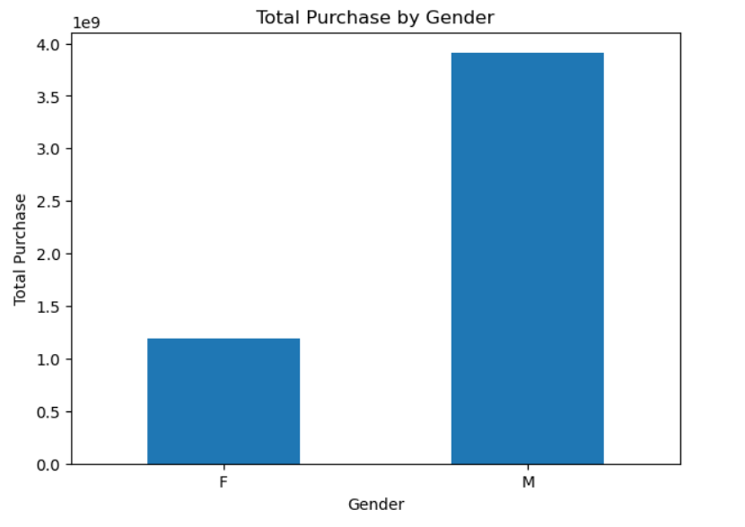
Step 64: 4. Gender Sales
Step 65: 4. Gender Sales Visualization (Total Purchase by Gender)
CODE
plt.figure(figsize=(7,5))
gender_sales.plot(kind='bar')
plt.title("Total Purchase by Gender")
plt.xlabel("Gender")
plt.ylabel("Total Purchase")
plt.xticks(rotation=0)
plt.show()
OUTPUT / RESULT
CODE
gender_sales = df.groupby('Gender')['Purchase'].sum()
gender_sales
OUTPUT / RESULT
Gender
F 1186232642
M 3909580100
Name: Purchase, dtype: int64
groupby() groups the dataset according to gender.
['Purchase'].sum() calculates total purchases for each gender.
INTERPRETATION
The grouped Series contains total Purchase by gender: F = 1,186,232,642 and M = 3,909,580,100. These values are then used for the following bar chart.
INTERPRETATION
The bar chart visualizes total Purchase by gender. The underlying totals show a much larger total for M than F in this dataset.

Slide 49
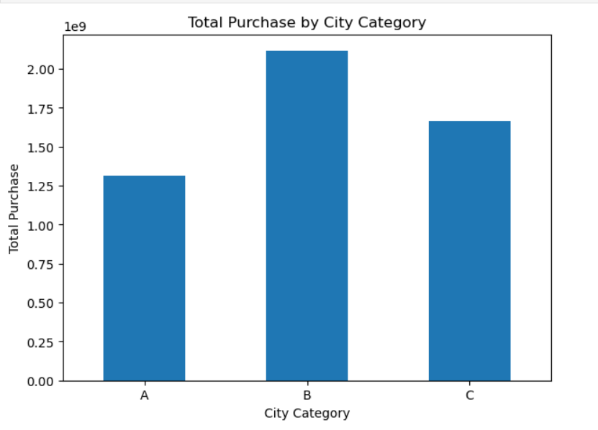
Step 66: 5. City Sales Chart
CODE
plt.figure(figsize=(7,5))
city_sales.plot(kind='bar')
plt.title("Total Purchase by City Category")
plt.xlabel("City Category")
plt.ylabel("Total Purchase")
plt.xticks(rotation=0)
plt.show()
OUTPUT / RESULT
INTERPRETATION
The bar chart visualizes total Purchase by city category. The underlying totals are B = 2,115,533,605, C = 1,663,807,476 and A = 1,316,471,661.

Slide 50
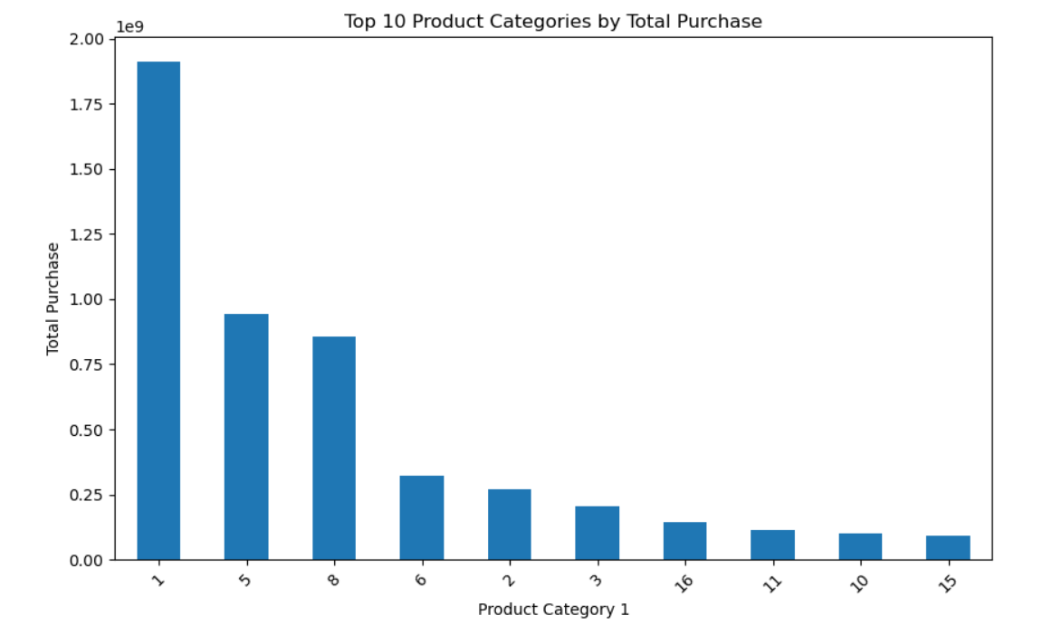
Step 67: 6. Product Category Chart
CODE
plt.figure(figsize=(10,6))
category1_sales.head(10).plot(kind='bar')
plt.title("Top 10 Product Categories by Total Purchase")
plt.xlabel("Product Category 1")
plt.ylabel("Total Purchase")
plt.xticks(rotation=45)
plt.show()
OUTPUT / RESULT
INTERPRETATION
The bar chart displays the top 10 Product_Category_1 values by total Purchase. The underlying ranking places category 1 first, followed by 5 and 8.
67/85

Slide 51
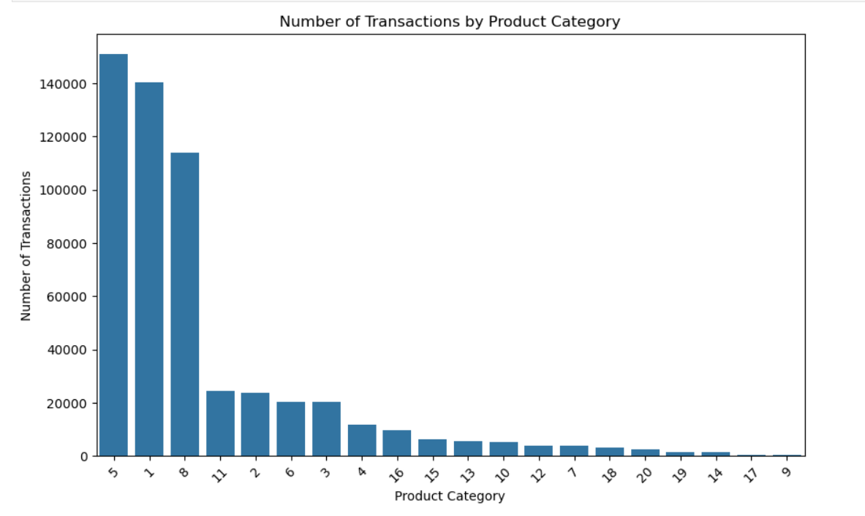
Step 68: 7. Product Category Count
OUTPUT / RESULT
CODE
plt.figure(figsize=(10,6))
sns.countplot(
data=df,
x='Product_Category_1',
order=df['Product_Category_1'].value_counts().index
)
plt.title("Number of Transactions by Product Category")
plt.xlabel("Product Category")
plt.ylabel("Number of Transactions")
plt.xticks(rotation=45)
plt.show()
INTERPRETATION
The count plot displays transaction frequency for Product_Category_1 and orders the bars from most frequent to least frequent. It is intended to identify categories with the most transaction records.
68/85

Slide 52
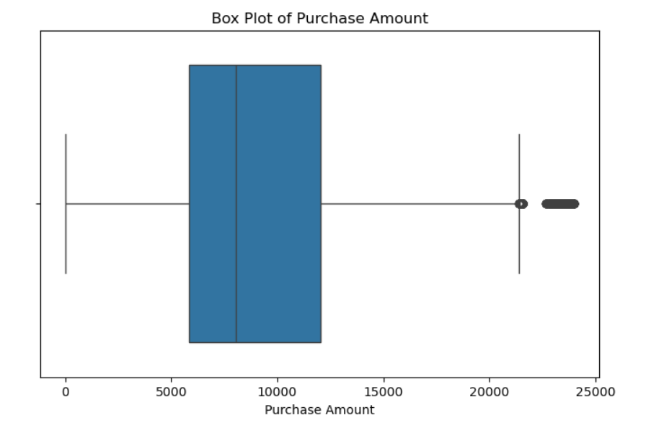
Step 69: 8. Purchase Box Plot
OUTPUT / RESULT
CODE
plt.figure(figsize=(8,5))
sns.boxplot(x=df['Purchase'])
plt.title("Box Plot of Purchase Amount")
plt.xlabel("Purchase Amount")
plt.show()
INTERPRETATION
The box plot summarizes the distribution of Purchase amounts using the median, quartiles and possible outliers. It helps assess median spread and unusually low or high transactions.
Typical purchases are moderately low : between 5000 and 13,000.
The data is symmetrically distributed. (extend out to roughly 0 to 21,000 equally). This indicates a very balanced, symmetrical distribution of standard purchase amounts.
High-value outliers are present. There is an isolated data point near 22,000, showing that while rare, some individual purchases significantly exceed the standard customer spending range.

Slide 53
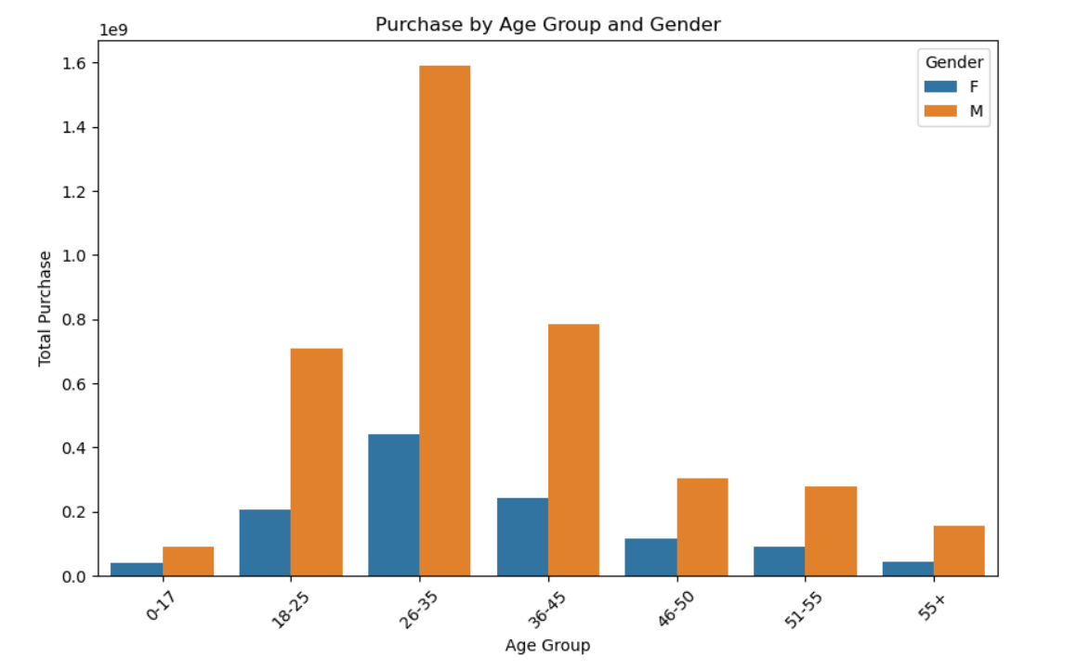
Step 70: 9. Puchase Analysis by Age and Gender
CODE
plt.figure(figsize=(10,6))
sns.barplot(
data=gender_age_sales,
x='Age',
y='Purchase',
hue='Gender'
)
plt.title("Purchase by Age Group and Gender")
plt.xlabel("Age Group")
plt.ylabel("Total Purchase")
plt.xticks(rotation=45)
plt.show()
OUTPUT / RESULT
hue='Gender' creates separate bars for genders.
This allows us to compare purchasing patterns across age groups and gender
INTERPRETATION
The grouped bar chart compares total Purchase across age groups, separated by gender. The underlying table shows male totals above female totals in every age group shown.

Slide 54
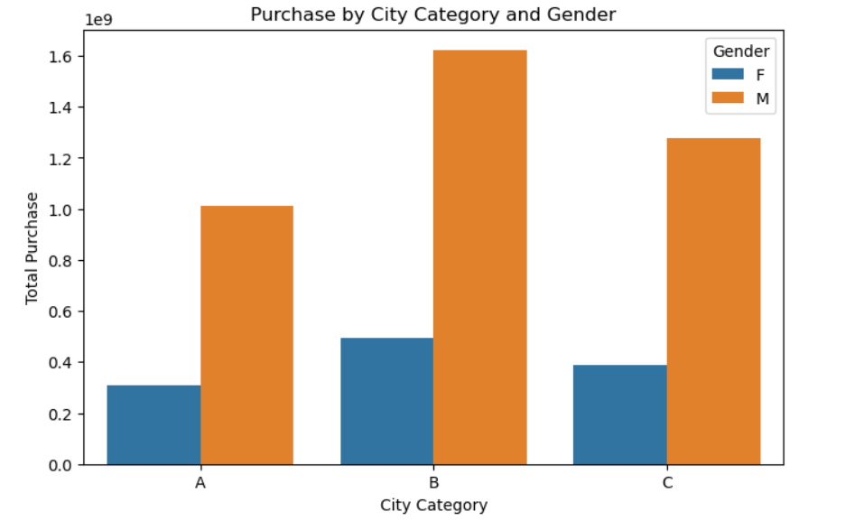
Step 71: 10. City - gender Chart
OUTPUT / RESULT
CODE
plt.figure(figsize=(8,5))
sns.barplot(
data=city_gender_sales,
x='City_Category',
y='Purchase',
hue='Gender'
)
plt.title("Purchase by City Category and Gender")
plt.xlabel("City Category")
plt.ylabel("Total Purchase")
plt.show()
INTERPRETATION
The grouped bar chart compares total Purchase across city categories, separated by gender. The underlying values show male totals above female totals for A, B and C.

Slide 55
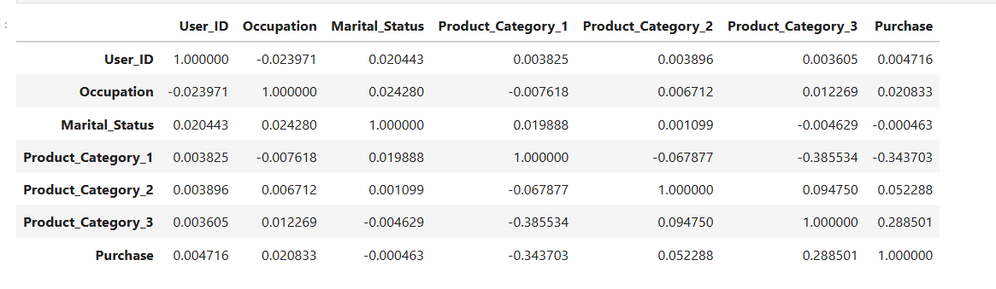
Step 72: 11. Correlation Analysis
CODE
numeric_columns = df.select_dtypes(include=np.number)
correlation = numeric_columns.corr()
correlation
Output / Result
INTERPRETATION
This repeats the numeric correlation calculation and stores the matrix in correlation. It prepares the data for the heatmap in the next step.

Slide 56
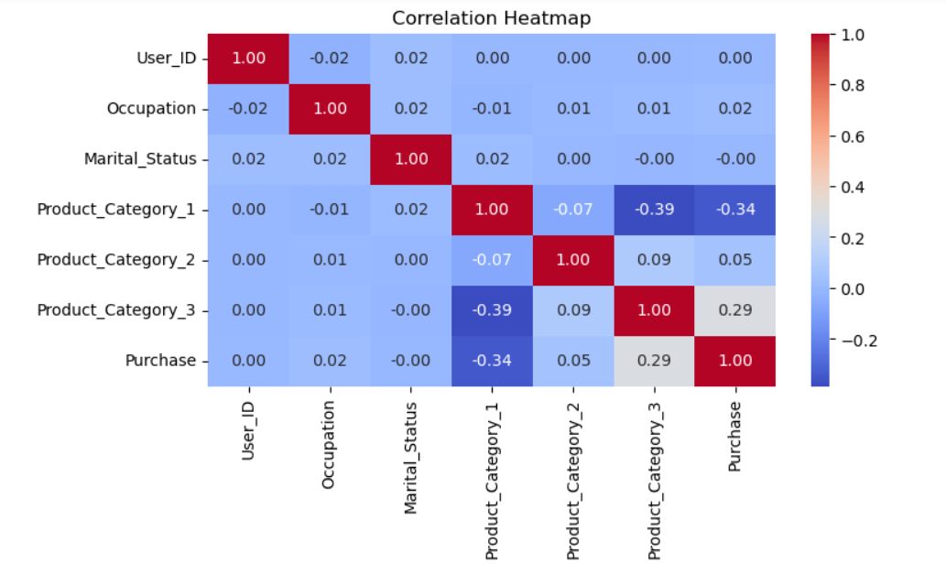
Step 73: 12. Correlation Heatmap
CODE
plt.figure(figsize=(12,8))
sns.heatmap(
correlation,
annot=True,
cmap='coolwarm',
fmt='.2f'
)
plt.title("Correlation Heatmap")
plt.show()
OUTPUT / RESULT
'annot=True' displays the correlation numbers.
fmt='.2f' displays values to two decimal places.
INTERPRETATION
The heatmap displays the correlation matrix with numeric annotations. Values near +1 indicate strong positive linear association, values near -1 indicate strong negative association, and values near 0 indicate weak linear association.

Slide 57
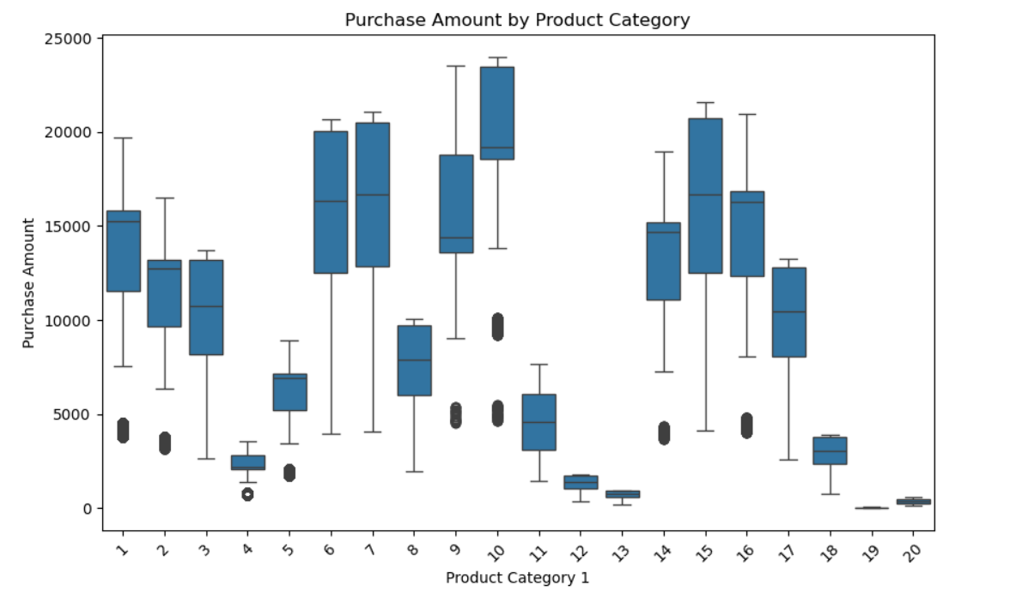
Step 74: 13. Purchase vs Product Category (Box Plot)
OUTPUT / RESULT
CODE
plt.figure(figsize=(10,6))
sns.boxplot(
data=df,
x='Product_Category_1',
y='Purchase'
)
plt.title("Purchase Amount by Product Category")
plt.xlabel("Product Category 1")
plt.ylabel("Purchase Amount")
plt.xticks(rotation=45)
plt.show()
The box plot compares Purchase distributions across Product_Category_1 categories. It helps examine median, spread and potential outliers for each category.
INTERPRETATION
The box plot compares Purchase distributions across Product_Category_1 categories. It helps examine median, spread and potential outliers for each category.
High value product categories: Category 10 has the highest median purchase amount and highest overall spending values, followed c;osely by Categories 6,7, and 17.
Low value product ategories:. Categpries 19, 20 show extremely low purchase amounts near zero with virtually no variation.. Categories 4,12 and 13 also consistently fall in the lower price / spending range(under 5000).Data spread and variability:
. Categories with tall boxes and long whiskers (categories 6,7,9,10,15) show high variability, meaning customer spending in these categories ranges widely.
. Categories with narrow boxes (categories 4,12,13,19,20) have very consistent purchase amounts.
Presence of Outliers: Several categories (1,2,4,5,9,10,14,16) feature black dots below their lower whiskers. These indicate usually low individual transaction amounts compared to the bulk of purchases in those categories.

Slide 58
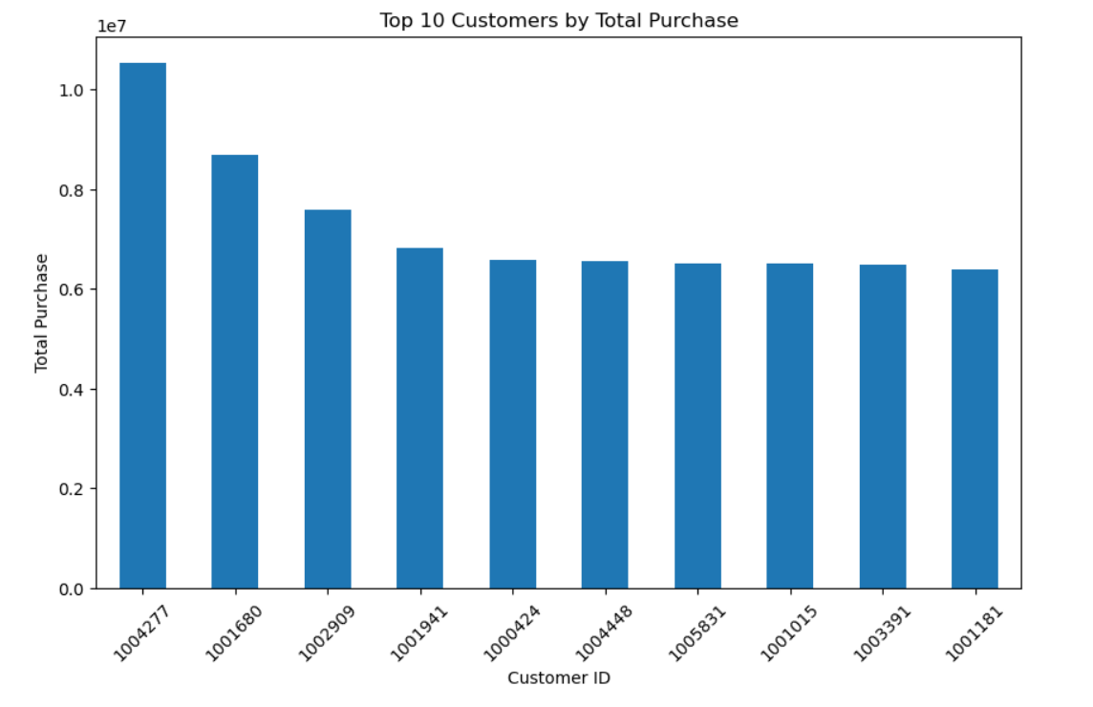
Step 75: 14. Top Customers Chart
OUTPUT / RESULT
CODE
plt.figure(figsize=(10,6))
top_customers.plot(kind='bar')
plt.title("Top 10 Customers by Total Purchase")
plt.xlabel("Customer ID")
plt.ylabel("Total Purchase")
plt.xticks(rotation=45)
plt.show()
INTERPRETATION
The bar chart visualizes the ten customers with the highest total Purchase. The largest bar corresponds to customer 1004277 based on the underlying top_customers Series.
75/85

Slide 59
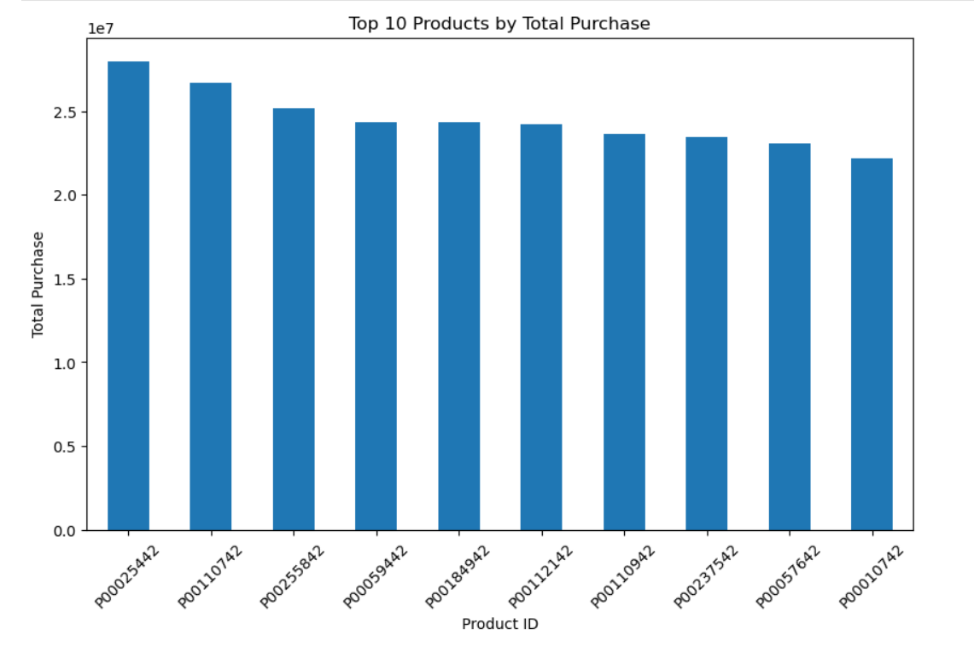
Step 76: 15. Top Products Chart
OUTPUT / RESULT
CODE
plt.figure(figsize=(10,6))
top_products.plot(kind='bar')
plt.title("Top 10 Products by Total Purchase")
plt.xlabel("Product ID")
plt.ylabel("Total Purchase")
plt.xticks(rotation=45)
plt.show()
INTERPRETATION
The bar chart visualizes the ten products with the highest total Purchase. The largest bar corresponds to product P00025442 based on the underlying top_products Series.

Slide 60
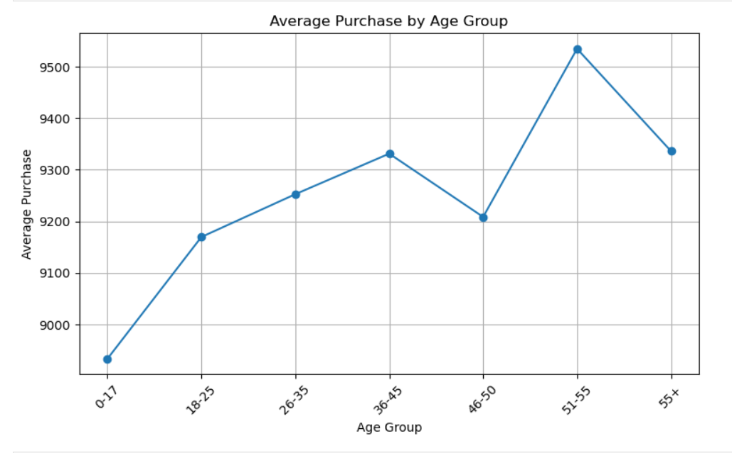
Step 77: 16. Average Purchase by Age Chart
OUTPUT / RESULT
CODE
plt.figure(figsize=(9,5))
age_avg_purchase.plot(kind='line', marker='o')
plt.title("Average Purchase by Age Group")
plt.xlabel("Age Group")
plt.ylabel("Average Purchase")
plt.xticks(rotation=45)
plt.grid()
plt.show()
INTERPRETATION
The line chart shows average Purchase by age group. The underlying averages range from about 8,933.46 for 0-17 to about 9,534.81 for 51-55, allowing the pattern across age groups to be compared.
77/85

Slide 61
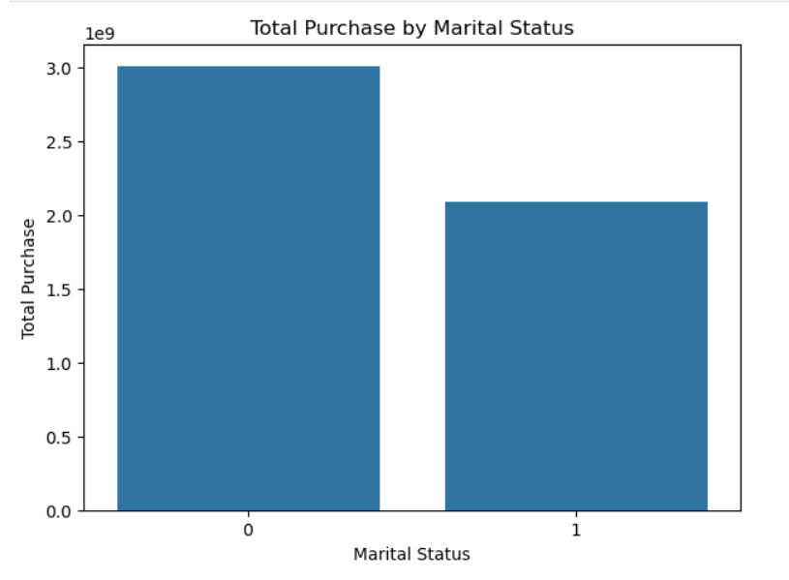
Step 78: 17. Marital Status Chart
OUTPUT / RESULT
CODE
plt.figure(figsize=(7,5))
sns.barplot(
x=marital_sales.index,
y=marital_sales.values
)
plt.title("Total Purchase by Marital Status")
plt.xlabel("Marital Status")
plt.ylabel("Total Purchase")
plt.show()
INTERPRETATION
The bar chart compares total Purchase for the two Marital_Status codes. Status 0 has the larger total in the underlying data.

Slide 62
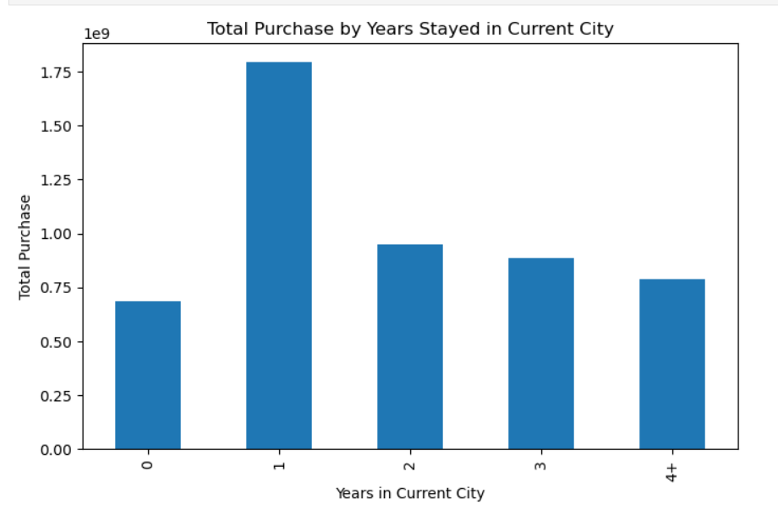
Step 79: 18. Stay Duration Chart
CODE
plt.figure(figsize=(8,5))
stay_sales.plot(kind='bar')
plt.title("Total Purchase by Years Stayed in Current City")
plt.xlabel("Years in Current City")
plt.ylabel("Total Purchase")
plt.show()
OUTPUT / RESULT
INTERPRETATION
The bar chart compares total Purchase by years stayed in the current city. The underlying totals are highest for 1 year and lowest for 0 years.
79/85

Slide 63
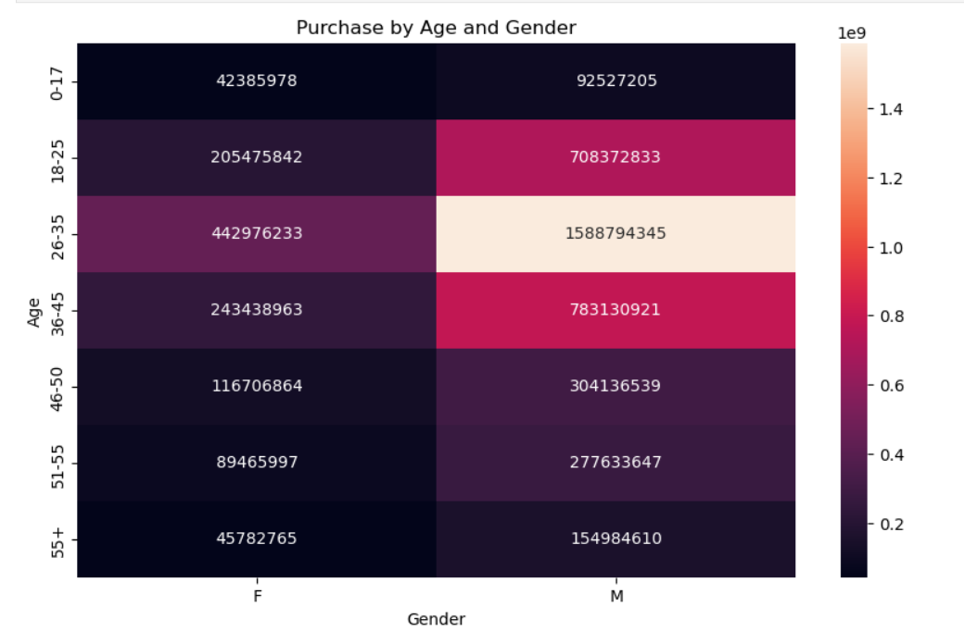
Step 80: 19. Pivot Table Visualization
OUTPUT / RESULT
CODE
plt.figure(figsize=(10,6))
sns.heatmap(
pivot_table,
annot=True,
fmt='.0f'
)
plt.title("Purchase by Age and Gender")
plt.show()
INTERPRETATION
The heatmap displays the Age × Gender total-Purchase pivot table with numeric annotations. It makes the combined demographic totals easier to compare.
Males under the age group 26-35 indicates the highest total purchase, while females under the age group 0-17 indicates the lowest.

Slide 64
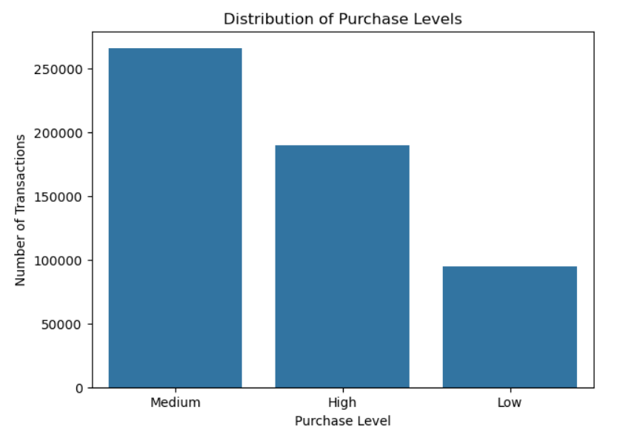
Step 81: 20. Purchase Level Chart
OUTPUT / RESULT
CODE
plt.figure(figsize=(7,5))
sns.countplot(
data=df,
x='Purchase_Level'
)
plt.title("Distribution of Purchase Levels")
plt.xlabel("Purchase Level")
plt.ylabel("Number of Transactions")
plt.show()
INTERPRETATION
The count plot shows the number of transactions in each Purchase_Level category: Low, Medium and High. The categories come from the thresholds defined earlier.
81/85

Slide 65
V
Insight Generation And Report

Slide 66
Step 82: Save Cleaned Dataset
Step 83: Save Analysis Tables
CODE
df.to_csv(
"Black-Friday-Cleaned-Dataset.csv",
index=False
)
print("Cleaned dataset saved successfully")
CODE
age_summary.to_csv(
"Age_Summary.csv",
index=False
)
city_summary.to_csv(
"City_Summary.csv",
index=False
)
gender_summary.to_csv(
"Gender_Summary.csv",
index=False
)
product_summary.to_csv(
"Product_Category_Summary.csv",
index=False
)
OUTPUT
No printed/table output is stored for this cell. A successful run without an exception is the expected result.
OUTPUT / RESULT
Cleaned dataset saved successfully
INTERPRETATION
The cleaned DataFrame is exported to Black-Friday-Cleaned-Dataset.csv without the pandas index. The printed message confirms the save operation completed.
INTERPRETATION
Four summary tables are exported as separate CSV files: Age_Summary.csv, City_Summary.csv, Gender_Summary.csv and Product_Category_Summary.csv. These files make the aggregated analysis reusable outside the notebook.

Slide 67
Step 84: Final Dataset Check
CODE
print("Final Dataset Shape:", df.shape)
print("\nMissing Values:")
print(df.isnull().sum())
print("\nDuplicate Rows:")
print(df.duplicated().sum())
OUTPUT / RESULT
Final Dataset Shape: (550068, 13)
Missing Values:
User_ID 0
Product_ID 0
Gender 0
Age 0
Occupation 0
City_Category 0
Stay_In_Current_City_Years 0
Marital_Status 0
Product_Category_1 0
Product_Category_2 0
Product_Category_3 0
Purchase 0
Purchase_Level 0
dtype: int64
Duplicate Rows: 0
INTERPRETATION
The final dataset has 550,068 rows and 13 columns because Purchase_Level was added. All columns show 0 missing values and the duplicate-row count is 0, confirming the final cleaning checks passed.

Slide 68
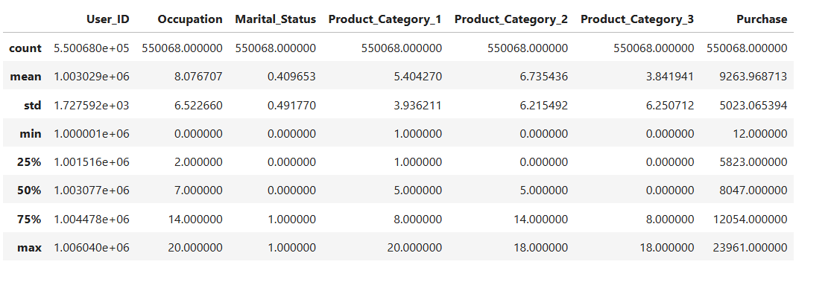
Step 85: Final Statistical Summary
CODE
df.describe()
Output
INTERPRETATION
The final descriptive statistics are shown after cleaning. Product_Category_2 and Product_Category_3 now include zeros, so their count is 550,068 and their means have changed from the original missing-data summary. Purchase statistics remain unchanged.

Slide 69
Key Insights
The analysis shows that customer demographics, purchasing behavior, product categories, city categories and sales patterns.
2. The age group 26-35 generates the highest total purchase.
3. The gender M generates the highest total purchase.
4. City category B has the highest total purchase.
5. Product category group1 generates the highest total purchase.
The analysis of customer-level purchases shows that
the customer 1004277 has the highest total purchase among the customers in the dataset.
The correlation analysis indicates that most demographic variables have
very weak or negligible relationships with purchase behavior.
In particular, User_ID (r = 0.0047), Occupation (r = 0.0208), and Marital_Status (r = −0.0005) show
almost no correlation with Purchase, suggesting that these variables have little linear association with purchasing behavior.
Among the product categories, Product_Category_1 has a moderate negative correlation with Purchase (r = −0.3437),
while Product_Category_3 has a moderate positive correlation (r = 0.2885).
Product_Category_2 shows a very weak positive correlation (r = 0.0523) with Purchase.
Overall, the results suggest that product category variables, particularly Product_Category_1 and Product_Category_3,
have a stronger association with purchase behavior than the demographic variables.
However, correlation does not imply causation, and these results only describe linear relationships..

Slide 70
Key Insights(Continue…)
The final statistical summary indicates that the dataset contains 550,068 observations,
with complete data across all variables. The Purchase variable has a mean of approximately 9,264 and
a standard deviation of 5,023, indicating substantial variation in purchase amounts.
Purchase values range from 12 to 23,961, with 50% of observations having purchase values below approximately 8,047.
Among the categorical variables, Occupation has a mean of 8.08, while Marital_Status has a mean of 0.41,
indicating that the majority of observations belong to the non-married category
if the coding is 0 = unmarried and 1 = married. Product categories also show considerable variation,
particularly Product_Category_2 and Product_Category_3, as reflected by their relatively large standard deviations.

Slide 71
The major findings are:
The 26–35 age group generated the highest total Purchase.
2. Male customers generated higher total Purchase than female customers.
3. City Category B had the highest total Purchase.
4. Product Category 1 had the highest total Purchase among Product_Category_1
categories.
5. Product Category 10 had the highest average Purchase among the displayed
categories.
6. Customer and product analysis helped identify the highest-value customers and
products.
7. The final dataset contained no missing values and no duplicate rows.

Slide 72
Final Conclusion
The Black Friday sales dataset was analyzed using Python and Pandas.
The project included data loading, data cleaning, missing-value handling, duplicate checking, statistical analysis, exploratory data analysis, groupby analysis, pivot tables, correlation analysis, and data visualization.
Original data: 550,068 rows × 12 columns.
After adding Purchase_Level: 550,068 rows × 13 columns.
Missing values in Product_Category_2 and Product_Category_3 were replaced with 0.
No exact duplicate rows were found.
Total Purchase: 5,095,812,742; average transaction: about 9,263.97.
Different visualizations were used to understand customer demographics, purchasing behavior, product categories, city categories, and sales patterns.
The analysis helped identify important patterns in customer purchasing behavior and product sales.
The findings can be used to understand customer preferences and support future sales and marketing decisions.
Cleaned and summary CSV files are exported for reuse.

Slide 73
THANK YOU
Ms. Anusha Haridas (Faculty)
Madam, Thank you so much for your kind support and guidance for the completion of this project .
Sona Raj (Co-Ordinator)
Madam, Thank you so much for your kind support and co-ordination.

Slide 74
THANK YOU

