Slide 1
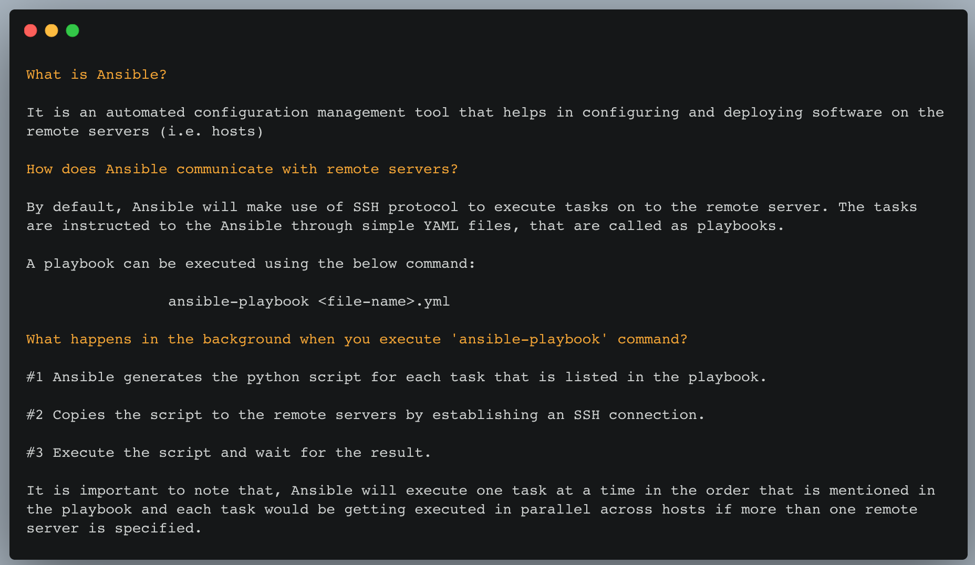

understanding
A N S I B L E
Courtesy:
Ansible Up and Running
by Lorin Hochstein, Rene Moser
Mail : sakthishanmugam02@gmail.com Twitter : @sakthis02
Medium : @sakthishanmugam02
#The16BitsWord
“little drops make the mighty ocean”
techgoals.in

