Slide 1


#The16BitsWord
techgoals.in
A few facts on Virtual Machines (VM):
-------------------------------------
#1 BareMetal servers on the cloud data centre have become so powerful.
#2 To avoid under-utilization, use VM concepts to its full extent.
#3 Hence reduces the cost of running the data centre.
#4 vSwitch helps in establishing communication between VM's and the host.
#5 But this also drives the need for high-bandwidth Ethernet interfaces.
Remember, 1GbE, 10GbE?
Mail : sakthishanmugam02@gmail.com Twitter : @sakthis02
Medium : @sakthishanmugam02
“little drops make the mighty ocean”

Slide 2
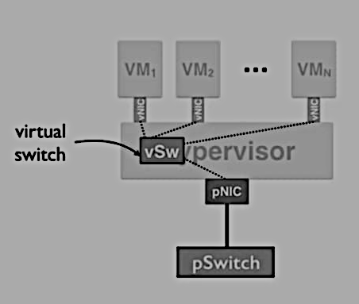
#The16BitsWord
techgoals.in
A few facts on server virtualization – vSwitch:
-----------------------------------------------
#1 Virtualization is achieved with the help of a hypervisor
#2 Hypervisor manages physical NIC (pNIC) and exposes virtual NIC (vNIC) to VM's for communication
#3 To move packets between pNIC and vNIC, the hypervisor runs software called vSwitch
#4 Moving around packets, consumes more CPU resources; especially when many VM's exists on the host
#5 Hence application that runs on the VM gets less CPU, that is not always acceptable!
Heard of SR-IOV? that is one of the alternatives. Remember, everything is a trade-off.
Mail : sakthishanmugam02@gmail.com Twitter : @sakthis02
Medium : @sakthishanmugam02
“little drops make the mighty ocean”

Slide 3
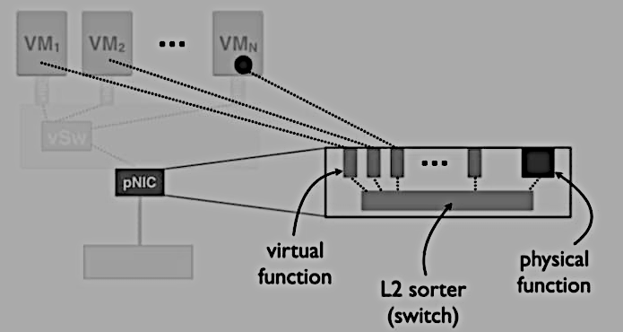
#The16BitsWord
techgoals.in
A few facts on server virtualization -SR-IOV [SingleRootInputOutputVirtualization]:
--------------------------------------------
#1 Hypervisor runs vSwitch to move packets between VM's and to the host that eventually consumes more CPU resources which should have been allocated to applications running on the VM
#2 Alternative could be SR-IOV, that is physical NIC supports virtualization by providing virtual functions in the form of queues which give transmit and receive support along with the physical function [real ethernet port]
#3 Virtual functions and the ethernet port would communicate [or gets mapped] via L2 switch inside the physical NIC
#4 Packets bypasses hypervisor when it is transferred between VMs and the virtual functions with the help of Direct Memory Access [DMA], hence lesser CPU cycles. => hypervisor is used only to map virtual functions with VMs
#5 [Advantage] higher throughput - [Disadvantage] VM migration becomes hard as VMs are tightly coupled with a particular pNIC virtual function resources
Remember, everything is a trade-off.
Mail : sakthishanmugam02@gmail.com Twitter : @sakthis02
Medium : @sakthishanmugam02
“little drops make the mighty ocean”

Slide 4
#The16BitsWord
techgoals.in
A few facts on Virtual Machines (VM) Migration:
-----------------------------------------------
#1 What happens if the physical server that is running your VMs went down? Or you want to move VMs to a higher config server that supports sudden application demand
#2 In any case, users should not be affected during these events, right? Agility matters for seamless migration
#3 The VM migration means, is not only about spinning up another instance of a VM. Agility achieved when the system is good enough in Memory and Network migration
#4 Storage and memory migrations help in retaining the data the VM was holding and it is achieved by either duplicating the memory faster and attach it to a new instance, or having something like Storage Access Network (SAN) => common storage pool [so that the new VM just needs point to the address location of shared disk]
#5 Network migration (updating IP rules in switches) needs to be handled as well so that the new VM instance can be reached seamlessly.
Remember, application requests that use TCP can bare with packet loss (as it can retry), but not the storage-related transmissions as it can impact the consistency of the data across the system. So a reliable network is most important!
Mail : sakthishanmugam02@gmail.com Twitter : @sakthis02
Medium : @sakthishanmugam02
“little drops make the mighty ocean”

Slide 5
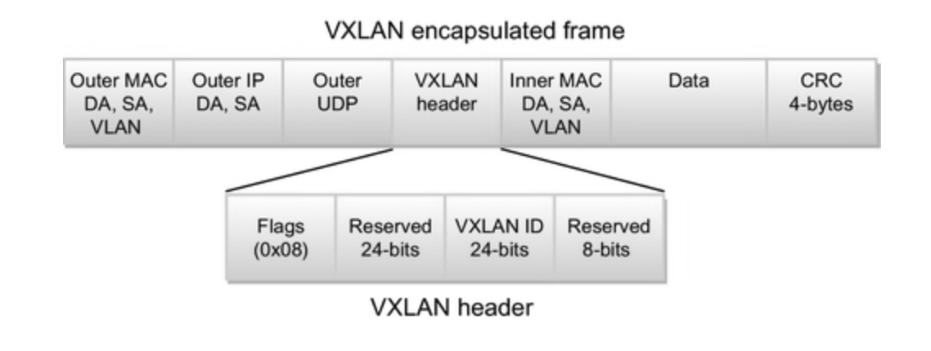
#The16BitsWord
techgoals.in
A few facts on Virtual Extensible Local Area Network (VXLAN):
-------------------------------------------------------------
#1 VXLAN is an overlay technology that lets you stretch layer 2 connections over the layer 3 network.
#2 VXLAN is used for network isolation typically to support a multi-tenant environment in a large data centre.
#3 VXLAN supports more isolations compared to VLAN due to its bits length: 24 bits VLAN Network ID (VNI in short)
#4 VXLAN is a more preferable option to segregate customers than VLAN from a provider point of view. So that customers can make use of VLAN for their internal network isolations within that VXLAN network.
#5 MAC address learning is done through a multicast IP. i.e. all VTEP [VXLAN Tunnel Endpoint] belong to given VNI would join to the same multicast group.
#6 VXLAN makes life easier for VM migrations.
Remember, using VXLAN will eventually increase the frame size that might require a higher MTU size in underlying devices.
Mail : sakthishanmugam02@gmail.com Twitter : @sakthis02
Medium : @sakthishanmugam02
“little drops make the mighty ocean”

Slide 6
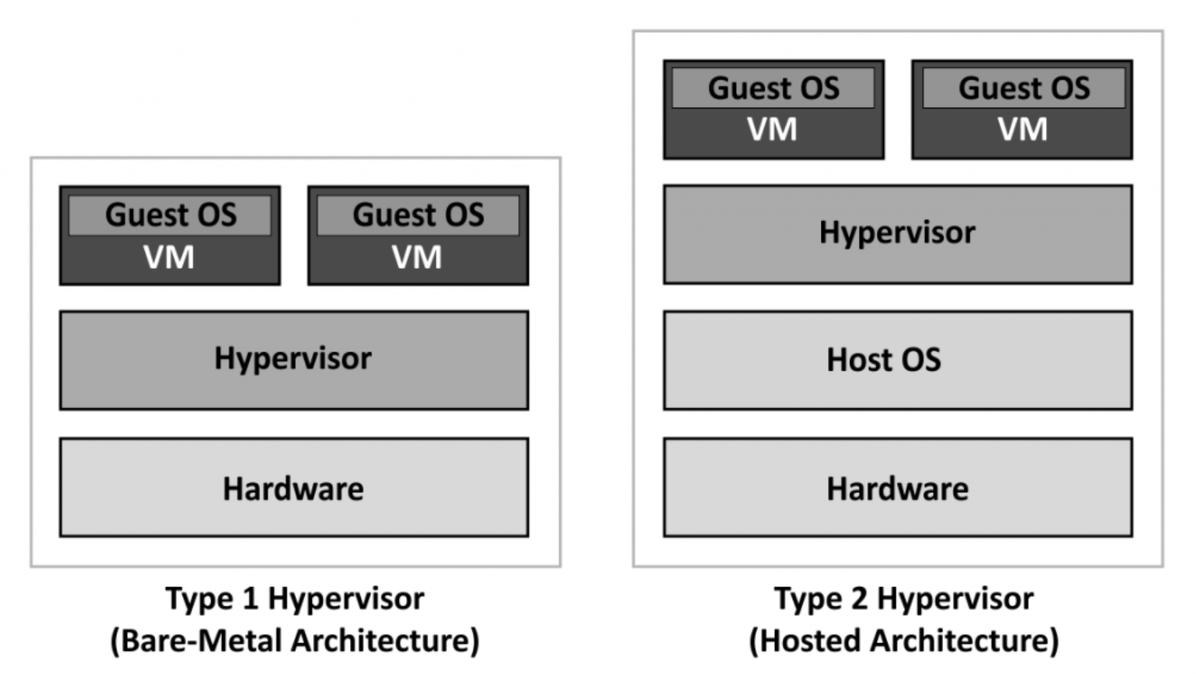
#The16BitsWord
techgoals.in
A few facts on Hypervisors:
---------------------------
#1 Hypervisors are software that allows you to run multiple Virtual Machines (VM) on top of a host server hardware.
#2 Two types: Type-1 [BareMetal-based] = e.g. KVM & Type-2 [hosted-on-top-of-OS] = e.g. VirtualBox
#3 Type-1 is considered to be more secure as it reduces the attack surface area that is caused by the heavy OS on which hosted hypervisors (type-2) like VirtualBox are installed.
#4 In terms of performance, latency is more in Type-2 hypervisors as the data needs to pass through the additional OS layer on which hypervisor is hosted.
#5 KVM is a Type-1 hypervisor; to install, you need, 'kvm' that is hypervisor software, 'virt-install' is the CLI tool to manage VMs, and 'libvirt' is the library that exposes some set of functions to interact with hypervisors & vms using ‘virsh’ command.
Remember, libvirt-python module also available if there is a need for automation using Python.
Mail : sakthishanmugam02@gmail.com Twitter : @sakthis02
Medium : @sakthishanmugam02
“little drops make the mighty ocean”

Slide 7
#The16BitsWord
techgoals.in
A few facts on Virtual Machine Disk Provisioning:
-------------------------------------------------
#1 Virtual Machine [VM] is like creating a computer within the computer that means VMs are getting sandboxed (isolated) from the rest of the system ( other VMs! ). It provides a layer of security that malfunctioning of a particular VM won't cause a problem to other VM.
#2 To spin up the VM, we need a virtual disk that would contain a boot image. As we install any OS (e.g. Windows) on our laptop with some storage volume ( unless we do Network BOOT [PXE] ).
#3 These virtual disks could be provisioned as either THICK (or) THIN. and the size of the disk could be specified during VM creation time.
#4 THICK means the max disk size specified during the creation is
reserved and will not be available for other VM.
#5 THIN means the disks are only be allocated on-demand (based on the I/O operations) and the unused disks (remaining of max disk size) could be used by other VMs too.
Remember that before the memory is allocated and ready for write operations, the disk has to be zeroed (means garbage clean-up). => This can increase the IOPS [Input Output Per Second]
Mail : sakthishanmugam02@gmail.com Twitter : @sakthis02
Medium : @sakthishanmugam02
“little drops make the mighty ocean”

Slide 8
#The16BitsWord
techgoals.in
A few facts on KVM ( Kernel-Based Virtual Machine ) :
-----------------------------------------------------
#1 KVM is providing hypervisor capabilities to Linux.
#2 That means, hypervisor components like memory manager, scheduler, network stack, I/O stacks, security managers, the device drivers, and many are provided as part of Linux Kernels.
#3 So that multiple isolated environments “guests” can be spin up/hosted from Linux server (host machine). [guests = Virtual Machines]
#4 Virtual Machines (VMs) are like a regular Linux process that has dedicated resources.
#5 VMs also have dedicated virtual hardware such as network adapters (vNIC).
Remembering this? - "KVM converts Linux into a type-1 (bare-metal) hypervisor".
Mail : sakthishanmugam02@gmail.com Twitter : @sakthis02
Medium : @sakthishanmugam02
“little drops make the mighty ocean”

