Slide 1

RUST
SAKTHI SARAVANAN S
sakthishanmugam02@gmail.com

Slide 2
INSTALLATIONS
To install:
curl https://sh.rustup.rs -sSf | sh
To configure it in the terminal:
source $HOME/.cargo/env
To check the version:
rustc --version

Slide 3
Package Manager
Cargo is the package manager for Rust
cargo --version

Slide 4
To create a new project
To create a binary:
cargo new --bin “myproject”
To create a library:
cargo new --lib “mylibrary”

Slide 5
To build and run a project
To build:
cargo build
To run: (executables with debug functionality)
./target/debug/myproject

Slide 6
To make a release
Make release by running:
cargo build --release
Binary release in the below path:
./target/release/myproject

Slide 7
Build and Run
Run the below command:
cargo run

Slide 8
Offline Documentation
Run:
rustup doc

Slide 9
Editor & Extension
Visual Studio Code
Rust (rlx) extension

Slide 10
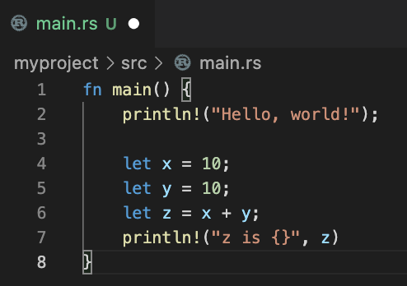
My first program with variables ‘let’ keyword

Slide 11
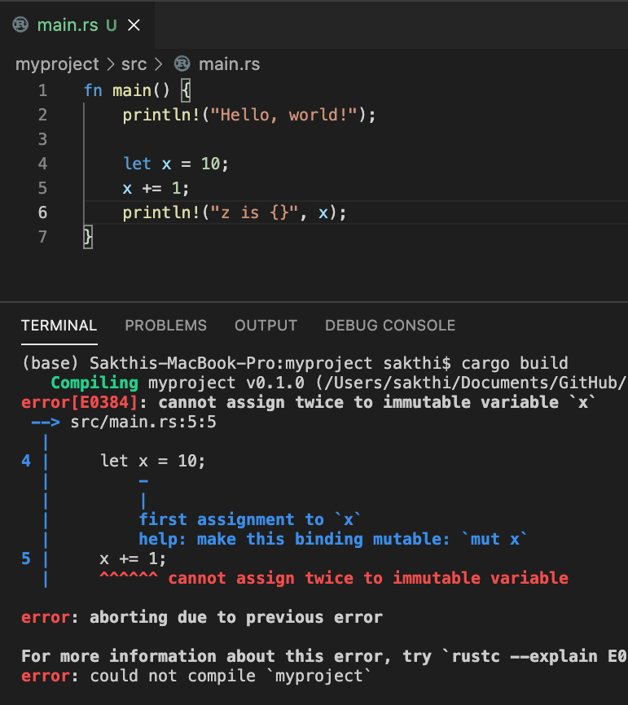
Variables are immutable by default !!

Slide 12
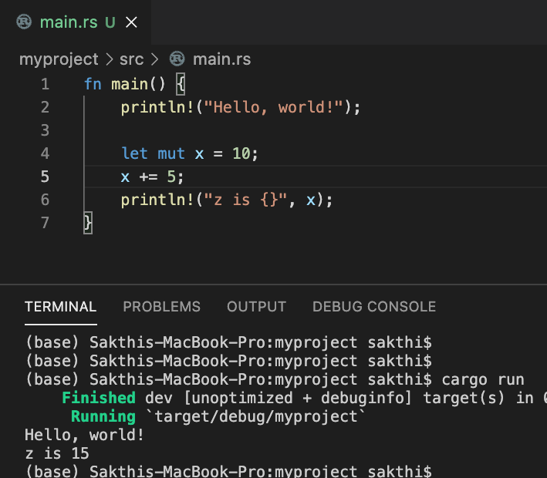
add ’mut’ keyword to make it mutable

Slide 13
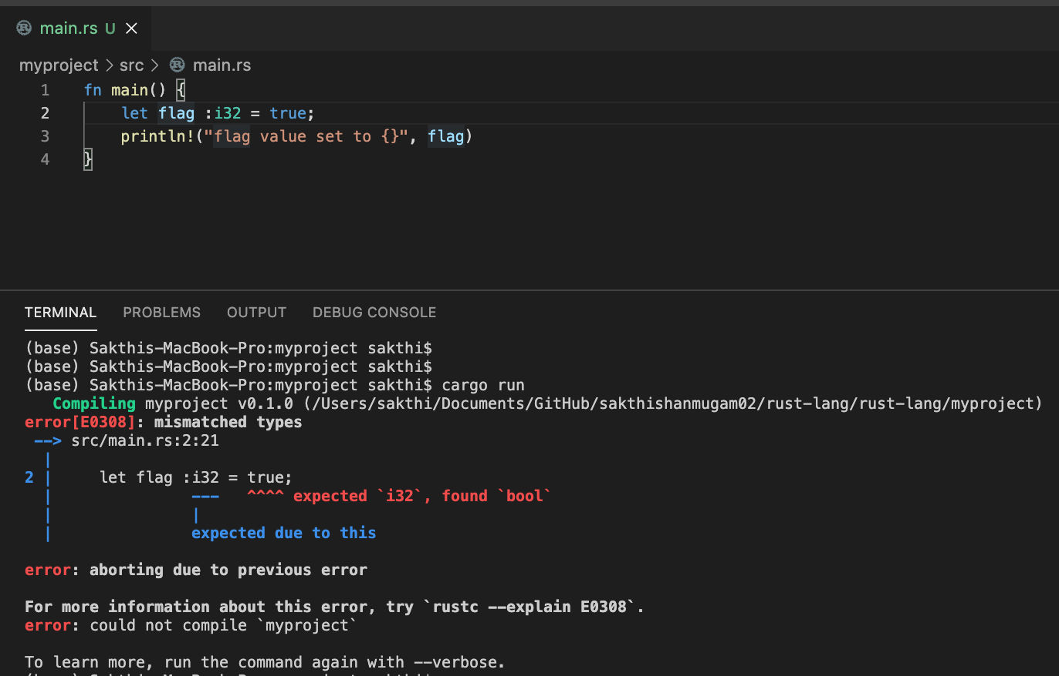
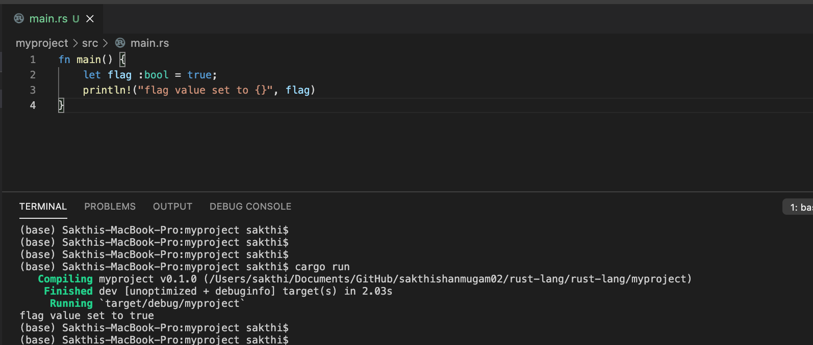
All variables are typed by default use: annotation to specify the datatype (if required, generally not?!)

Slide 14
Primitive Data Types (Simple)
Boolean
- bool
Integer
- signed (i8, i16, i32, i64) => i32 is default for Integer if it is not specified
- unsigned (u8, u16, u32, u64)
Floating Point
- f32
- f64 => default if it is not specified
Character
- char

Slide 15
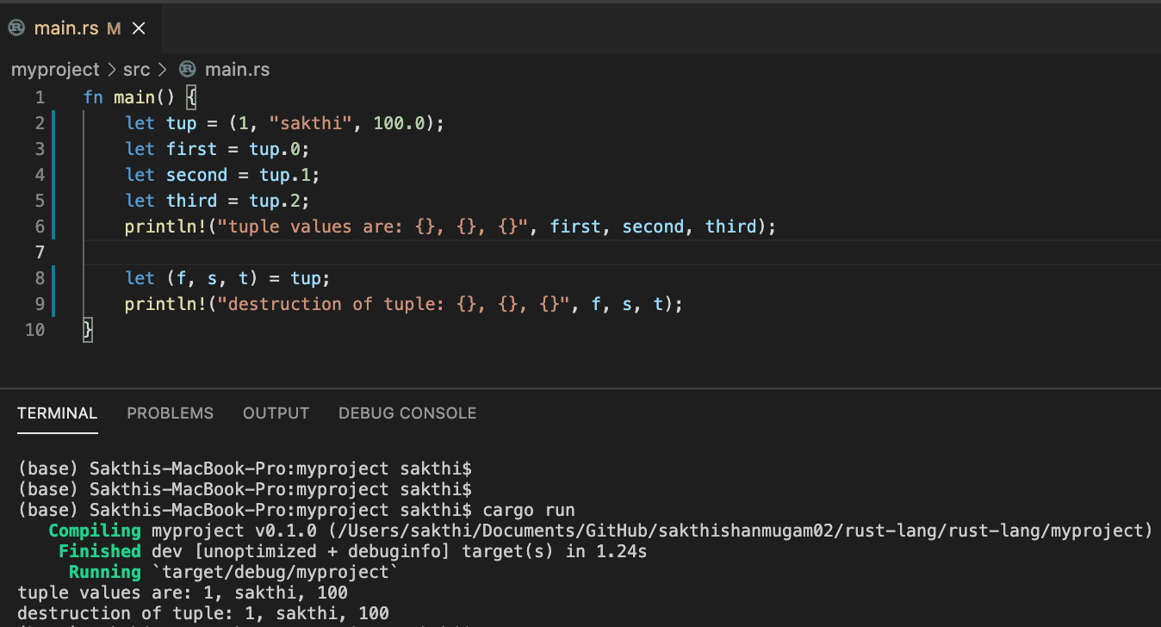
Primitive Data Types Compound – tuple Note: multiple type under same type
Tuple

Slide 16
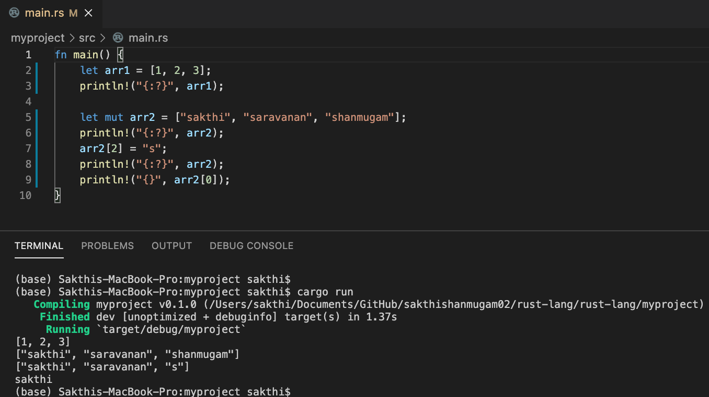
Primitive Data Types Compound – array Note: similar type under same type
Tuple

Slide 17
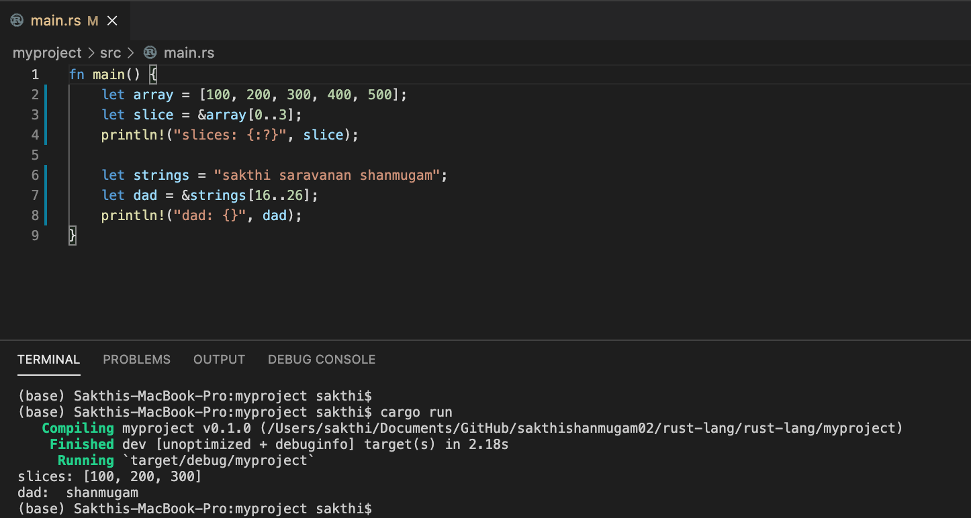
Primitive Data Types Compound – slices Note: most popular one; strings treated as slices?!

Slide 18
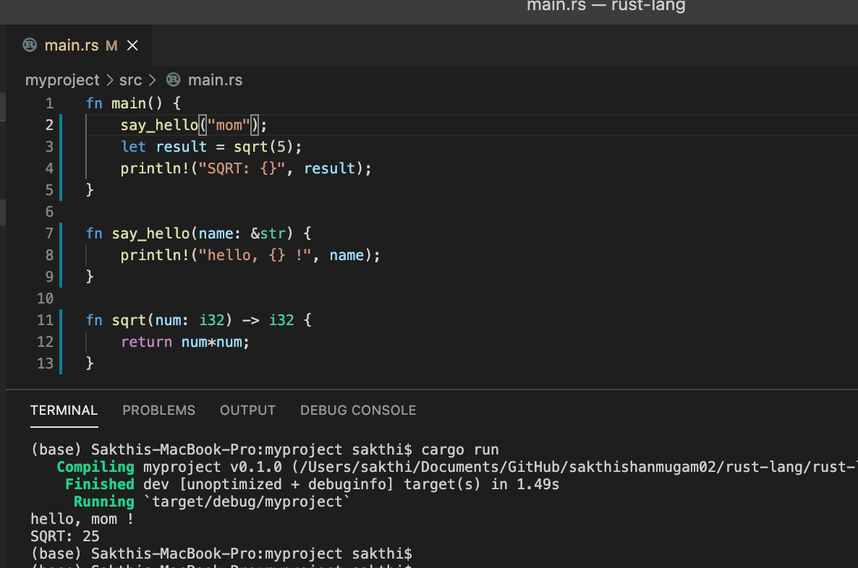
Functions If function has single line, then return keyword and ’;’ not required for .e.g. fn sqrt(n: i8) { n*n }

Slide 19
Control Flow Statement – IF.. ELSE IF.. ELSE..
if <cond> {
...
} else if <cond> {
…
} else {
…
}

Slide 20
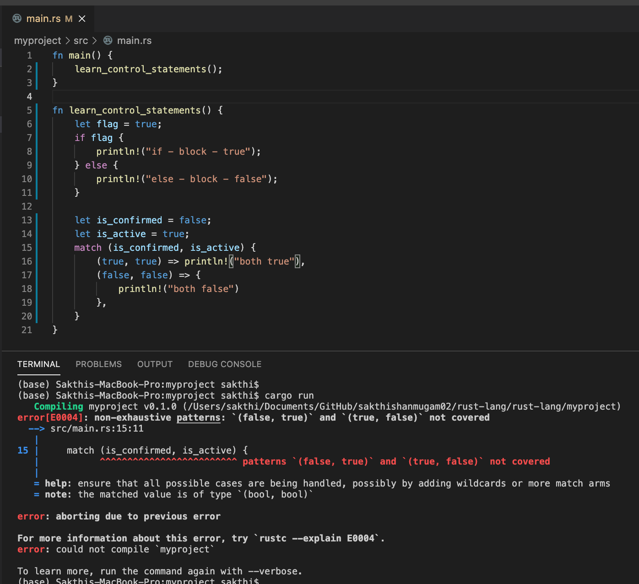
Control Flow Statement – match => switch?! (more powerful?): compiler will throw error for missing combinations!!

Slide 21
Control Flow Statement – loop & break
loop {
run forever;
}
Loop {
..
break;
}

Slide 22
Control Flow Statement – while
while <condition> {
..
..
}

Slide 23
Control Flow Statement – for .. in ..
for value in collection {
.. .
.. .
}

Slide 24
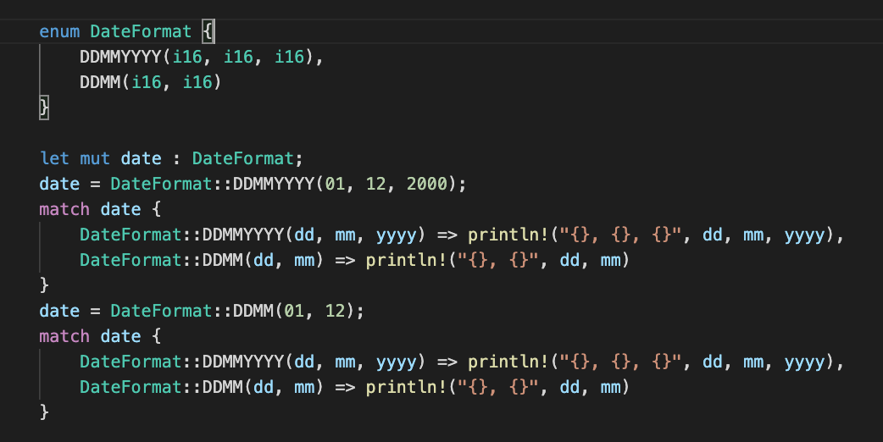
User Defined Data Types Enums
Enum values could be anything: - simple - tuple (in the example)
- struct

Slide 25
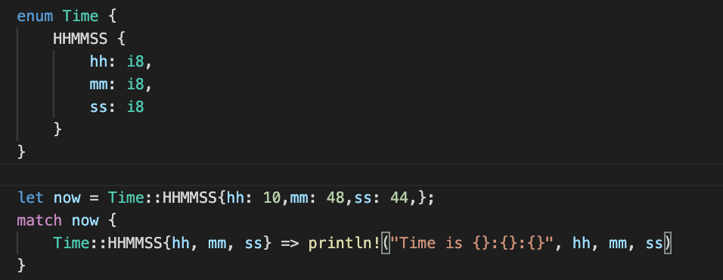
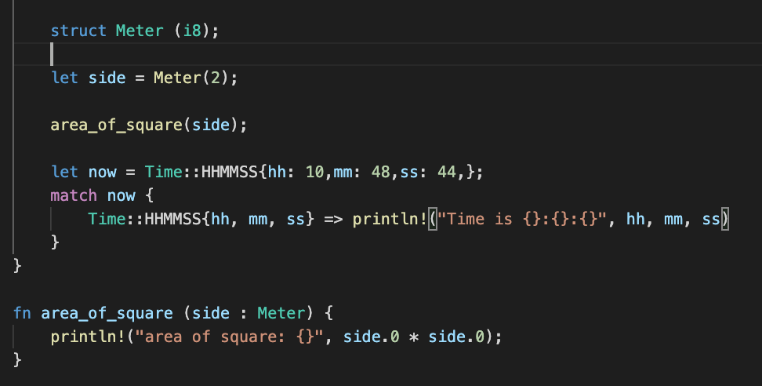
User Defined Data Types Struct
Struct are below kinds: - normal/simple - tuple struct (useful, measurements) - unit struct (when there is no field)
- enum struct

Slide 26
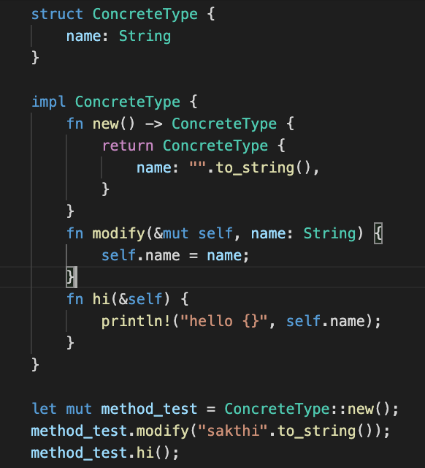
Methods
Methods: => useful when defining behavior
e.g., Player shoots, but not the Coach
- ‘impl’ keyword - ‘new’ function => associated function
- & => borrower (to get read access to self) - &mut => ownership (to get write access to self)

Slide 27
OWNERSHIP
OWNERSHIP
every piece of data is owned, and the owner is responsible for cleaning, auto-clean when out of scope and decides mutability
How it is different from other languages?
C - Manual Memory Management
Use After Free
Memory Leak
Double Free
Java – Garbage Collector
The String Datatype (Data, Length and Capacity)
Moving Ownership (when values passed between functions, ownership changes)
Cloning Data (To send/have duplicate)

Slide 28
BORROWING
Lending out values instead of ownership (equivalent to pointers, but compile time)
Reduce memory allocation and improves performances
Borrowing Vs Pointers (both uses & symbol but in Rust it is compile time)
Rust makes sure references are always valid; no nil pointer, dangling pointer.

