Slide 1

College Academic Materials Management System
Revolutionizing access to academic resources for students and administrators.

Slide 2
Presentation Overview
1
Project Objectives & Scope
2
Technical Foundation
Understanding the core goals and boundaries of the Academic Materials Management System.
Delving into the chosen technologies that power the application.
3
Key Features & Architecture
4
Implementation & Future Directions
Exploring the functionalities and underlying structure of the system.
Outlining the development process and next steps for enhancement.

Slide 3

Project Objectives
Our primary objective was to develop a user-friendly web application for managing and distributing academic materials. The system aims to provide structured access to educational content, categorized by Department, Semester, and Subject, enhancing the overall learning experience for students and simplifying administration for staff.

Slide 4





Robust Technology Stack
Backend
Database
Python and the Flask Framework provide a lightweight yet powerful foundation for server-side logic and API development.
SQLite was selected for its simplicity, server-less operation, and ease of integration, ideal for managing relational data.
Frontend
Authentication
HTML, CSS, Bootstrap, and Jinja2 Templates ensure a responsive, modern, and consistent user interface.
HTTP Basic Authentication secures administrative access, protecting material uploads and management functionalities.

Slide 5



Core System Features
The system is designed with a dual-user approach, catering to both students and administrators with distinct functionalities.
Student Access: Browse and download materials without a login.
Intuitive Navigation: Seamlessly navigate through Departments, Semesters, and Subjects.
Direct Downloads: Immediate access to academic files for students.
Admin Uploads
Material Management
Secure panel for uploading new academic materials.
Administrators can delete outdated or incorrect materials with ease.

Slide 6



System Architecture
Database Schema
Flask Application
The core web application, built with Flask, handles all requests and serves as the central hub.
Departments
id, name
Semesters
id, name, department_id
REST API Support
Subjects
id, name, semester_id
Enables seamless communication between the frontend and backend, facilitating data exchange.
Materials
id, subject_id, filename, original_filename
File Storage
The relational database schema ensures efficient organization and retrieval of categorized academic content.
Materials are securely stored within the server's filesystem under a dedicated 'uploads' directory.

Slide 7
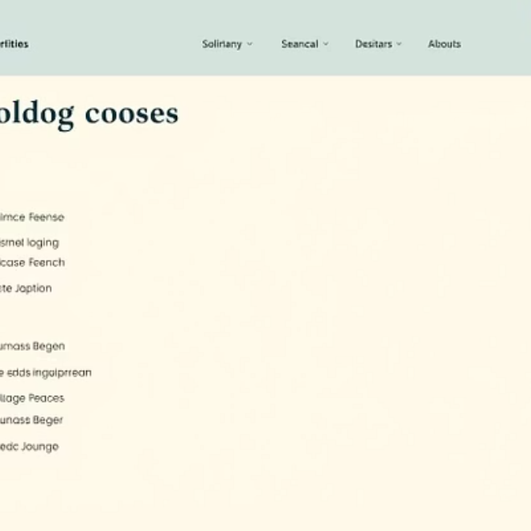
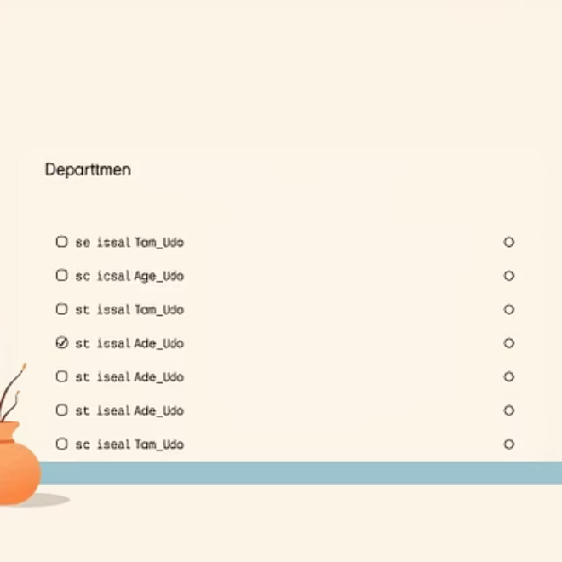
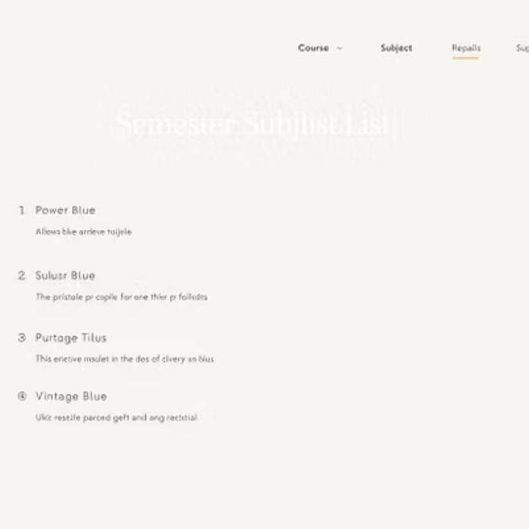
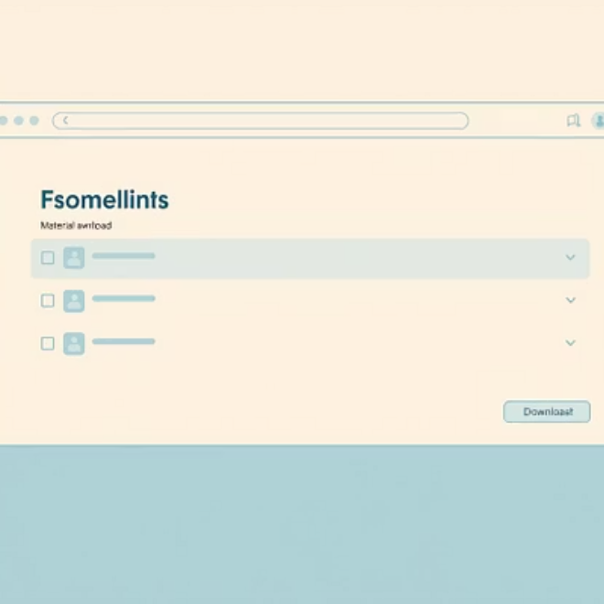
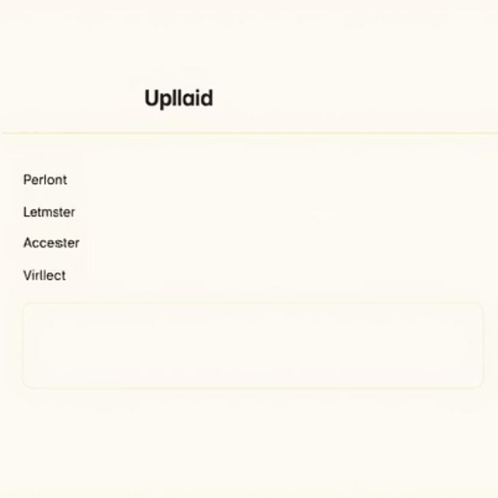
User Interface Prototypes
The UI is designed for intuitive navigation, from department selection to material download, ensuring a smooth experience for all users. The admin interface features dynamic cascading dropdowns for efficient material categorization.

Slide 8
Implementation Roadmap
Flask & Database Setup
Initialize Flask application and define SQLite database schema for data integrity.
Student Navigation Routes
Implement backend routes and views for seamless student browsing and material access.
Admin Management Routes
Develop secure routes for material uploads, deletions, and administrative tasks.
Frontend Development
Build responsive and user-friendly templates using Bootstrap and Jinja2 for visual appeal.
Dynamic Dropdown Integration
Incorporate JavaScript for interactive cascading dropdowns in the admin panel, enhancing usability.

Slide 9
Challenges & Solutions
User-Friendly UI Design
Secure Admin Authentication
Challenge: Ensuring an intuitive and easy-to-navigate interface for diverse users. Solution: Employing Bootstrap for responsive design and consistent styling across all pages.
Challenge: Protecting administrative functions from unauthorized access. Solution: Implementing HTTP Basic Authentication with secure credentials management.
Efficient File Handling & Storage
Real-time Material Updates
Challenge: Managing large volumes of academic materials and file uploads. Solution: Centralized file storage on the server with clear naming conventions and error handling for uploads.
Challenge: Ensuring immediate availability of newly uploaded or modified materials. Solution: Integrating dynamic page rendering with Jinja2 and client-side JavaScript for seamless content refresh.

Slide 10
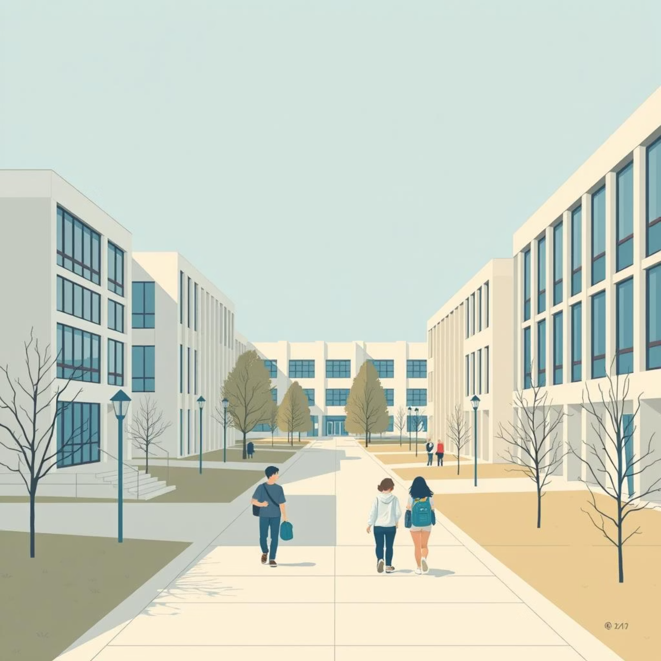
Conclusion & Next Steps
Key Achievements
Developed a robust and user-friendly academic resource management web application.
Enabled easy navigation and efficient management of educational materials.
Established a secure and scalable architecture for future growth.
Future Enhancements
User accounts for students with personalized dashboards.
Analytics dashboard for administrators to track material usage.
Search functionality for materials.
Integration with college learning management systems (LMS).

