Slide 1
Scalable Fitness data exploration
Sakthi Swarup Vasanadu Kasi – 62
Chanti Lalitha Pragnya Ravula - 45
Jyoshitha Yannam – 67
Notes:
ID=d924773e-9a16-4d6d-9803-8cb819e99682 Recipe=text_billboard Type=TextOnly Variant=0 FamilyID=AccentBoxWalbaum_Zero

Slide 2
Introduction
This project aims to analyze fitness tracker data using Microsoft Azure to gain insights into physical activity and health trends. By examining data from devices like Fitbit, we will explore patterns in daily steps, calories burned and distance traveled.

Slide 3
Dataset Description
The dataset is acquired from Kaggle.
The data consists daily records of user activities such as steps, distance covered in different activity intensities, minutes spent in different activity levels and calories burned.
Overall, the dataset provides a detailed view of users' physical activity over time.

Slide 4
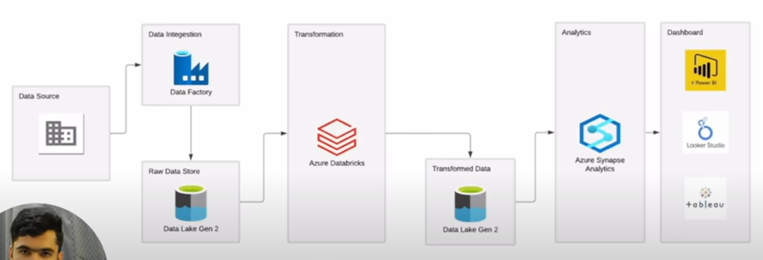
Azure Architecture

Slide 5
Creating storage account
The storage account is the cornerstone of any Azure-based data project.
This storage account serves as the central repository for all data, ensuring that it is securely stored and easily accessible throughout the project lifecycle.
This step is crucial for setting the foundation for all subsequent data processing activities.

Slide 6
Creating a Container in Data Storage
Organizing data within the storage account through containers is essential for managing large volumes of data efficiently.
Containers allow for logical segregation of data, making it easier to manage, retrieve and secure. This organization is particularly important when dealing with multiple datasets or when different access controls need to be applied to various parts of the data.

Slide 7
Azure Data Factory
The ETL (Extract, Transform, Load) process is the backbone of the project’s data pipeline, enabling the seamless flow of data from various sources into a format that is ready for analysis.
Through the ETL process, raw data is cleaned, transformed and enriched making it more useful for analysis. This step enhances data quality and ensures that the data used in analysis is accurate, up-to-date, and relevant, thereby supporting more informed decision-making.

Slide 8
GitHub Integration
Integrating GitHub into the Azure project provided a powerful platform for version control and collaboration.
It allowed multiple team members to work on the project simultaneously, with changes being tracked and managed effectively. This setup minimized the risks associated with code conflicts and ensured that all team members were working with the latest version of the code.

Slide 9
Cluster Creation
The cluster provides the computing power needed to process large datasets and run complex tasks.
It ensures that our data processing is efficient and can scale up or down based on the workload.

Slide 10
App Registration in Azure Active Directory
Registering the application in Azure Active Directory (AAD) was a critical step in securing access to Azure resources.
By doing so, we ensured that only authorized applications and users could interact with sensitive project data and services, thereby protecting the project from unauthorized access and potential security breaches.

Slide 11
Power BI: Data Visualisation
Power BI was used to transform the processed data into interactive visualizations and reports. These reports made complex data more understandable and actionable.
The visualizations created in Power BI played a crucial role in enhancing decision-making within the project. By presenting data in a clear and visually appealing manner, these reports helped uncover insights that might have been missed in raw data form, supporting more strategic and informed decisions.

Slide 12
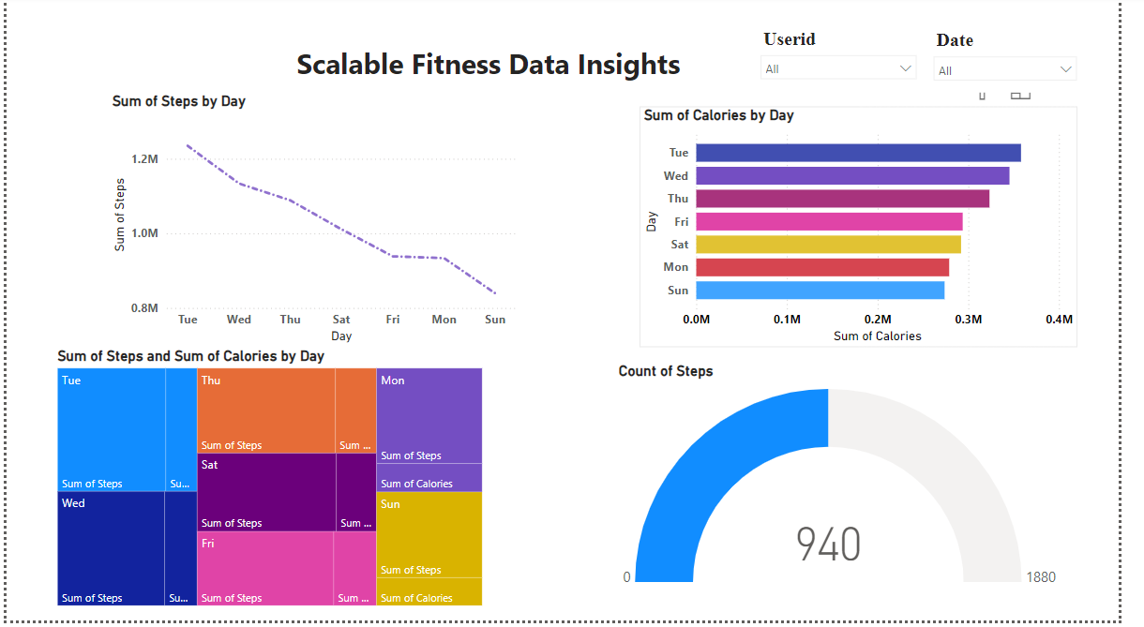
Power BI: Data Visualisation

Slide 13
Conclusion
We successfully set up and used Azure services to store, process, and analyze our project data. This setup made our work more efficient and our analysis more accurate.

