Slide 1
CHATBOT FOR HEALTHCARE
TEAM MEMBER:
ABITHA T
KAVIYA R
RAGAV C T
SAKTHI T M

Slide 2
IDEA
An application that acts as a personal assistant for health and medical related informations.
This chatbot was developed for better organization of patient medical reports, medication management, help in emergency situations or with first aid, offering a solution for simpler medical issues.
The chatbot provides information about the active ingredients present in the medication and alternative medicines.
A personal mental health assistant to help the patient’s with mental health issues by suggesting them with proper meditational solutions.

Slide 3
Incase of emergency the user gets a list of nearby hospitals and pharmacies.
Custom reminders can created to remind the users for weekly and monthly health checkups.
The complete track of the patients records will be available for convenient future reference.
Diet recommendations for patients with different health conditions.
A community for users to share their experience in overcoming the health issues and few remedies which they find useful.
During very urgent times, based on your choice of hospitals, it will automatically connect with ambulance

Slide 4
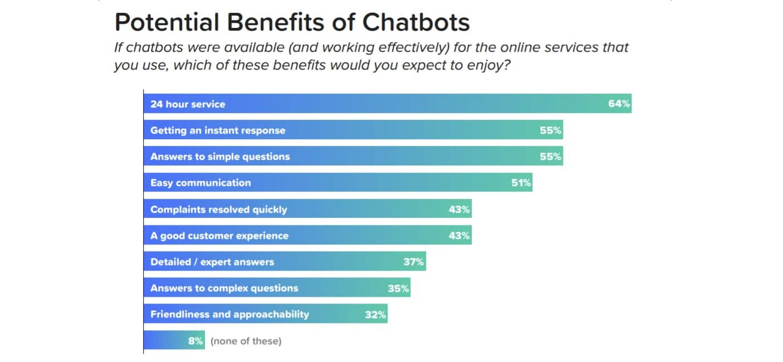

Slide 5
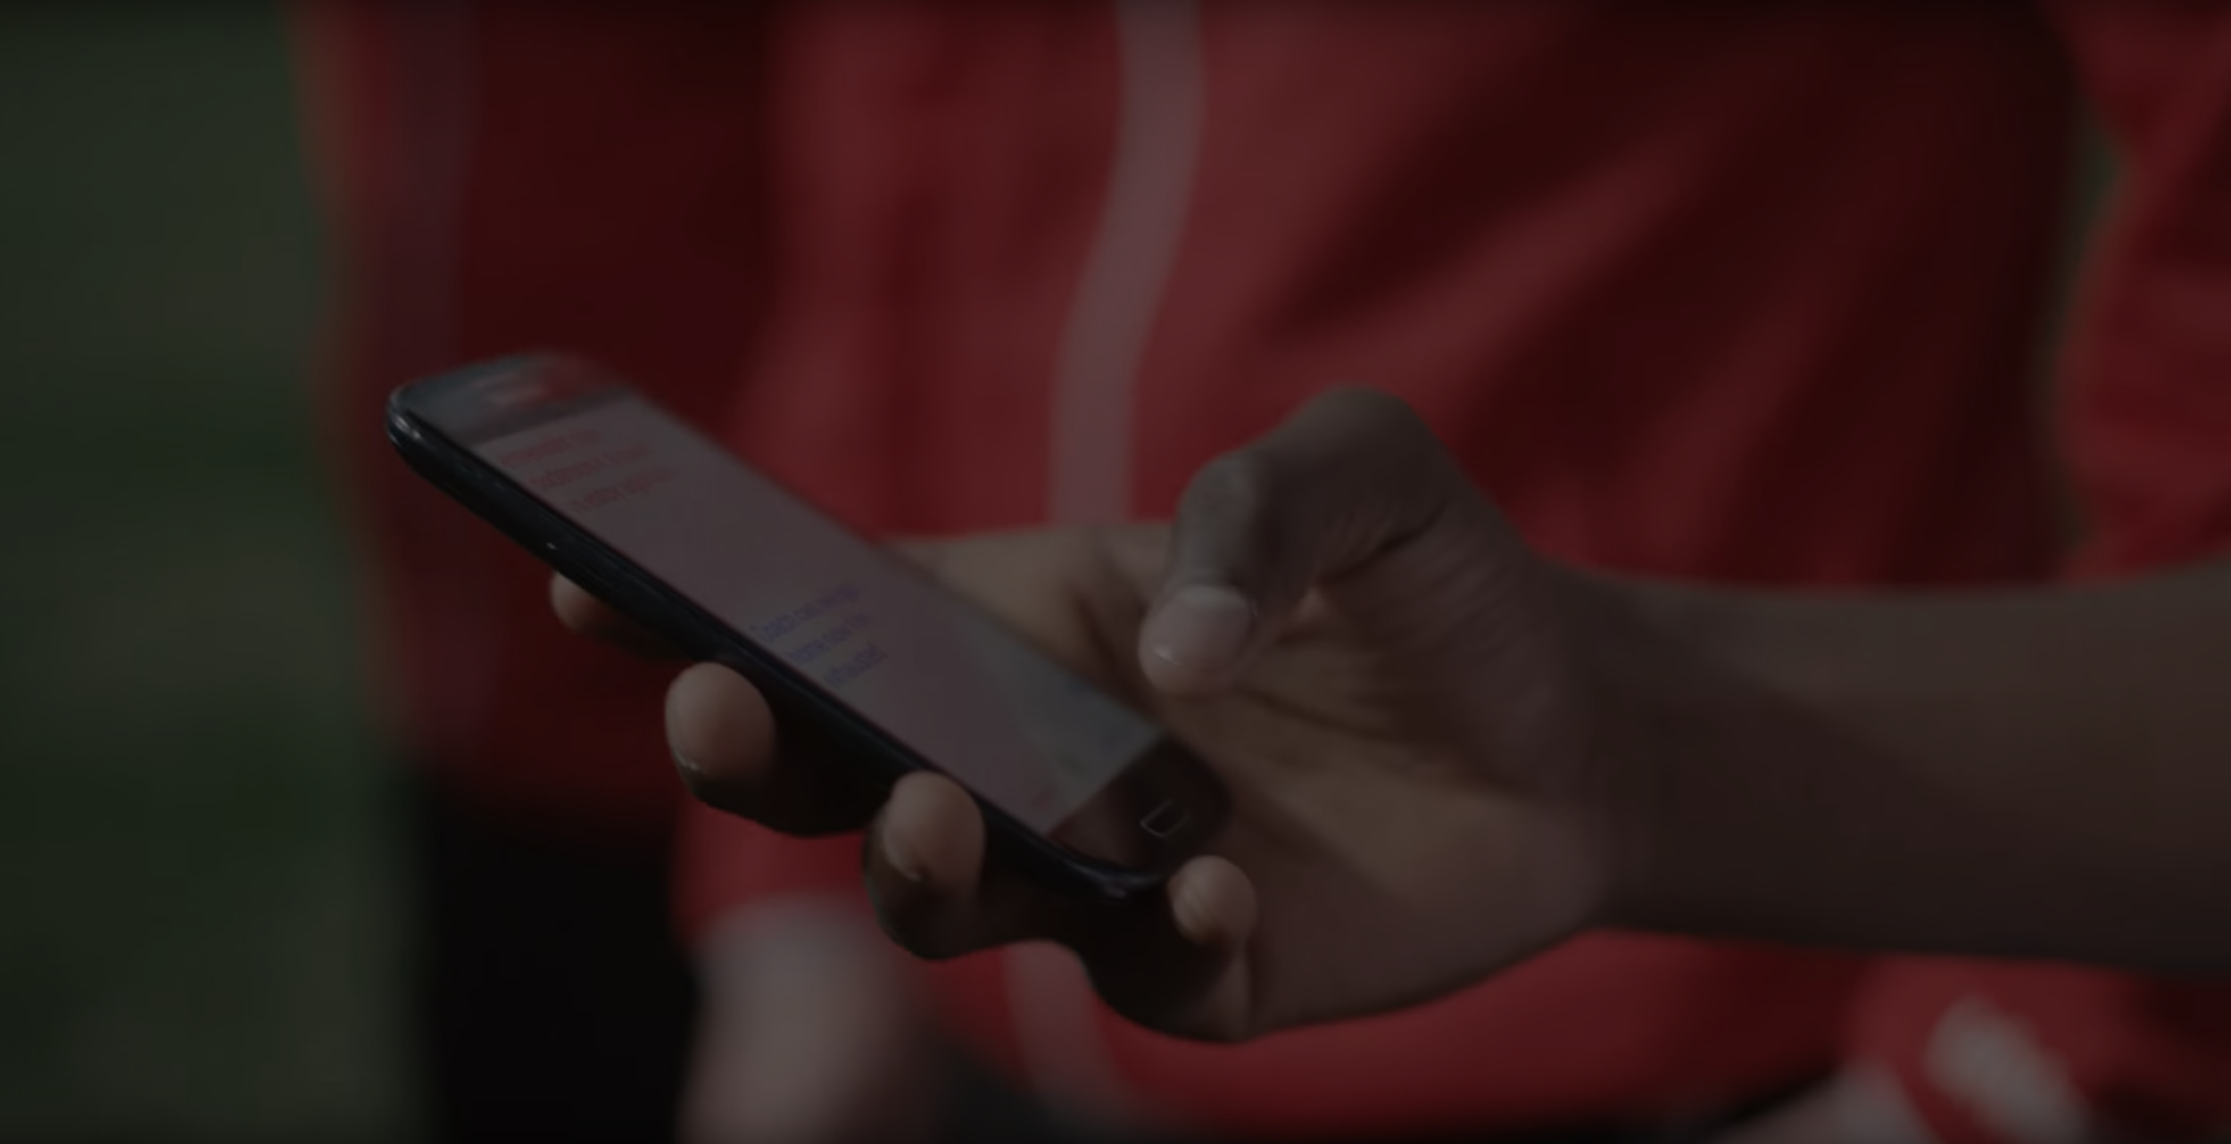
Concept
The users informations and reports are stored in the database
The symptoms provided by the user is inputted to the Machine Learning model.
Using NLP and the output data of the model the chatbot replies to the user.
Google maps API’s are used for locating nearby hospitals and pharmacies.
Diet plans are created by the ML models as well.

Slide 6
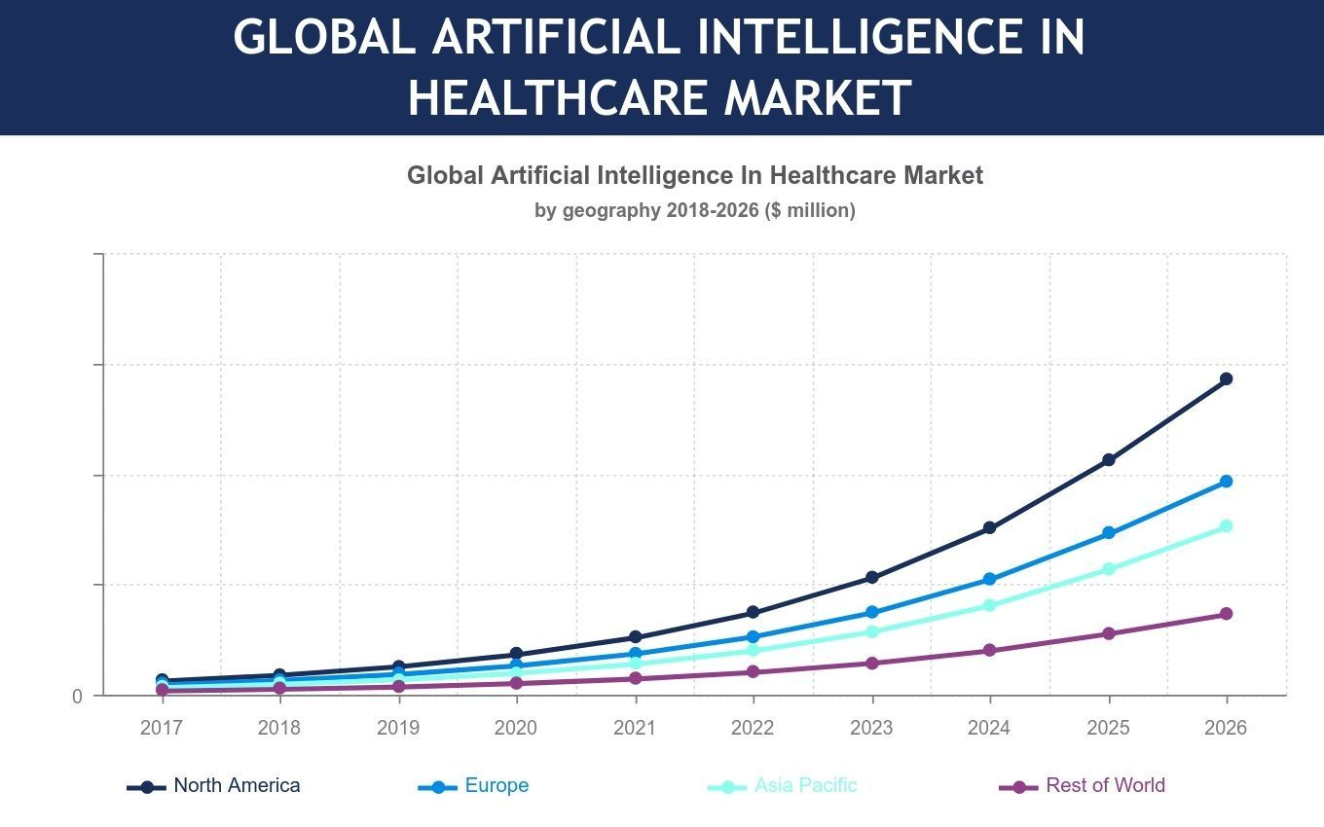
AI IN GLOBAL HEALTHCARE MARKET
• In Canada, the city of Hamilton’s health department has collaborated with IBM to built AI capabilities that can improve health outcomes and decrease the cost of care , by leveraging existing patient data .
• Chief Information Officer ( CIO ) in healthcare organization are ready to engage AI platforms to achieve greater customer experience , particularly as a recent survey by HCF revealed that over 80% of australians are comfortable with AI being used to diagnose common medical problems are interpret test results

Slide 7
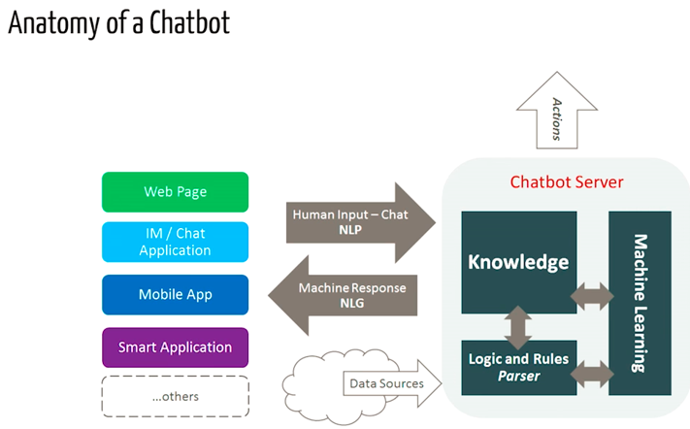

Slide 8
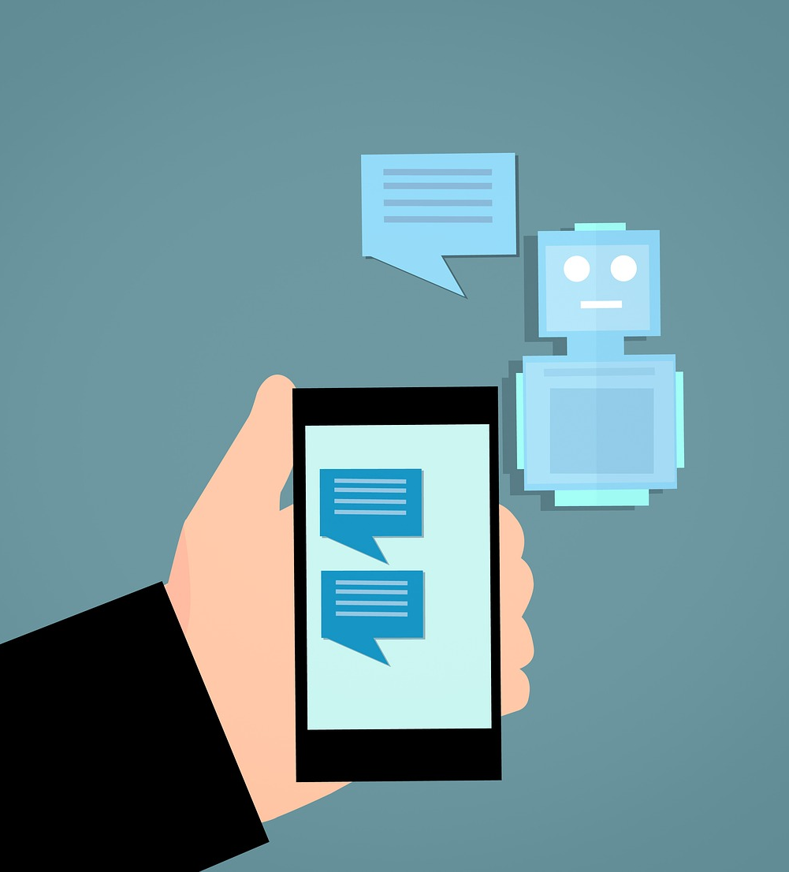
Technological Stack:
•Frontend: HTML, css, javascript, bootstrap
•Backend: 1. Google colab notebook
2. NLP and ML libraries
3. Programming Language -
python.
4. Database(MySql)

Slide 9
Thank you

