Slide 1
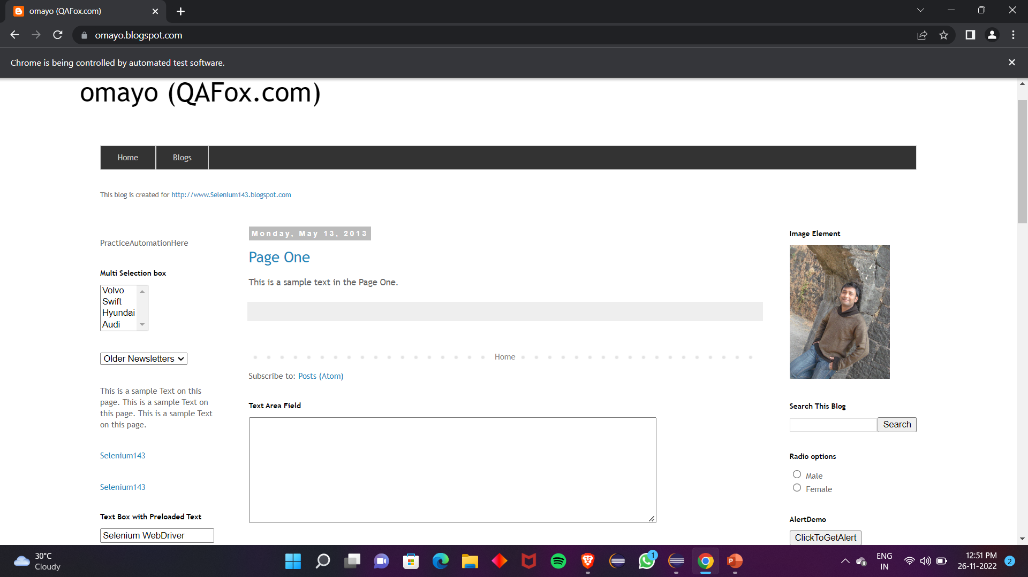
REFERENCE WEBSITE
https://omayo.blogspot.com/

