Slide 1
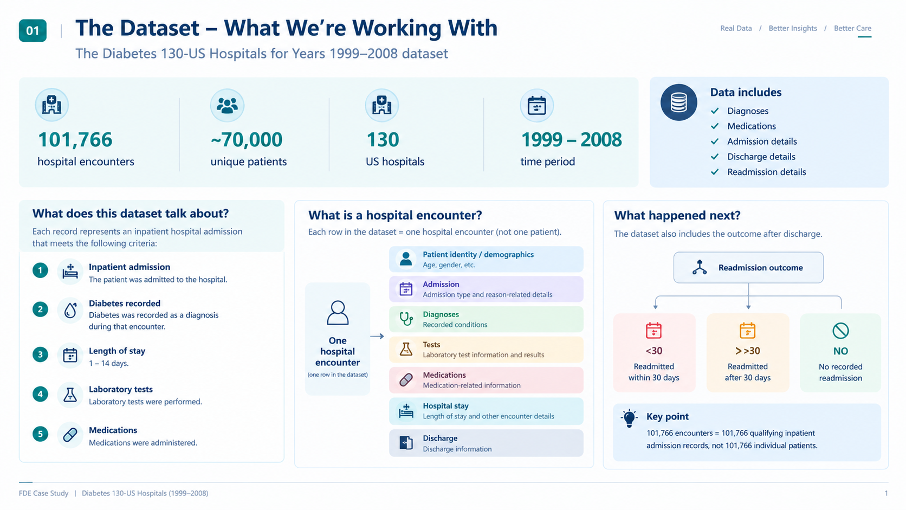
Notes:
One record represents a qualifying inpatient admission, not a unique person. All encounters include diabetes recorded somewhere, though diabetes is not always the primary diagnosis. Data come from 130 US hospitals, 1999–2008. Readmission labels describe a subsequent recorded admission and do not establish preventability. The source research separately examined HbA1c testing.

Slide 2
02
DATASET SEGMENTATION
Diabetes is not always the primary reason for admission
We separated encounters by primary diagnosis before investigating early readmission patterns.
GROUP A / DIABETES PRIMARY
GROUP B / OTHER PRIMARY
8,757
93,009
Diabetes was the primary diagnosis.
Another condition was primary; diabetes was recorded elsewhere.
Observed 30-day readmission rates
Diabetes primary
12.98%
Other primary
10.99%
KEY FINDING
The diabetes-primary group has a slightly higher rate. Next: does prior inpatient utilisation reveal a stronger signal?
FDE CASE STUDY / DIABETES & HOSPITAL READMISSIONS
02 / 07
Notes:
Group A includes 8,757 encounters with primary diagnosis ICD-9 250.xx; Group B includes 93,009 encounters where diabetes was recorded but another condition was primary. Early readmission labels: 1,137 in A and 10,220 in B. Differences are descriptive, not causal. Rates are encounter-based. This segmentation is an analytical starting point; broader high-use patients may represent more total readmissions.

Slide 3
03
HIGH-UTILISATION PATTERN
Prior inpatient visits reveal a much stronger readmission signal
Among encounters with diabetes as the primary diagnosis
Observed 30-day readmission rate by previous inpatient visits
0 previous visits
7.98%
1 previous visit
15.19%
2+ previous visits
27.18%
HIGH-UTILISATION SEGMENT / DIABETES PRIMARY + 2+ PRIOR INPATIENT VISITS
1,700
1,124
462
8,170
qualifying encounters
distinct patients
early readmission labels
bed-days in qualifying encounters
BUSINESS OPPORTUNITY
Investigate whether clinically appropriate post-discharge support can improve continuity and reduce avoidable utilisation.
FDE CASE STUDY / DIABETES & HOSPITAL READMISSIONS
03 / 07
Notes:
The previous inpatient count is a historical utilisation indicator. Among diabetes-primary encounters, early readmission rates rise from 7.98% with zero prior inpatient visits to 15.19% with one and 27.18% with two or more. The 1,700 encounters are 1,124 distinct patients and account for 8,170 bed-days during the qualifying stays, not subsequent readmission bed-days. This association does not prove preventability or a care-coordination gap. A broader other-primary high-utilisation segment has 12,915 encounters and 2,666 early readmission labels, and deserves consideration in eligibility design.

Slide 4


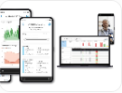
04 / SOLUTION FEASIBILITY
Three ways to improve post-discharge care
Compare practical alternatives before selecting technology — preliminary engineering judgement
01
02
03
Improve existing discharge processes
Digital follow-up and workflow automation
Connected-care platform with AI
Standardise discharge checklists, schedule follow-up appointments, improve medication reconciliation and clarify staff responsibilities.
Enrol eligible patients, schedule check-ins, collect responses, flag clinically approved concerns and create tasks for care coordinators.
Integrate relevant medical devices, analyse longitudinal patient information, use validated risk models and support clinician-led escalation.
Low technology complexity. Fastest to test. May be sufficient if problems are process-related.
Moderate complexity. Supports measurable workflow improvement without predictive AI.
Highest complexity. Requires device integration, clinical validation, governance and model monitoring.
FEASIBILITY ASSESSMENT
Evaluation criterion
Option 1: Process
Option 2: Automation
Option 3: AI + IoT
Implementation complexity
Low
Medium
High
Upfront investment
Low
Medium
High
Data requirements
Low
Medium
High
Clinical governance burden
Standard care
Workflow + alert governance
Clinical + model governance
Potential to scale follow-up
Staff-dependent
High, if effective
High, integration-dependent
Speed to pilot
Fast
Moderate
Slow
Demonstrated effectiveness
Not established
Not established
Not established
Suitability for first MVP
Good
Strong
Premature
Assessment is qualitative; none of the three approaches has demonstrated effectiveness in this dataset.
FDE CASE STUDY / DIABETES & READMISSIONS
04 / 06
Notes:
Compare the three alternatives without assuming the answer must involve AI. Option 1 can be sufficient if the true constraint is an existing discharge process. Option 2 is the preferred testable workflow hypothesis, not a proven winner. The table is preliminary judgement, not a clinical trial result.

Slide 5
05 / RECOMMENDED SOLUTION + IMPLEMENTATION
From discharge to action: a technology-enabled care workflow
Option 2 — targeted digital follow-up, with clinician-owned escalation and measurable outcomes
PREFERRED APPROACH
Digital check-ins + approved rules + human review
01
02
03
04
Discharge & enrol
→
Scheduled check-in
→
Rules & routing
→
Clinical follow-up
Clinician confirms eligibility; patient consents
Patient receives and answers questions
Approved logic flags concerns and creates tasks
Care team reviews, acts and records outcome
Care coordinator
Patient web interface
FastAPI + rules
Care-team dashboard
TECHNOLOGY & DATA LAYER
Patient experience
API + automation
Clinical dashboard
Responsive check-in; accessible alternatives
FastAPI; outreach; rules; task creation
React; review, assignment, resolution
POSTGRESQL DATA + AUDIT
Enrolment • consent • responses • tasks • audit events
SAFETY BY DESIGN
Clinical protocols • human oversight • access controls • escalation coverage
Notes:
We recommend Option 2 as a pilot hypothesis, conditional on finding an actionable gap in existing post-discharge care. Follow the patient journey: clinician-approved enrolment and consent, scheduled check-in, approved rule-based routing, and clinician-owned follow-up. React interfaces connect to FastAPI services; PostgreSQL records enrolment, responses, tasks and audit events. This is not autonomous clinical triage. Existing process improvements may be sufficient; connected devices and validated AI are future options only if they add incremental value.

Slide 6
06 / VALUE & VALIDATION
Prove patient benefit and financial value before scaling
Illustrative break-even scenario; historical multi-hospital data cannot establish actual savings
1,000
AUD $4,000
AUD $120,000
Eligible annual discharges
Assumed net value / avoided readmission
Assumed annual programme cost
BREAK-EVEN THRESHOLD
30 avoided readmissions / year
= 3 percentage-point absolute reduction
VALIDATION GATES
1 Validate
2 Pilot
3 Measure
Review causes, preventability, existing workflows and real costs
Test with clinical governance and an appropriate comparator
Track safety, follow-up, readmissions, workload and net value
DECISION: Scale only if the intervention is clinically safe, operationally feasible and financially worthwhile.
FDE CASE STUDY / DIABETES & READMISSIONS
06 / 06
Notes:
All financial inputs are hypothetical Australian-dollar assumptions, not measured US hospital savings. Break even: $120,000 / $4,000 = 30 avoided readmissions. At 1,000 annual eligible discharges, that represents a 3 percentage-point absolute reduction. Validate net benefit against actual hospital costing, reimbursement, implementation costs, safety and pilot outcomes. Historical dataset figures are not single-hospital annual rates.

