Slide 1
AWS Cloud Internship Project
Custom VPC + EC2 Web Application + S3 Storage + IAM Roles + CloudWatch Monitoring + Automated Backup and Cost Control
Final Project Presentation

Slide 2
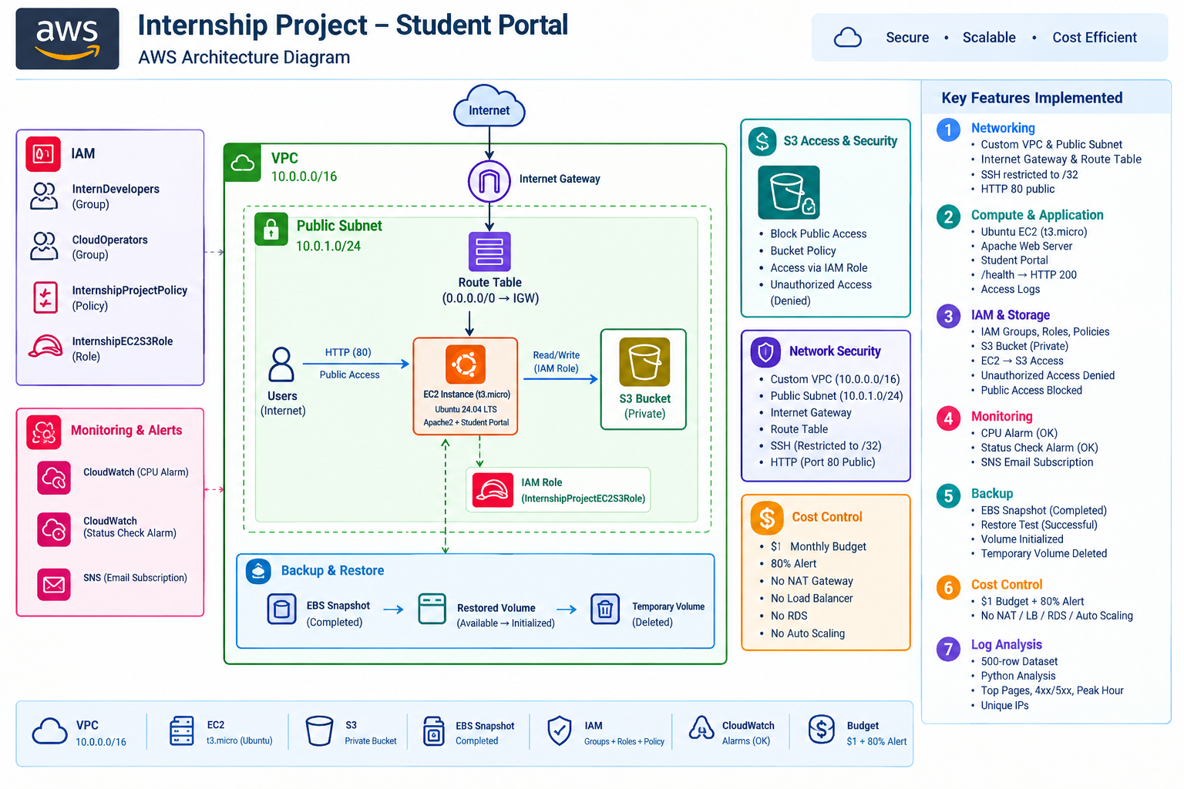
Project Architecture

Slide 3
1. Project Overview
This project demonstrates a secure, cost-conscious AWS environment for an internship/student web application. The implementation combines a custom VPC, public subnet, Internet Gateway, Linux EC2 web server, S3 storage, IAM roles and policies, CloudWatch monitoring, SNS notifications, EBS backup/restore, AWS Budget controls, and web-access-log analysis.

Slide 4
2. Project Objectives
The project objectives were to build a custom VPC and public subnet, deploy a Linux web server, apply least-privilege IAM controls, integrate EC2 with S3 without hardcoded credentials, monitor the EC2 instance with CloudWatch, send alerts through SNS, create an EBS snapshot and validate restoration, control cost with AWS Budgets, and analyze a sample web-access-log dataset.

Slide 5
IAM & Security
Root MFA enabled; no active root access keys
InternDevelopers + InternshipProjectPolicy
EC2 uses InternshipEC2S3Role
S3 access scoped to the designated project bucket
Unrelated S3 access tested and denied

Slide 6
VPC & Networking
VPC: 10.0.0.0/16
Public subnet: 10.0.1.0/24 in ap-south-1a
Internet Gateway + public route table
HTTP 80 allowed
SSH 22 restricted to the user's IP /32

Slide 7
EC2 & Student Portal
Ubuntu Linux t3.micro
8 GiB gp3 root volume
Apache2 hosts /student-portal/
/health endpoint returns HTTP 200
IMDSv2 required and IAM instance profile attached

Slide 8
S3, Monitoring & Backup
Private S3 bucket with Block Public Access
CloudWatch CPU and status-check alarms
SNS email subscription confirmed
EBS snapshot completed
Temporary restore volume validated and deleted

Slide 9
Log Analysis Results
500 total requests
Top pages include / and /health
21 4xx errors; 6 5xx errors
35 unique IP addresses
Peak hour: 16:00–16:59 with 63 requests

Slide 10
Cost Control
No NAT Gateway, load balancer, RDS, or Auto Scaling
Recurring $1 monthly AWS Budget
80% actual-spend alert
Project tagging applied
Temporary restored EBS volume cleaned up

Slide 11
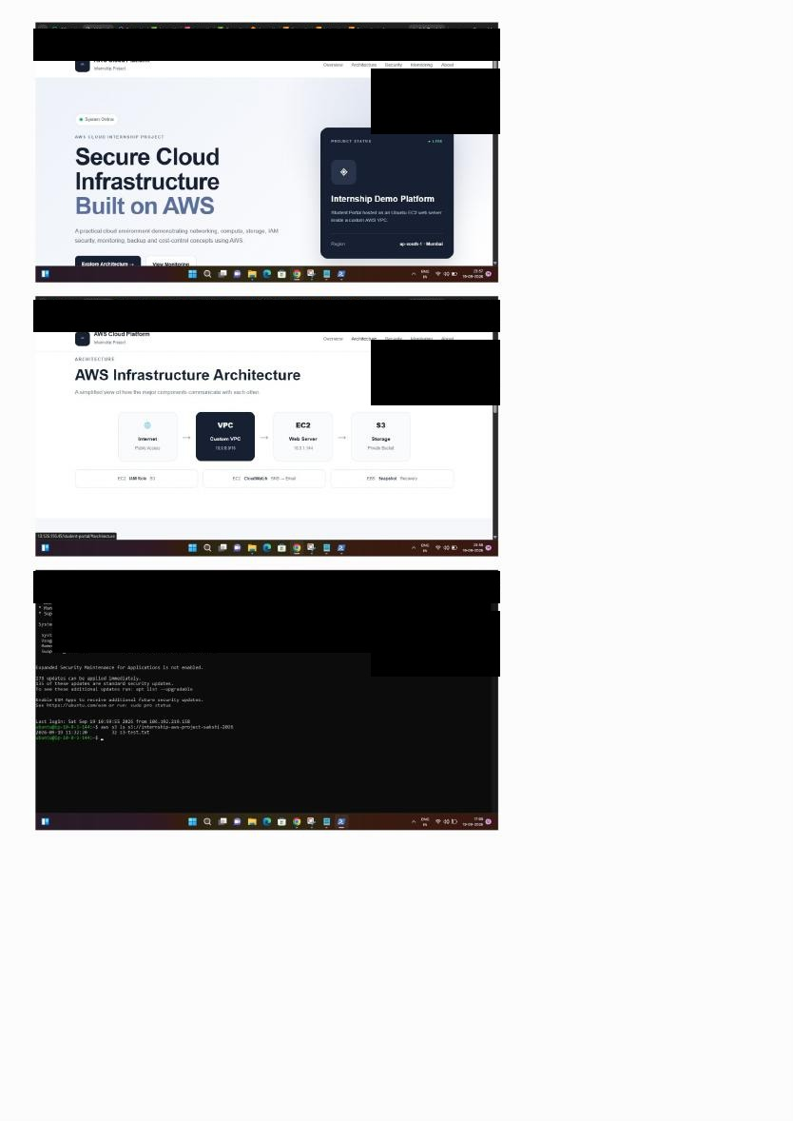
Evidence 1
Evidence Plate 1 — Student Portal landing page, AWS architecture page, and EC2/application terminal evidence.

Slide 12
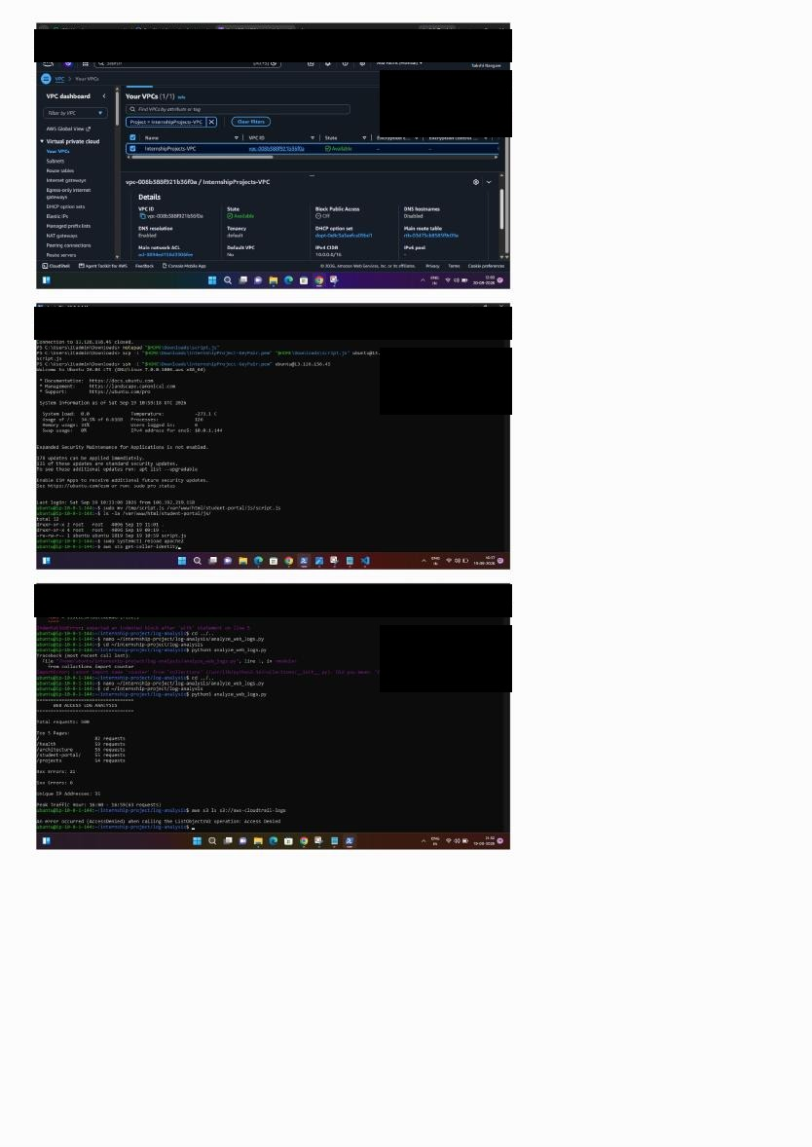
Evidence 2
Evidence Plate 2 — Custom VPC configuration, Linux/Apache validation, and Python web-log analysis output.

Slide 13
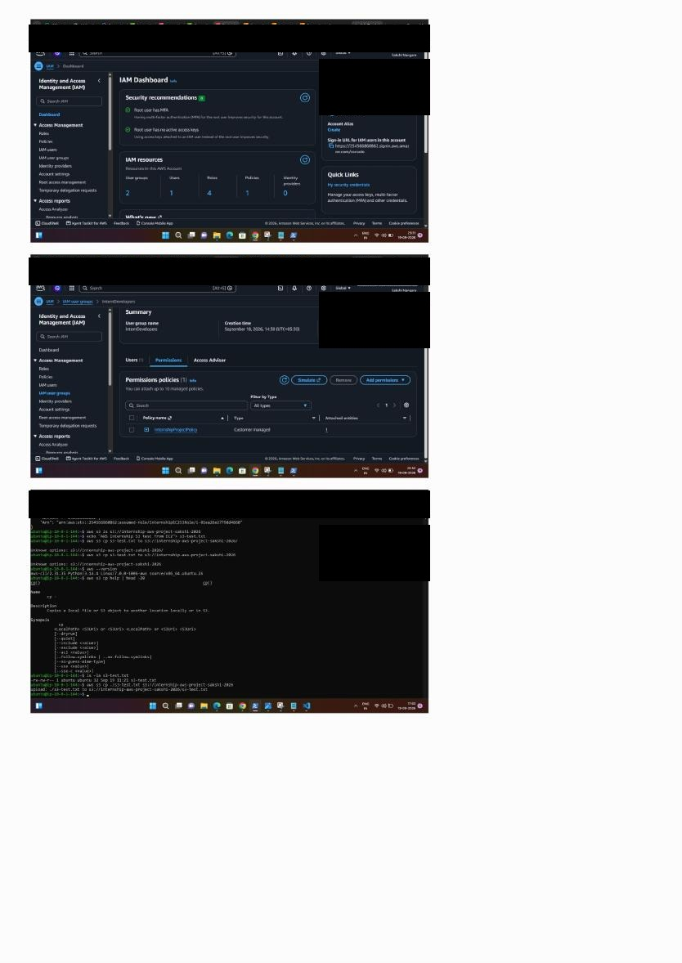
Evidence 3
Evidence Plate 3 — IAM Dashboard and security configuration evidence.

Slide 14
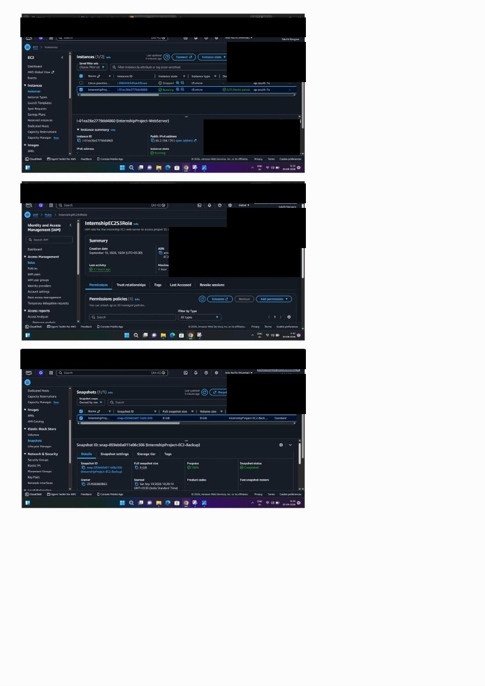
Evidence 4
Evidence Plate 4 — EC2 instance and related compute configuration evidence.

Slide 15
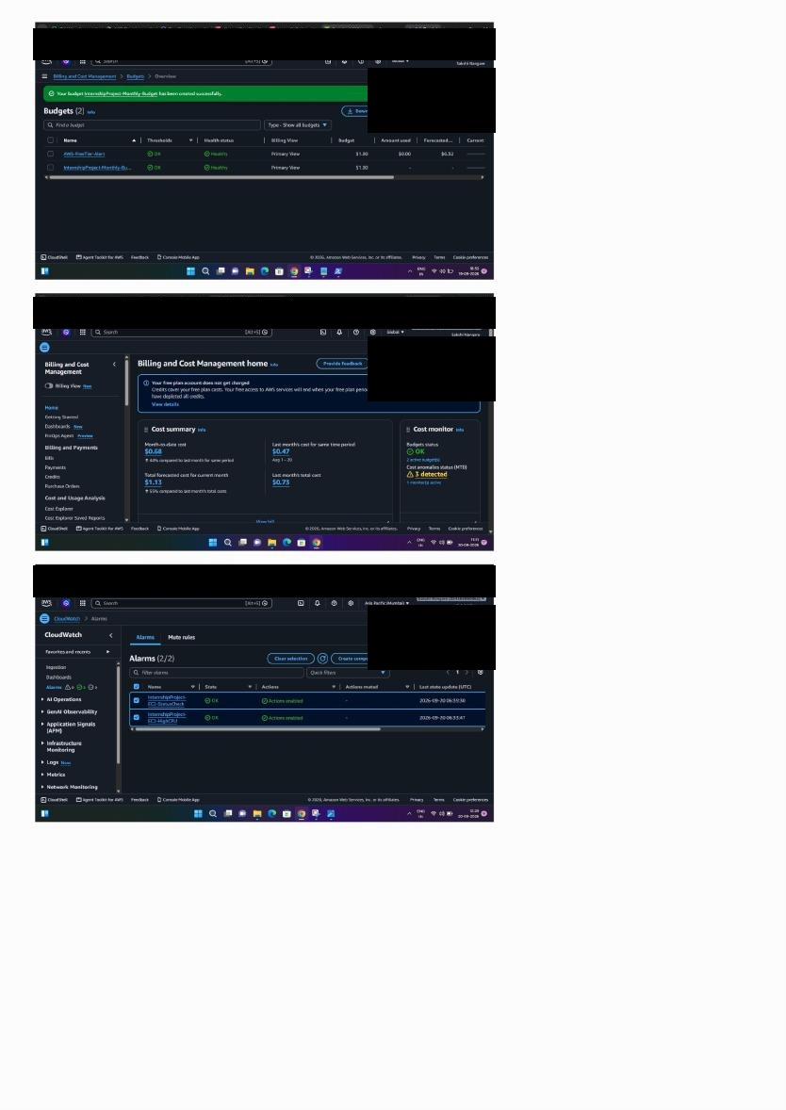
Evidence 5
Evidence Plate 5 — AWS Budget and cost-control evidence.

Slide 16
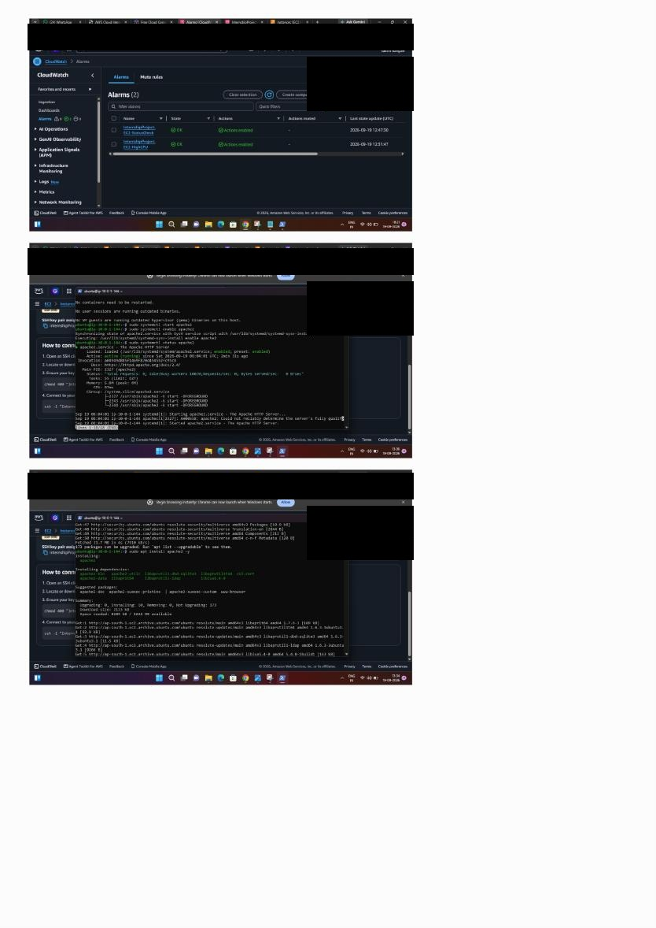
Evidence 6
Evidence Plate 6 — CloudWatch alarm configuration and monitoring evidence.

Slide 17
Testing & Validation
Student Portal reachable over HTTP
/health returned HTTP 200
EC2 role could list and upload to project S3
Unrelated S3 access returned AccessDenied
CloudWatch alarms remained in OK state during verification
EBS snapshot completed and restore test succeeded
Budget and resource cleanup checks completed

Slide 18
Conclusion
The completed environment demonstrates an end-to-end AWS workflow: secure identity, custom networking, Linux web hosting, S3 integration, monitoring and alerting, backup/restore, log analysis, testing, and cost control.

