Slide 1

Tribhuvan University, IOE Pulchowk Campus
Dept. of Electronics & Computer Engineering
FEATURE EXTRACTION FOR
IMAGE & VIDEO ANALYSIS
Comparing statistical, classical, and deep-learning approaches to turning raw pixels into compact, meaningful representations
ABHISHU PANTHI (080BCT009)
JENIF KHADKA (080BCT036)
KUSHAL K.C. (080BCT041)

Slide 2





01
WHY FEATURE EXTRACTION?
Raw pixels are high-dimensional and redundant. Feature extraction re-expresses an image or video as a compact, meaningful vector. The same input, seen through three different lenses.
STATISTICAL
CLASSICAL
DEEP LEARNING
PCA
CANNY EDGE DETECTION
RESNET18 (CNN)
Finds the directions of maximum variance and projects pixels onto a handful of them, a compact, reconstructable summary.
A hand-crafted detector that isolates object boundaries and structure from intensity gradients.
A pretrained network learns a hierarchy of visual patterns automatically, no manual design needed.
And it doesn’t stop at images, the same ideas extend to video, adding spatial structure and temporal motion.
2

Slide 3
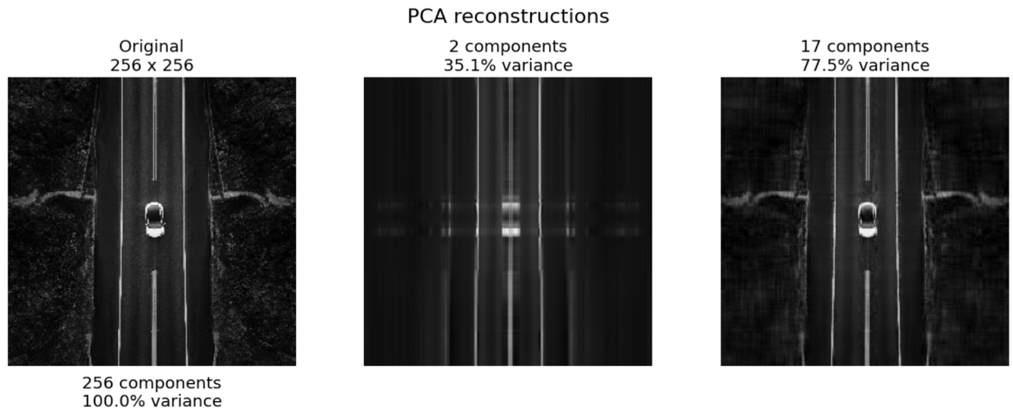
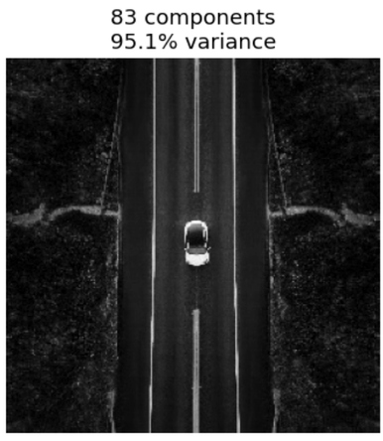
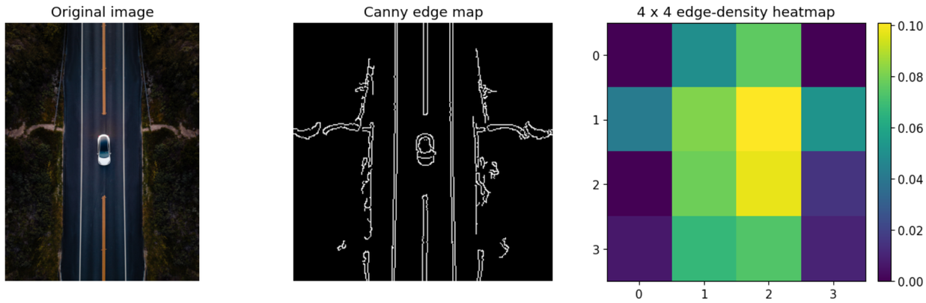
02
STATISTICAL & CLASSICAL FEATURE EXTRACTION
PCA → Dimensionality Reduction 83 of 256 components capture 95.2% of the variance (reconstruction MSE 120.4)
Canny Edge Detection 4.7% global edge density → 16-value block feature vector (4×4 grid)
3

Slide 4
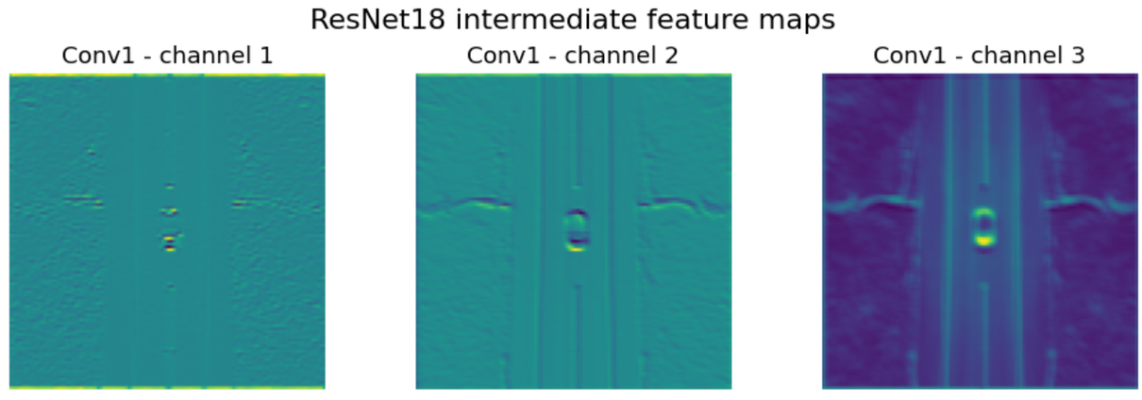
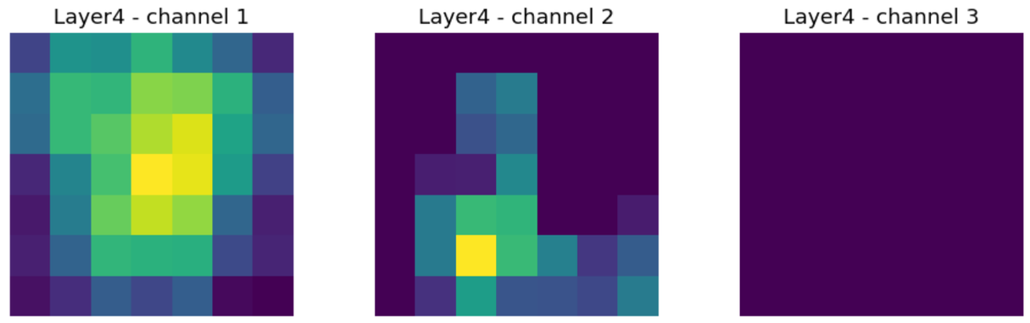
03
DEEP-LEARNED FEATURES: RESNET18
A convolutional neural network pretrained on ImageNet is used purely as a feature extractor. Early layers respond to edges and colour; deeper layers respond to abstract shapes and object parts, the network learns what to look for, rather than being told.
512-D
Feature vector length (global average pooled output)
CONV1 → LAYER4
Progression from raw edges to abstract, coarse patterns
‖V‖ = 27.2523
Conv1 (early layer) vs. Layer4 (late layer) feature maps for the same input image.
L2 norm of the final feature vector, a dense content summary
4

Slide 5
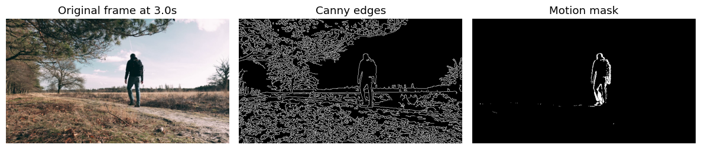
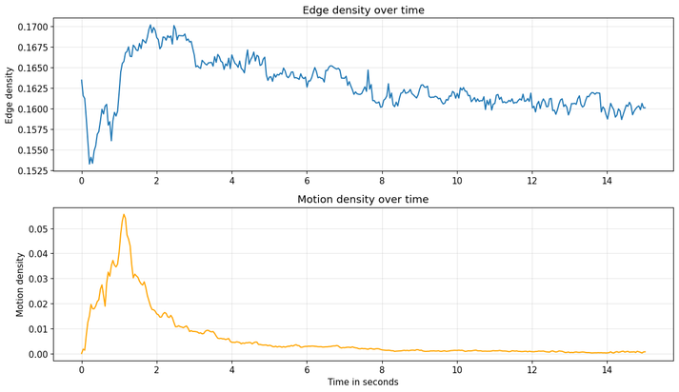
04
FROM IMAGES TO VIDEO AND WHAT WE LEARNED
1280×720 RESOLUTION
23.98 FPS
361 FRAMES
15.06 S DURATION
Spatial feature (Canny edge density) and temporal feature (frame-differencing motion) extracted for every frame.
CONCLUSION
PCA, Canny, and ResNet18 capture complementary aspects of an image - variance, structure, and abstraction. Extending the same idea to video adds spatial and temporal features over time, turning raw pixels and frames into compact inputs ready for classification, retrieval, detection, or clustering.
Feature Extraction for Video Analysis
5

Slide 6
