Slide 1
ANAVIZ
Dataset-independent time-series visualization
How the code connects APIs, caches data, preserves gaps, and renders evidence
Example source: CERN ATLAS HLT p-beat
Project: generic HTTP time-series explorer
Presentation-ready deck | code + diagrams + speaking cues

Slide 2
The big idea
OVERVIEW
Anaviz is an adapter and evidence layer, not an HLT-only chart.
ANY HTTP
TIME-SERIES API
config.json
+ adapter
CHART
+ HEATMAP
+ HISTOGRAM
→
→
timestamps + values
possibly different field names
possibly different JSON shape
maps source fields
fetches uncovered ranges
translates to canonical models
fast display
visible gaps
quality + fidelity
SPEAKER CUE | The HLT dataset demonstrates the architecture; the frontend is designed for any timestamp-and-value HTTP API.
ANAVIZ | Dataset-independent time-series visualization
2

Slide 3
The example dataset: ATLAS HLT p-beat
DATASET
Real monitoring data from CERN's ATLAS trigger system.
HLT = High Level Trigger
The system makes fast event-selection decisions at the LHC.
p-beat = periodic heartbeat/rate monitoring
Each channel represents a DCM computing node and its measured rate.
datasource/ingest_hlt.py
ELEMENT_ID_OFFSET = 900_000
# column 0 -> 900000
# column 1 -> 900001
Plain English: The importer gives each source column a stable entity ID.
Data facts
~3,690 channels | large CSV files | long time range
NaN means no valid sample — not zero.
datasource/ingest_hlt.py
chunksize = 5000
reader = pd.read_csv(path, chunksize=chunksize)
# process a small part of the large CSV
Plain English: Chunking prevents a multi-gigabyte file from filling memory.
SPEAKER CUE | Introduce the data, then immediately connect it to the design problem: large volume plus missing samples.
ANAVIZ | Dataset-independent time-series visualization
3

Slide 4
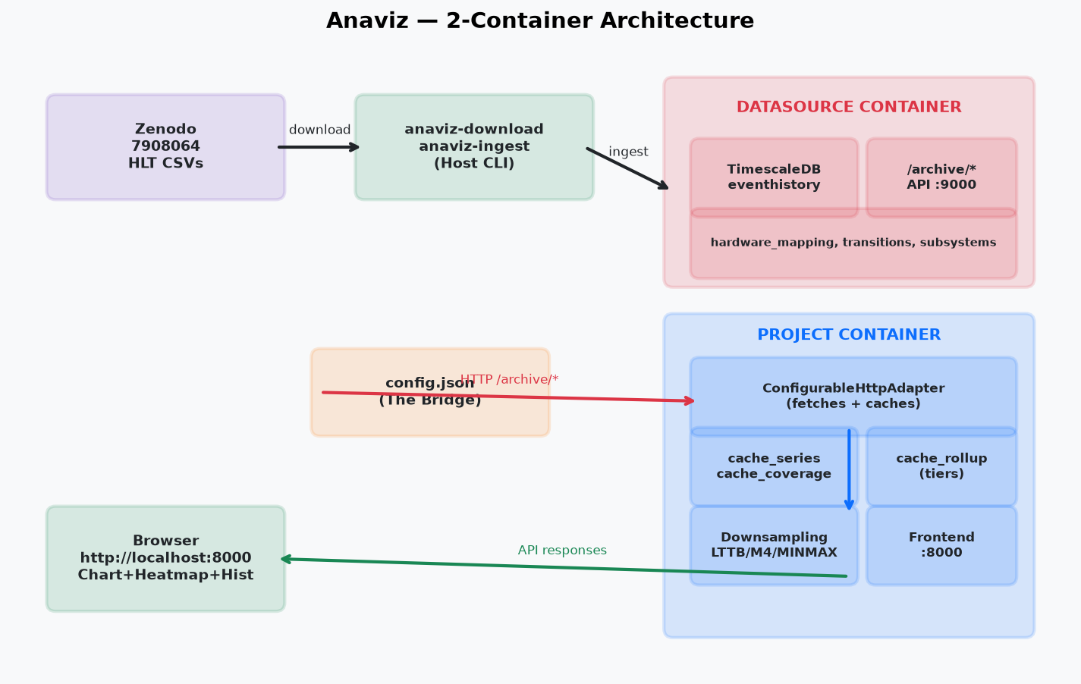
Architecture: two independent containers
ARCHITECTURE
Separate ownership protects the real dataset.
SPEAKER CUE | Datasource owns the source of truth. Project owns generic visualization and cache. They communicate over HTTP, not shared database tables.
ANAVIZ | Dataset-independent time-series visualization
4

Slide 5
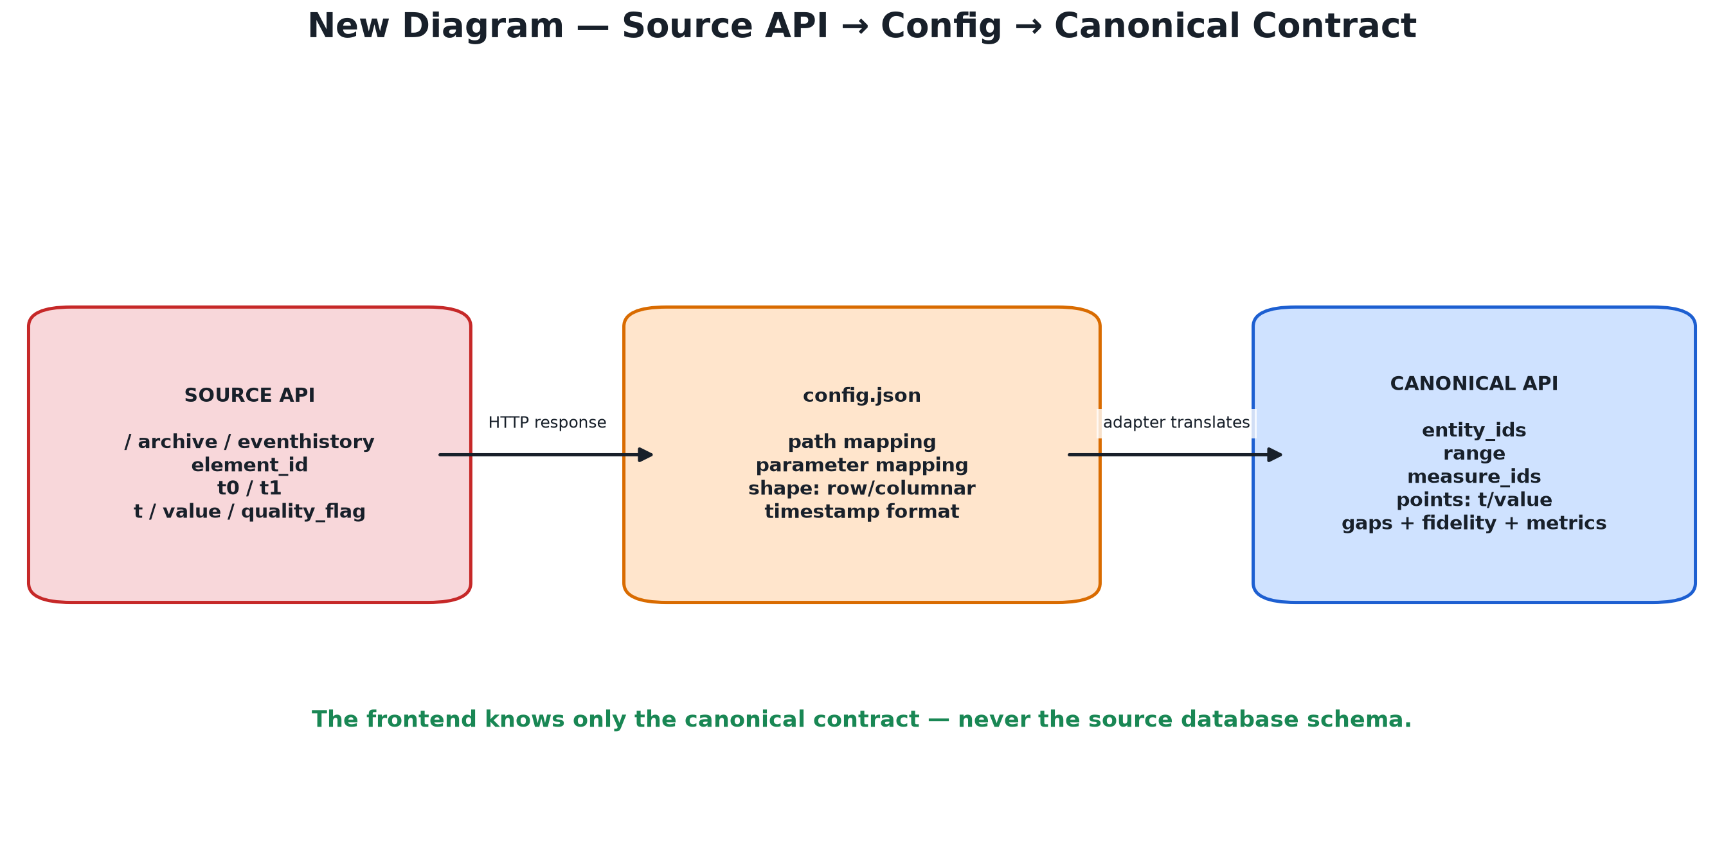
The bridge: source API → config → canonical contract
ARCHITECTURE
The frontend does not learn every source's database vocabulary.
SPEAKER CUE | The adapter translates source-specific names like element_id and quality_flag into generic entities, points, gaps, fidelity, and metrics.
ANAVIZ | Dataset-independent time-series visualization
5

Slide 6
config.json: declarative integration
CONFIGURATION
The user describes the API instead of writing a new renderer.
user config.json
Important fields
source.base_url — where to fetch
endpoints — which paths to call
mapping — where timestamp/value/quality live
pagination — how to follow pages
rollup_levels — optional bucket sizes
"source": {"base_url": "http://datasource:9000"}
"series": {
"path": "/archive/eventhistory",
"shape": "columnar",
"parameters": {
"entity": "element_id", "start": "t0", "end": "t1"
}
}
server/api/config.py
if not value.startswith(("http://", "https://")):
raise ValueError("base_url must be http(s)")
Plain English: This maps Anaviz names to the source API's paths and parameters.
Plain English: Validation rejects unsafe or unusable source URLs before registration.
SPEAKER CUE | config.json is the bridge. It is data, not executable code.
ANAVIZ | Dataset-independent time-series visualization
6

Slide 7
Canonical request and response
API
The contract keeps backend and frontend independent.
REQUEST: SeriesQuery
RESPONSE: CanonicalSeries
server/api/contracts.py
server/api/contracts.py
dataset_id
entity_ids
measure_ids
range: start / end
resolution: pixels × points
downsampling: M4 / LTTB / RAW
points: t / value / min / max
gaps
quality_summary
fidelity
metrics: source / scanned / returned
Plain English: The browser describes what it wants; it does not choose SQL.
Plain English: The result explains both the values and how they were produced.
SPEAKER CUE | This is the central abstraction: source-specific data enters, canonical evidence leaves.
ANAVIZ | Dataset-independent time-series visualization
7

Slide 8
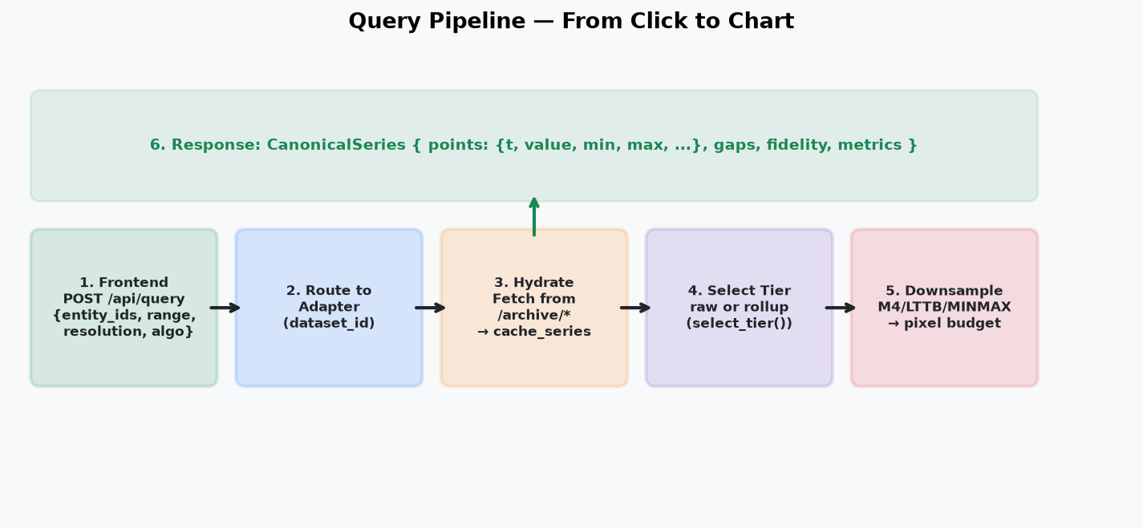
Query pipeline: from click to chart
QUERY
One user action triggers a controlled six-stage flow.
SPEAKER CUE | Hydrate only missing ranges, select a suitable tier, downsample to the pixel budget, and return fidelity metadata.
ANAVIZ | Dataset-independent time-series visualization
8

Slide 9
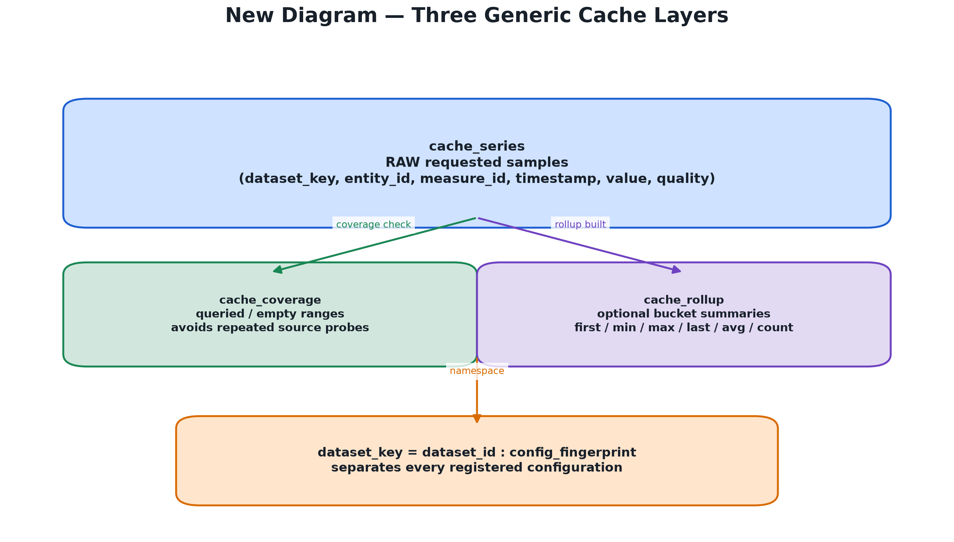
Hydration: fetch only what is missing
CACHE
The first query may be slower; later queries reuse the project cache.
server/api/configurable.py
covered = await cache.coverage(entity, measure, start, end)
gaps = coverage_gaps(start, end, covered)
for a, b in gaps:
rows = await fetch_source(a, b)
await cache.store(entity, measure, rows)
Plain English: Coverage tells the adapter which portions have already been checked. Only uncovered portions go back to the source.
SPEAKER CUE | cache_series stores samples; cache_coverage avoids repeated probes; cache_rollup stores optional summaries. dataset_key isolates configurations.
ANAVIZ | Dataset-independent time-series visualization
9

Slide 10
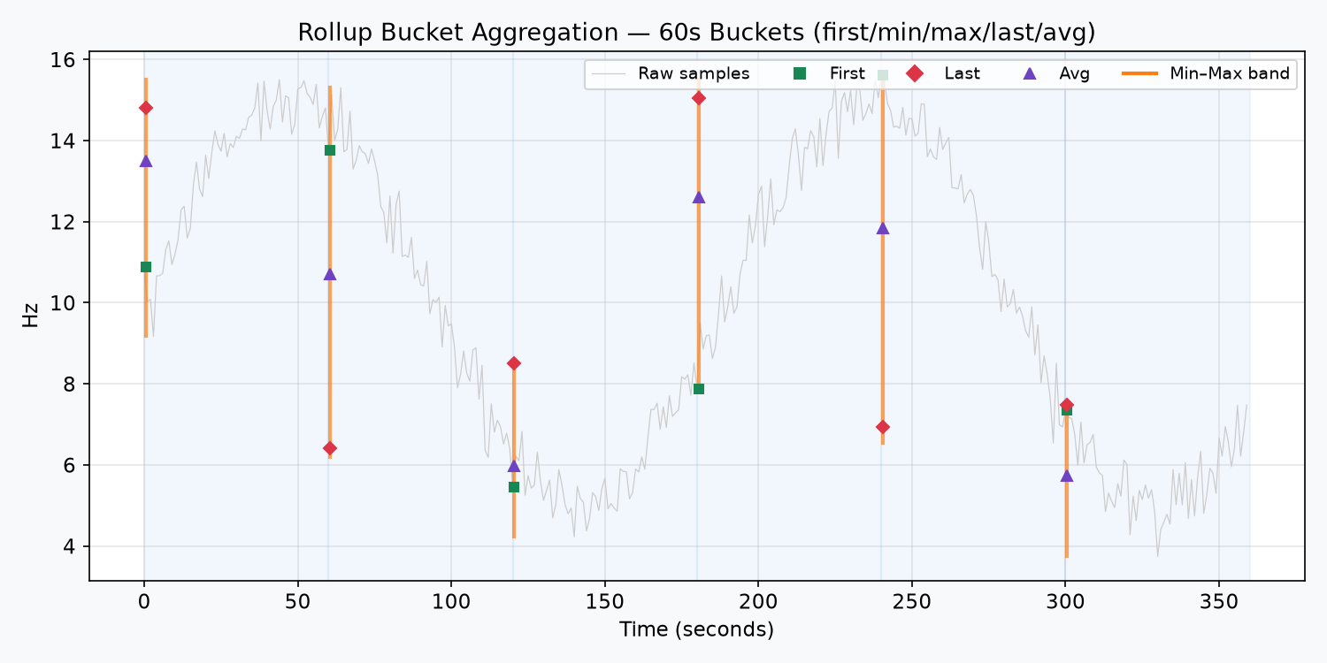
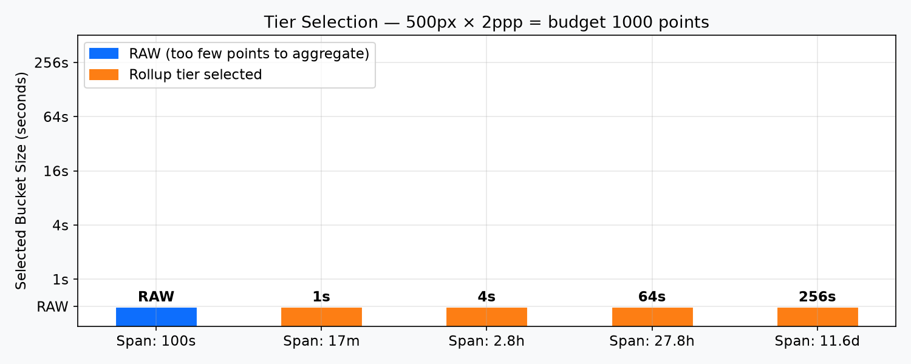
Rollup tiers: less data, same important evidence
PERFORMANCE
Rollups are explicit and opt-in.
SPEAKER CUE | A bucket keeps first, min, max, last, average, count, and quality. Short spans stay raw; large spans use coarser configured tiers.
ANAVIZ | Dataset-independent time-series visualization
10

Slide 11
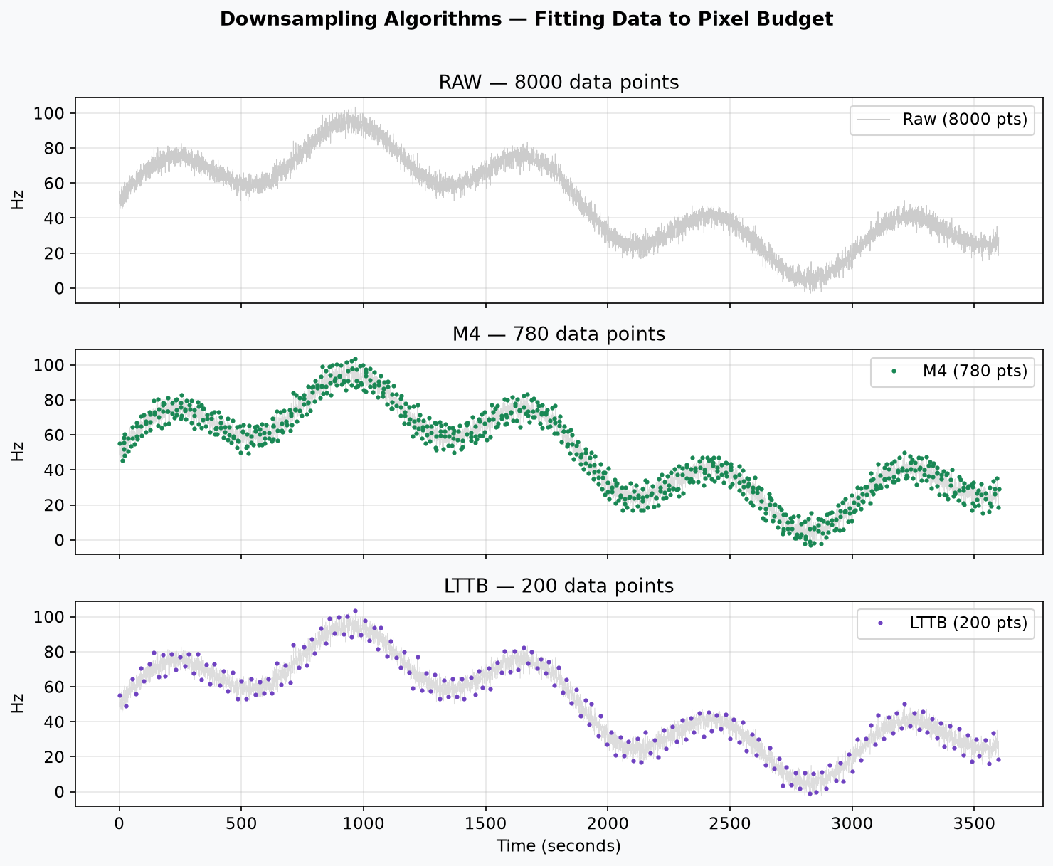
Downsampling: fit the screen, preserve the shape
PERFORMANCE
The point budget comes from pixels, not an arbitrary number.
Algorithms
RAW — exact selected points
M4 — first/min/max/last
LTTB — shape-aware selection
MINMAXLTTB — shape + extrema
server/downsample/__init__.py
budget = pixel_width * points_per_pixel
if algo == "RAW": return payload
if algo == "M4": return m4_series(...)
if algo == "LTTB": return lttb_indices(...)
Plain English: Only the display response is reduced; raw cache rows remain available.
SPEAKER CUE | With 1,000 pixels and 2 points per pixel, the target is about 2,000 display points.
ANAVIZ | Dataset-independent time-series visualization
11

Slide 12
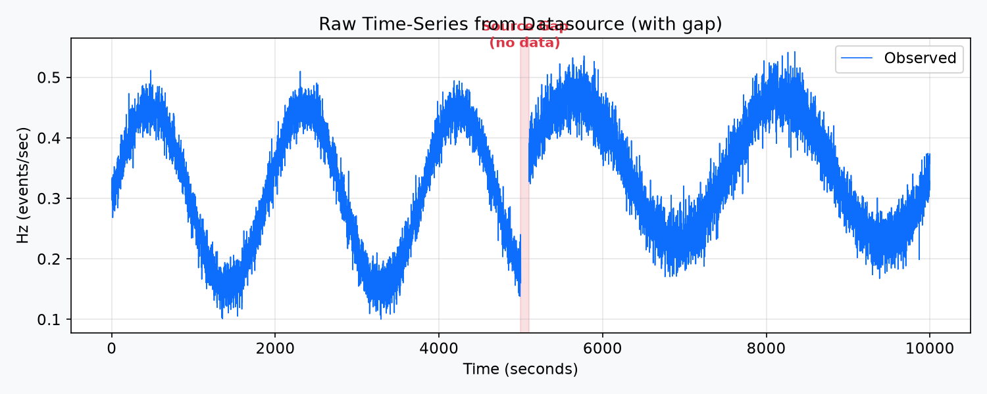
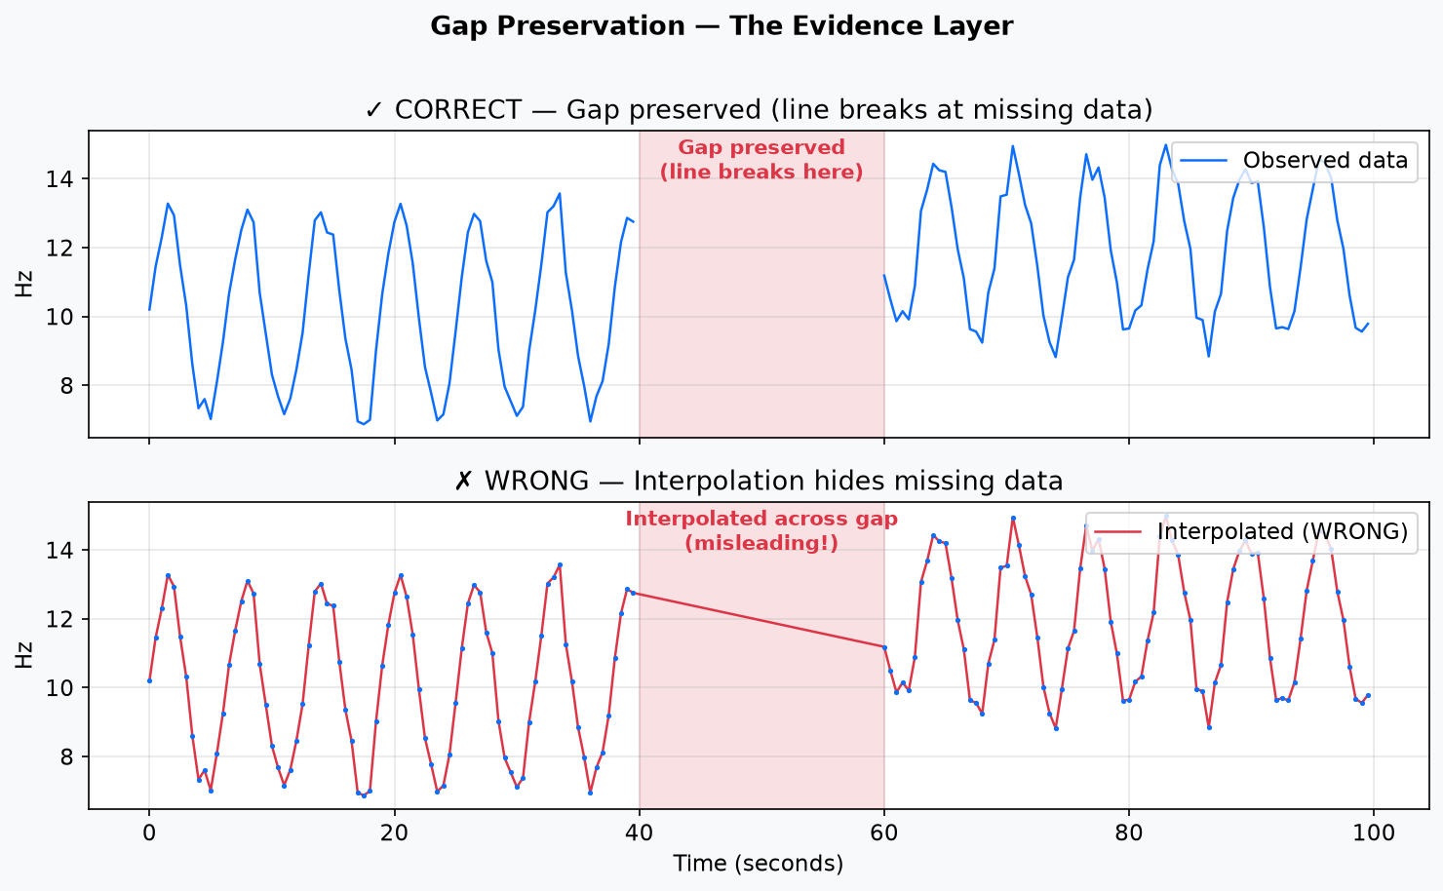
Gap preservation: missing data is evidence
FIDELITY
Anaviz does not draw a false line through an unobserved interval.
server/api/common.py + frontend/utils.js
if timestamp_gap > threshold:
gaps.append([start, end])
if in_gap:
value = null
Plain English: The backend declares the gap; the frontend inserts null so the line breaks.
SPEAKER CUE | Missing is not zero. The tooltip and visible break tell the operator that the source had no observation.
ANAVIZ | Dataset-independent time-series visualization
12

Slide 13
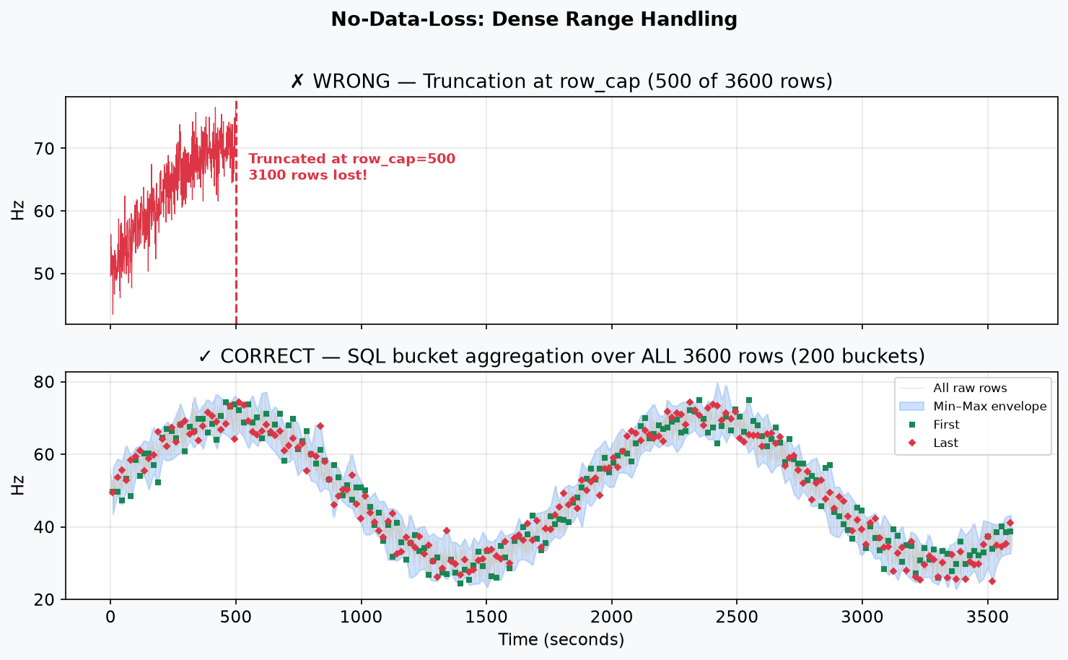
Dense ranges: no silent truncation
FIDELITY
row_cap triggers aggregation, not an early chart stop.
server/api/configurable.py — dense path
if total > row_cap:
bucket_s = span_seconds / pixel_budget
data = read_bucketed(bucket_s)
# SQL uses min, max, avg, count, first, last
Plain English: Every cached row contributes to a pixel-sized bucket; the rendered response still preserves the full time range and extrema.
Raw rows remain in cache_series.
The chart receives a faithful summary, not a truncated prefix.
SPEAKER CUE | The important distinction: not every raw row is drawn individually, but no part of the requested range is silently thrown away.
ANAVIZ | Dataset-independent time-series visualization
13

Slide 14
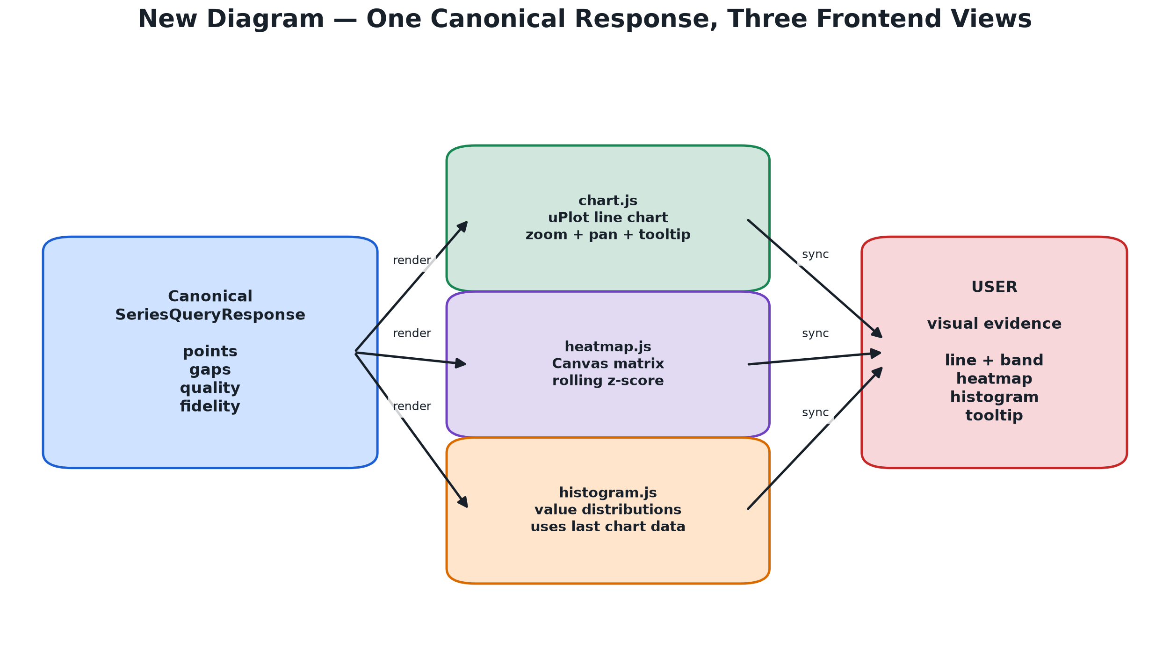
One response, three coordinated frontend views
FRONTEND
The canonical response feeds chart, heatmap, and histogram.
SPEAKER CUE | chart.js shows time and bands; heatmap.js shows abnormality by entity and time; histogram.js shows value distributions from already-fetched data.
ANAVIZ | Dataset-independent time-series visualization
14

Slide 15
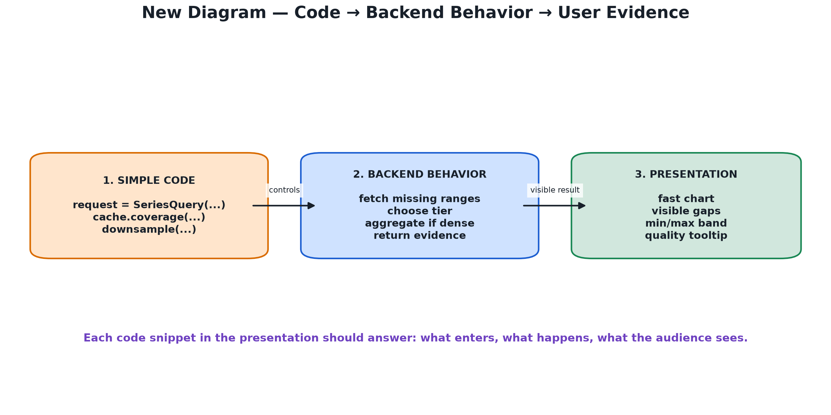
How to explain code snippets
PRESENTATION
Always connect code to behavior and to what the audience sees.
SPEAKER CUE | For every snippet answer three questions: what enters, what happens, and what does the user see?
ANAVIZ | Dataset-independent time-series visualization
15

Slide 16
Where the important code lives
CODE MAP
Use this slide if someone asks for implementation details.
BACKEND
DATASOURCE + FRONTEND
• server/app.py — routes and adapter registry
• server/api/config.py — config validation/fingerprint
• server/api/contracts.py — canonical models
• server/api/configurable.py — fetch/cache/query/fidelity
• server/api/common.py — gaps/coverage/matrix math
• server/downsample/ — rollups and algorithms
• db/cache_schema.sql — generic cache tables
• datasource/ingest_hlt.py — CSV to source DB
• datasource/archive_server.py — /archive/* HTTP API
• frontend/app.js — state and API calls
• frontend/chart.js — uPlot chart and tooltip
• frontend/heatmap.js — Canvas matrix
• frontend/histogram.js — distributions
• frontend/utils.js — alignment and gap nulls
SPEAKER CUE | The generic project never imports the HLT-specific datasource package; HTTP plus config is the boundary.
ANAVIZ | Dataset-independent time-series visualization
16

Slide 17
The five guarantees to remember
CONCLUSION
These are the strongest claims in the presentation.
1
Dataset independent
Any HTTP time-series API can be described by config.json.
2
Source isolated
Datasource and project cache are separate owners.
3
No false gaps
Missing data remains missing and visible.
4
No silent truncation
Dense ranges use full SQL bucket aggregation.
5
Evidence returned
Quality, counts, resolution, fidelity, and metrics travel with the series.
SPEAKER CUE | The project is not only fast; it is designed to make the result explainable and honest.
ANAVIZ | Dataset-independent time-series visualization
17

Slide 18
Thank you
Anaviz turns arbitrary HTTP time-series data into an evidence-aware visualization.
Questions?
Key closing line: The HLT dataset demonstrates the system, but config.json makes the architecture reusable.
ANAVIZ | Presentation deck

