Slide 1
DPS and coordinated muting
Pranav Sakulkar

Slide 2
Contents
Introduction
Motivation for CoMP
Techniques for cell-edge rate improvement
Dynamic point selection (DPS)
Coordinated muting
How to optimally combine the two?
Simulation results
Conclusion

Slide 3
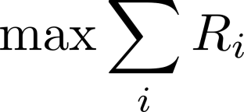

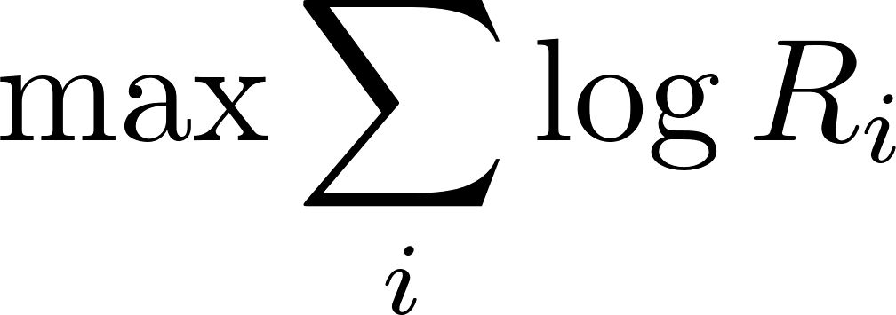
Introduction
Every cell serves its users by allocating various resource blocks to them over time
Schedulers have different objectives
Max-rate scheduler
Max-min fair scheduler
Equal rates for all the users
Proportionally fair (PF) scheduler
Equi-partition of time and resource blocks

Slide 4
Motivation
Cell-edge users have higher path loss than the cell-centre users and hence lower signal strengths
Proximity to neighboring cells causes higher interference
Lower SINR values imply lower rates
Cell-edge users form a bottleneck
To improve the cell-edge performance
DPS
Coordinated muting

Slide 5
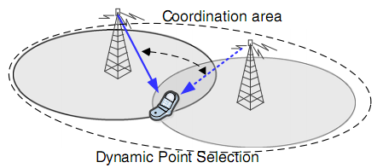
Dynamic Point Selection
Cell-edge user could be served by a neighboring cell if that channel is better
Heavily loaded cell can offload some cell-edge users to its neighbor

Slide 6
Coordinated Muting
Muting the neighboring cell removes the dominant interferer and boosts SINR
Improvement in rates is higher for edge users
Lightly loaded can be muted often for fairness across cells
Muting patterns could be different for different resource blocks (RB)

Slide 7
Comparison of Schedulers

Slide 8
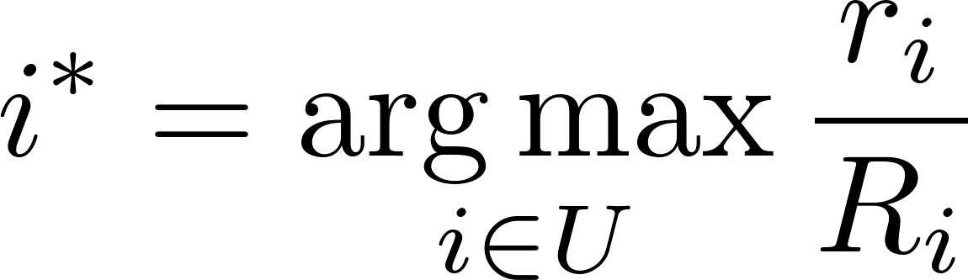





Non-CoMP system
No coordination among cells
Independent proportionally fair (PF) schedulers
Scheduled user is
Here
is the scheduled user
is the set of all users in the cell
and are the instantaneous and average rates of user

Slide 9
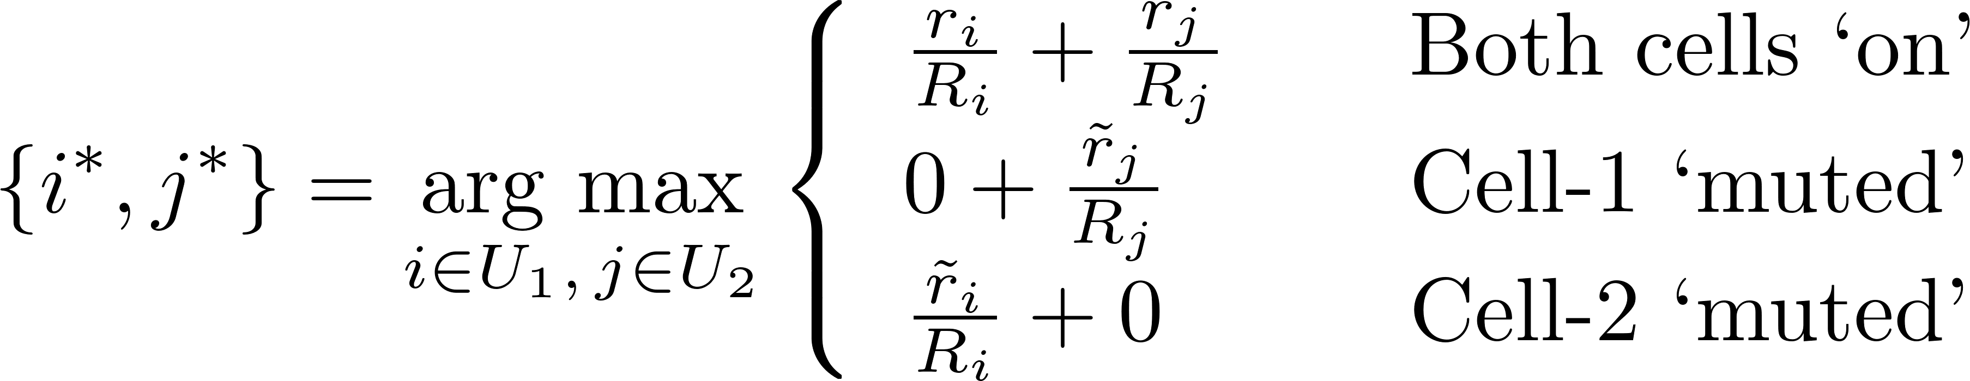


Coordinated Muting
Muting decision and the scheduling decision are taken simultaneously
For scheduling two coordinating cells, the joint PF scheduler-
Here
and are the boosted instantaneous rates due to muting of the other cell

Slide 10
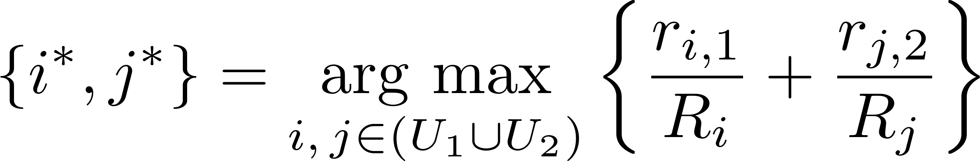
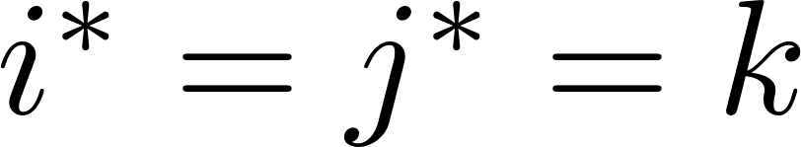
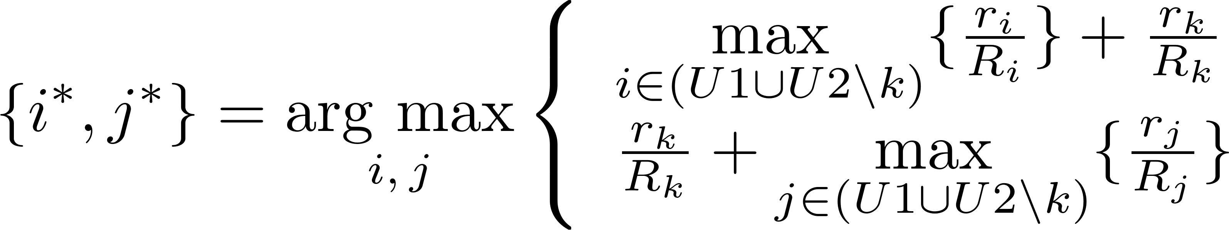
DPS
User association and the scheduling decisions are taken simultaneously at every TTI
The 2-cell joint PF scheduler:
When , conflict is resolved as follows:

Slide 11
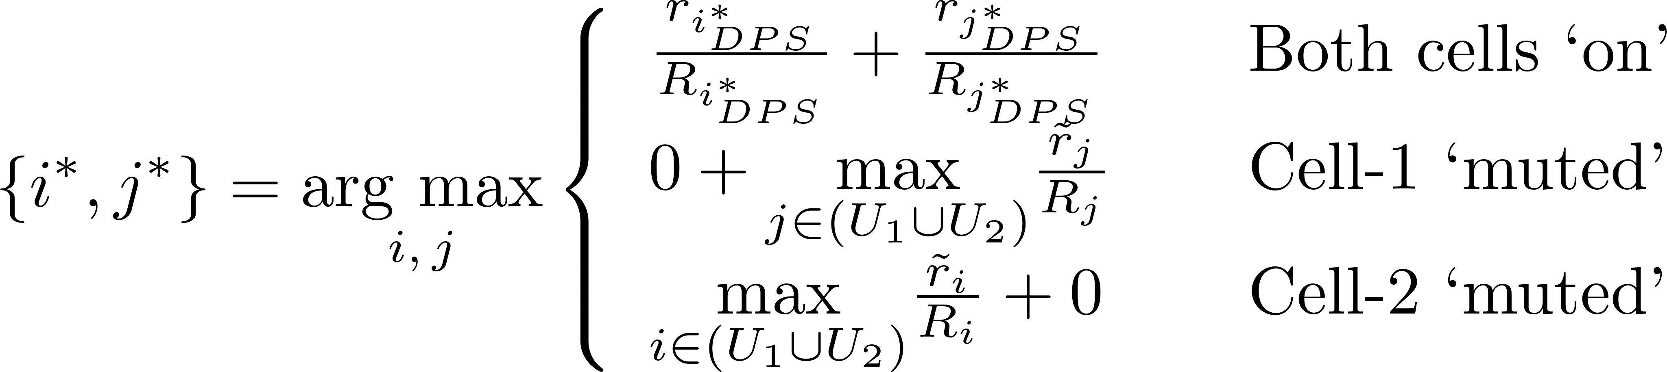
DPS with Coordinated Muting
User association, muting and scheduling decisions taken all at once
Joint scheduler is:

Slide 12
Simulation Parameters
Parameter | Value
Cells | 19
ISD | 500 m
Noise PSD | -174 dBm/Hz
Tx power | 46 dBm
Channel realizations | 1000
User drops | 50
Path loss model (dB) | 128.1 + 37.6 * log(d (km))

Slide 13
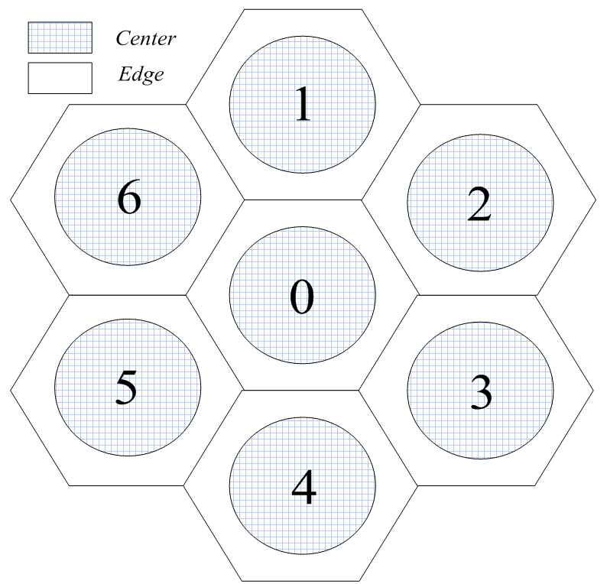
Cluster Design
19 cell cluster consisting of
Tier-0: 1 cell
Tier-I: 6 cells
Tier-II: 12 cells
Rates analyzed for tier-0 and tier-I cells
Tier-II cells used for modeling interference

Slide 14
Case 1 - Imbalanced Load
0th cell
10 centre users
4 edge users
Tier-I and tier-II cells
10 centre users

Slide 15
Average Rates
Assigning the RBs according to max-PF criterion and not the max-rate criterion decreases average rate
2.2% decrease from static to DPS with muting

Slide 16
Cell Edge User Rates
Improved rates for the intended beneficiaries, i.e. the cell-edge users
43.3% improvement in rate for the cell-edge users

Slide 17
Geometric Mean of the Rates
Maximization of the geometric mean (GM) of the rates is equivalent to maximization of sum-PF metric
Muting techniques benefit from the rate-boosts in tier-II cells

Slide 18
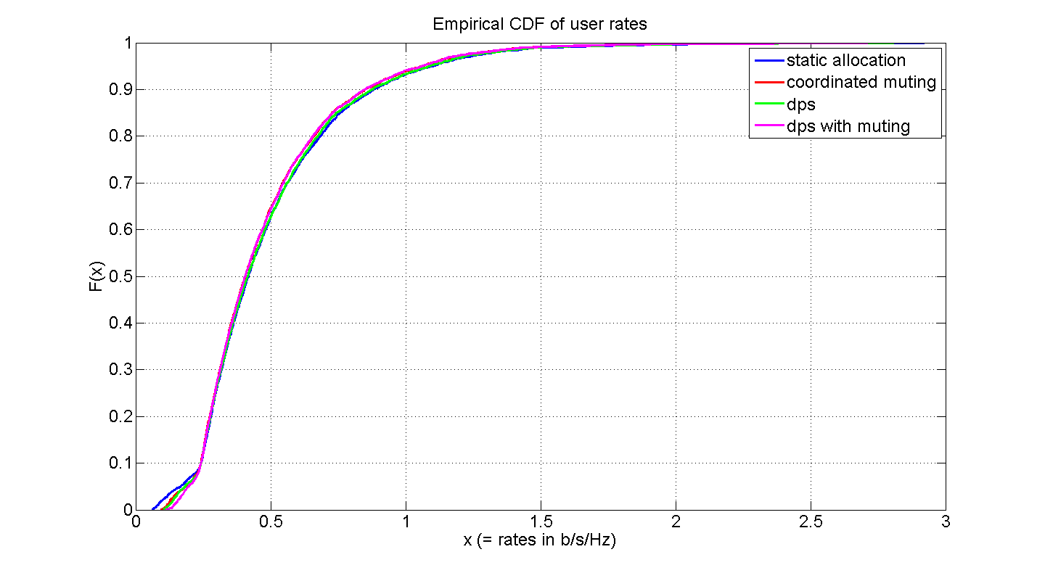
Empirical CDFs
Low-rate users are critical
Any improvement in rate for these users is significant

Slide 19
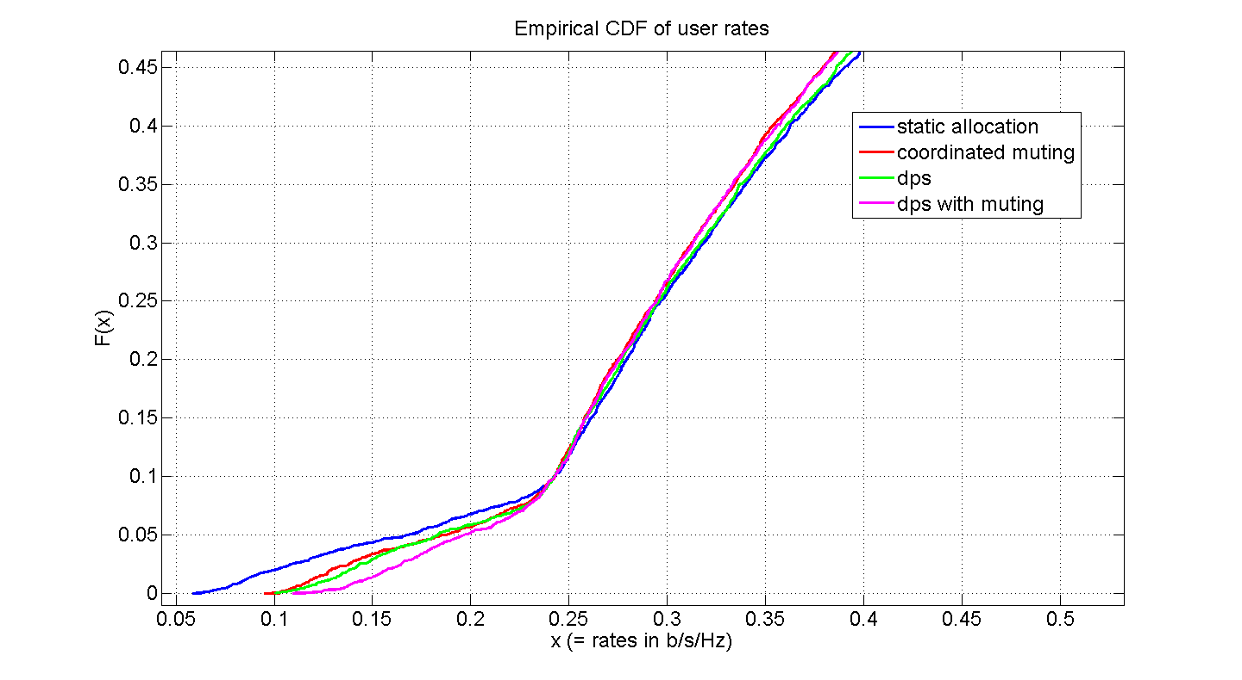
Empirical CDFs - Zoomed

Slide 20
Case 2 - Balanced Load
All Cells have
10 centre users
4 edge users

Slide 21
Average Rates
DPS benefits from contributions from tier-II cells
1.8% decrease from static to DPS with muting

Slide 22
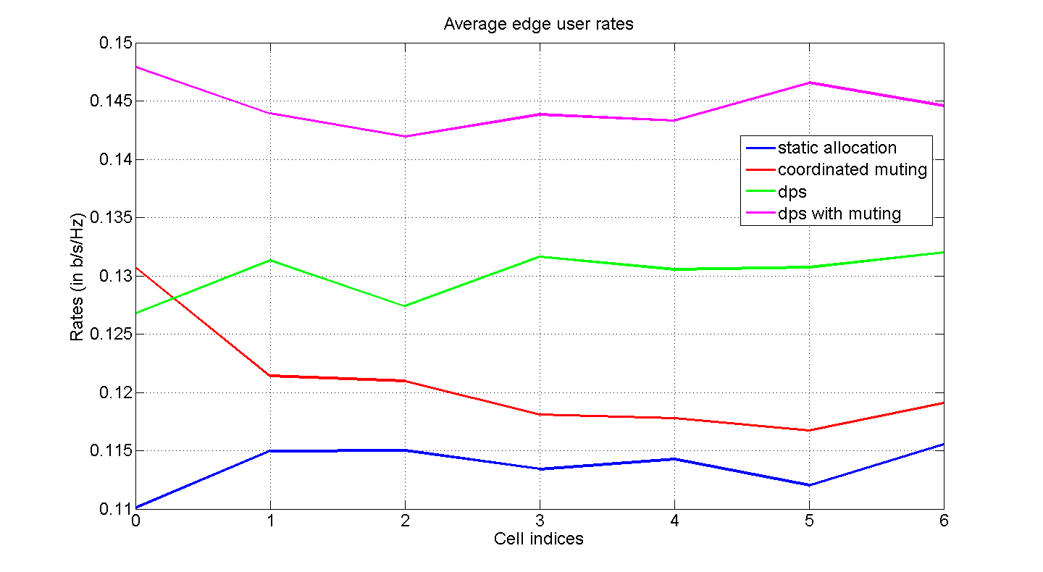
Cell Edge User Rates
Increase in cell-edge rates seen for all the cells

Slide 23
Cell Edge User Rates
27.3 % increase from static to DPS with muting

Slide 24
Geometric Mean of the Rates
5.5 % increase from static to DPS with muting

Slide 25
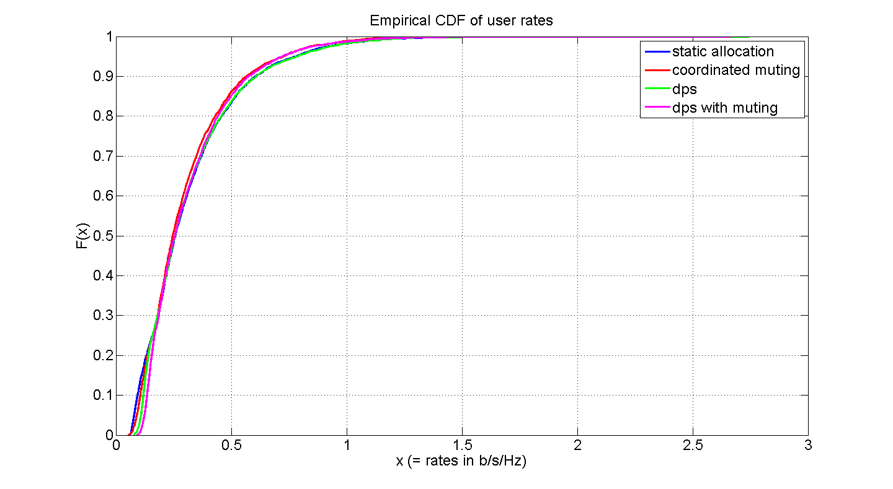
Empirical CDFs
Improvement in the rates in the critical region
Gains not pronounced due to edge-users in all cells

Slide 26
Conclusion
DPS and coordinated muting independently improve the cell-edge user rates substantially
DPS and muting can be combined to improve the cell-edge rates further
Gains for joint scheme are still less than the sum of the individual gains

Slide 27
Questions?

Slide 28
Backup Slides

Slide 29
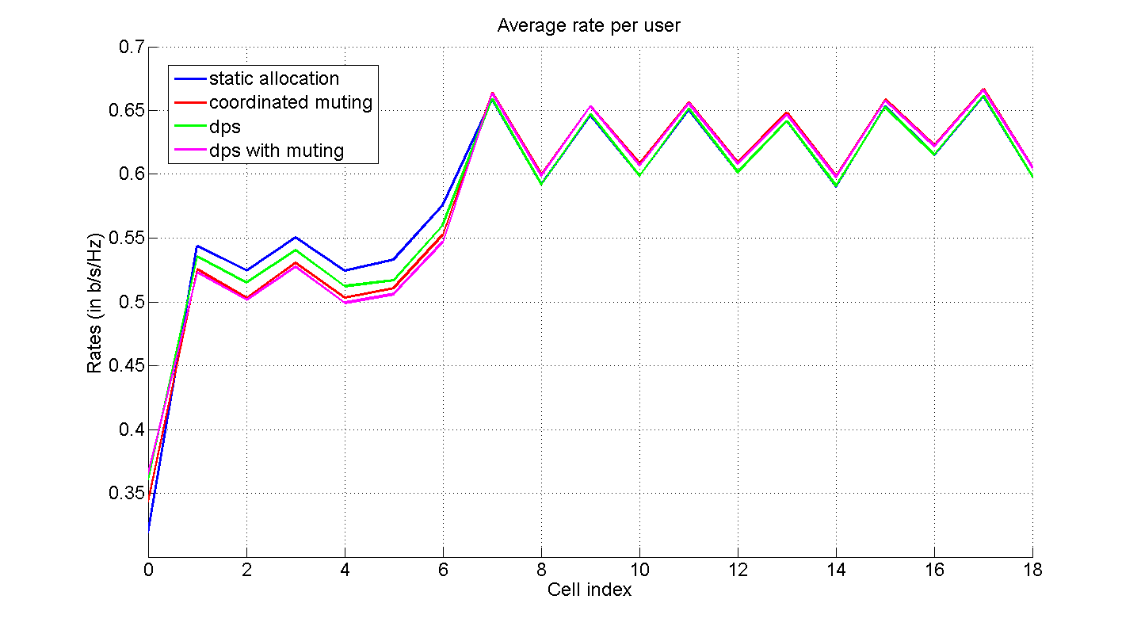
Case 1

Slide 30
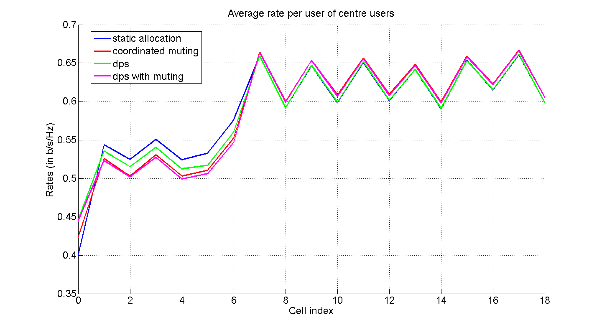
Case 1

Slide 31
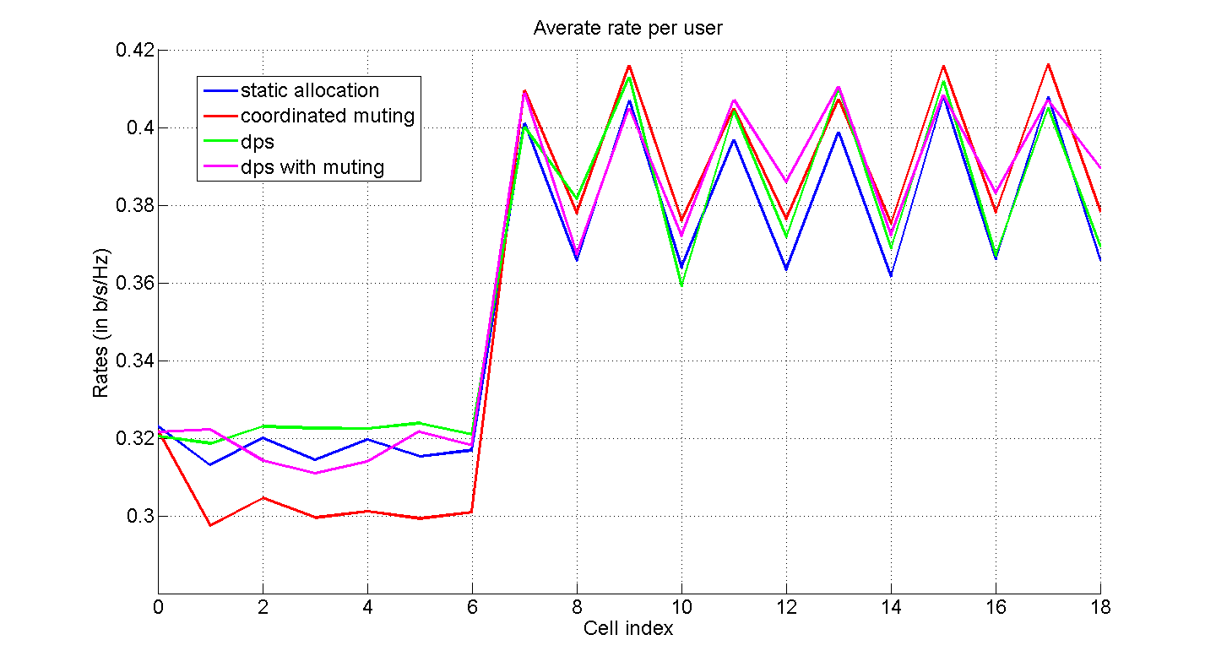
Case 2

Slide 32
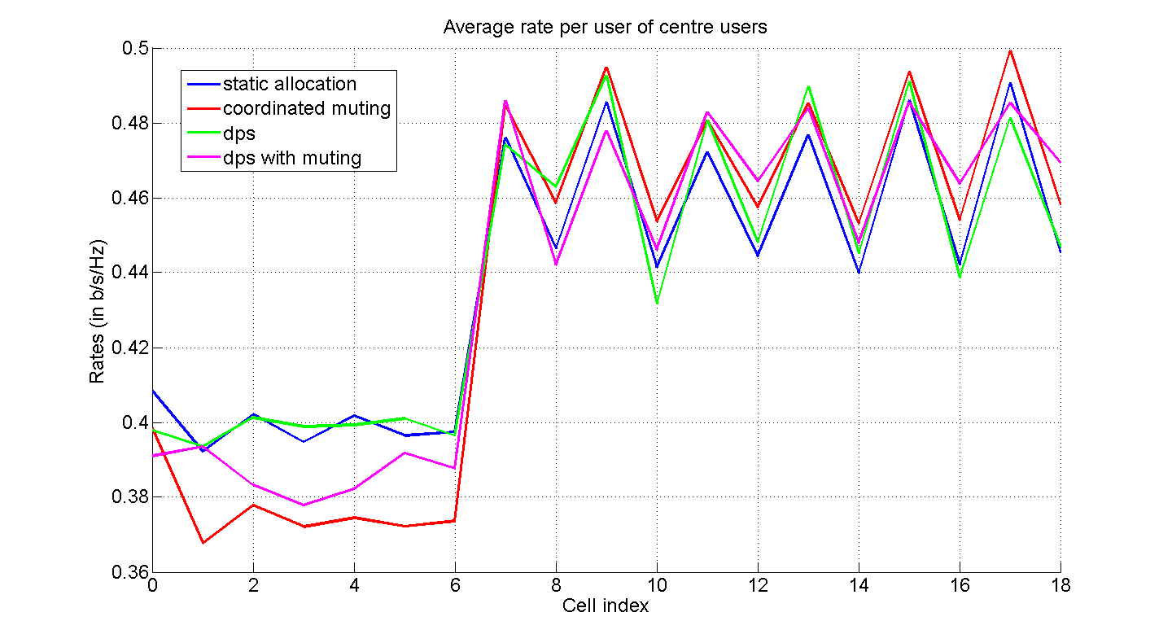
Case 2

