Slide 1

Geometry in Style
3D Stylization via Surface Normal Deformation
Nam Anh Dinh, Itai Lang, Hyunwoo Kim, Oded Stein, Rana Hanocka
CVPR 2025 • University of Chicago • University of Southern California

Slide 2
Research Overview
01
The Challenge & Core Idea
04
dARAP Technology
Fundamental trade-offs in 3D deformation.
Revolutionary differentiable deformation layer.
02
Method Overview
05
Versatility & Robustness
Complete optimization pipeline.
Cross-category and cross-style performance.
03
Core Method
06
Comparison & Conclusions
Surface normal representation.
Performance analysis and impact.

Slide 3
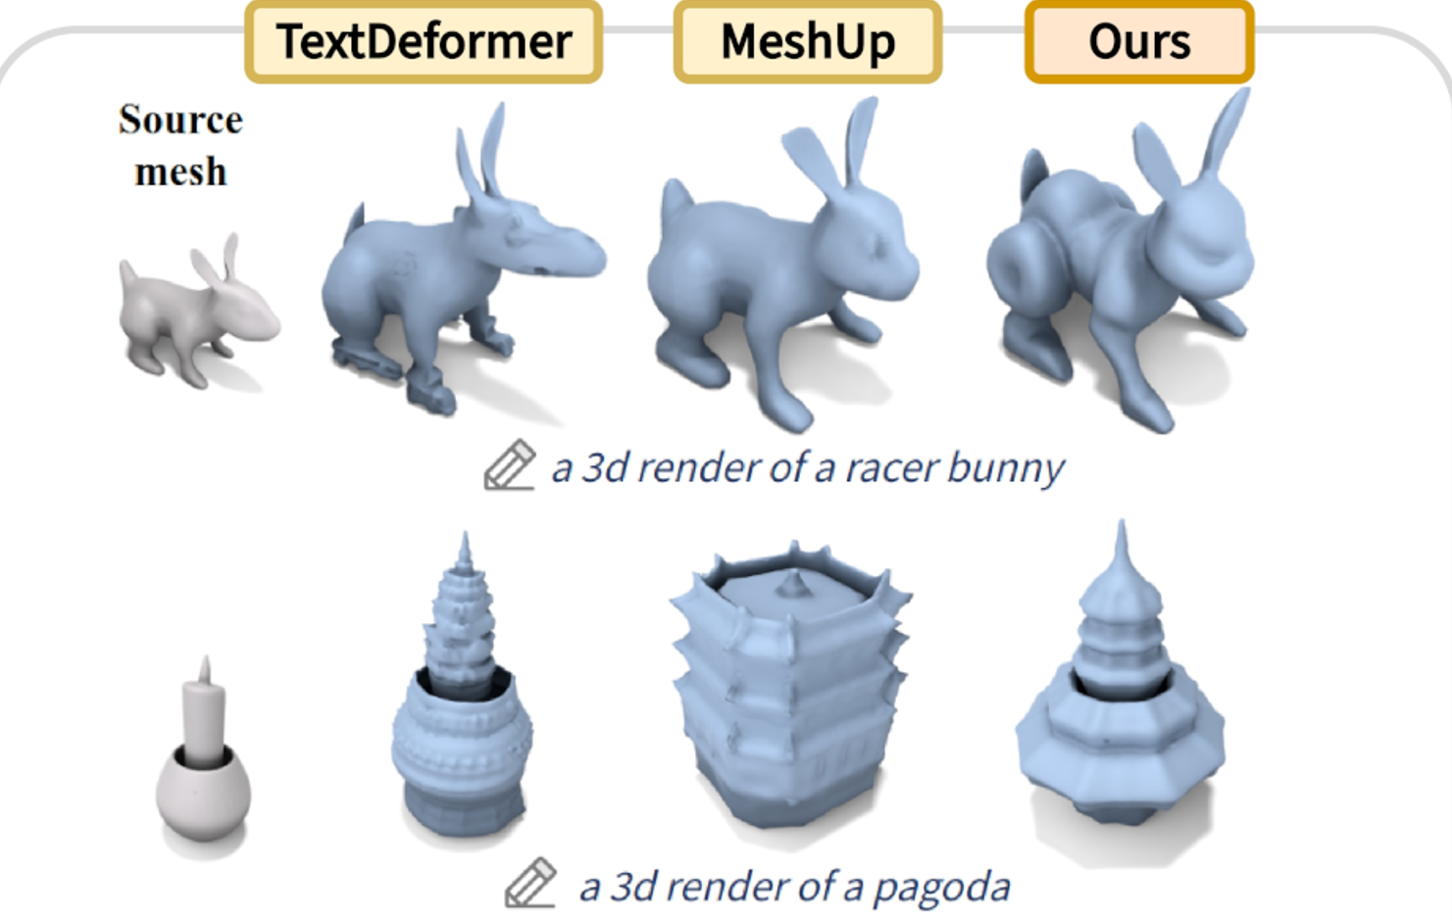
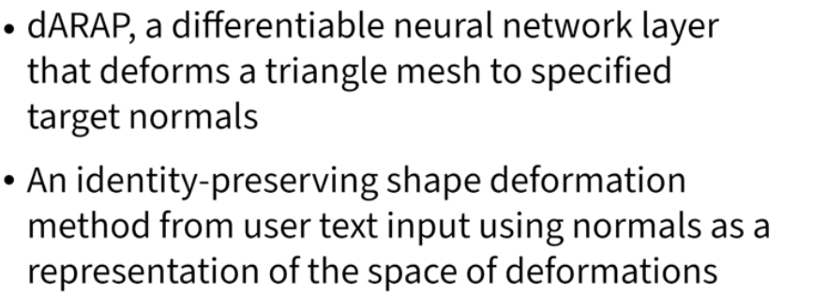
The Challenge & Our Core Idea
Existing Challenges
Key idea：
Current text-guided 3D deformation faces a critical challenge: balancing expressiveness and fidelity(表达力和表真度). Existing methods either apply overly restrictive deformations or destroy the original shape's identity.
Instead of directly moving vertices, we optimize surface normals to define deformation—expressive enough for detailed stylizations, yet restrictive enough to preserve shape identity.

Slide 4
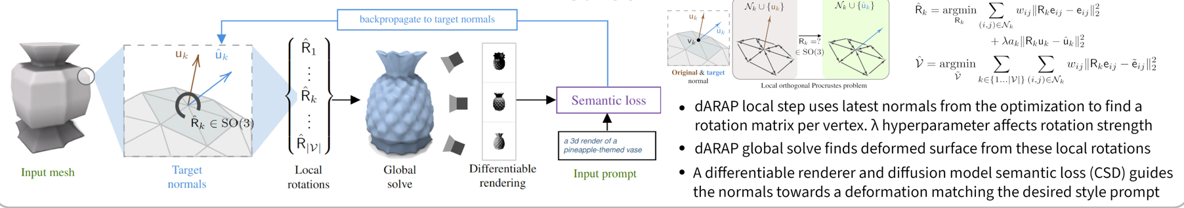
Method Overview
1
Initialize
2
Deform
3
Render
4
Optimize
Start with input mesh and initialize target normals for each vertex neighborhood.
Feed normals into dARAP layer to compute rotations and solve for deformed mesh.
Render deformed mesh from multiple views using differentiable renderer.
Compute semantic loss against text prompts and update target normals via backpropagation.

Slide 5
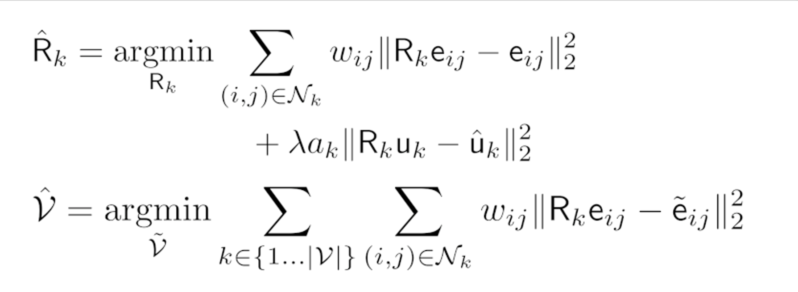
TECHNOLOGY
Key Technology: The dARAP Layer
L
Local Step
G
Global Step
Computes optimal rotations for each vertex neighborhood to align with target normals.
Integrates all local rotations into a coherent global deformation via linear system solve.
Benefits:
Benefits:
• Preserves local rigidity • Prevents stretching • Maintains surface details
• Seamless integration • Global consistency • Single-step efficiency

Slide 6
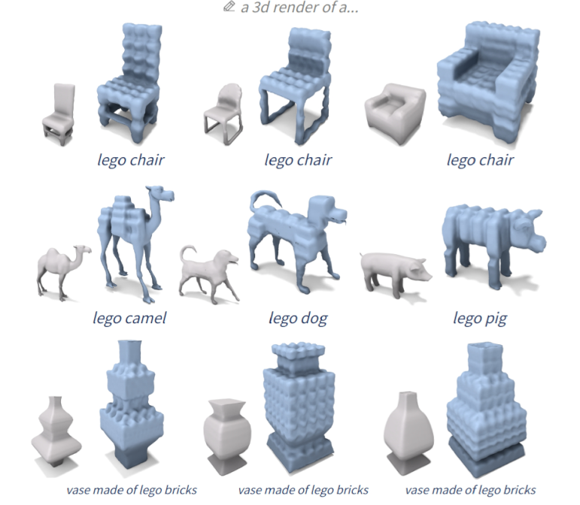
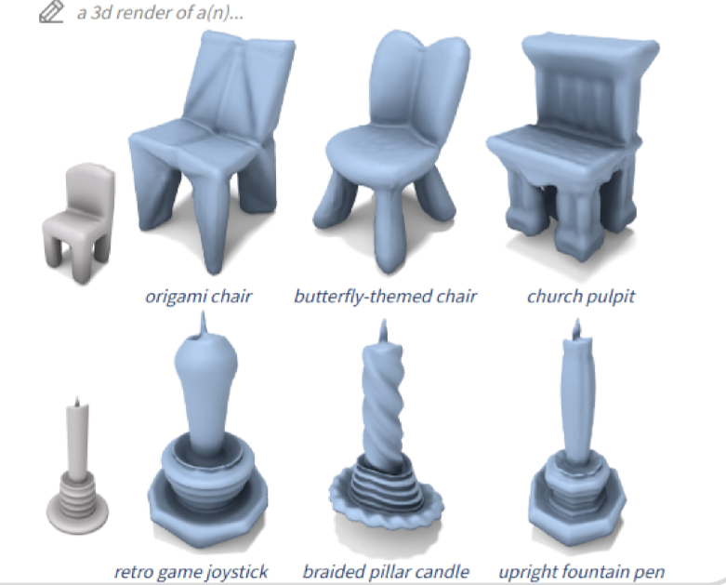
RESULTS
Versatility & Robustness
Same Shape, Different Styles
Different Shapes, Same Style

Slide 7
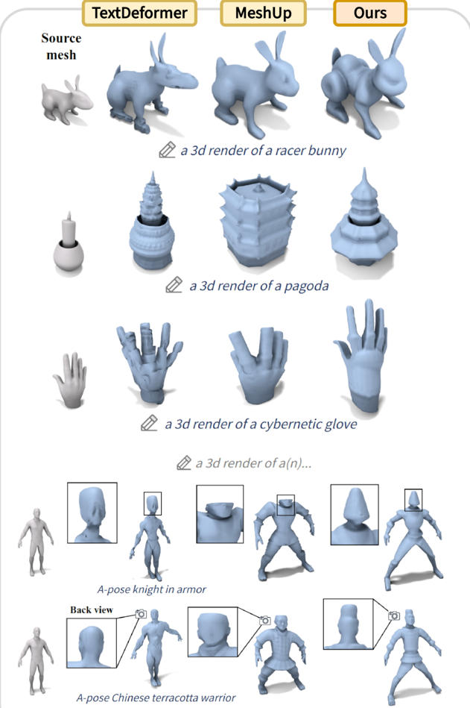
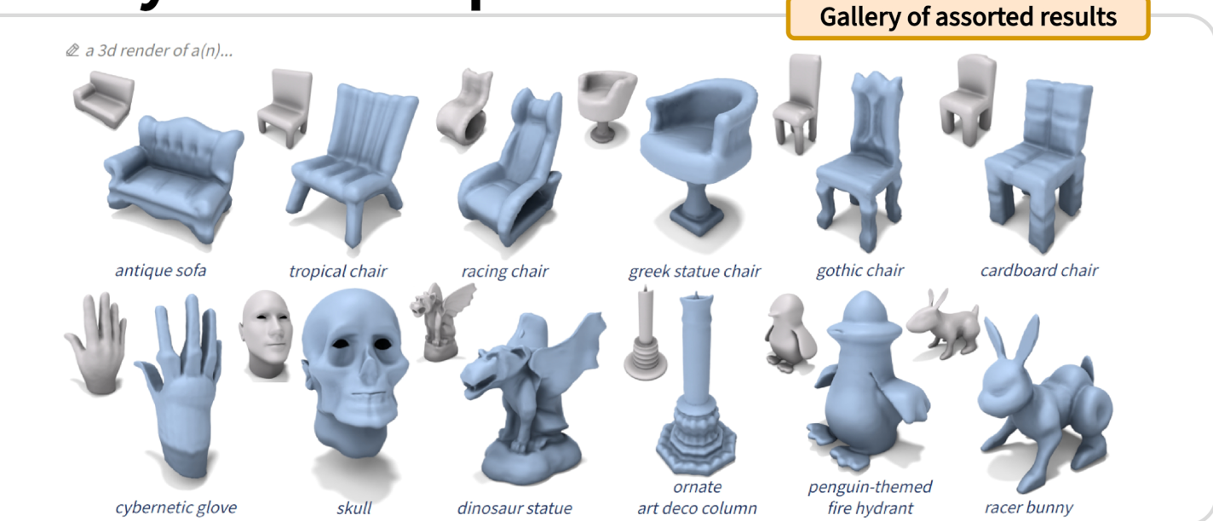
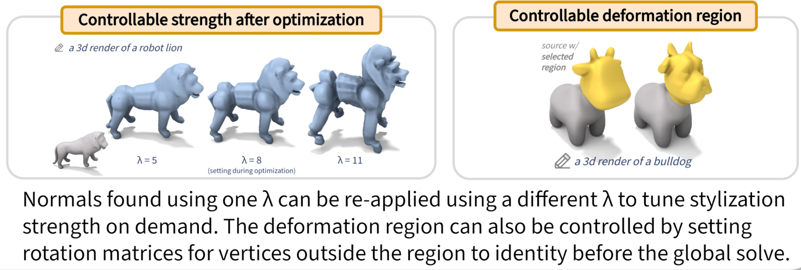
EVALUATION
Comparison & Controllability
Comparison & Controllability

Slide 8
IMPACT
A New Paradigm
Geometry in Style introduces a paradigm shift in 3D stylization through normal-based deformation and the differentiable dARAP layer, achieving high-quality, controllable, and robust text-guided geometric deformations.
Novel Representation
dARAP Layer
Creative Control
Surface normal-based deformation
Differentiable, efficient deformation
High-quality, controllable results
This work opens new possibilities for creative 3D content generation and establishes a foundation for future research.

