Slide 1
Data Analysis of client network usage in August and September 2015
Botagoz Mukatova
27/06/2017

Slide 2
Content:
Data Overview
Total Revenue
Data Revenue and Traffic
Voice Revenue and Usage
Client/Service Activation Information
Conclusion

Slide 3
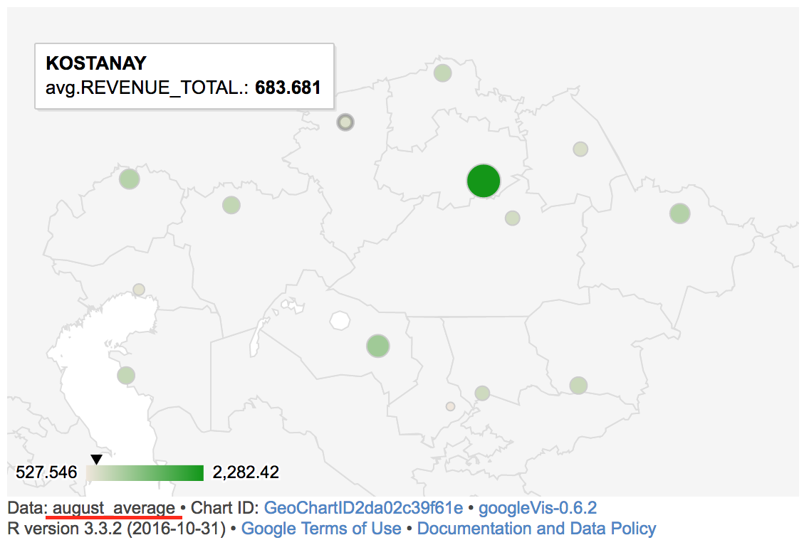
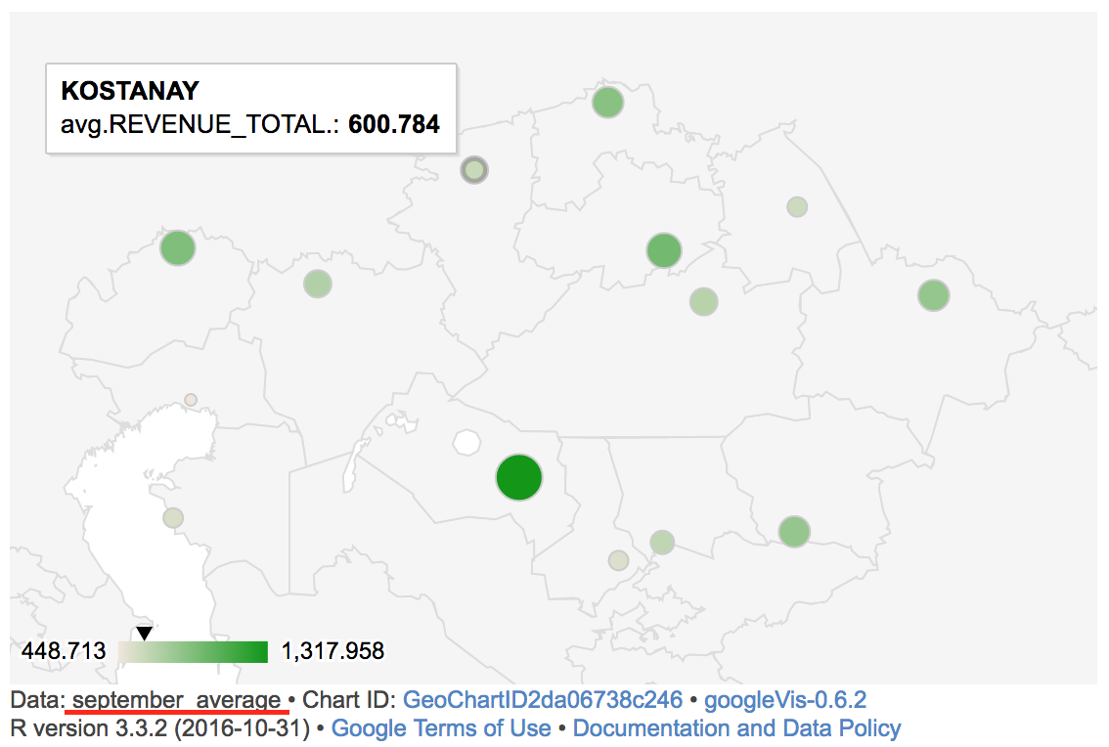
Data Overview
14 regions are covered;
Average Total Revenue per Region varies from August to September 2015;
Notes:
For more closer look refer:
August average: http://127.0.0.1:13961/custom/googleVis/MergedID2da046acbb24.html
September average: http://127.0.0.1:13961/custom/googleVis/MergedID2da03ba764d.html

Slide 4
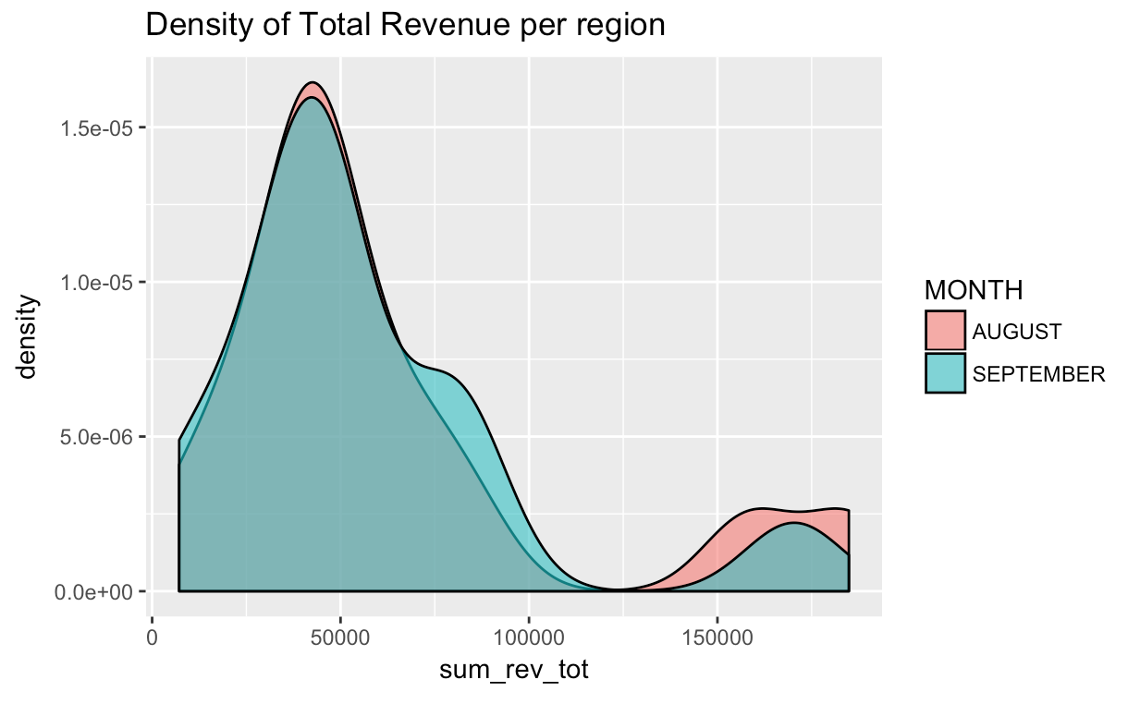
Distribution of Total Revenue per Region
Notes:
* Each region spends about similar
* However, higher expenditure (above 125000) is visible in August

Slide 5
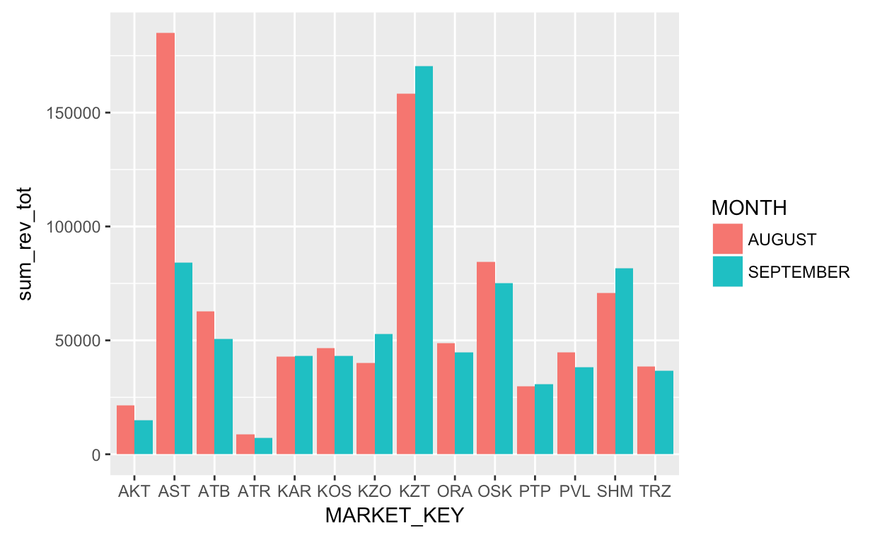
Total Revenue for each Region in each month
Notes:
*Higher spending is noticeable in AST region in August

Slide 6
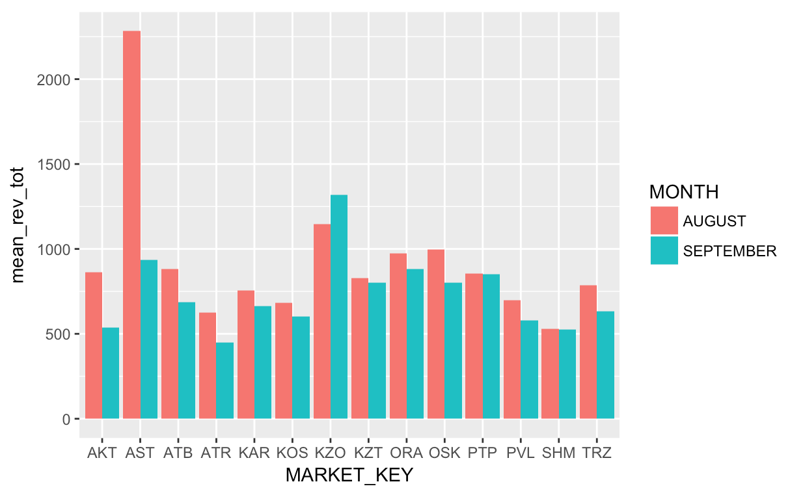
Total Revenue mean for each Region in each month
Notes:
* Average data also shows that AST region brings higher revenue in August

Slide 7
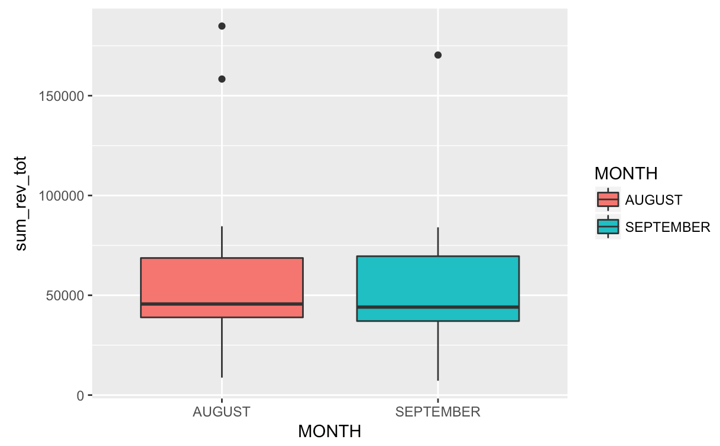
Total Revenue summary
Notes:
Distribution of total revenue is very similar, except 2 high revenues in August and 1 high revenue in September by regions.
We can consider 3 points over 150000 as outliers.

Slide 8
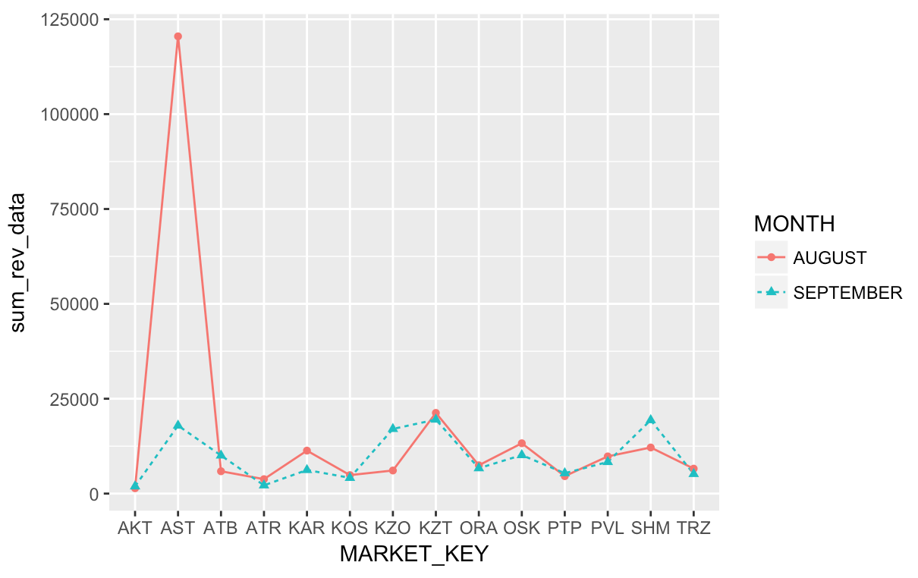
Total Data Revenue
Notes:
All regions, except AST shows similar revenue from Data and especially in August.
Very high Revenue from Data usage can be accidental, since only sample data (about 1000 rows) is being used. Also, high data revenue only is seen in August.

Slide 9
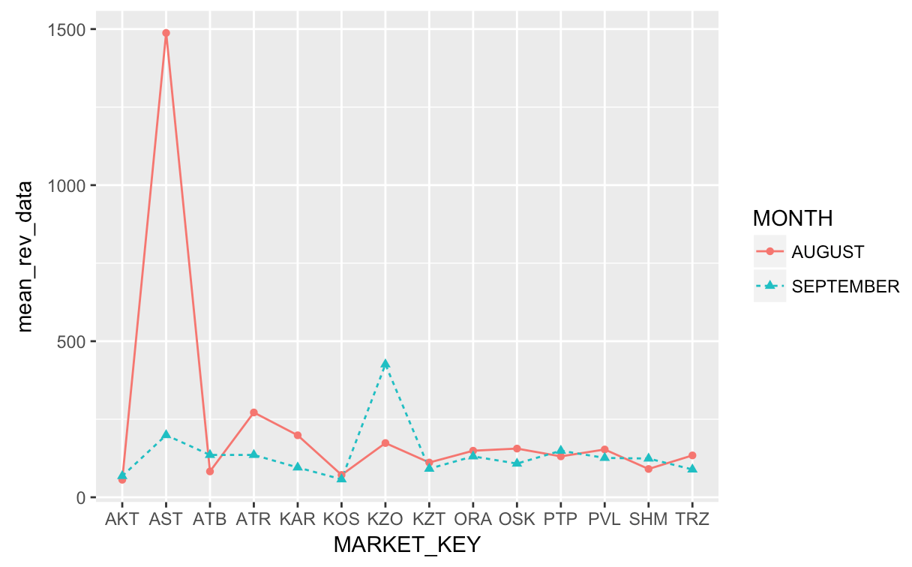
Average Data Revenue
Notes:
* Average data also shows that AST is the major region to bring revenue from Data.

Slide 10
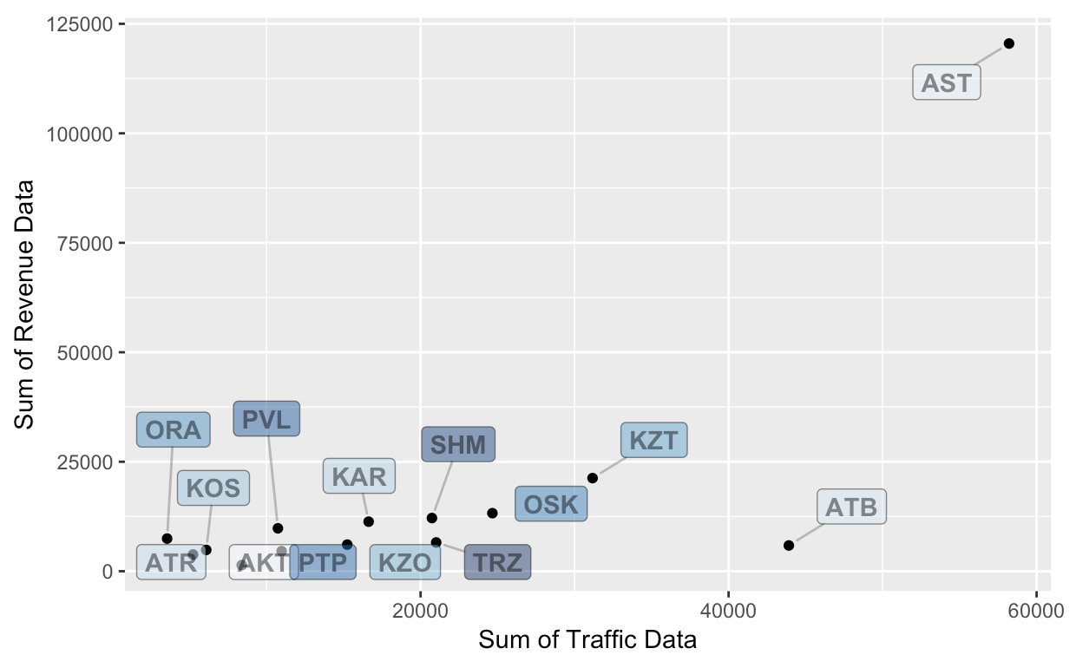
August: Sum of Revenue Data and Sum of Traffic Data usage
Notes:
* Higher usage of Traffic Data does not necessarily mean higher revenue. For example: in ATB traffic data usage is about 45000 Mb and in KZT it is about 30000 Mb, however, in KZT the Revenue coming from Data Traffic is greater than in ATB.

Slide 11
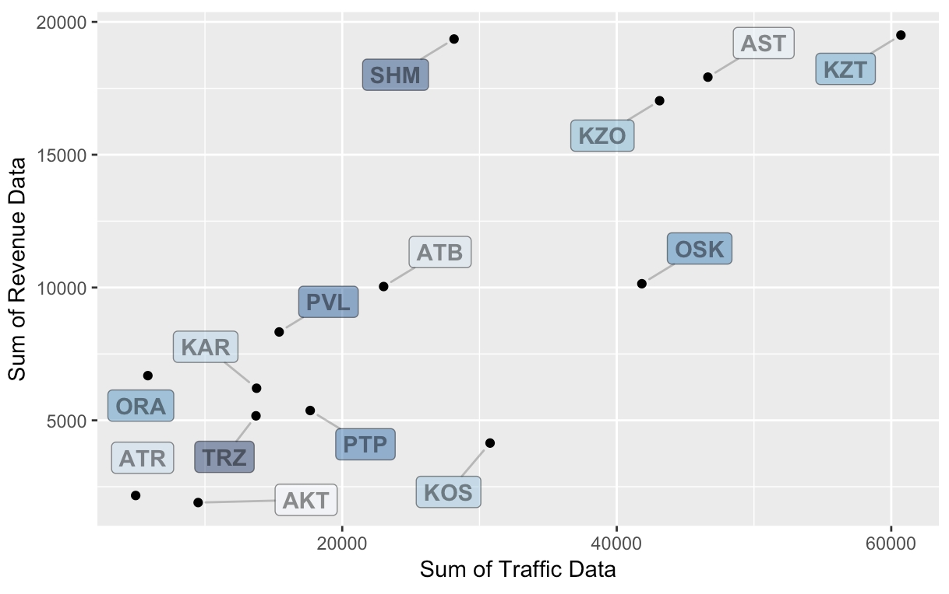
September: Sum of Revenue Data and Sum of Traffic Data usage
Notes:
* Top Right hand side of the graph shows high usage and high revenue of Data. By looking at this corner we can see 5 major regions driving ahead: KZT, SHM, AST, KZO, and OSK

Slide 12
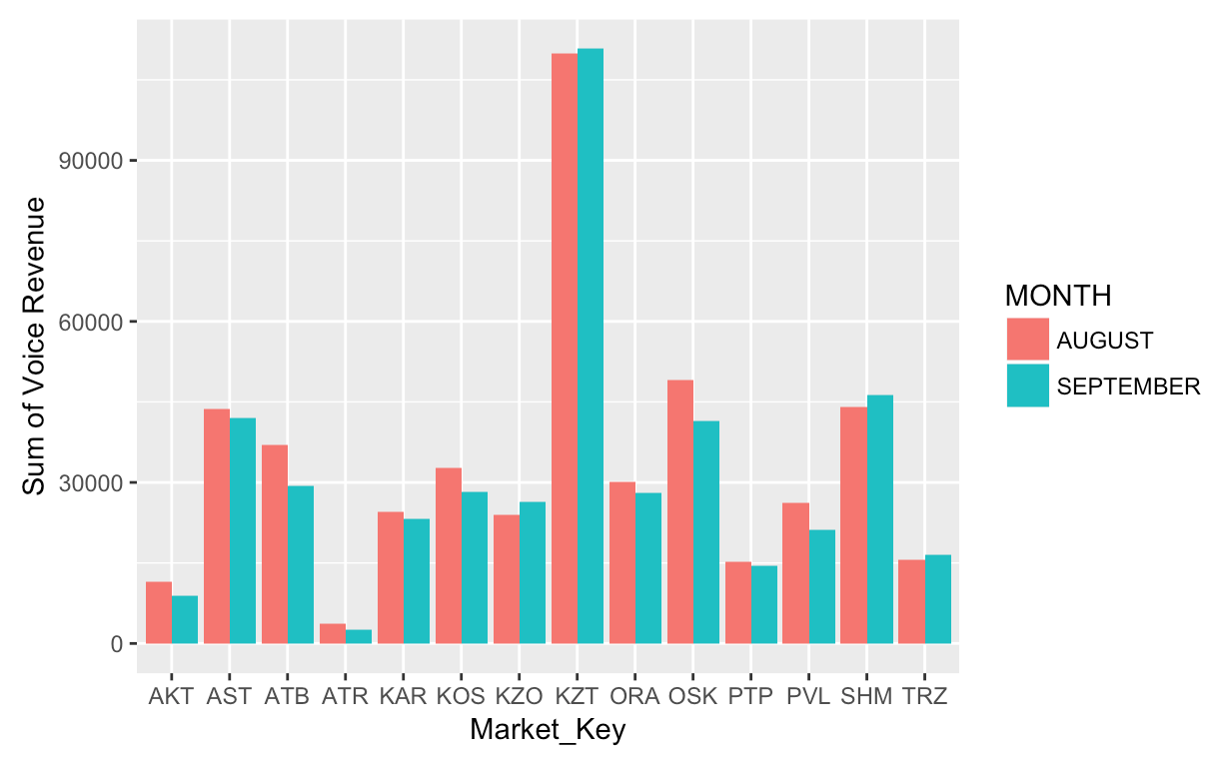
Total Revenue from Voice
Notes:
Majority of Revenue comes from Big regions like KZT, SHM, AST, ATB, OSK
Both months have similar revenue, without any visible outliers

Slide 13
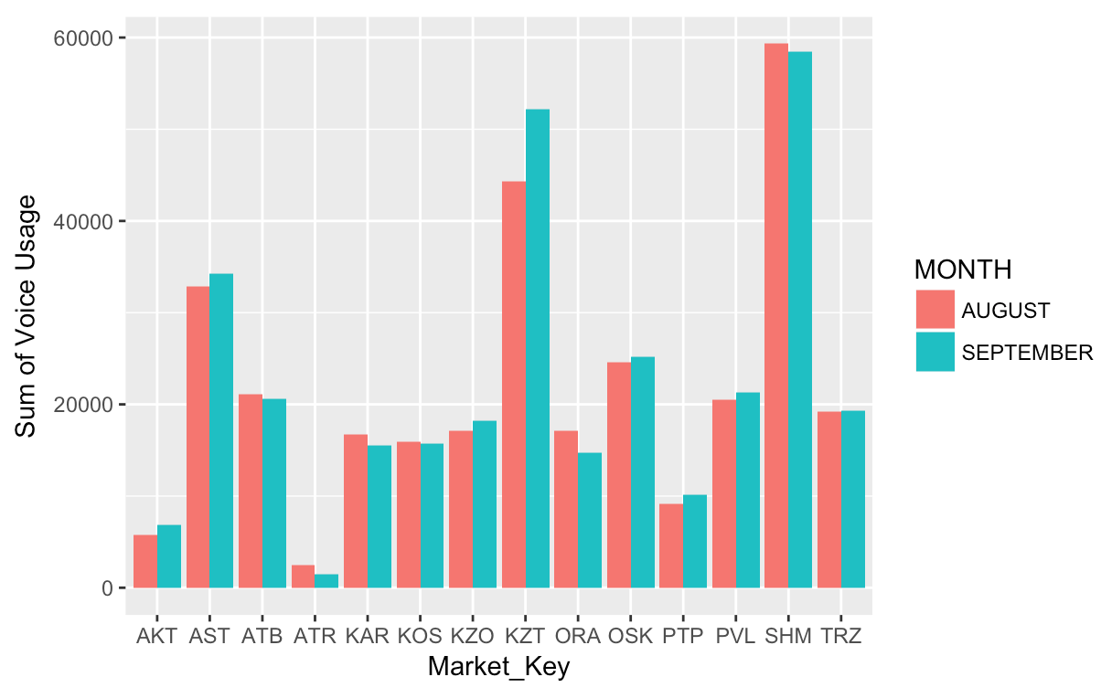
Total Voice Usage
Notes:
* Voice usage is high in SHM, KZT, and AST regions, however, greater revenue comes from KZT. Even though, revenue from voice in KZT is twice as high as in SHM, the voice usage is higher in SHM than in KZT. (Reason: There should be some voice plans that varies from region to region or from usage to usage)

Slide 14
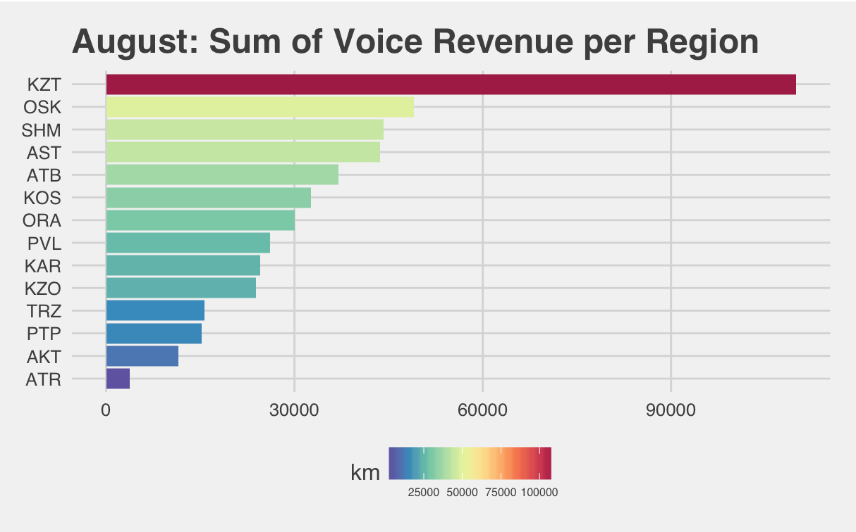
Notes:
* Small revenue from Voice service is indicated in ATR, AKT, PTP, TRZ regions.
* There is a strong contrast between revenue from KZT and other regions. SHM with more population than KZT has twice as less revenue than from KZT. (Reason: may be there are better voice options in Almaty)

Slide 15
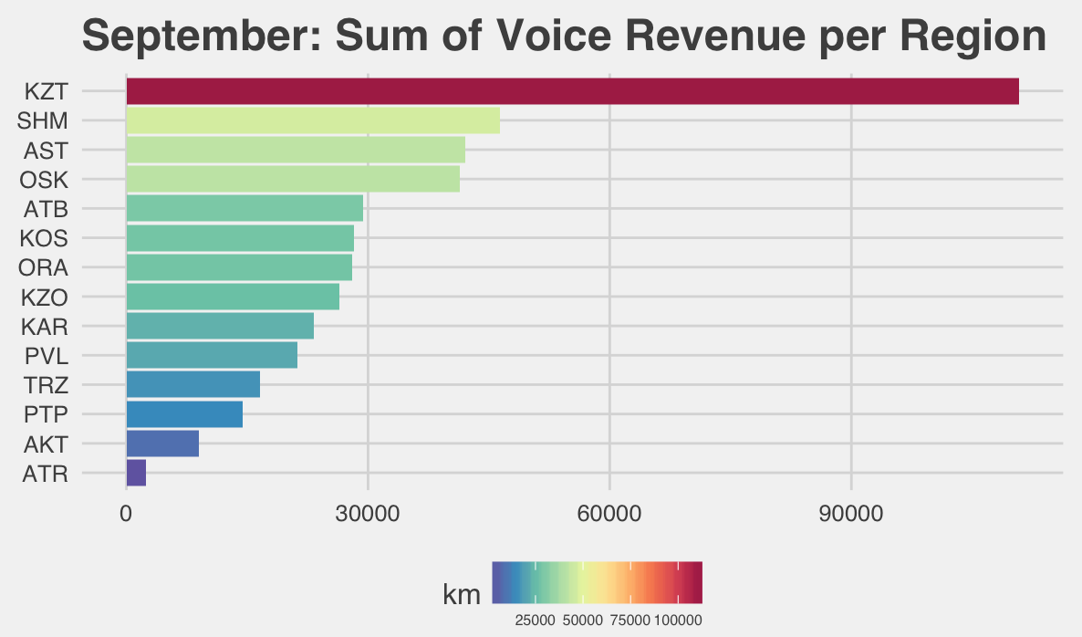
Notes:
* Almost the same

Slide 16
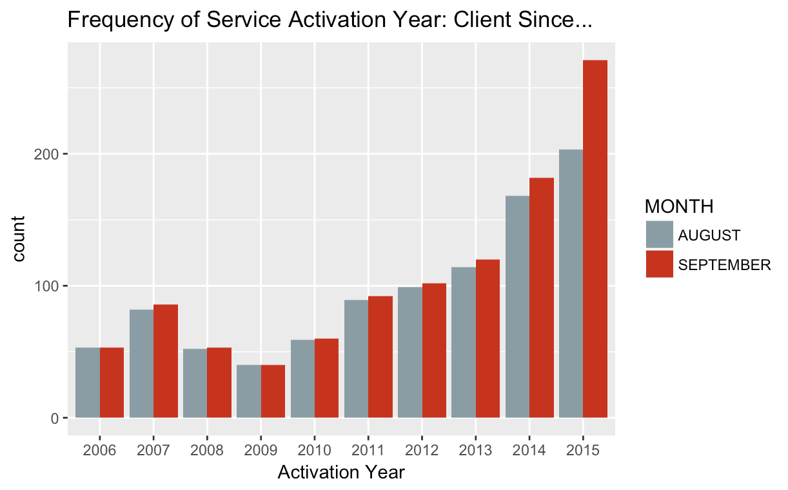
Service Activation Frequency: Y2006 – Y2015
Notes:
Sample data from both months shows that the oldest SIM Card Activation period starts from 2006.
SIM Activation gradually increases through the course of the period, however in the last 2014 and 2015 years there are rapid increases in Client SIM Card Activation.
It is tough to guess demographic, economic status of the clients, since the high indication of service activation in recent years (2014, 2015) does not explicitly show more members. That is, there is no solid ground to say that Beeline has more clients in recent years.
However, recent changes in the country allows people to have one cell-phone number and only change a carrier. This change made a lot easier for people to shift between mobile carriers (Beeline, K-cell, Tele2, and so on).

Slide 17
Conclusion
The carrier (Beeline) covers all 14 regions in Kazakhstan. Total Revenue are brought by major regions: AST, KZT, SHM, KZO. However, average revenue was the highest in AST in August, and in KZO in September.
Suggestion: Target revenue increase in KZT, SHM, KAR, OSK, TRZ since this regions have more than 1 million population
Sample Data is provided for August and September 2015, with around 1000 instances in each month. In slide 8 there is a very high indication of Data Revenue in AST region in August only. However, in September the indication is five times less.
Suggestion: the number of instances should be increased or more months should be included for more reliable results.

Slide 18
Conclusion
Revenue from voice in KZT is twice as high as in SHM, however, the voice usage is higher in SHM than in KZT. What are the reasons?
Suggestion: Demographic, Social, and Economic Data on clients are needed to explore client behavior

