Slide 1
How to classify an eamil as spam
Group 25: Hang Cheng, Haowei Yan, Weijan Li, Wenli Lyu, Zehao Wang

Slide 2
行业PPT模板http://www.1ppt.com/hangye/
1
Introduction
2
Data Preparation
contents
3
Data Visualization
4
Regression Results
5
Assess the Model
6
Data Summary
7
Conclusions
8
Future Work

Slide 3
1
PART ONE
Introduction

Slide 4


Introduction
Background
Spam has caused some distress in people's daily life, so identifying spam correctly becomes more and more important nowadays.
Objective
This study aims to finding Which text characteristics influence whether an email will be classified as spam or not by analyzing the data shared with the UCI Machine Learning Repository.

Slide 5
2
PART TWO
Data Preparation

Slide 6
Data Preparation
Data Reading
Variable
Variable
Data Processing
Divide "crl.tot" by 100 because the number is much larger than other data.
Read data from dataset of UCI Machine Learning Repository.
Explanatory vairable:
crl.tot dollar
bang money
n000 make
Response variable:
yes no

Slide 7
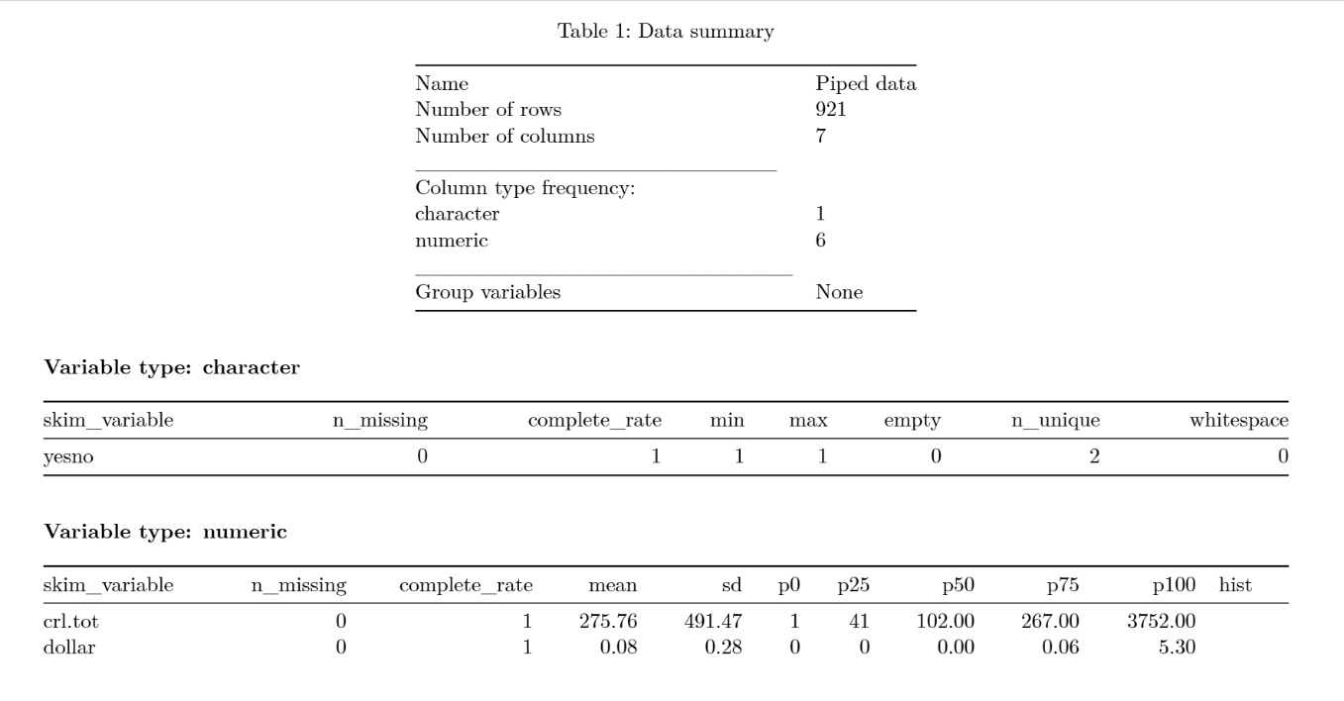
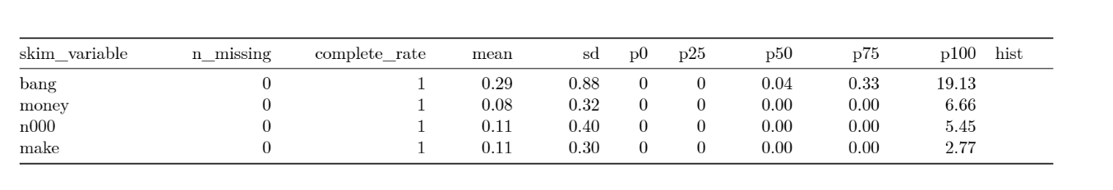
Summary of Data

Slide 8
3
PART THREE
Data Visualization

Slide 9
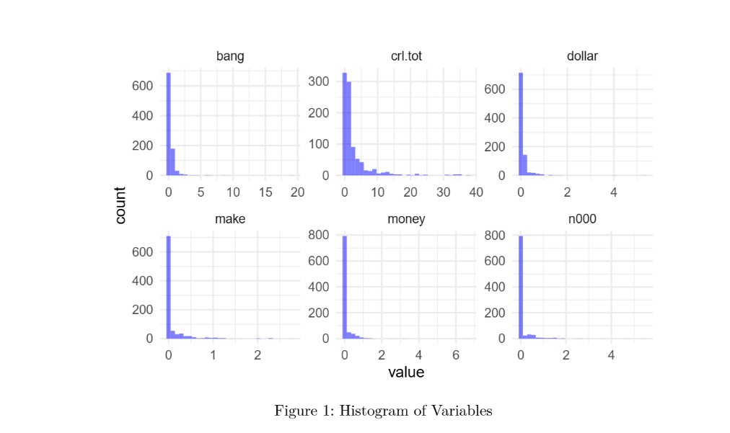
Data Visualization
These histograms show that, most variables are right-skewed, many variables contain mostly zero values. Especially “money”, “make” and “n000”, these words do not appear in many emails.

Slide 10
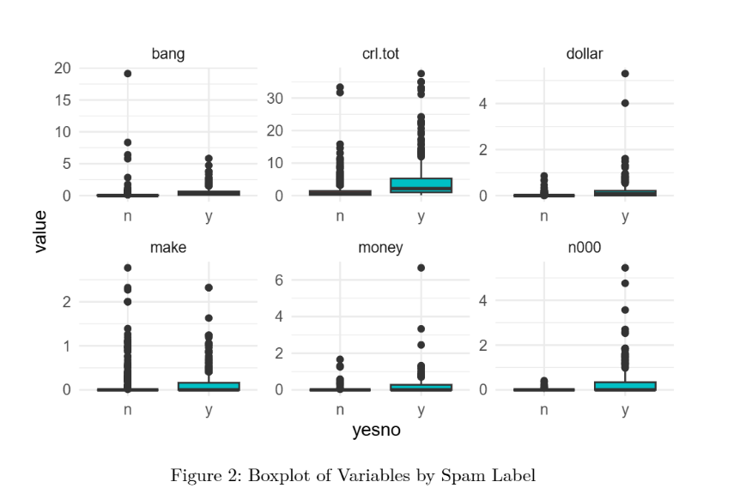
Data Visualization
These boxplots show that, on average, spam emails tend to have higher values for most features. Especially the occurences of capital letter and n000 in spam are obviously more than that in a noraml email.

Slide 11
4
PART FOUR
Regression Results

Slide 12
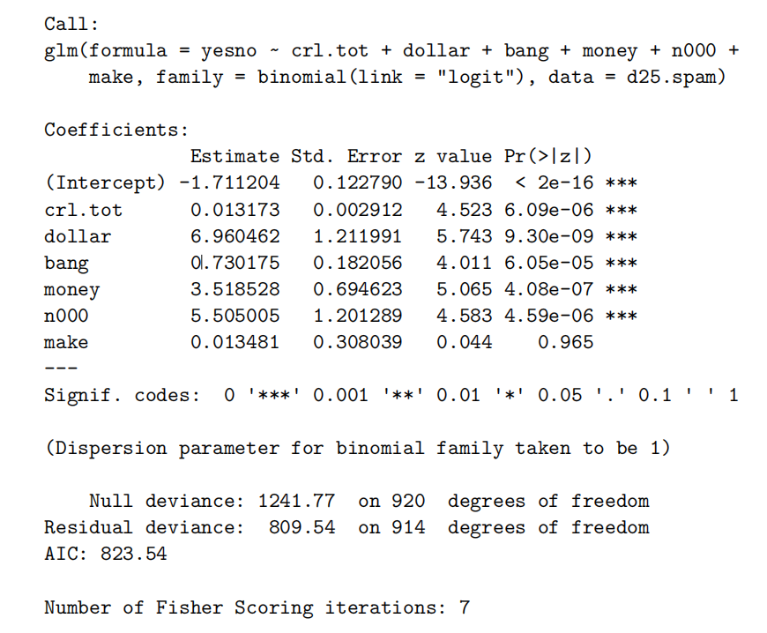
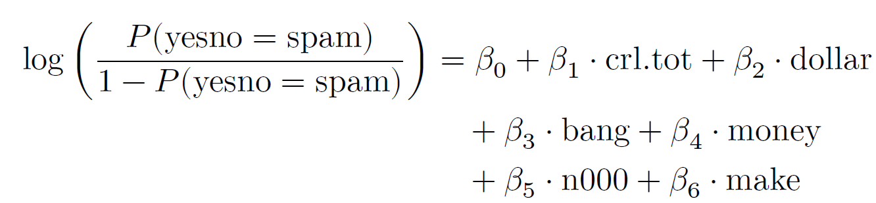
Fitting the Full Model
The result suggests that spam tends to have more of these text characteristics.

Slide 13
Transformation of Data
Crl.tot shows a right-skewed distribution (mean 2.758, maximum 37.52), but there is a high proportion of non-zero values, which is suitable for mitigating the skewness by logarithmic transformation. Bang is heavily right skewed (mean 0.292, max 19.13), but has a certain percentage of non-zero values (median 0.044), which is suitable for logarithmic transformation.
Most of the values of dollar, money, n000 and make are 0, with more extreme values, and the model can be simplified by binning to reduce noise and nonlinear effects.

Slide 14
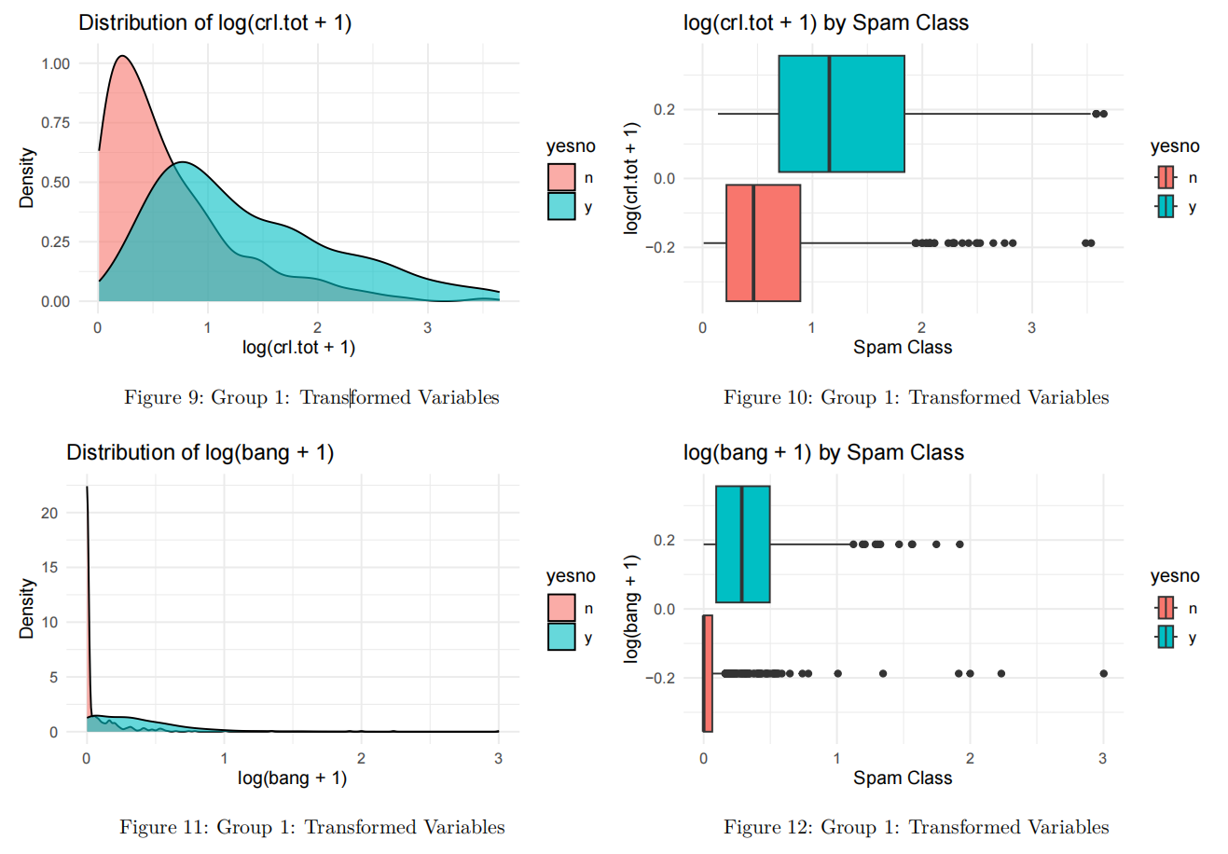
Visualization of Processed Data

Slide 15
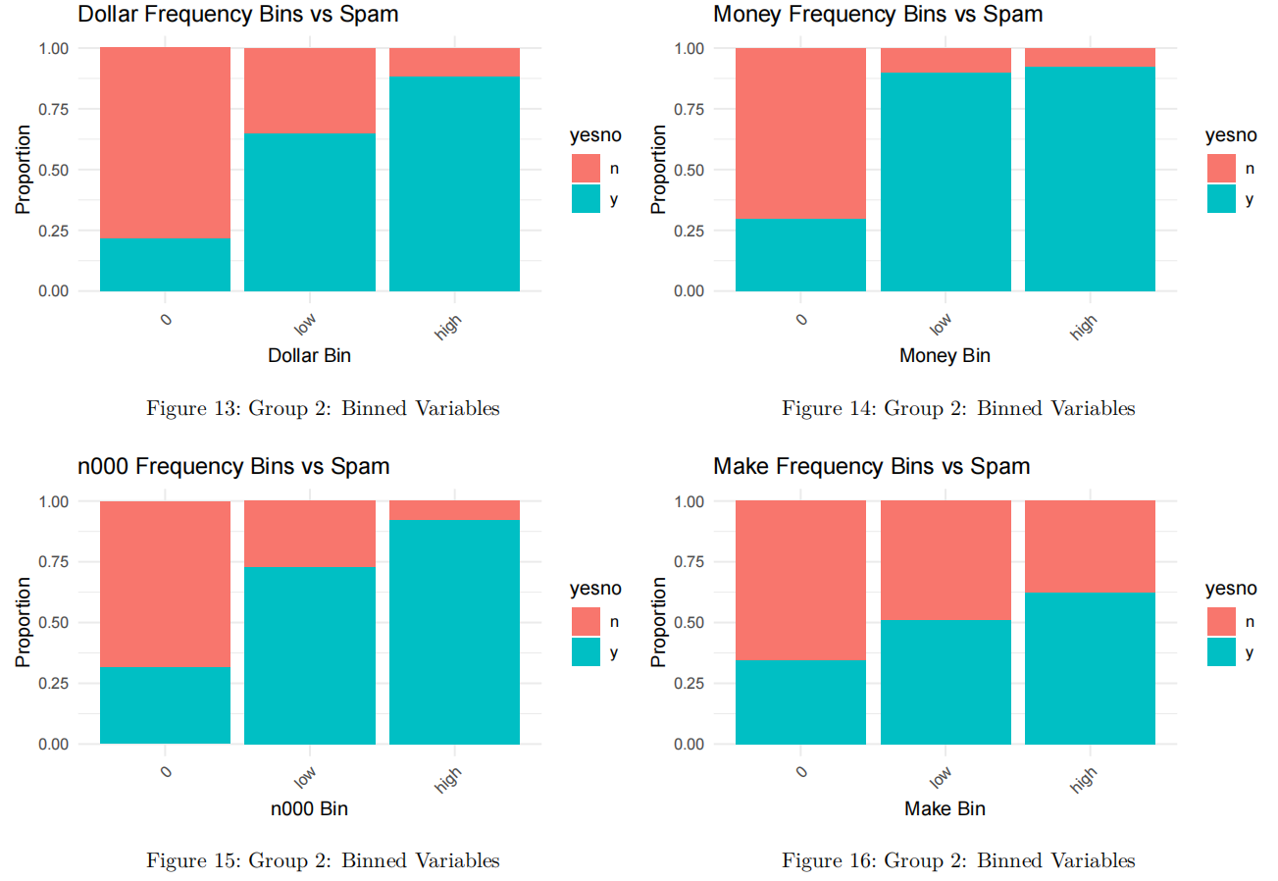
Visualization of Processed Data

Slide 16
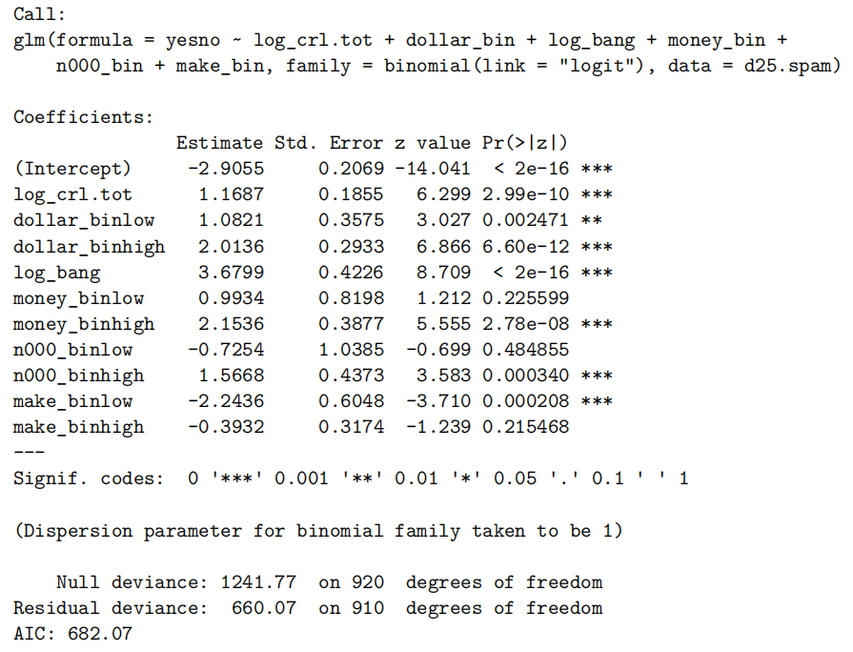
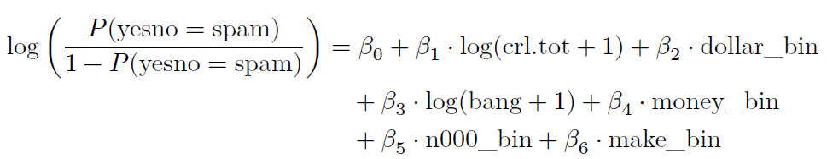
Fitting a model with processed data
This model does not have the warning messages that appear in the full model.
We chose to merge certain variable categories (e.g., combining “low” and “0” frequency bins) to address statistical insignificance while preserving meaningful information.

Slide 17
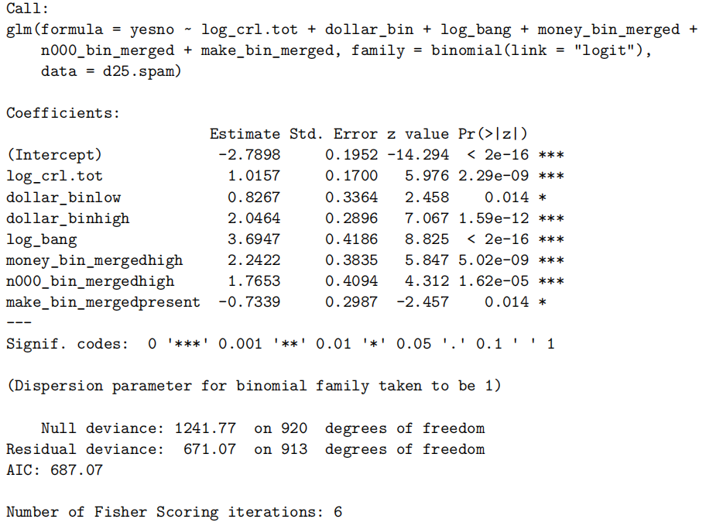
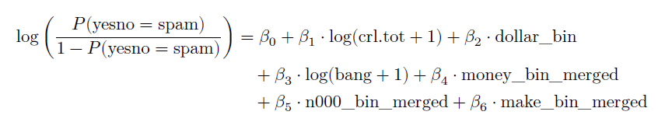
Combining insignificant variables and fitting a new model
The refined model demonstrates strong statistical performance with all retained variables achieving significance at 𝛼 = 0.05
or stricter thresholds.

Slide 18
5
PART FIVE
Assess the Model

Slide 19
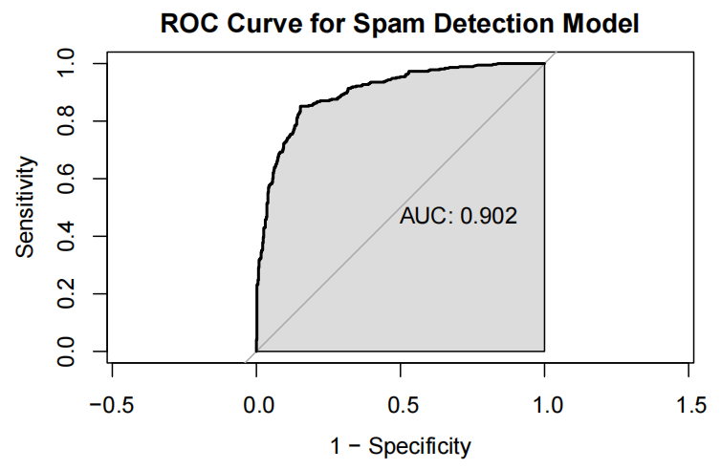
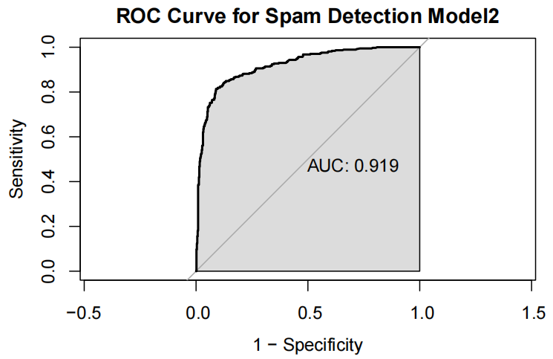
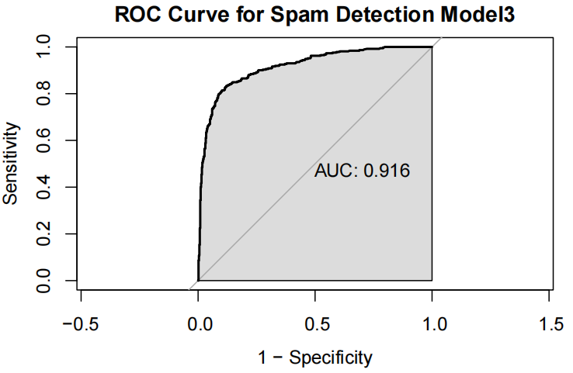
Assess the predictive power
The three models all achieve an excellent AUC, indicating strong discriminatory power to distinguish spam from non-spam emails. The AUC of the second model is a little bit better than the AUC of the third model, but the difference is very small.

Slide 20
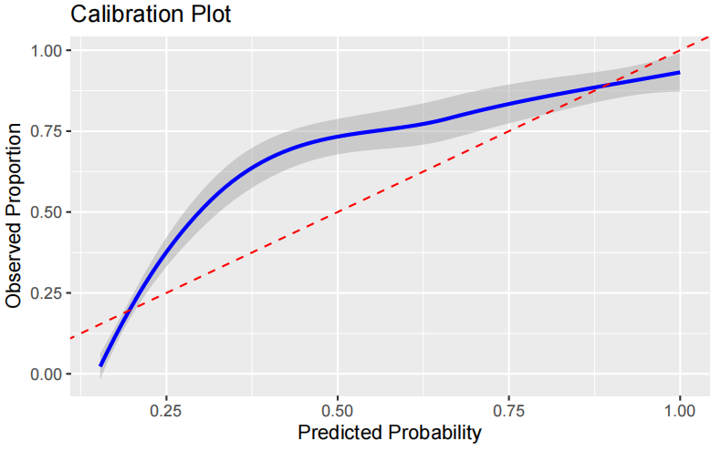
Hosmer-Lemeshow goodness of fit test
Model1
The p-value for the first model is much less than 𝛼 = 0.05, and the calibration plot also shows very large calibration biases.
X-squared = 108.24, df = 5, p-value < 2.2e-16

Slide 21
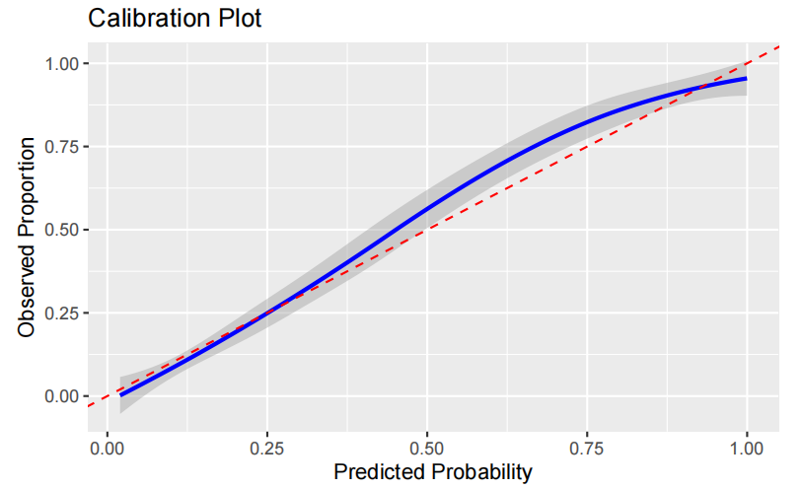
Hosmer-Lemeshow goodness of fit test
Model2
The second model also has a p-value of less than 𝛼 = 0.05, and the calibration plot also has more segments than the third model calibration biases.
X-squared = 13.75, df = 5, p-value = 0.01728

Slide 22
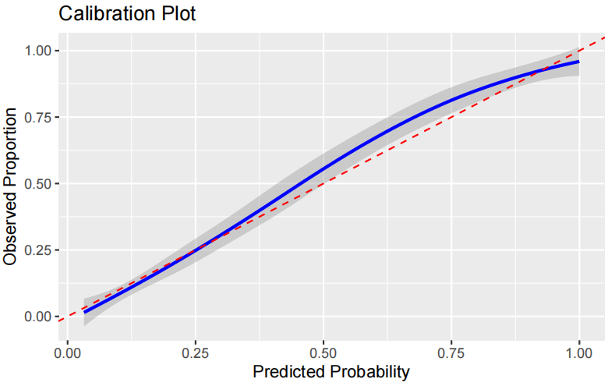
Hosmer-Lemeshow goodness of fit test
Model3
The Hosmer-Lemeshow test of the third model (p = 0.059) indicates borderline non-significant evidence of miscalibration, suggesting the model’s predicted probabilities may slightly deviate from observed outcomes.
X-squared = 10.621, df = 5, p-value = 0.05944

Slide 23
6
PART SIX
Data Summary

Slide 24
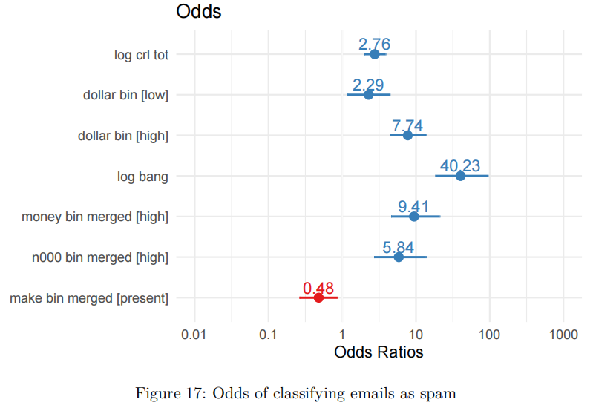
Data Summary

Slide 25
7
PART SEVEN
Conclusions

Slide 26
Conclusions
These findings highlight the importance of financial symbols ($, “money”), exaggerated punctuation (!), and anomalous patterns (capital bursts, “000”) as spam indicators, while terms like “make” may signal non-spam context. This evidence directly informs targeted improvements for spam filtering systems.

Slide 27
8
PART EIGHT
Future Work

Slide 28
Future Work
Increase the size of the dataset, especially by using a larger-scale real email dataset to enhance the model's generalization ability.
Test the model in a real email classification system.
Investigate spam detection in different languages and email formats to assess the model's applicability.

Slide 29
Thank You

