Slide 1



Network Manage
S1054004 許書瑋

Slide 2
Function
01

Slide 3
OID search
Device IP
Create
Search
設備IP
創建要輸入的OID
查詢

Slide 4
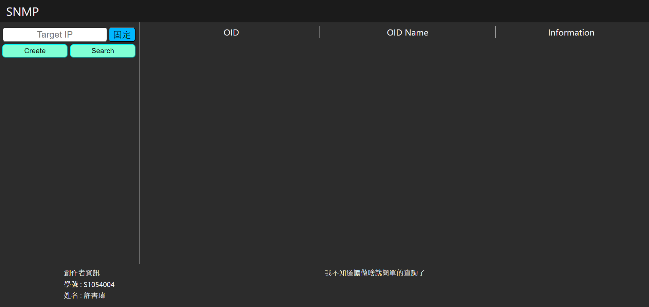
Initial screen

Slide 5
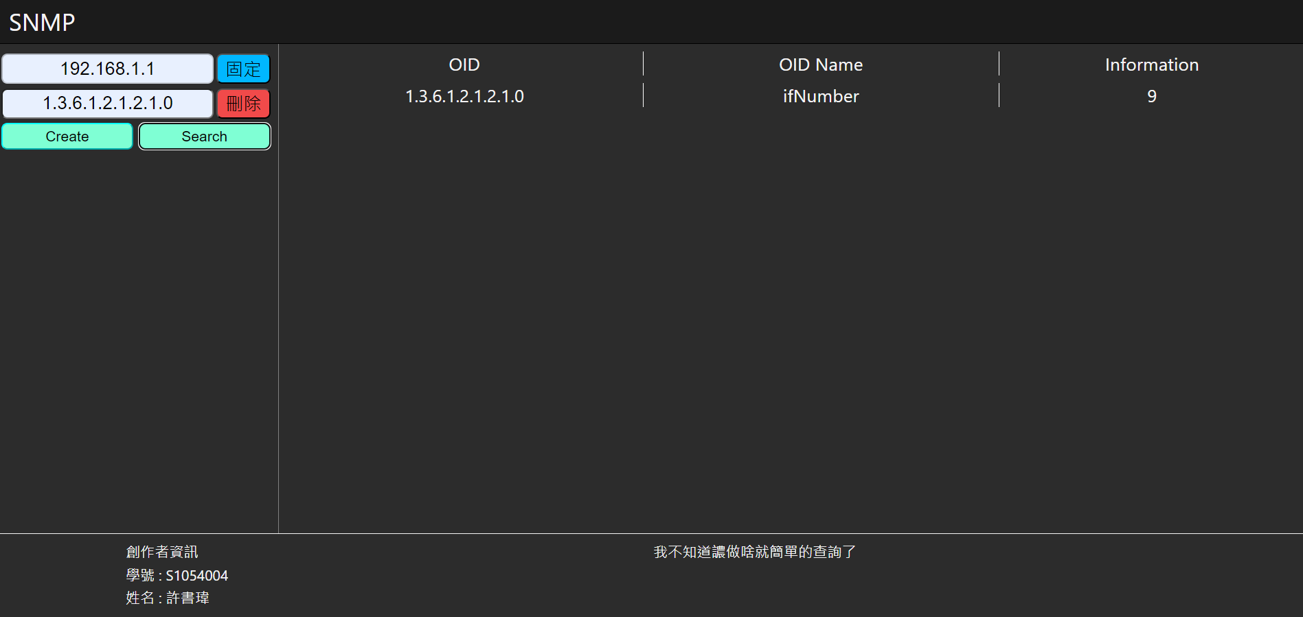
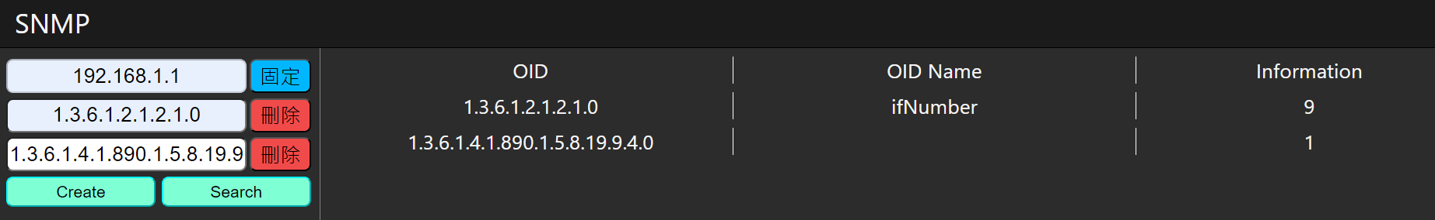
Search screen

Slide 6
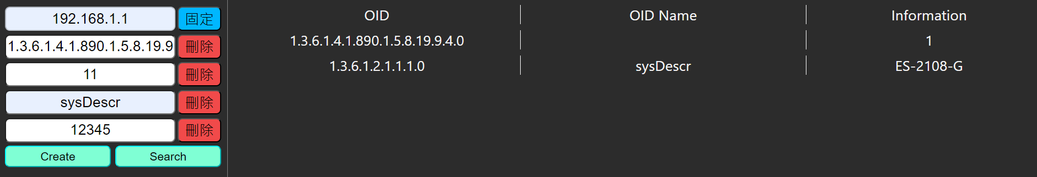
Search screen2

Slide 7
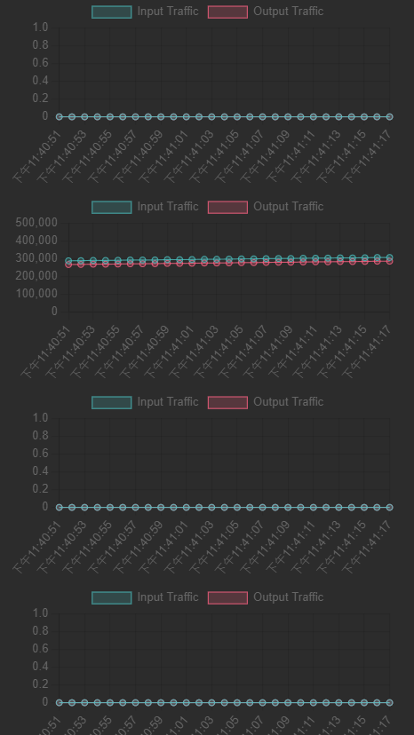
Realtime

Slide 8

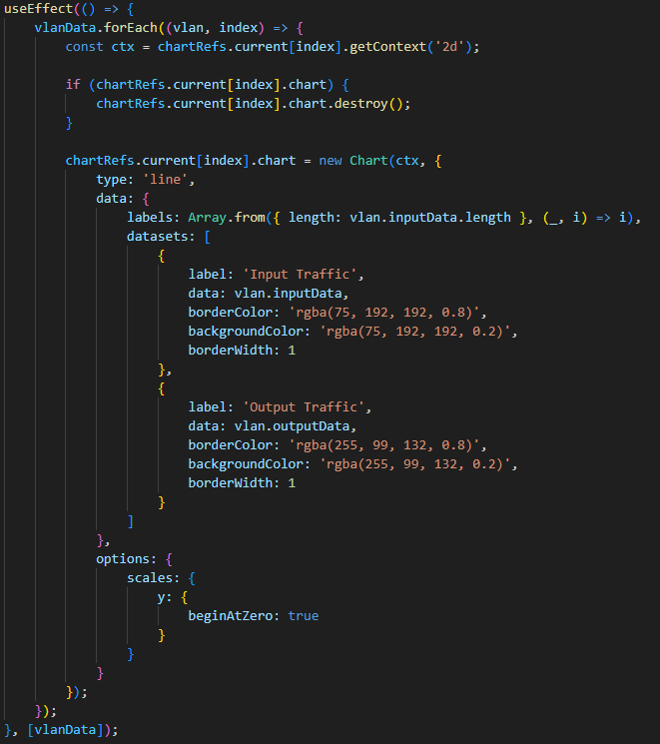
Core Code(frontend)

Slide 9
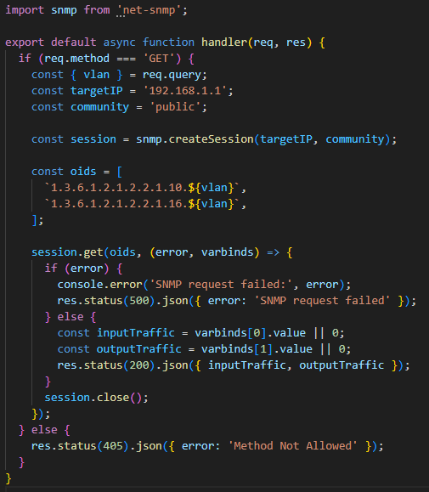
Core Code(backend)

Slide 10
DEMO

