Slide 1
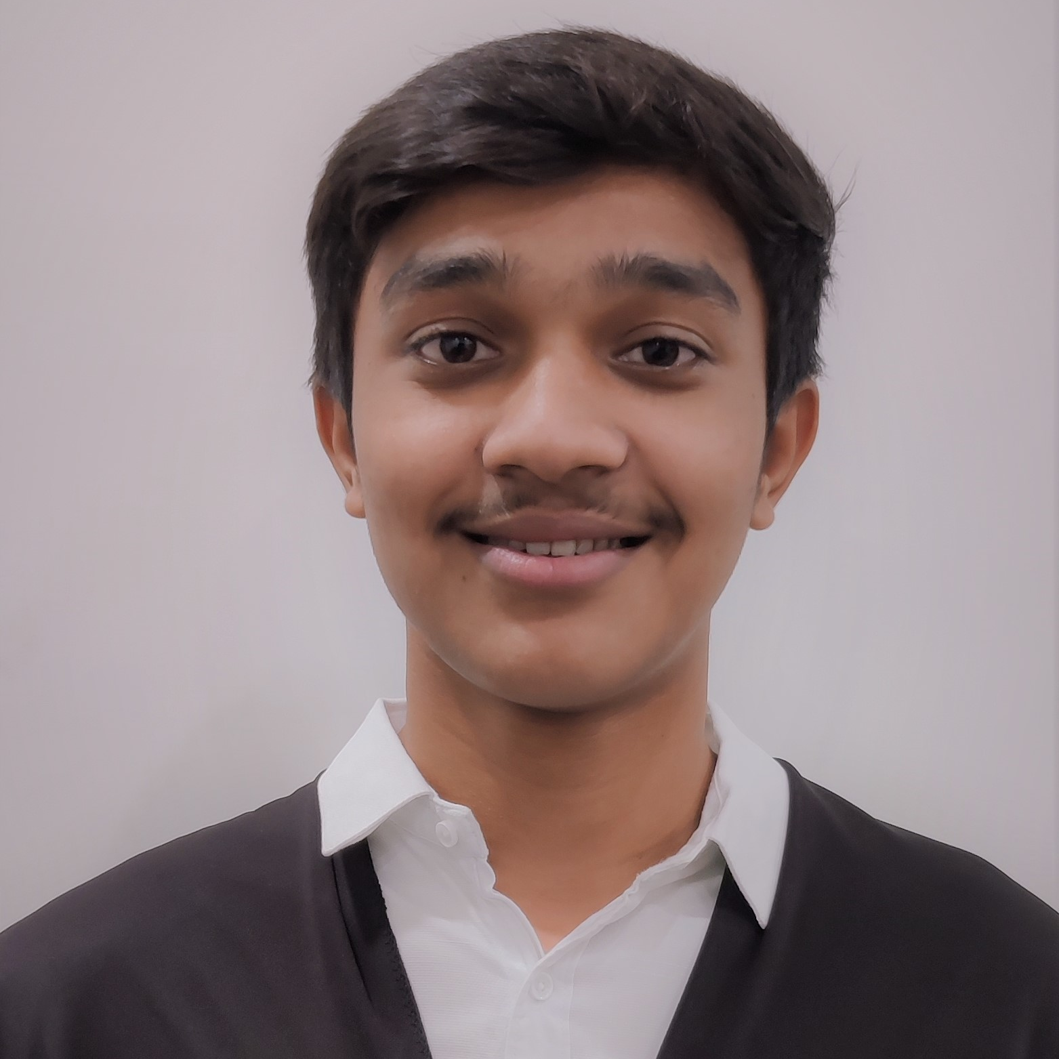



Tanmay Sakure
Bachelor of Engineering
E : 2018 - 2022
Analyst A4
Skills
Java 11 /J2EE | Java Basics, OOPS, Generics, Collections, Arrays, Loops, Lambda Exp, Stream API Junit, Mockito, Servlets
Spring core | IOC & Dependency Injection, Autowire
Spring REST | REST controllers, Implementation of GET, POST, PUT & DELETE, Bean Validation & Exception Handling, Testing Services, Controller & Repository layer
Spring Data JPA | Implement DAO layer using spring Data repositories, Transaction Management
Spring Boot Microservices | Spring Boot Starters, annotations, Messaging Service, Sync/Async comms, Swagger API documents
Spring Cloud | Eureka, Netflix Ribbon, Feign Client, Netflix Hystrix, Netflix Zuul & Config Server
Angular | Components, Services, Modules, Routing, Forms & Validation, Testing using Jasmine & Karma
Database | MongoDB No SQL Basics, My SQL RDS Basics
UI Tech | HTML 5 & CSS 3,JavaScript, ES6 & TypeScript Reusable templates, Optimized UI Designed
Tools | Git, Postman, Maven, IDE
Devops | CI/CD, Jenkins configuration, Build Pipelines, notifications, quality gate understanding
Add On skills | Communications, Team management. Peer learning
Mumbai
tanmay.shamlal-sakure@capgemini.com
+91 7030709301
Male
Frontend, Cloud & Basic of Java Full Stack Developer with Angular
Hands on experience in Fronted. Created
Hands on experience in creating microservices with Spring boot, Spring Security, Spring Cloud Rest API Gateway, Eureka server, swagger, load balancing.
Proficient in creating Single page Web Application in Angular with Authentication, Angular reactive forms, angular routing.
Hands on experience with NodeJS & spring boot in case study and upskilling his knowledge continuously.
Basic understanding of deploying spring boot applications.
On-demand Car wash Application in Internship
Completed end to end case study of On-demand carwash Application along with JWT authentication, Swagger and payment testing using Stripe, responsive UI with Tailwind CSS and Angular used for user interface.
backend (MongoDB), Midware (Spring Boot) and Frontend (Angular) at Capgemini Degreed Platform
Certified in Amazon Cloud Practitioner.
Certified in Google Cloud Digital Leader.
Working on Smart UI builder tool by ETAP.
Check out my work on GitHub & Video Profile

