Slide 1
60
32
16
8
4
2
1
Output
Input

Slide 2
128 x [5x5]
64 x [7x7]
2x2 pooling
16 x [9x9]
2x2 pooling
4 x [9x9]
Input Image
Encoded Image

Slide 3
128 x [5x5]
64 x [7x7]
2x2 pooling
16 x [9x9]
2x2 pooling
4 x [9x9]
8 x [9x9]
8 x [7x7]
2x2 unpooling
3 x [7x7]
2x2 unpooling
3 x [7x7]
Input Image
Encoded Image
Decoded
Image
Encoder
Decoder

Slide 4
8 x [9x9]
8 x [7x7]
2x2 unpooling
3 x [7x7]
2x2 unpooling
3 x [7x7]
Encoded Image
Decoded
Image

Slide 5
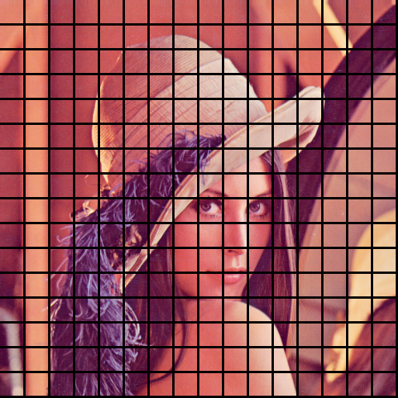

Slide 6
Encoder
Decoder
Transfer weights
CIFAR
Encoder
Decoder
Test Image Patches

Slide 7
Input Image
Intermediate output
Auto-encoder
+
-
+
Error Image
Intermediate output
Auto-encoder

