Slide 1



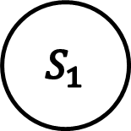
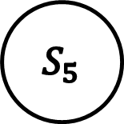


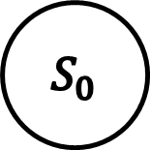

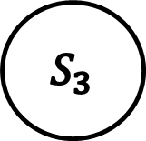

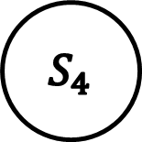



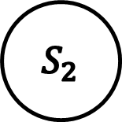


$$1/1$$
$$0/0$$
$$S_{2}$$
$$S_{3}$$
$$0/0$$
$$1/0$$
$$0/0$$
$$S_{0}$$
$$S_{1}$$
$$0/1$$
$$1/0$$
$$1/0$$
$$1/1$$
$$0/0$$
$$S_{4}$$
$$S_{5}$$
$$0/0$$
$$1/1$$

Slide 2

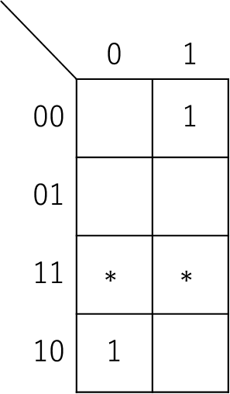

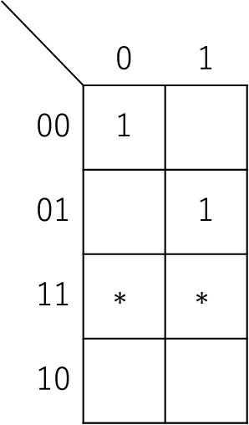



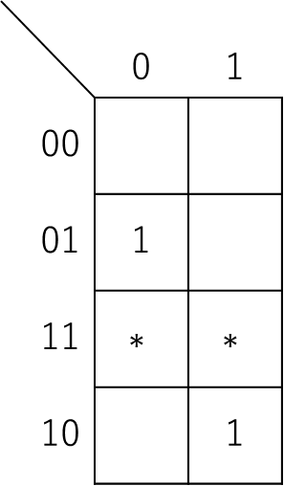

$$x$$
$$x$$
$$x$$
 | 0 | 1
00 | 1
01 |  | 1
11 | $$∗$$ | $$∗$$
10
 | 0 | 1
00 |  | 1
01
11 | $$∗$$ | $$∗$$
10 | 1
 | 0 | 1
00
01 | 1
11 | $$∗$$ | $$∗$$
10 |  | 1
$$s_{1} s_{0}$$
$$s_{1} s_{0}$$
$$s_{1} s_{0}$$

Slide 3

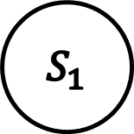

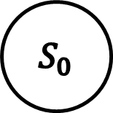


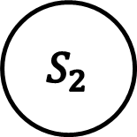

$$1/0$$
$$0/0$$
$$S_{0}$$
$$S_{1}$$
$$S_{2}$$
$$0/1$$
$$1/0$$
$$1/1$$
$$0/0$$

Slide 4
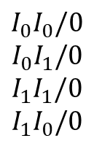
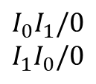
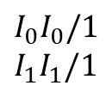
$$I_{0}I_{1}/0$$
$$I_{1}I_{0}/0$$
$$I_{0}I_{0}/0$$
$$I_{0}I_{1}/0$$
$$I_{1}I_{1}/0$$
$$I_{1}I_{0}/0$$
$$S_{0}$$
$$S_{1}$$
$$I_{0}I_{0}/1$$
$$I_{1}I_{1}/1$$

Slide 5

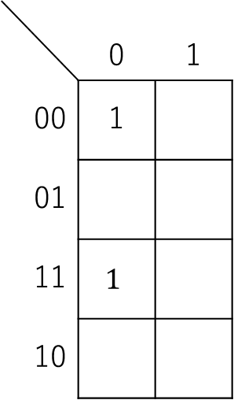



$$S$$
$$S$$
 | 0 | 1
00 | 1
01
11 | $$1$$
10
 | 0 | 1
00 |  | 1
01 | 1 | 1
11 |  | 1
10 | 1 | 1
$$xy$$
$$xy$$

