Slide 1



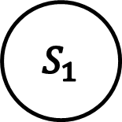





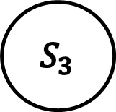








$$1/1$$
$$0/0$$
$$S_{2}$$
$$S_{3}$$
$$0/0$$
$$1/0$$
$$0/0$$
$$S_{0}$$
$$S_{1}$$
$$0/1$$
$$1/0$$
$$1/0$$
$$1/1$$
$$0/0$$
$$S_{4}$$
$$S_{5}$$
$$0/0$$
$$1/1$$

Slide 2

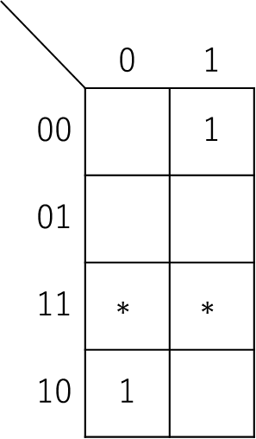

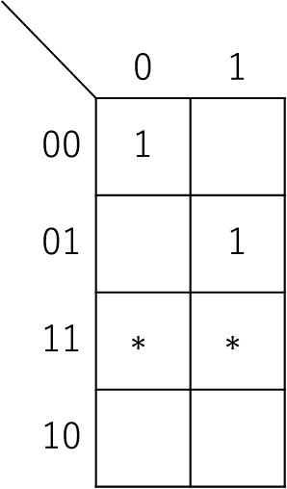



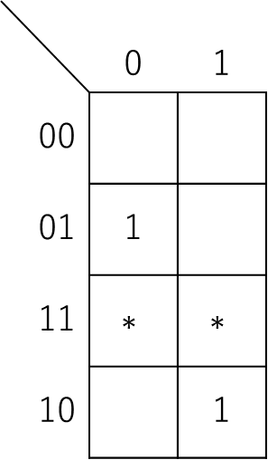

$$x$$
$$x$$
$$x$$
 | 0 | 1
00 | 1
01 |  | 1
11 | $$∗$$ | $$∗$$
10
 | 0 | 1
00 |  | 1
01
11 | $$∗$$ | $$∗$$
10 | 1
 | 0 | 1
00
01 | 1
11 | $$∗$$ | $$∗$$
10 |  | 1
$$s_{1} s_{0}$$
$$s_{1} s_{0}$$
$$s_{1} s_{0}$$

Slide 3

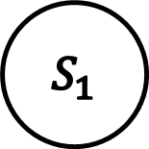






$$1/0$$
$$0/0$$
$$S_{0}$$
$$S_{1}$$
$$S_{2}$$
$$0/1$$
$$1/0$$
$$1/1$$
$$0/0$$

