Slide 3
z
+Mz
z1
-Mx
+Mx
z0
-Mz
x
磁界観測点
x0
x1

Slide 4
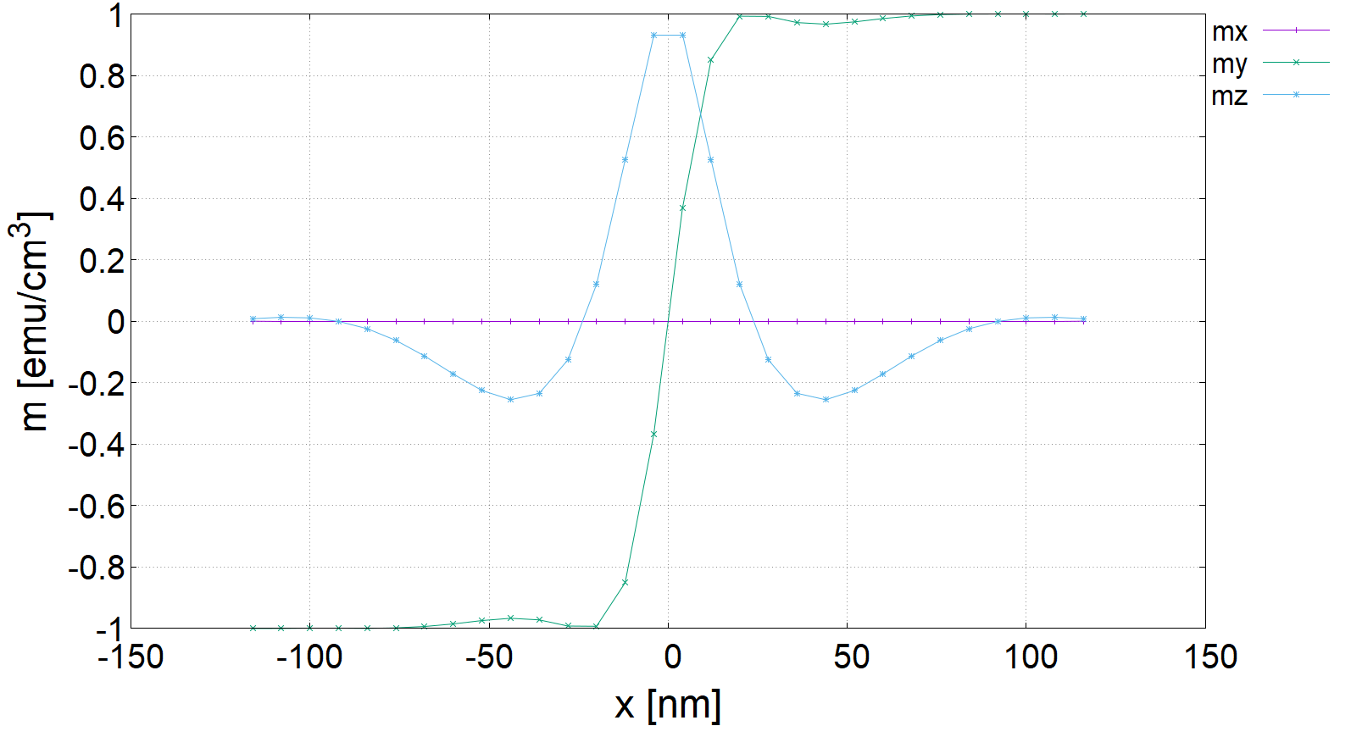

$θ$ [π]

Slide 5
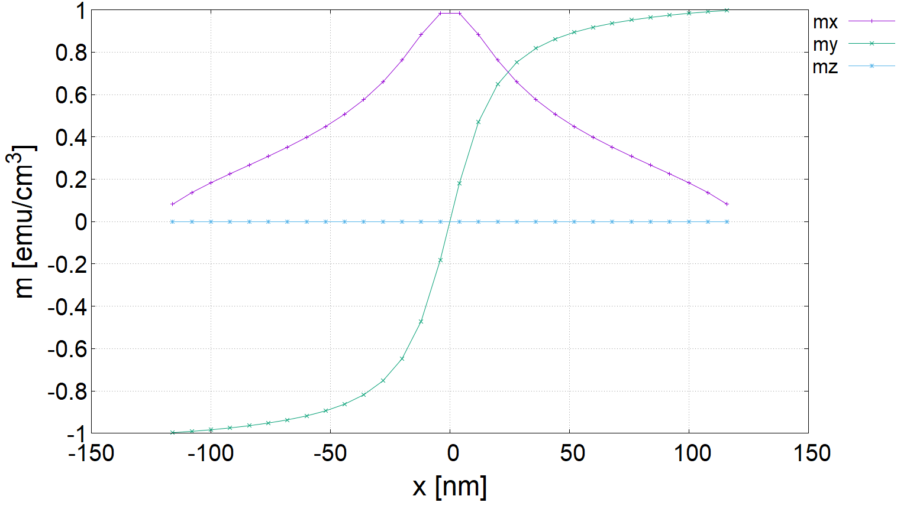

$θ$ [π]

