Slide 2
E-governance
E-governance in public sector
Buisness Process Management
Purchasing Business Process

Slide 3
The Business Model Canvas : Smart Business Process Management System S-BPMS
Problem
Solution
Unique value
Customer Relationships
Customer Segments
Formalizing the design and the execution of Business Processes
Reducing financial wastes
Vendors trust in the business process fairness
Vendors
Purchasing in public sector is budgetary loophole
Locking and securing the transactions within the Purchasing Business Process via ICT
Promote transparency
Financial services ensure rationalization of expenditure
Financial Services
Lack of transparency and consistency
Ordering party ensure the quality of purchasing order
Ordering party
Key metrics
Periodic audit reports
Channels
Smart Business Process Management System S-BPMS
Annual report of the Moroccan court of accounts
Cost Structure
Revenue Streams
Cloud Hosting
~80$/Month
S-BPMS development
$30,000 - $45,000
Rationalize the governance of state public expenditure
Smart Contract Deployment Ethereum
~70$/Month
Maintenance
~3000$/Year

Slide 4
Design Science Research DSR
Model Driven Architecture
The modeling of structural, behavioral and component of the proposed system
Literature survey
examination of the literature in order to identify gaps, and develop research questions.
Simulation Method
Simulate, explore, and predict NLP dataset and analyze reviews Data
Experimental Method
conducting prototyping experiments to validate and assess our proposal

Slide 5
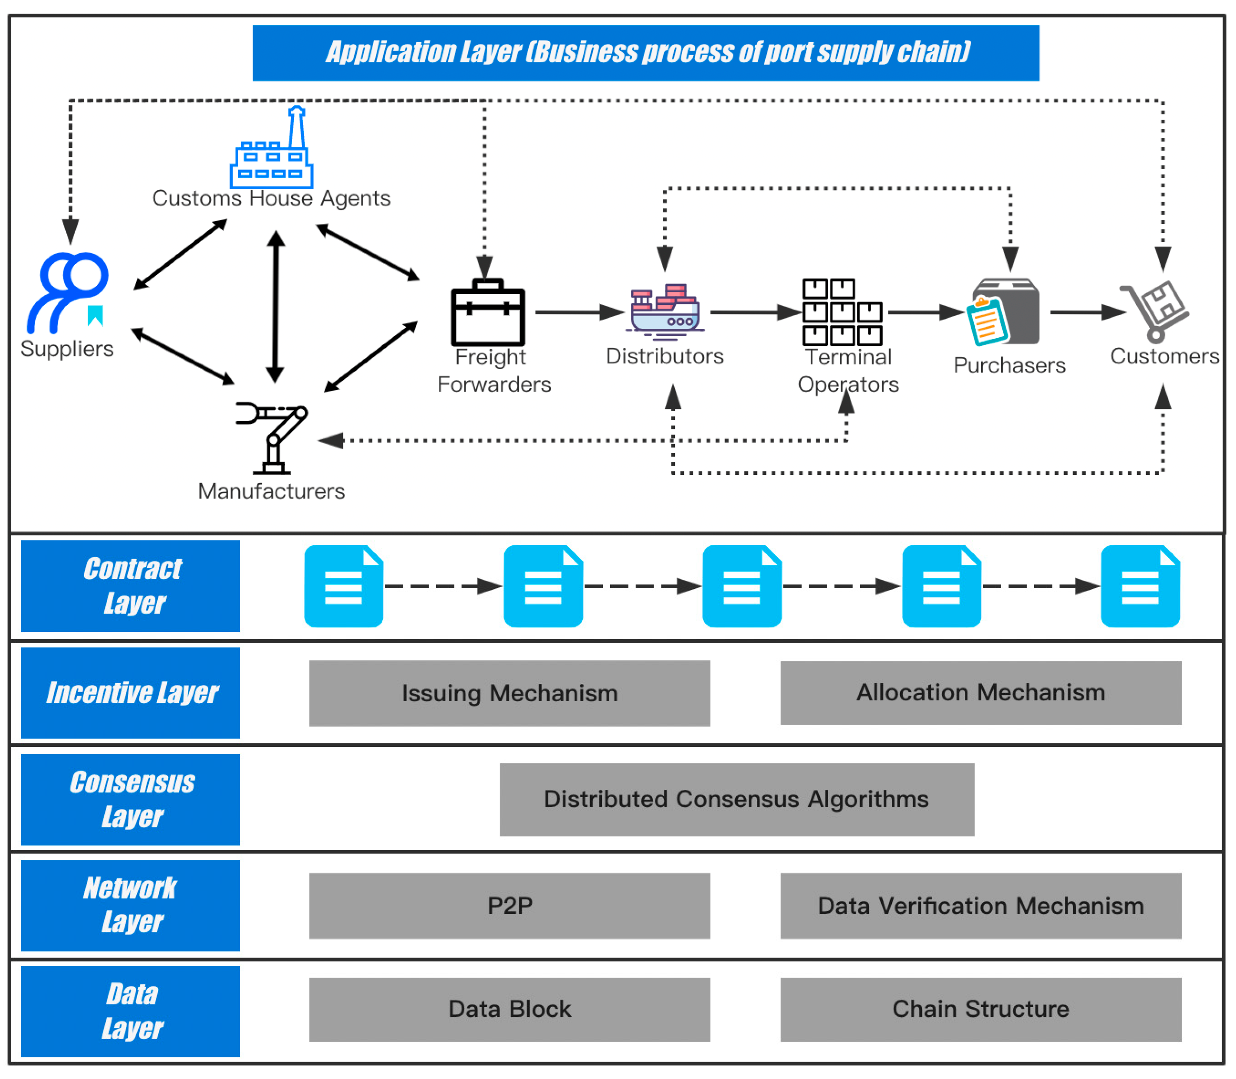
Application Layer Blockchain Purchasing Business Process

