Slide 1
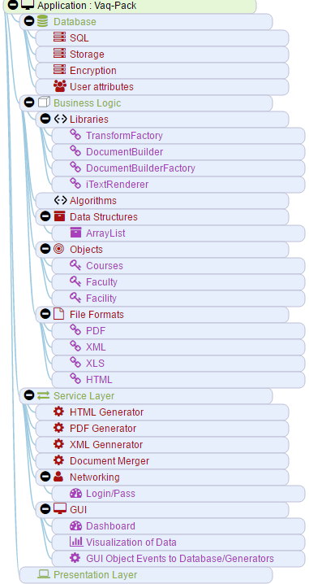
Modeled after : Eri, Thomas from “Service Oriented Architecture”
Presentation Layer
GUI
Service Layer
Generators
Widgets
Business Logic
File Format
Objects
Network Sockets/Libraries
Libraries
Network
Structures
Network
Network
Database
Insert
Modify Records
DATABASE
Retrieve Records

