Slide 1
Class Project presentation: MS/MS Viewer
Salwa Elsaadawy

Slide 2

INTRODUCTION
My project is about analyzing the mass spectrometry data to determine whether the peptide is a good match to the spectrum or not.

Slide 3
the program meets the requirements
The requirements: 1- The command line takes mzXML file, a scan number, and a peptide sequence as input.
2- Computation of peptide's b-ion and y-ion m/z values
3- peaks matching these m/z values
4-values annotated with appropriate labels.
5- output figure/plot

Slide 4

scientific modeling trade-offs
1-I didn’t use the exact decimal numbers for monoisotopic masses of amino acids.
2- I didn’t count for all ions produced from fragmentation of peptides

Slide 5
Modules & Packages, strengths and weaknesses
1- System Module
2- XML Parsing Module
3- Array Handling Module
4- Base64 Encoding Module
5- Data Visualization Module

Slide 6
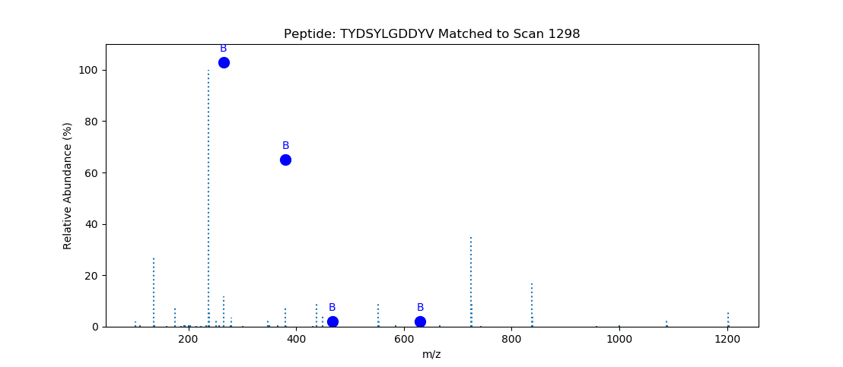
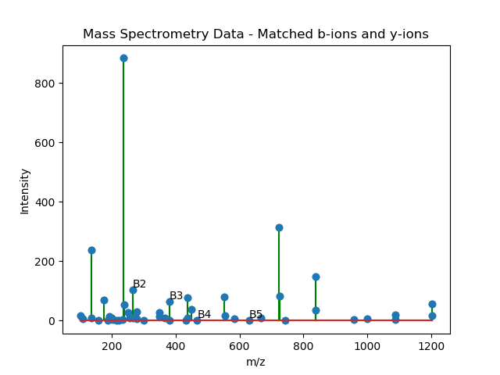
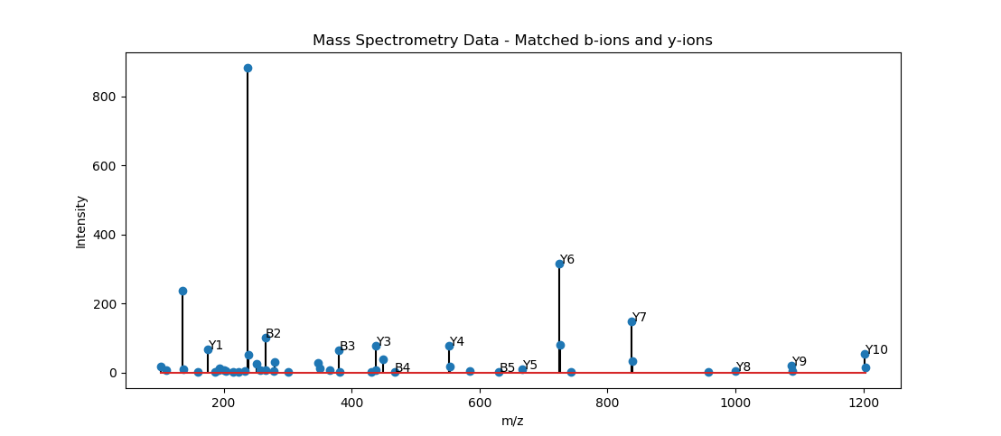
Chalenges:
Making the plot

Slide 7
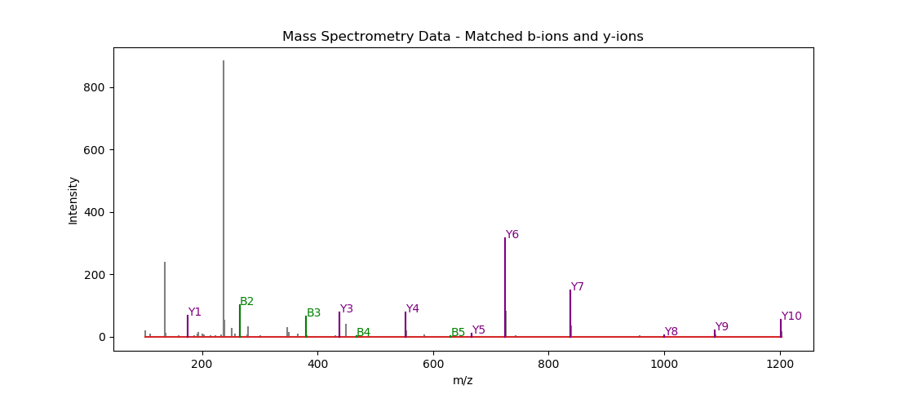
Graph produced from 1289 scan number and peptide sequence TYDSYLGDDYVR

Slide 8

Bugs:
The Y ion matched ions is always an empty list in the output

Slide 9
Python in bioinformatics
1- Data Interpretation 2- Interdisciplinary Approach 3- Big Data Handling

Slide 10
programming
1- Problem-Solving and Logic 2- Performance Optimization 3- Data Structures 4- Debugging Skills

Slide 11
THANK YOU
Salwa Elsaadawy
sme76@georgetown.edu

