Slide 1

Heat Waves in the United States: Mortality Risk during Heat Waves and Effect Modification by Heat Wave Characteristics in 43 U.S. Communities
G. Brooke Anderson and Michelle L. Bell
Published: 18 November 2010

Slide 2
Comparison
Anderson / Bell | My Proposal
Mortality | Morbidity
43 US communities | ~407 U.S. hospitals
1998 - 2005 | 2000 - 2011
Daily outcome | Monthly outcome
Excluded mild climates (e.g. SF) | No current exclusions
%-ile calculated over study years, for warm season T_{mean} | Anomalies based on 30-yr climatology, daily
Adjusted dew point temperature for collinearity | No current dew point temperature adjustment
Continuous outcome data at each location | Missing years of outcome data based on NIS sampling design

Slide 3
Study Design
Exposure: heat waves (≥ 2 days with temperature ≥ 95th percentile for the community) [relative threshold]
Outcome: nonaccidental mortality
Co-Variates:
heat wave intensity, duration, timing in season
day of week, time, maximum temperature, adjusted dew point temperature
Time: 1987–2005, 01 May – 30 September
Space: 43 U.S. communities
Study type not explicitly stated – cross-sectional?
Notes:
to our knowledge this is the first multicity study of prolonged periods of high temperature (heat waves) in the United States to investigate the impacts of heat wave timing and the largest to examine effect modification by heat wave duration and intensity
We combined episodic and time-series approaches to estimate the risk of nonaccidental mortality during each individual heat wave compared with risk on non-heat wave days. Then we estimated whether heat wave intensity, duration, or timing in season explained variability in effect estimates. We examined regional differences in heat wave effects and in the modification of effects by heat wave characteristics.

Slide 4
Data
Daily nonaccidental mortality: National Morbidity, Mortality, and Air Pollution Study data set
Weather: NCDC (spatial averaged?)
daily relative humidity calculated from dew point temperature
RH used to calculate daily apparent temperature
dew point temperature adjusted for daily mean temperature to limit collinearity in the model

Slide 5
Heat wave characterization
Intensity: average T_{mean} during heat wave
Duration: length in days
Timing:
timing in season measured the day in the season when the heat wave started
first in season identified whether the heat wave was the first heat wave of its year
effect modifiers

Slide 6
Models
community-specific generalized linear models
mortality risk during each heat wave compared with non-heat wave days
Bayesian hierarchical modeling to generate overall effects at the community, regional, and national levels
controlled for:
daily maximum temperature to separate effects of heat waves from effects of single days of hot temperature
day of the week
adjusted dew point temperature
time trends - seasonal and long-term changes in mortality patterns in a community
used a nonordered categorical factor to identify heat waves

Slide 7
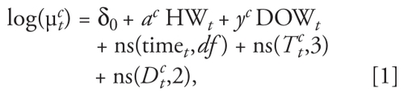
Separate mortality effect for each heat wave in a community
μ_{t}^{c} = expected mortality rate for community c on day t
δ₀ = model intercept
a^{c} = vector of regression coefficients for heat waves for community c (one per heat wave)
HW_{t}= 0 if day t is a non-heat wave day, 1 if day t is the first day of any heat wave, 2 if day t is the second or later day in the first heat wave in the community, 3 if day t is the second or later day in the second heat wave in the community, and so forth
y^{c}= vector of regression coefficients for day of the week for community c
DOW_{t} = categorical variable for day of the week
ns(time_{t}) = natural cubic spline of time, with 3 degrees of freedom (df) per warm season (1 May–30 September)
ns(T_{t}^{c}) = natural cubic spline of maximum temperature for community c for day t (df = 3 with knots at quantiles)
(D_{t}^{c}) = natural cubic spline of adjusted dew point temperature for community c on day t (df = 2)

Slide 8


Community-specific Bayesian hierarchical model
Overall heat wave effect for each community
β̂^{h} = estimated effect of heat wave h on mortality
β^{h} = true effect of heat wave h on mortality
v̂^{h} statistical variance of β̂^{h}
μ = true average heat wave effect across all heat waves
τ² = between-heat wave variance of the true effect
n = number of heat waves
Notes:
National and regional heat wave effects were estimated using similar multistage hierarchical Bayesian models. Results were generated separately for three U.S. regions, Northeast, Midwest, and South,

Slide 9

Hierarchical Bayesian model
Heat wave characteristics
x_{j}^{h} = heat wave characteristic j (intensity, duration, or timing) for heat wave h
x̄_{j} = mean characteristic j across all heat waves
α₀ = average ln(relative rate) when x_{j}^{h} = x̄_{j}, α_{1,j} = change in ln(relative rate) for unit increase in x_{j}^{h} − x̄_{j}
τ² = variance of heat wave effects

Slide 10
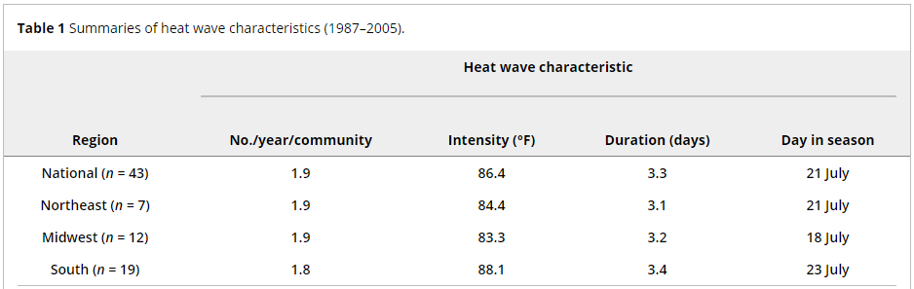
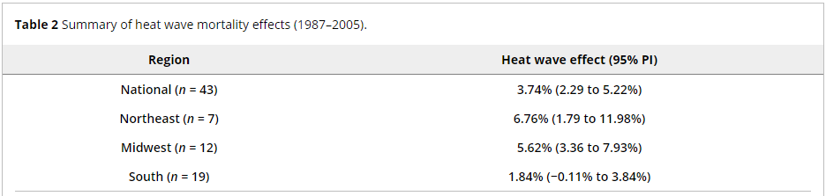
Some southern cities (e.g., Charlotte, NC; Dallas/Fort Worth, TX; Oklahoma City, OK; Tulsa, OK) showed no mortality increase during heat waves.

Slide 11
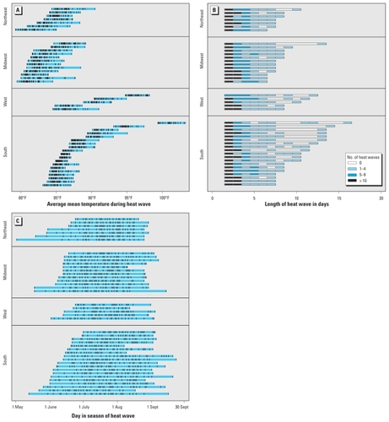
Fig. 1. Each horizontal line represents one community, and the length of each line indicates the range of each heat wave characteristic in that community.
Intensity of each individual heat wave within a community (tick marks within blue bars).
Number of heat waves according to duration (shading) by community. By definition, all heat waves lasted ≥ 2 days.
Heat wave timing in season by community (tick marks, individual heat waves).

Slide 12
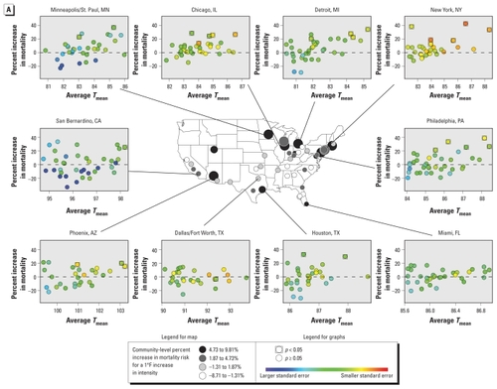
Impact of heat wave characteristics on mortality risk: 10 most populous communities

Slide 13
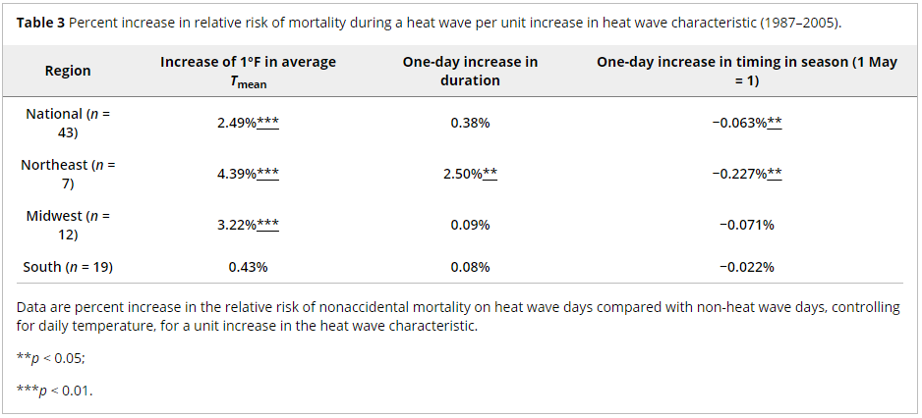

Slide 14
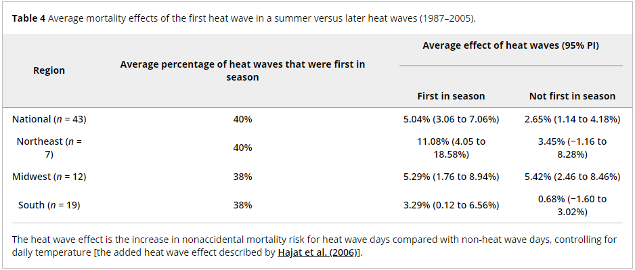

Slide 15
Discussion
Heterogeneity between communities in both heat wave effects and effect modification by heat wave characteristics:
a) physical acclimatization of residents of warmer communities
b) different levels of exposure in different communities (e.g., AC use, housing structure, clothing type)
c) different community-level responses to extreme heat (e.g., heat wave warning systems)
d) different demographics (e.g., population in high risk categories such as the elderly or less healthy)
e) different geographical, meteorological, or pollution factors within communities that might confound or modify temperature–mortality relationships.
indicates the importance of developing heat wave response plans that are community specific

