Slide 1

Examining Agricultural Workplace Micro and Macroclimate Data Using Decision Tree Analysis to Determine Heat Illness Risk
Valerie Vi Thien Mac, PhD, RN, Vicki Hertzberg, PhD, and Linda A. McCauley, PhD, RN
(Emory)
JOEM Volume 61, Number 2, February 2019
Funding: NIOSH R01OH010657 (PI: L. McCauley) and the National Institute for Nursing Research under grant T32NR012715 (PI: S. Dunbar)

Slide 2
Aspects of Interest
Examining variability between “regional” weather station and individual-level worksite exposure
Application of personal temperature logger – participants also wore physiological monitoring devices, but not reported in this paper
Use of conditional inference (regression) trees – Why???
Notes:
Instead of R2, RMSE

Slide 3
Objective / Aims
examine the associations between regional weather data and agricultural worksite temperatures in Florida
(1) determine whether regional weather data are associated with direct worksite monitoring of environmental conditions
(2) utilize regional weather data to build a useful model for predicting worksite environmental conditions for agricultural workers.

Slide 4
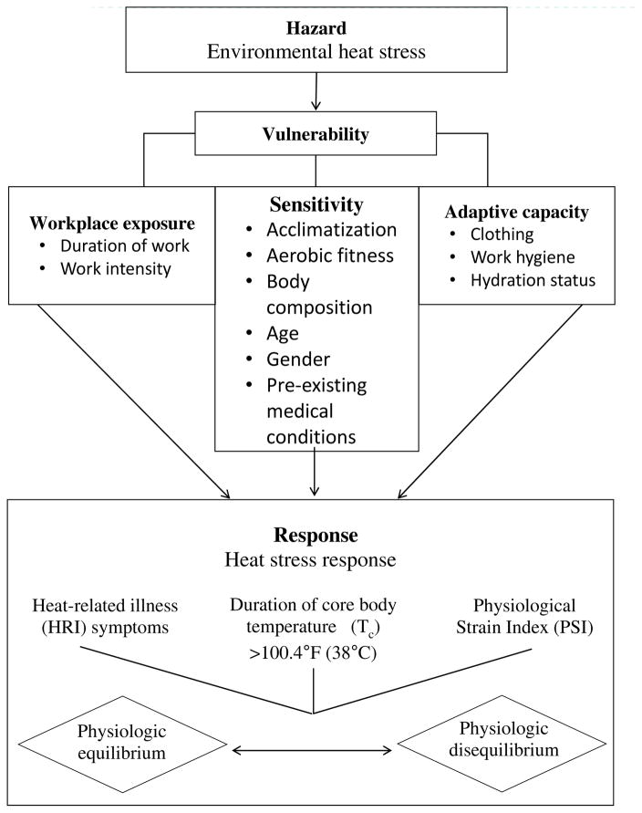
Farmworker Vulnerability to Heat Hazards Framework
Mac VVT, McCauley LA. Farmworker Vulnerability to Heat Hazards: A Conceptual Framework. J Nurs Scholarsh. 2017;49(6):617–624. doi:10.1111/jnu.12327

Slide 5
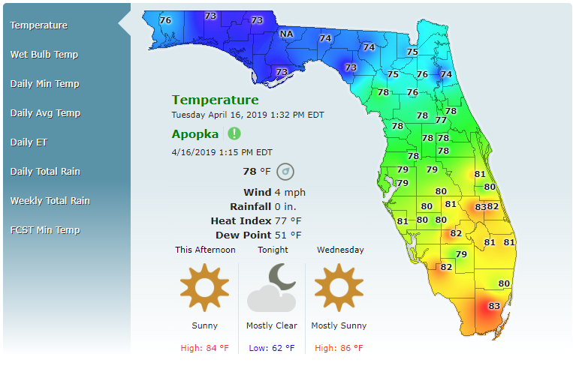

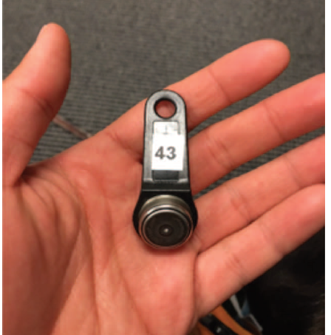
Study design
two different agricultural communities in Florida during the summers of 2015 to 2016: Apopka (n = 39), Immokalee (n = 66)
monitored up to 3 days – 284 days of data; 18,769 observations
weather: FAWN (35 stations in Florida), 15 minute resolution
Notes:
Stations present in communities – what about communities without stations

Slide 6
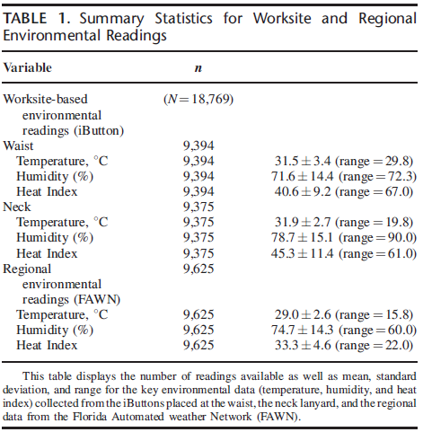
Notes:
2 locations – not stratified

Slide 7
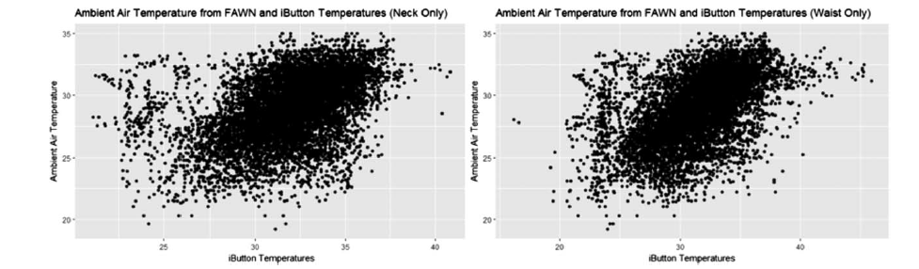
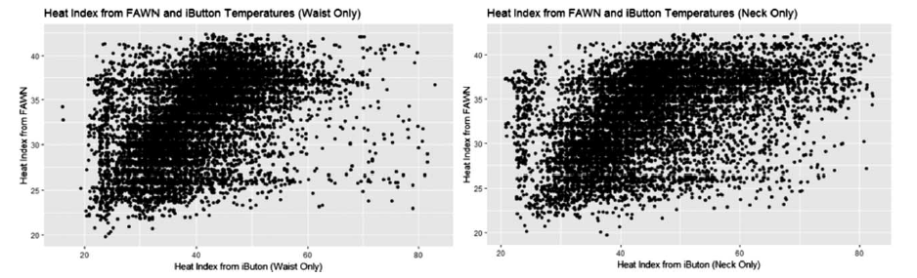

Slide 8
Conditional inference trees
unbiased recursive partitioning
non-parametric class of decision trees
uses a statistical theory (selection by permutation-based significance tests) in order to select variables instead of selecting the variable that maximizes an information measure (Gini coefficient or Information Gain)
tree growth is based on statistical stopping rules

Slide 9
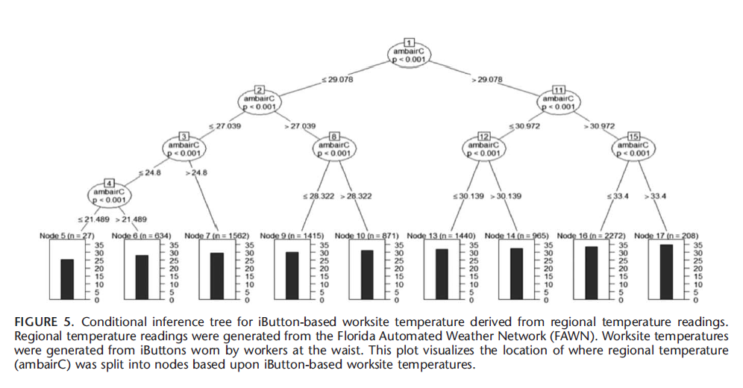

Slide 10
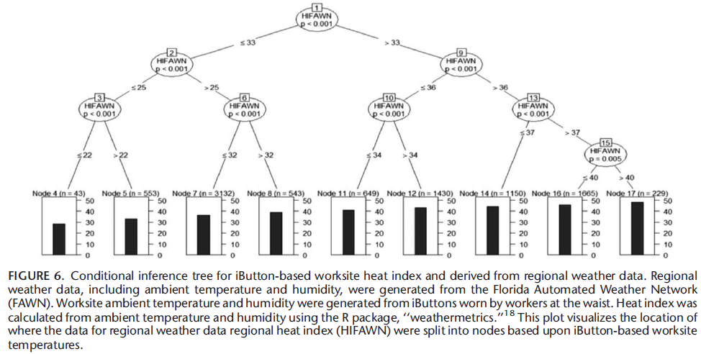

Slide 11
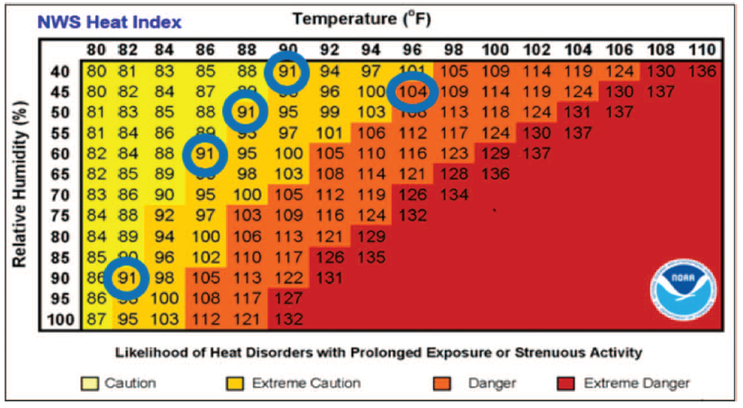
Partitioning at 33.08C (91.4 8F) indicates that two categories of worksite microenvironment calculations can be distinguished based upon the regional HI calculations from the FAWN, with over half of the observations being more than 33.08C ...
Of great interest are the nodes at 33.08C and 40.08C that appear to closely mirror the demarcation levels between ‘‘Caution’’ and ‘‘Extreme Caution’’

Slide 12
Results
The results of this study provide evidence that the weather monitoring stations in Florida can provide data that closely reflect the temperature conditions that workers are experiencing, particularly as the temperature rises.
- not what it looks like to me
These findings provide evidence that meteorological weather data and microenvironmental data have sufficiently strong correlations to identify levels that present a need to implement special
precautions to protect worker health.
- correlations not reported
-- The broader study framework appears promising

