Slide 1
Heat and Heat-illnesses AT CONUS US ARMY INSTALLATIONS
Shaman Lab Group, March 2019
Stephen Lewandowski

Slide 2
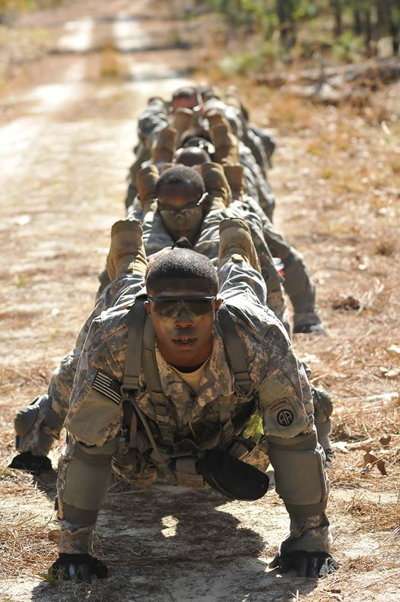
Overview
Background: Source population, incidence, locations, risk factors
Aims:
Association btw. heat and heat illness cases
(time-series analysis)
What is the relationship between heat exposure to HSI cases at each Army installation? Are there critical exposure thresholds, and do these vary by installation?
Risk factors / individual effect modifiers
(case-crossover analysis)
How do risk factors such as BMI, rank, or time in service modify the risk of HSIs?
Forecasting / Prediction
What are the implications of changing climate and population trends to the risk of HSIs in the Army?
Paratroopers from the 1st Squadron, 73rd Cavalry Regiment, 2nd Brigade Combat Team, 82nd Airborne Division, perform a team pushup in unison during the modified physical training test event of the battalion's Spur Ride qualification course on Fort Bragg, N.C., April 23. (Army Photo by Sgt. Eliverto V. Larios)

Slide 3
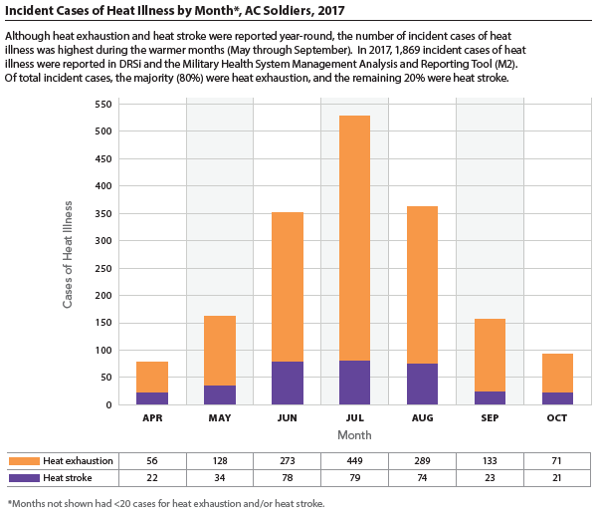
The number of reported
heat illnesses has increased
over the past 4 years.

Slide 4
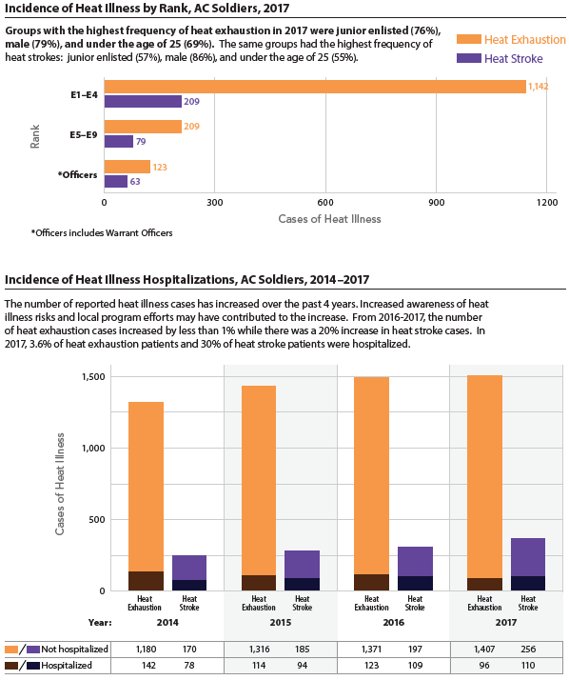
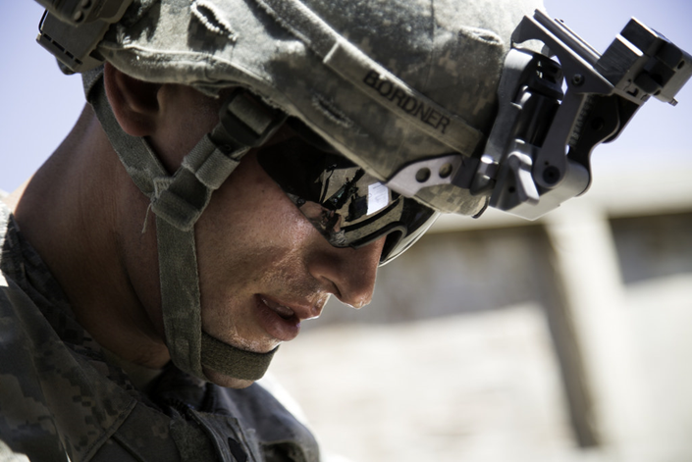
Spc. Brandon Bordner, infantryman, Company A, 2nd Battalion, 8th Infantry Regiment, 2nd Armored Brigade Combat Team, 4th Infantry Division sweats in the Kuwaiti sun as he assembles a radio during the brigade's Soldier and NCO of the Year competition at Camp Buehring, Kuwait, April 24, 2014. (U.S. Army photo by Sgt. Marcus Fichtl, 2nd ABCT PAO, 4th Inf. Div.)
Rates highest among junior enlisted,
males, and Soldiers <25 years of age
Strength: Data on non-hospitalized cases
In 2017, 3.6% of heat exhaustion patients and 30% of heat stroke patients were hospitalized.

Slide 5
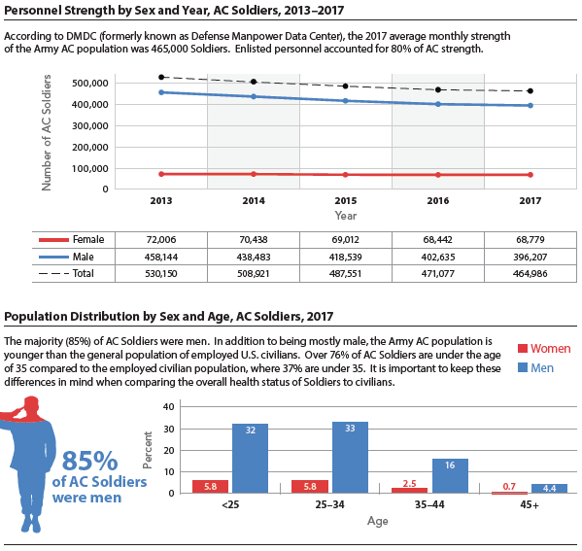


Army AC population demographics differ significantly from the U.S. civilian population, and can vary greatly by command and installation.
Initial Entry Trainees arrive at Echo Company, 2nd Battalion, 19th Infantry Regiment on Fort Benning, Ga., July 13, 2018 for the first day of the 22-week One Station Unit Training extension pilot program. (U.S. Army photo by Patrick A. Albright, Fort Benning Maneuver Center of Excellence)

Slide 6
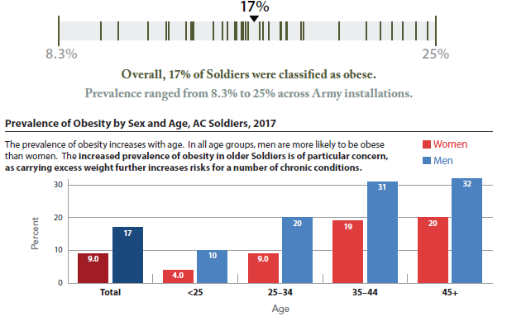
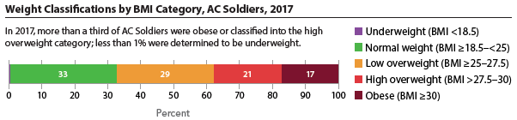
The high prevalence of obesity in the U.S. poses a serious challenge to recruiting and retaining healthy Soldiers.

Slide 7
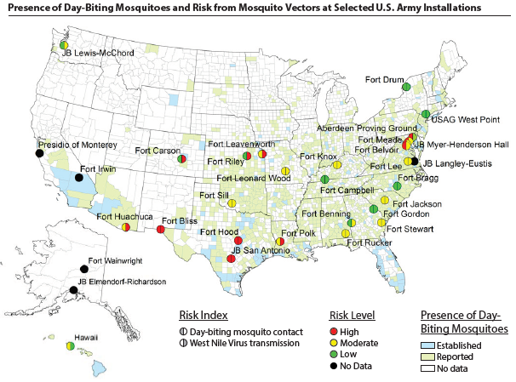

Slide 8
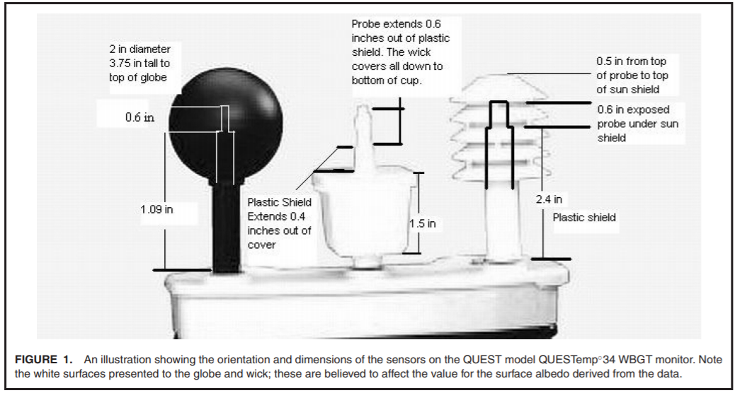
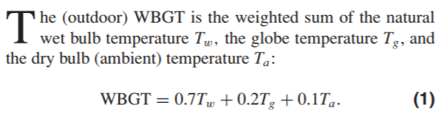
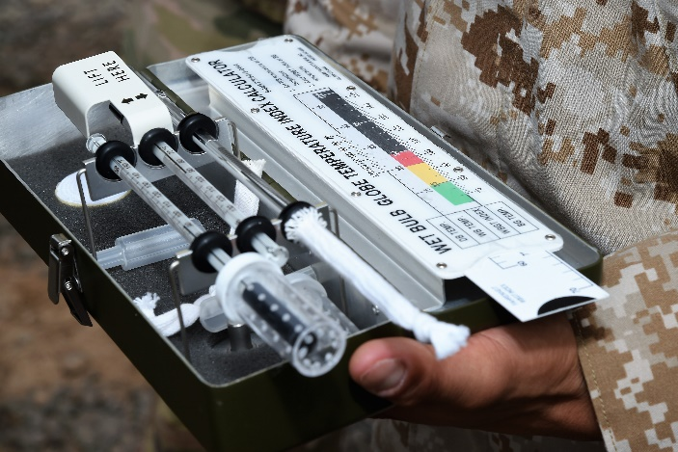
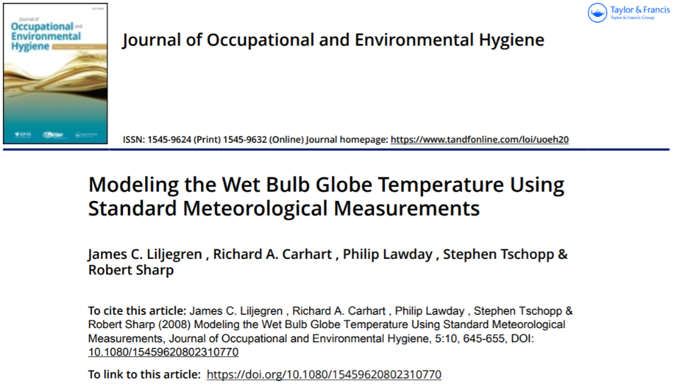
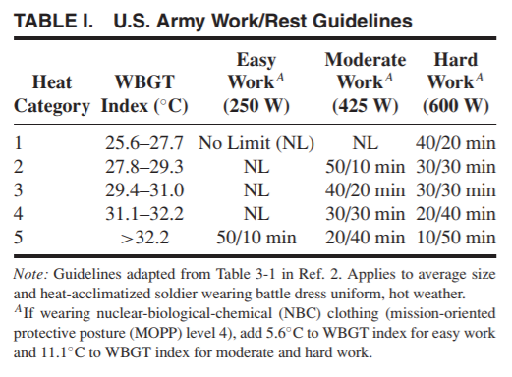
WBGT
(U.S. Air National Guard photo by Master Sgt. Paul Gorman)
Argonne National Laboratory, Decision and Information Sciences Division, Lemont, Illinois
Notes:
The WetBulb Globe Temperature (WBGT) is a measure of the heat stress in direct sunlight, which takes into account: temperature, humidity, wind speed, sun angle and cloud cover (solar radiation). This differs from the heat index, which takes into consideration temperature and humidity and is calculated for shady areas. If you work or exercise in direct sunlight, this is a good element to monitor. Military agencies, OSHA and many nations use the WBGT as a guide to managing workload in direct sunlight.

Slide 9
Outdoor WBGT Calculation (Liljegren et al.)
Sample calculations
Output
WBGT
Inputs
calculate the cosine solar zenith angle and the fraction of the solar irradiance due to the direct beam
calculate the convective heat transfer coefficient in W/(m2 K) for a long cylinder in cross flow and for flow around a sphere
calculate the saturation vapor pressure (mb) over liquid water or ice
calculate the dew point or frost point temperature, K
calculate the viscosity of air, kg/(m s)
calculate the thermal conductivity of air, W/(m K)
calculate the diffusivity of water vapor in air, m2/s
calculate the heat of evaporation, J/(kg K), for temperature in the range 283-313 K
calculate the atmospheric emissivity
estimate 2-m wind speed for all stability conditions
estimate the stability class
year, month, day, hour, minute, gmt, avg
lat, lon
solar,
pres,
Tair,
relhum,
speed,
zspeed,
dT,
urban
Tg, globe temp
Tnwb, natural wet bulb temp
Tpsy, psychrometric wet bulb temp
Twbg, wet bulb globe temp

Slide 10
Specific Aim 1
Heat indicator
Temperature
WBGT
Heat Index
Averaging (Daily)
Max
Mean
Min
Sum (degree-days)
Outcome
Heat exhaustion
Heat stroke
Heat exhaustion + heat stroke
Total HSI
Levels
Installation
Region
National
NLDAS-2,
GRIDMET
AFHSB
DMED
Method: Time-Series (non-linear), Poisson/Quasi-Poisson (counts), Rate ratio
Examine how day-to-day variation in “heat” is associated with day-to-day variation in the number of HSI events
Windows of Exposure: distributed lags (constrained, non-linear)
Assess breakpoint (hockey-stick) models; piecewise linear `segmented`
Random effects modeling for installation, regional, national levels
Generate installation-specific exposure-response curves for temperature metrics and lag structures

Slide 11
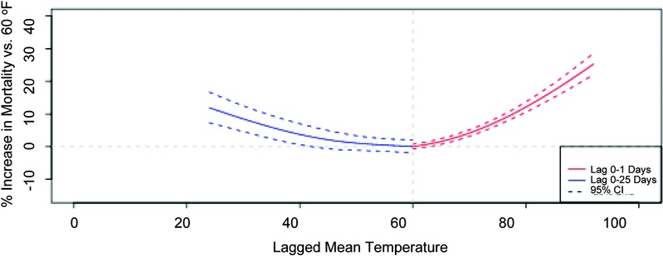
Example Plot – Time Series
Relationship between temperature and risk of mortality, comparing various temperature levels with a reference temperature of 60°F for New York City.
Weather-Related Mortality: How Heat, Cold, and Heat Waves Affect Mortality in the United States. Epidemiology20(2):205-213, March 2009.

Slide 12
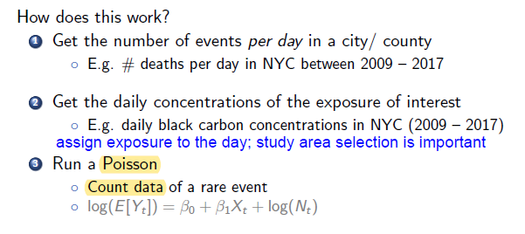
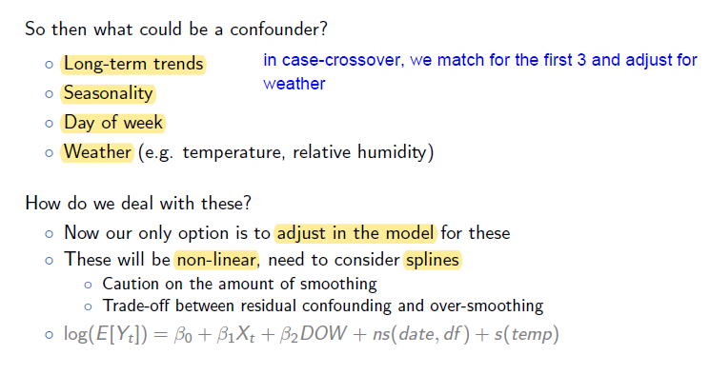
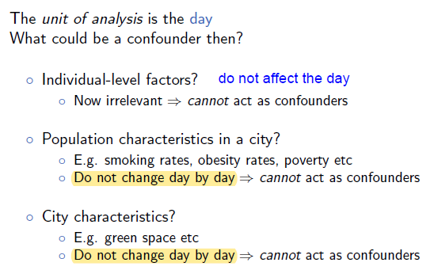
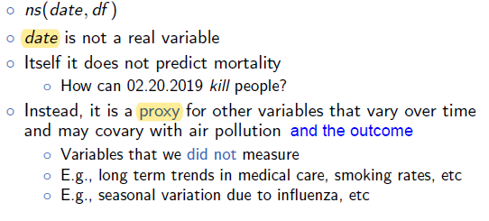
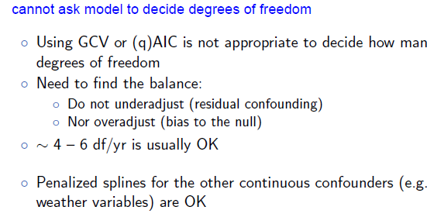
Time Series Model Variable Selection
Potential Confounders
Addressed by time series design:
Individual-level factors: do not affect the day
Population characteristics on an installation: do not vary day-to-day
Installation characteristics (e.g. green space): do not vary day-to-day
Adjust for in model:
Long-term trends
Seasonality
Day of week
Weather (main effect)
Air pollution

Slide 13
TS Model Development
glm, Poisson (linear)
$$\log\left(E\left[{HSI}_{t}\right]\right)= β_{0}+ {"heat"}_{1}X_{t}+ β_{2}DOW+ns\left(date, df∗\#yrs\right)$$
gam, Poisson (“heat” as spline)
$$\log\left(E\left[{HSI}_{t}\right]\right)= β_{0}+s("heat") + β_{1}DOW+ns(date,df∗\# yrs)$$
gam, Poisson, distributed lag nonlinear model
$$\log\left(E\left[{HSI}_{t}\right]\right)= β_{0}+cb.s("heat") + β_{1}DOW+ns(date,df∗\# yrs)$$
cb: cross-basis matrix for predictor and lags
gam, Poisson, distributed lag nonlinear model, random effects model (region)
$$\log\left(E\left[{HSI}_{t,ij}\right]\right)= {(β}_{0}+b_{0i})+{cb.s("heat")}_{ij}+ {β_{1}DOW}_{ij}+{ns(date,df∗\# yrs)}_{ij}$$
Notes:
two dimensions of predictor and lags, given the functions selected to model the relationship in each space. Then, these one-dimensions basis matrices are combined in order to create the related cross-basis matrix, which can be included in a model formula to fit distributed lag linear (DLMs) and non-linear models (DLNMs).
Note that in GAMs there is no “regression equation” that is produced. Instead, the sense of the relationships between the response and individual predictors is illustrated using “partial residual plots” for individual predictors that show the relationship between that predictor and the differences (residuals) of a prediction of the response using all other predictors.

Slide 14
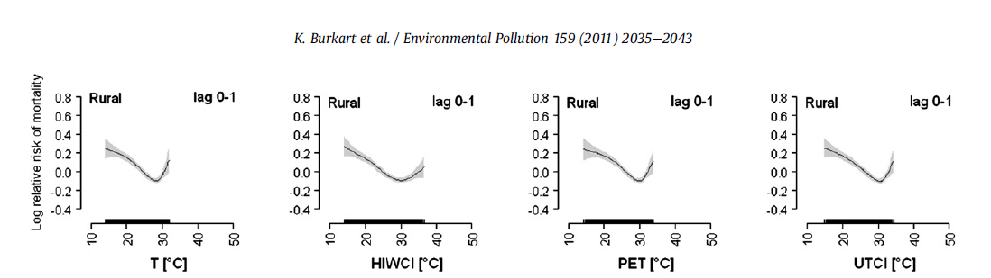
Breakpoint models (hockey stick models) were applied to detect threshold temperatures and to quantify the effect of cold and heat.
Fig. 3. Regression curves for daily all-cause mortality on the mean (equivalent) temperatures over the current and previous day (lag 0e1), the current and 6 previous days (lag 0e6), and the current and 13 previous days (lag 0e13). Curves are adjusted for trend, season, day of the month and age. The variable to which the plot applies (temperature or TPI) is displayed as a rug plot at the foot of each plot.

Slide 15
Specific Aim 2
Individual risk factors / effect modifiers
Method: Case-Crossover / conditional logistic regression / odds ratio
Sex
Age
Rank
BMI
Time in service
Deployments
Branch / MOS
Prior heat injury (?) / medical conditions
Pregnant
Each case serves as his/her own control
No confounding by time invariant variables
clogit: each case day is a strata
Interaction terms for effect modifiers

Slide 16
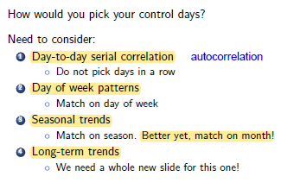
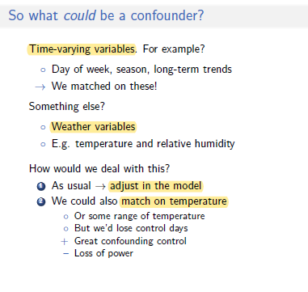
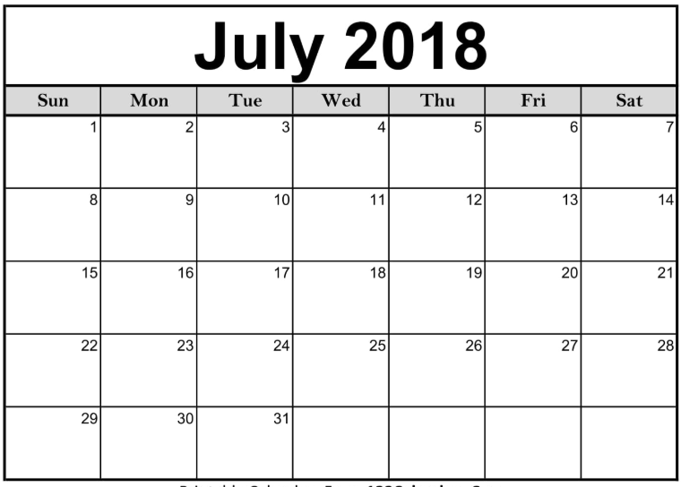
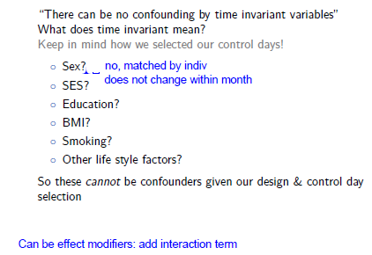




Control day selection
Notes:
GLM assumptions: The outcomes Y are independent
There is a linear relationship between the transformed outcome (link function!) and the predictors, but not with Y itself
NO homoscedasticity assumption
NO assumption of normally distributed errors

Slide 17

