Slide 1
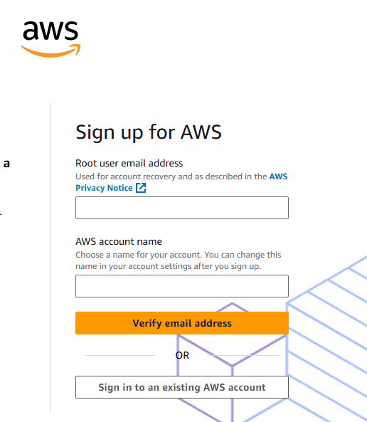
AWS Free Tier Account

Slide 2
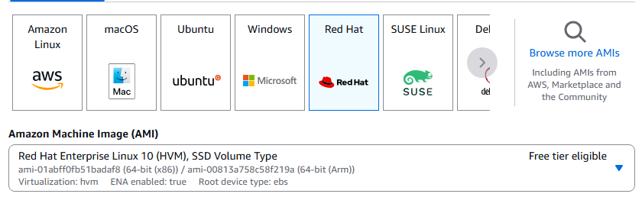
Choosing a Linux Flavor from AWS
Name the server: my-linux-server, Red Hat

Slide 3
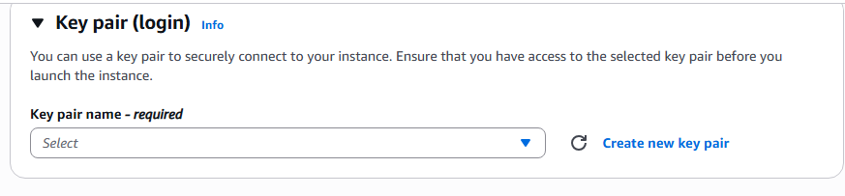
Choosing an SSH Key from AWS

Slide 4
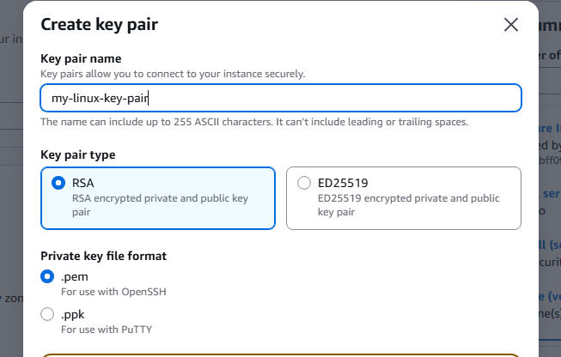
Choosing an SSH Key from AWS

Slide 5
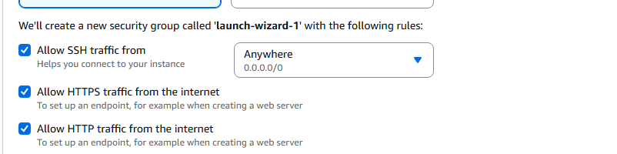
Allowing SSH, HTTPs & HTTP Connections to AWS
IP: 3.254.152.247

Slide 6
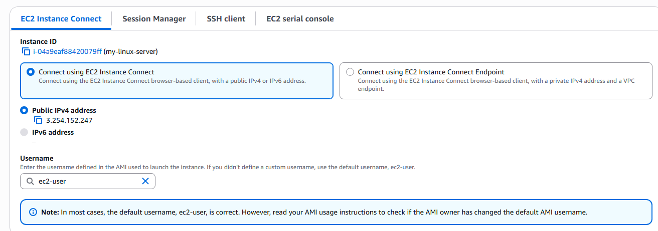
Instance Connections to AWS

Slide 7
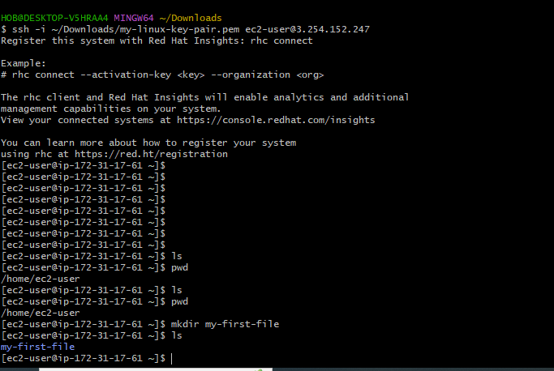
Login Successfully to AWS

