Slide 1
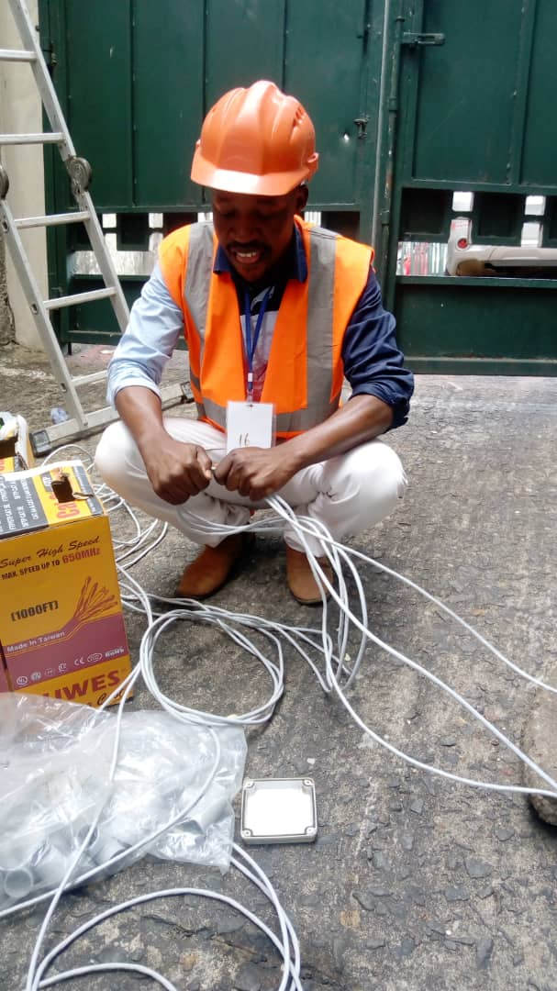
Network Practical Photos From the Industrial Attachment 2019 - 2021
1. Working With STP Cat6 Network Cables

Slide 2
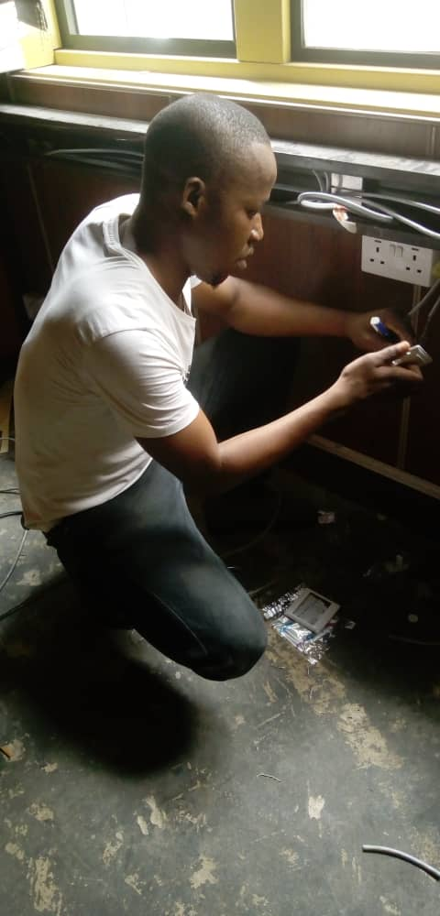
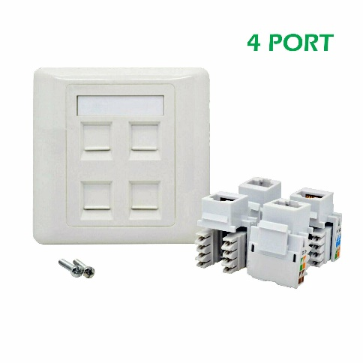
2. Fixing Jack Pinout into the faceplate to the walls

Slide 3
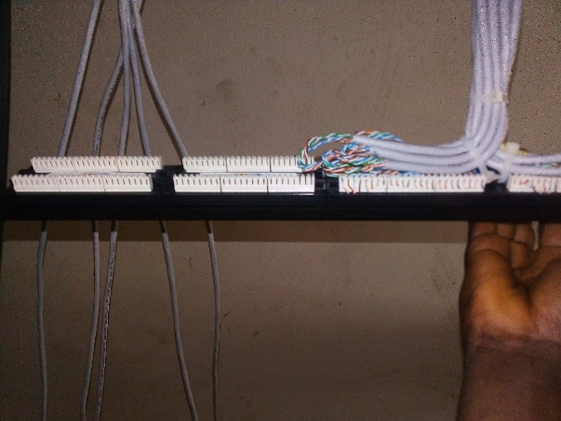
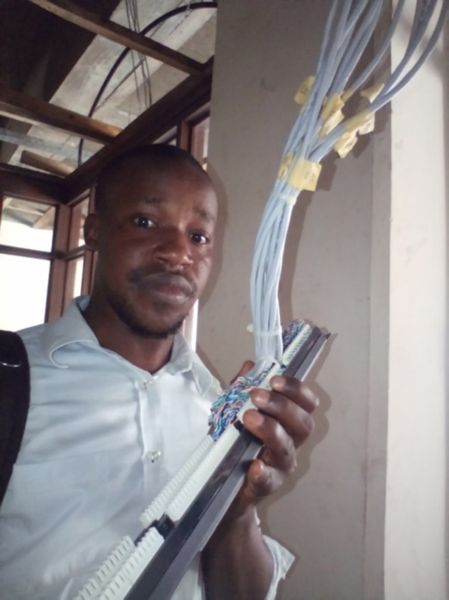
3. Punching Cat6 Cables into the Patch Panel

Slide 4
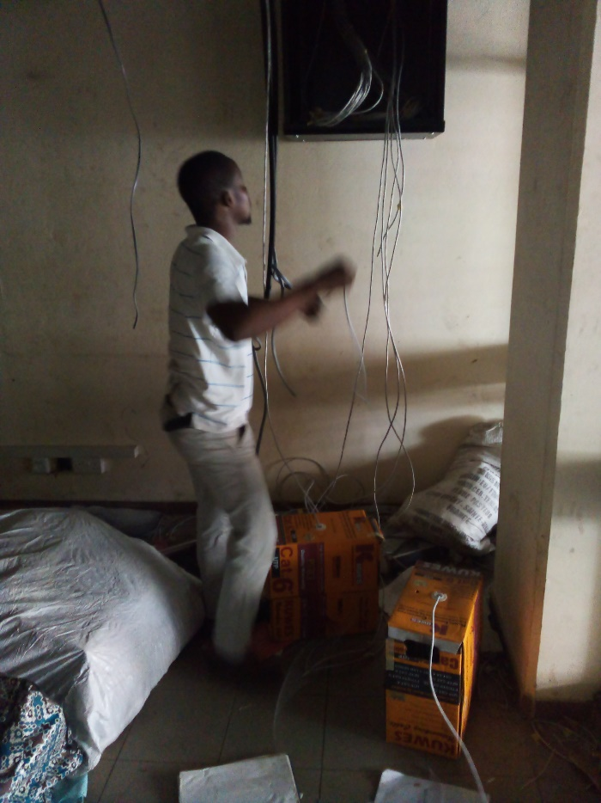
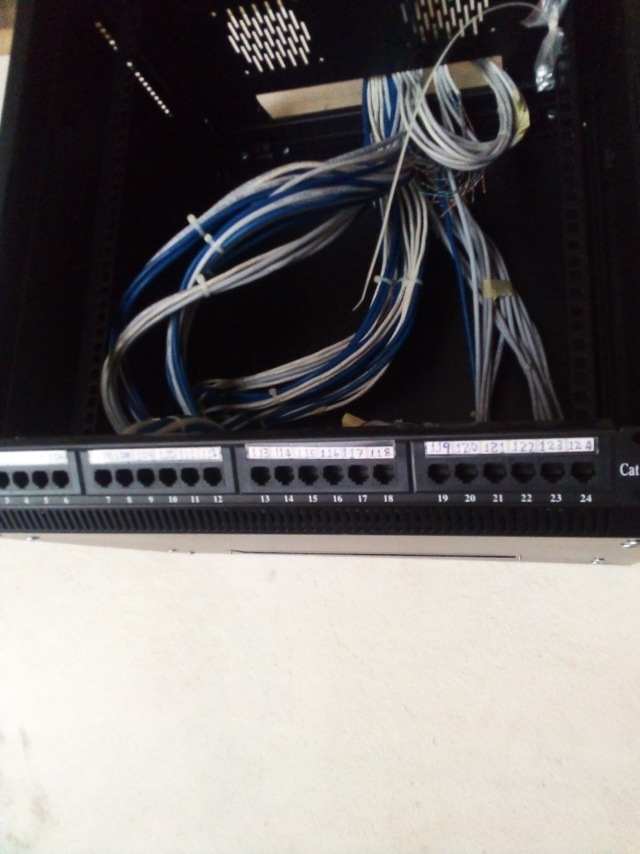
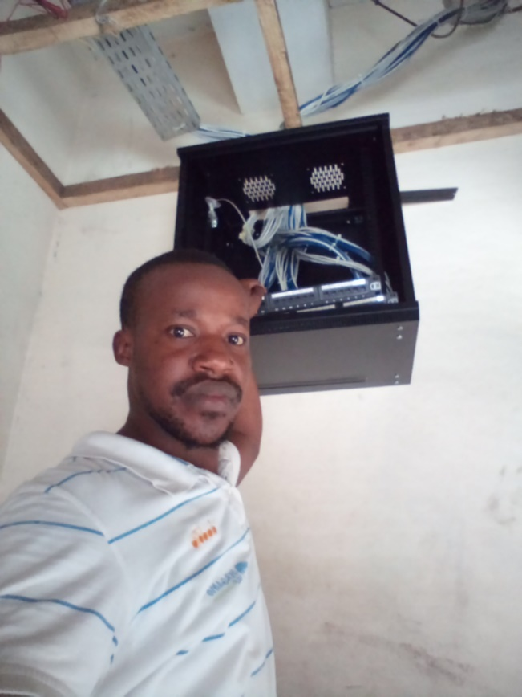
4. Mounting Patch Panels into the Cabinets

Slide 5
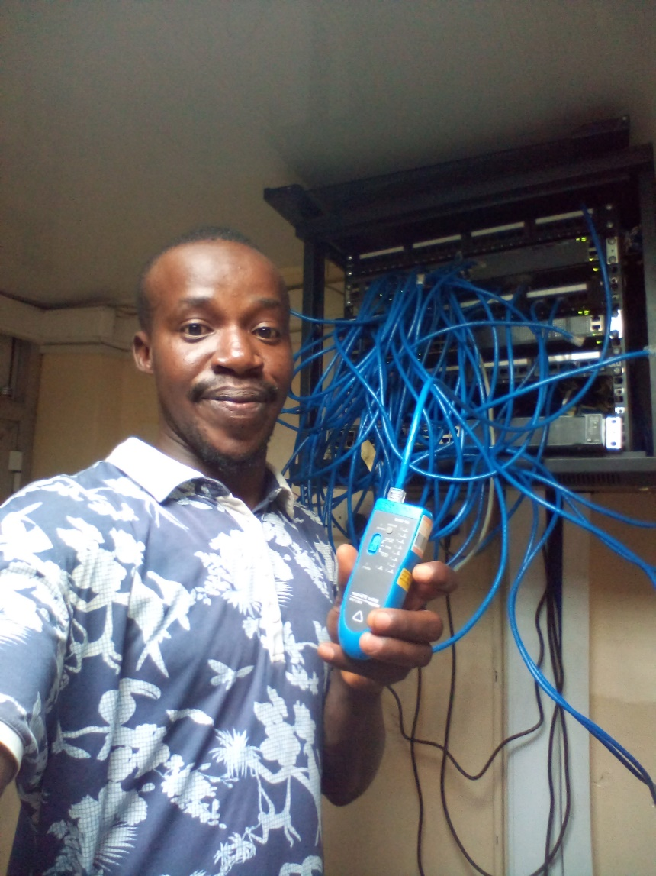
5.Troubleshooting Cat6 Network Cable Using Wire Tester

Slide 6
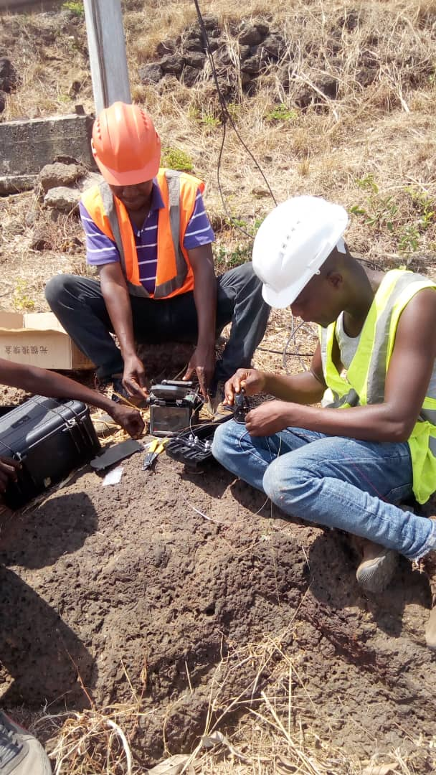
6. Splicing Multimode Optical Fiber Using Splicing Machine

Slide 7
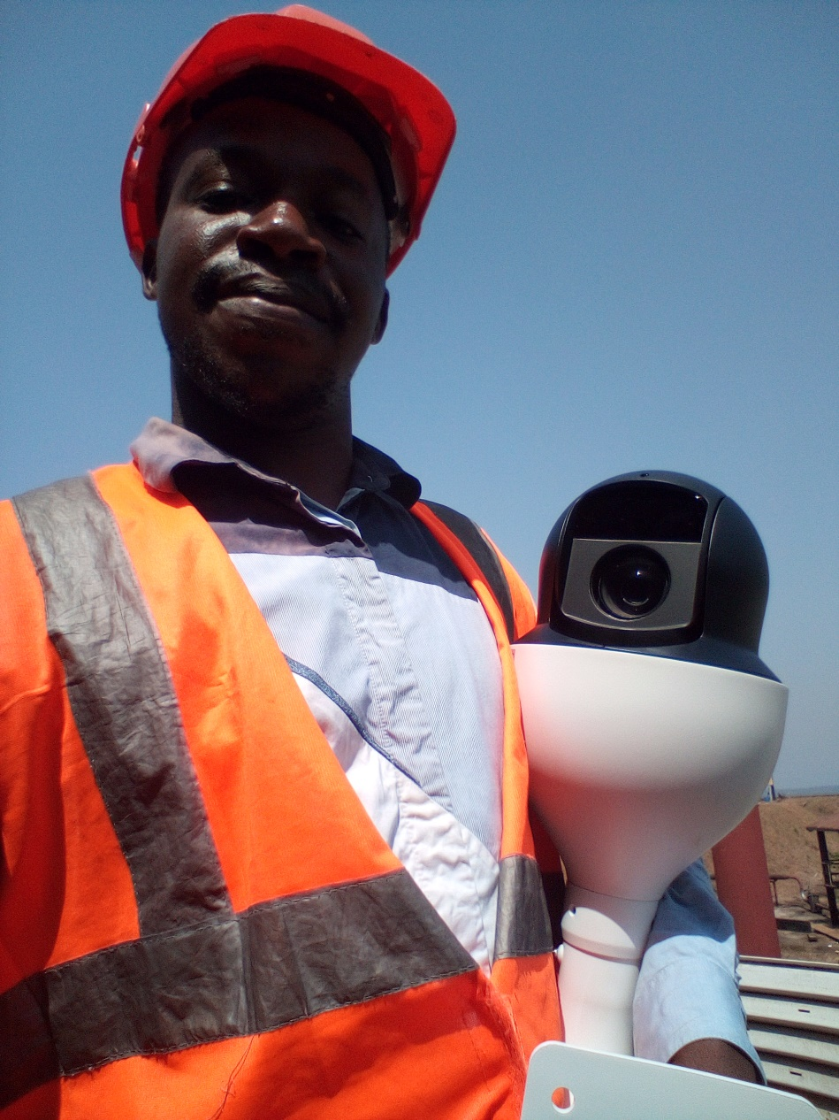
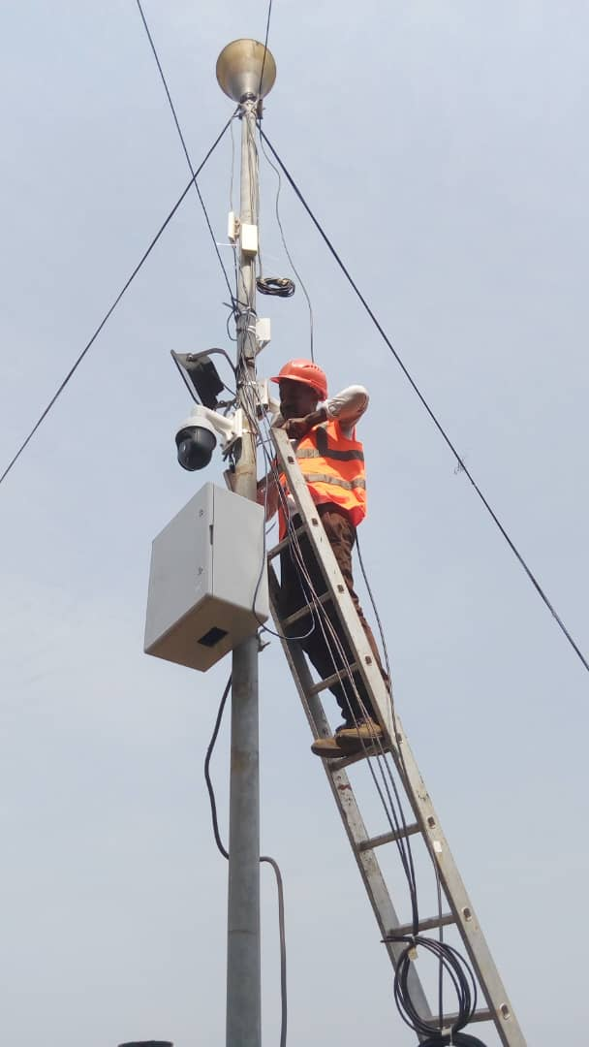
7. Hikvision IP Cameras Installation Using Multimode Fiber Cascaded with Cat6 Cables

Slide 8
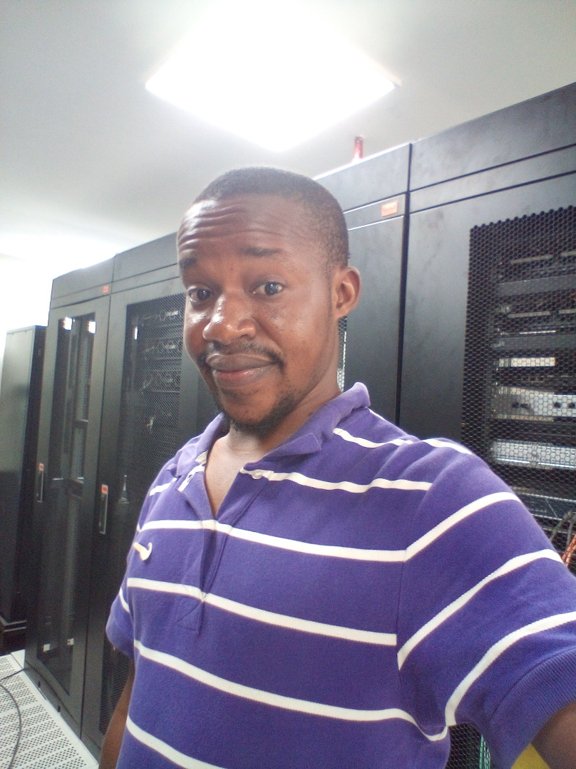
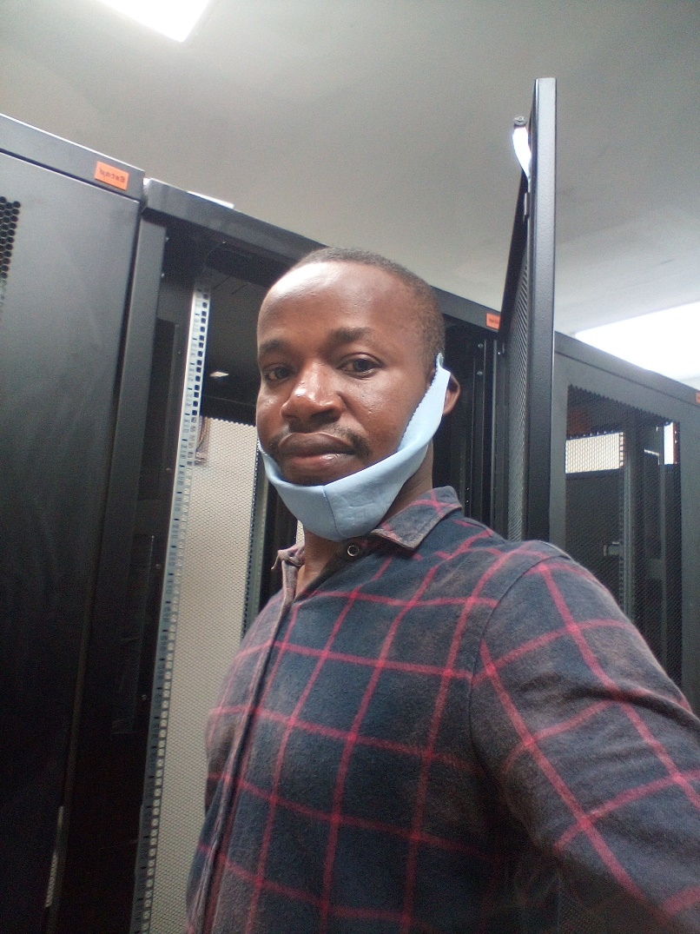
8. At the NASSIT Data Center Ongoing Installation

