Slide 1
Package embedder
Embed pure Python packages in a Python program/package
Ruud van der Ham, salabim.org

Slide 2
Package embedder
Use case:
Programs that rely on a pure Python package(s)
Packages that rely on a pure Python package(s)
No need for user to (pip) install these packages(s)
Guarantees that proper (older?) version is used
Examples:
PySimpleGUI, salabim, boltons, superstring, attr, skyfield, ...

Slide 3
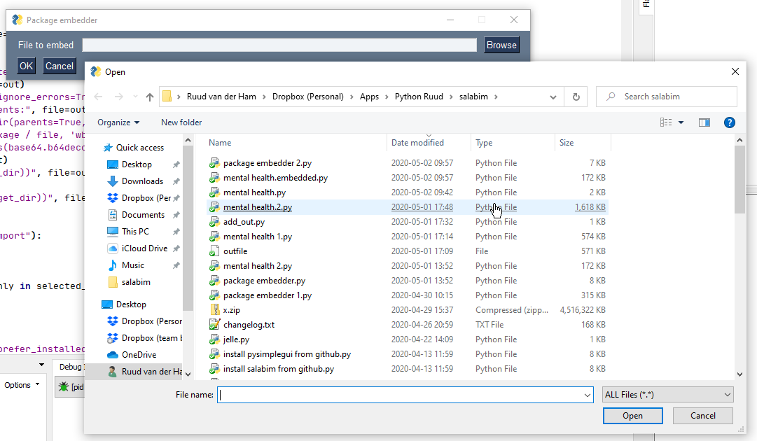
Package embedder
API
GUI to select program/package to embed package(s) in

Slide 4
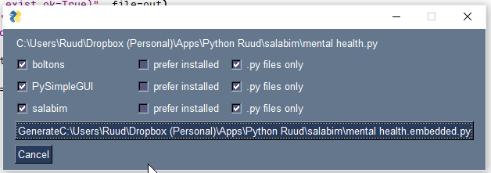
Package embedder
All embeddable package(s) are shown
Select which package(s) to embed
Select whether installed version should be preferred
Select whether only .py files should be embedded (e.g. salabim contains a number of font files in the package, skyfield contains a number of data files)

Slide 5
Package embedder
Result is written to a .embedded.py file

Slide 6
Package embedder
What happens at run time?
A copy of the original site-packages folder is written to the temp directory
This folder is either prepended or appended to sys.path
And then the program continues as usual
Consequences:
increases file size (e.g. appr. 190 kB for PySimpleGUI)
increases load time
leaves a copy of the package in the temp directory (is there a way to delete that at the termination of the program?)

Slide 7
Package embedder
Internals
Uses
PySimpleGUI as GUI engine → just some lines of code
pathlib for all file/folder handling
zlib to compress the package contents
base64.b64encode to encode the package contents
Reads input file to scan for import package ... or from package import ...
Checks whether package is in a site-packages folder
Encodes contents of all files in package folder in the output file
Excludes not pure Python packages (not 100% proof)

Slide 8
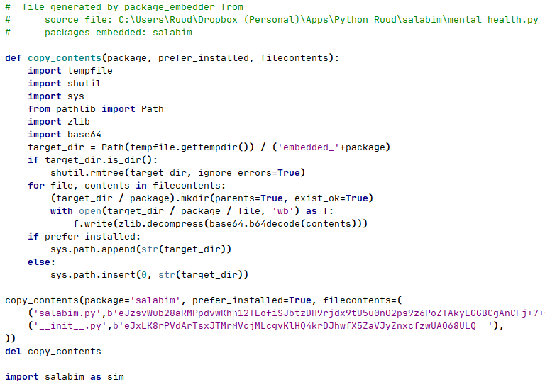
Package embedder

Slide 9
Package embedder
Source: https://github.com/salabim/package-embedder
Questions, remarks, feedback?

