Slide 1

DATA ENGINEERING
CHAPTER 5
Laszlo Sallo
SEPTEMBER 2020

Slide 2

WHY KNIME

Slide 3
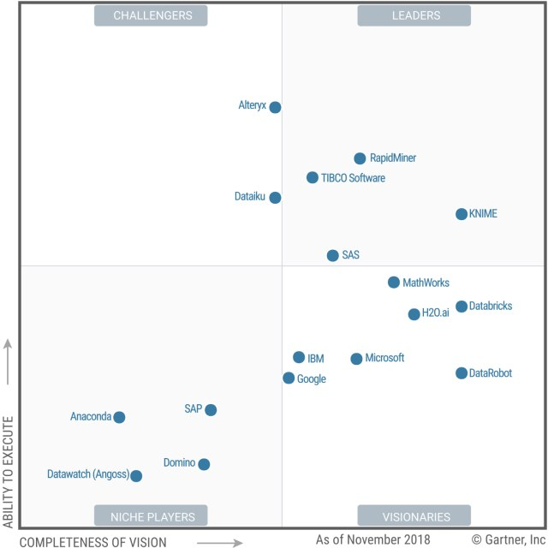
DATA SCIENCE AND ML PLATFORMS (GARTNER 2019)

Slide 4
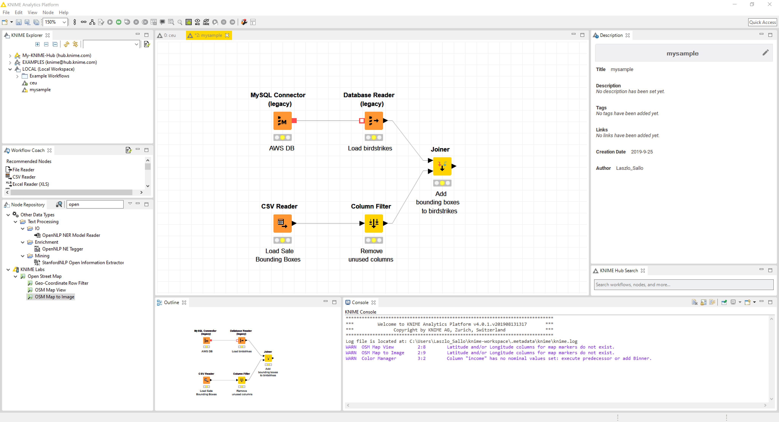

Slide 5
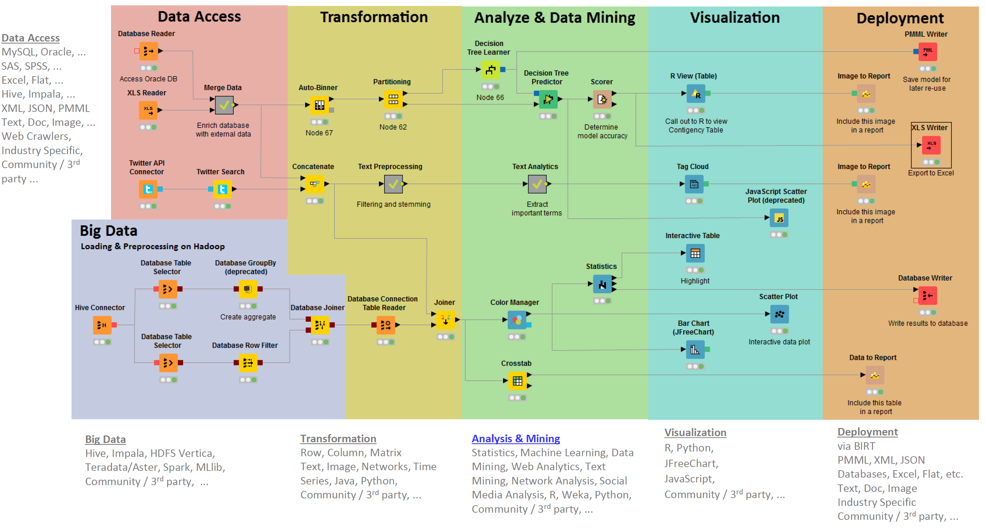
NODES CLASSIFICATION
Notes:
Why extensions figures separately?

Slide 6
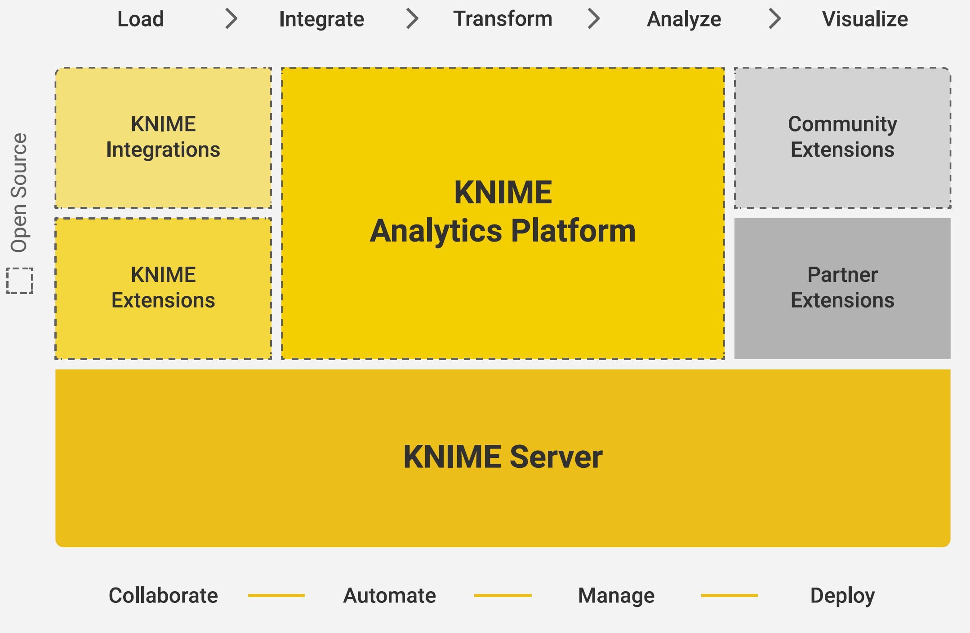
KNIME OVERVIEW
Notes:
Why extensions figures separately?
Knime server (enterprise feature)
collaboration
deployment with access rights
scheduler
web server
server in cloud

Slide 7
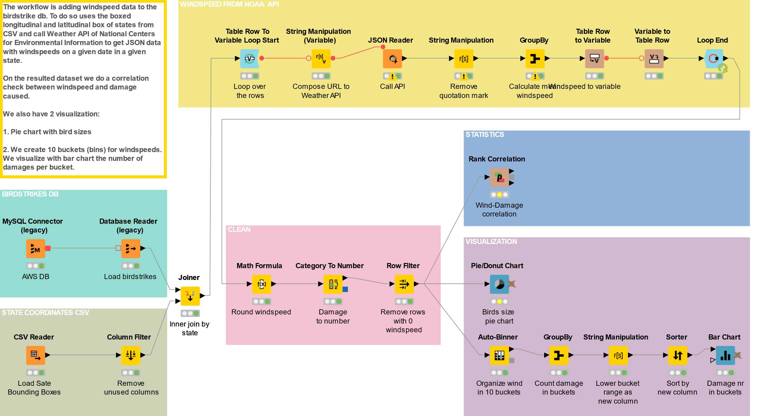

Slide 8
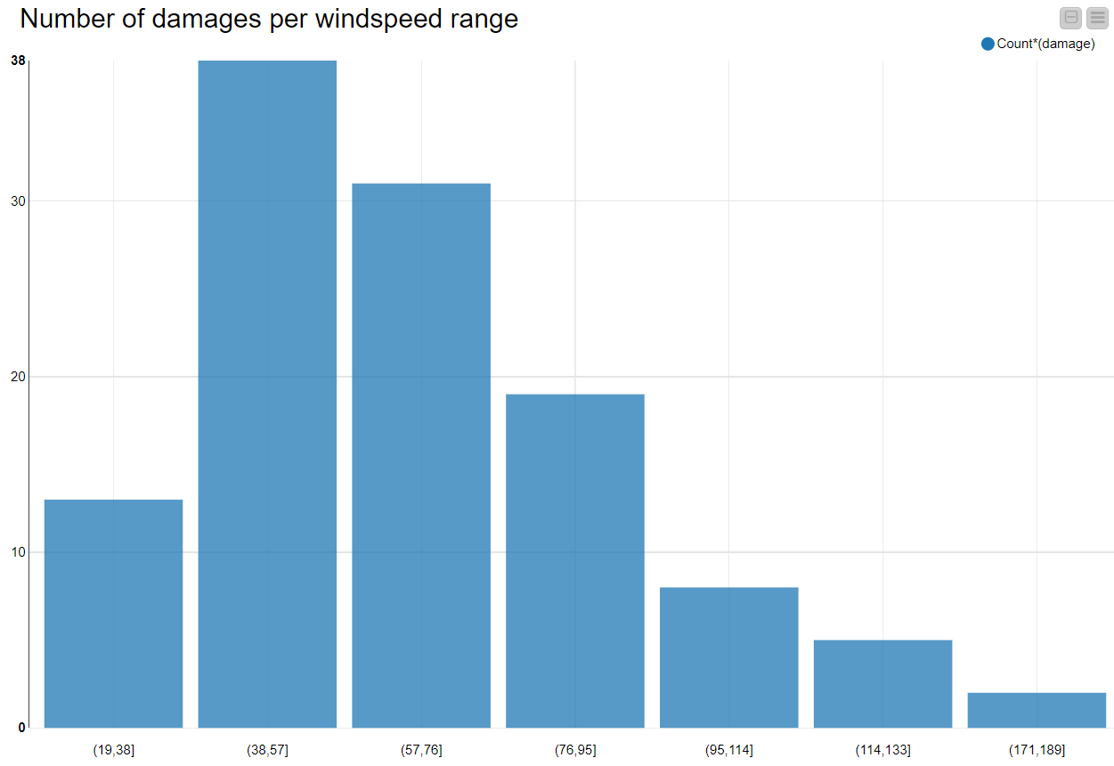
NUMBER OF DAMAGES PER WINDSPEED BUCKET

