Slide 1
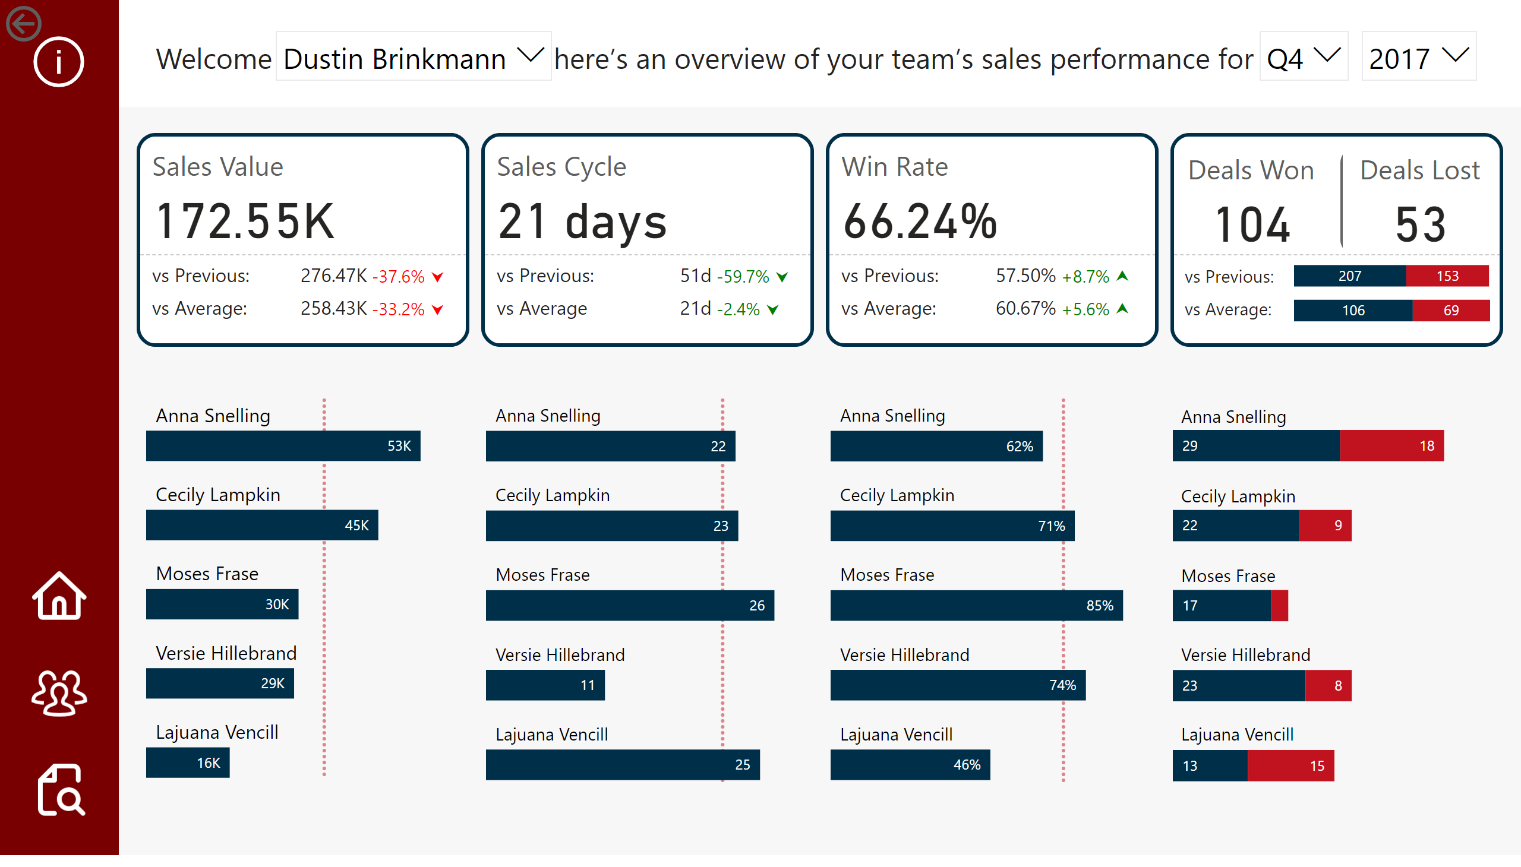
Page 1
Notes:
actionButton
No alt text provided
clusteredBarChart
No alt text provided
clusteredBarChart
No alt text provided
slicer
No alt text provided
slicer
No alt text provided
slicer
No alt text provided
textbox
No alt text provided
clusteredBarChart
No alt text provided
Sales
No alt text provided
Sales
No alt text provided
Deals Won, Deals Lost
No alt text provided
clusteredBarChart
No alt text provided
actionButton
No alt text provided
actionButton
No alt text provided
actionButton
No alt text provided
actionButton
No alt text provided
shape
No alt text provided
shape
No alt text provided
hundredPercentStackedBarChart
No alt text provided
hundredPercentStackedBarChart
No alt text provided

Slide 2
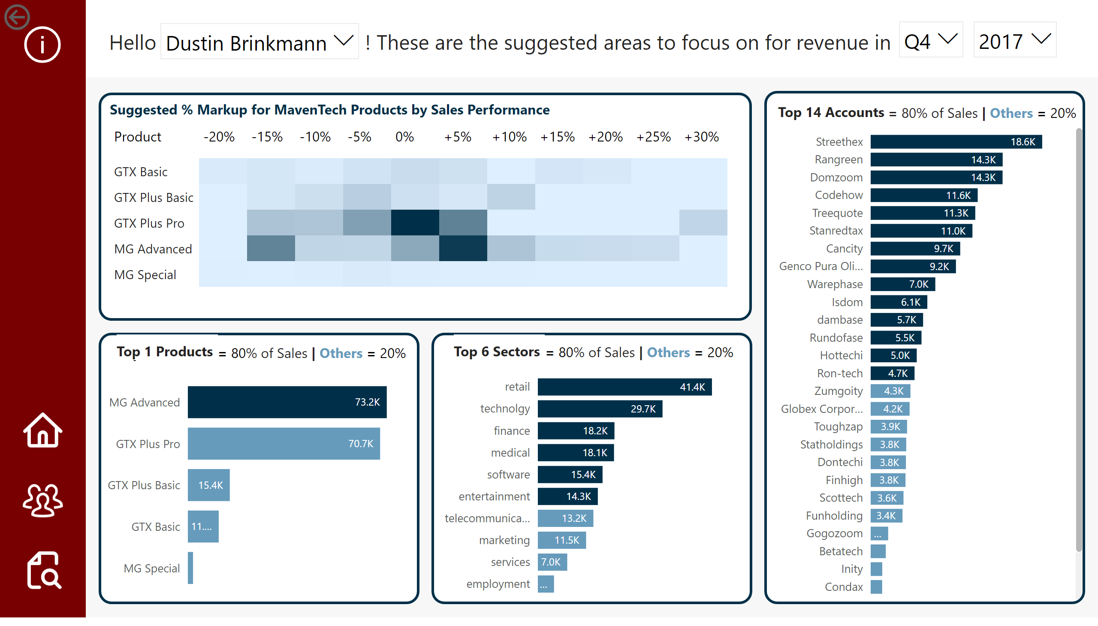
Page 2
Notes:
No alt text provided
slicer
No alt text provided
slicer
No alt text provided
slicer
No alt text provided
actionButton
No alt text provided
actionButton
No alt text provided
actionButton
No alt text provided
actionButton
No alt text provided
shape
No alt text provided
shape
No alt text provided
Suggested % Markup for MavenTech Products by Sales Performance
No alt text provided
actionButton
No alt text provided
textbox
No alt text provided
slicer
No alt text provided
slicer
No alt text provided
slicer
No alt text provided
Top X
No alt text provided
Top X
No alt text provided
cardVisual
No alt text provided
textbox
No alt text provided
cardVisual
No alt text provided
textbox
No alt text provided
textbox
No alt text provided
cardVisual
No alt text provided

Slide 3
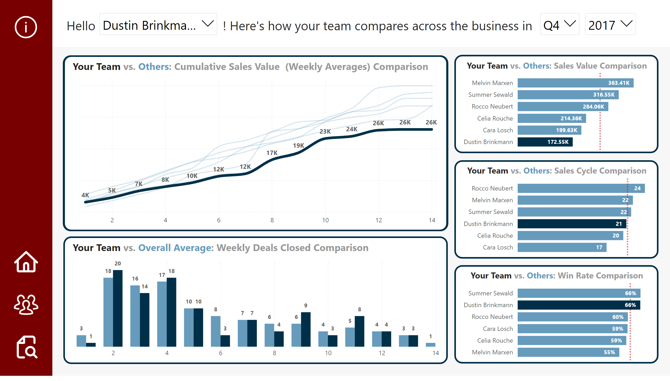
Page 3
Notes:
clusteredBarChart
No alt text provided
lineChart
No alt text provided
slicer
No alt text provided
slicer
No alt text provided
slicer
No alt text provided
slicer
No alt text provided
textbox
No alt text provided
shape
No alt text provided
shape
No alt text provided
slicer
No alt text provided
clusteredBarChart
No alt text provided
clusteredBarChart
No alt text provided
actionButton
No alt text provided
actionButton
No alt text provided
actionButton
No alt text provided
actionButton
No alt text provided
textbox
No alt text provided
textbox
No alt text provided
textbox
No alt text provided
textbox
No alt text provided
textbox
No alt text provided
clusteredColumnChart
No alt text provided
No alt text provided

Slide 4
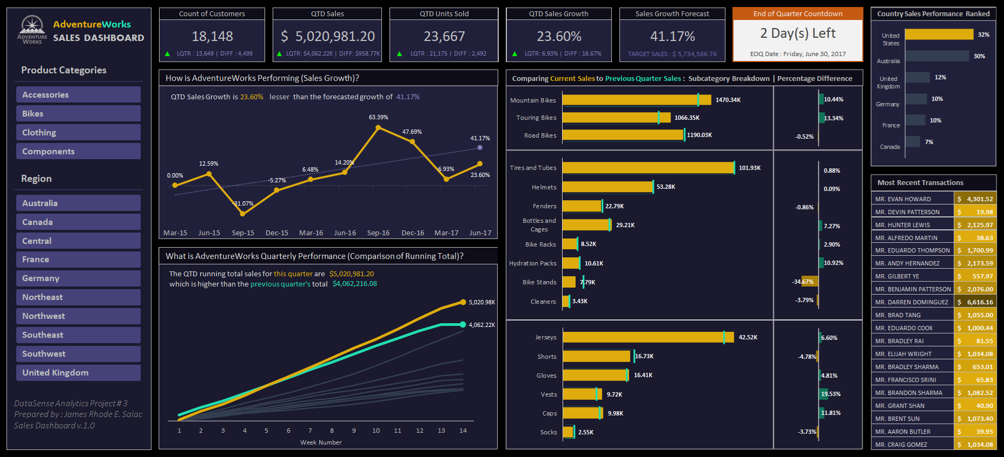

Slide 5
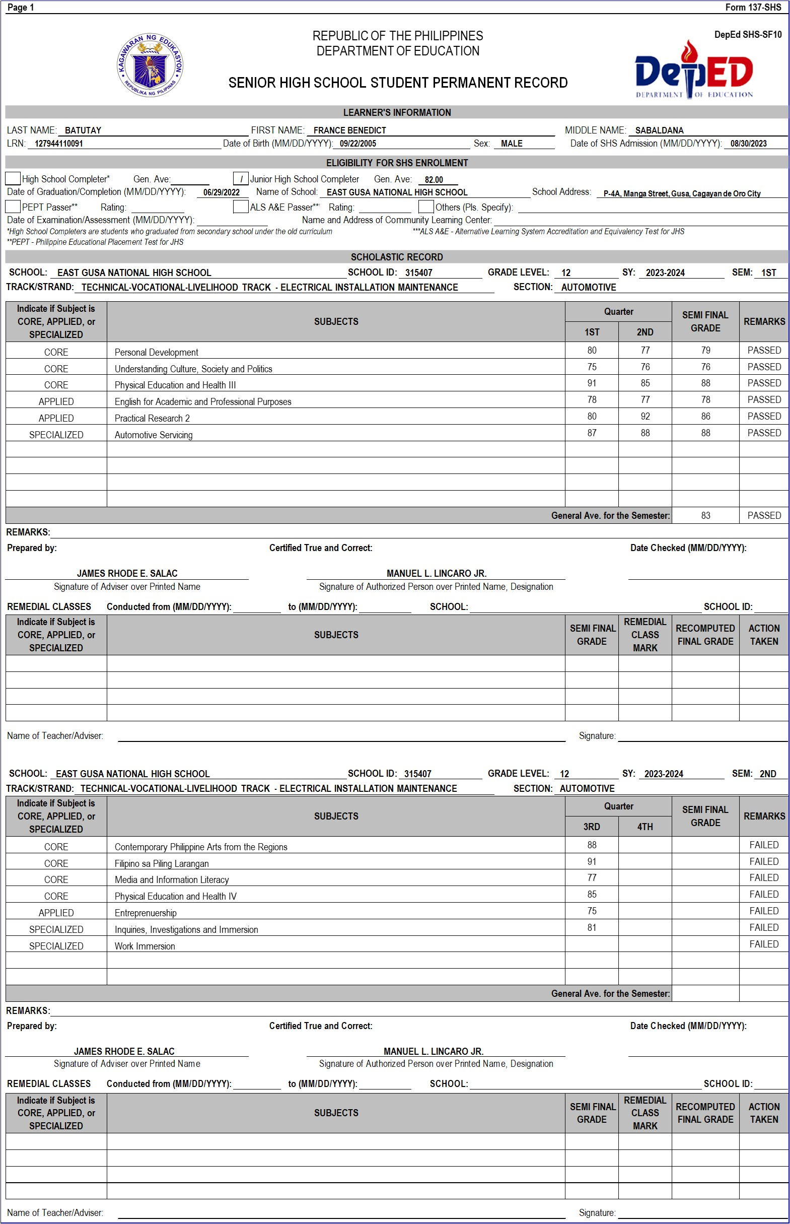
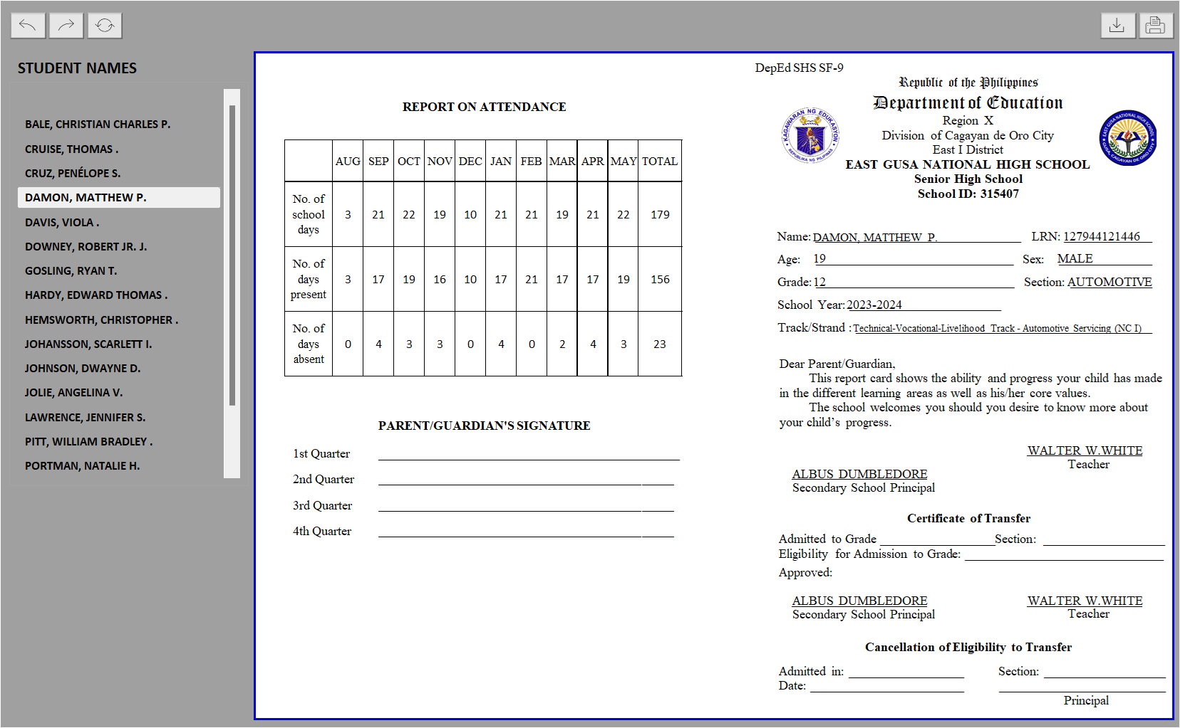
Automated
School
Forms v.1.0

Slide 6


