Slide 1
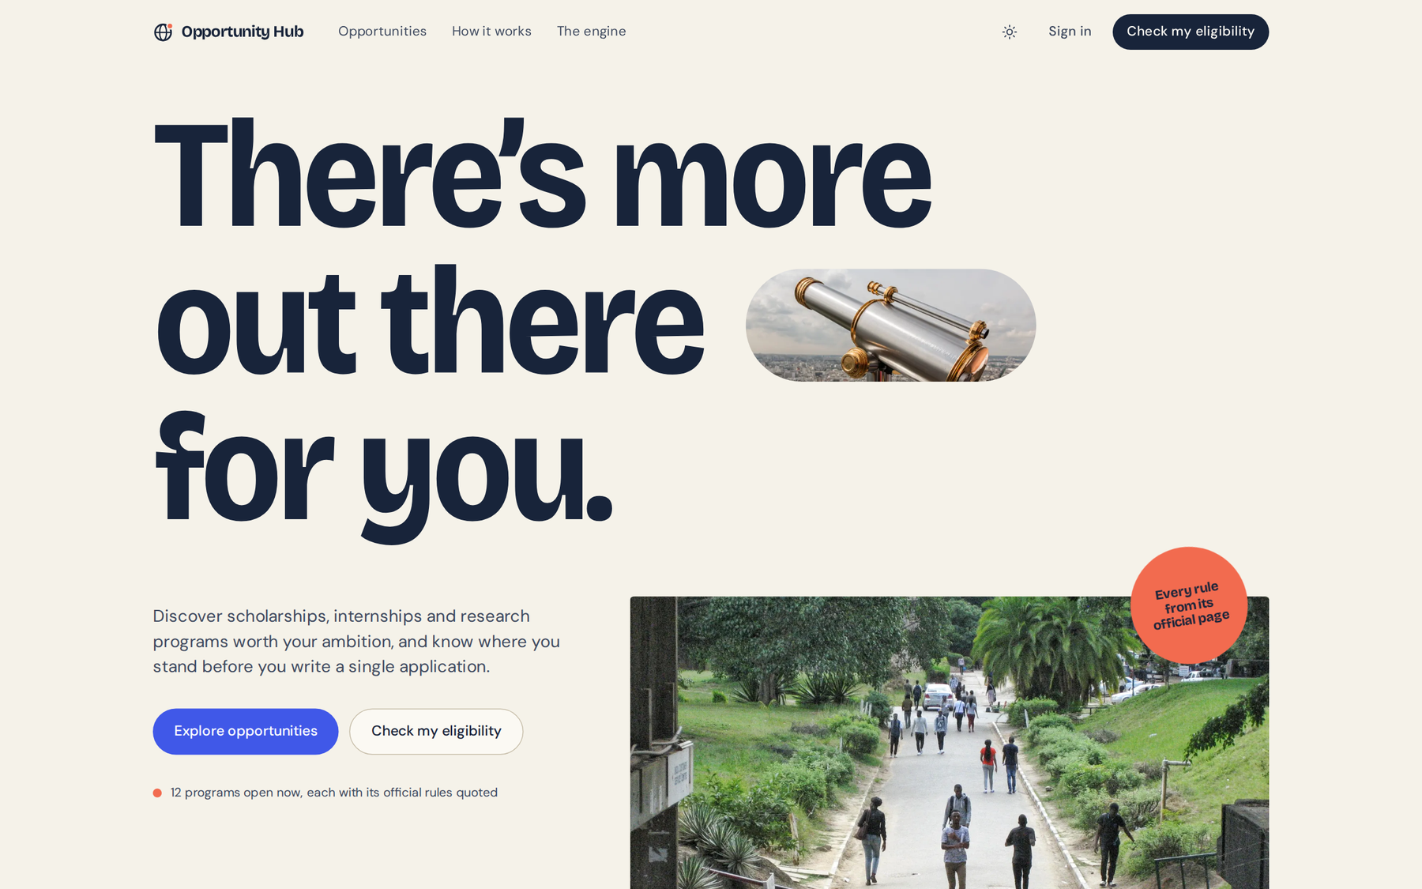
Live product
Opportunity Hub
Find the opportunities you actually qualify for, and see exactly why.
Opportunity Hub checks a student’s profile against the eligibility rules that scholarships, internships and research programs publish, and shows the evidence behind every verdict.
The live landing page
12
4
1
opportunities.sahelyon.com
real programs, rules quoted from official pages
clear verdicts, each with evidence
profile checked against every rule
Open it now: no account needed to explore
Notes:
Think about the last time you looked for a scholarship or an internship. You find a promising program, open its eligibility page, and meet a list of conditions written in that program's own words.
Opportunity Hub is opportunity discovery that tells you where you stand. It's live right now at opportunities.sahelyon.com. Every rule in it is copied word for word from an official page, and every answer comes with its evidence.

Slide 2
Eligibility is written for each program, not for the student
Scattered
KAUST Visiting Student Research Program
“Minimum GPA: 3.5 on a 4-point scale (or equivalent).”
Every program states its rules on its own page, in its own words.
Is my GPA on the same scale?
Inconsistent
Schwarzman Scholars
GPA scales, age cut-off dates, tables and exclusions, all formatted differently.
“Candidates must be at least 18 but not yet 29 years of age as of August 1 of their Schwarzman Scholars enrollment year…”
Old enough on which date?
Found out too late
KAUST Visiting Student Research Program
Miss one condition and the hours spent on an application are wasted.
“Current PhD candidates, KAUST students or KAUST alumni are not eligible to apply.”
Can a machine even check this?
Quoted verbatim from each program’s official eligibility page (retrieved 30 Oct 2026).
Notes:
Eligibility isn't hard because students are careless. It's hard because every program writes its rules differently. One gives a GPA on a 4-point scale. Another sets an age limit on a specific date two years away. Another excludes groups no form field can capture.
So students either spend hours decoding each page or apply anyway and find out later they never qualified. Either way, their most limited resource, time, goes into applications that couldn't succeed. These quotes are real, copied from the official pages.

Slide 3
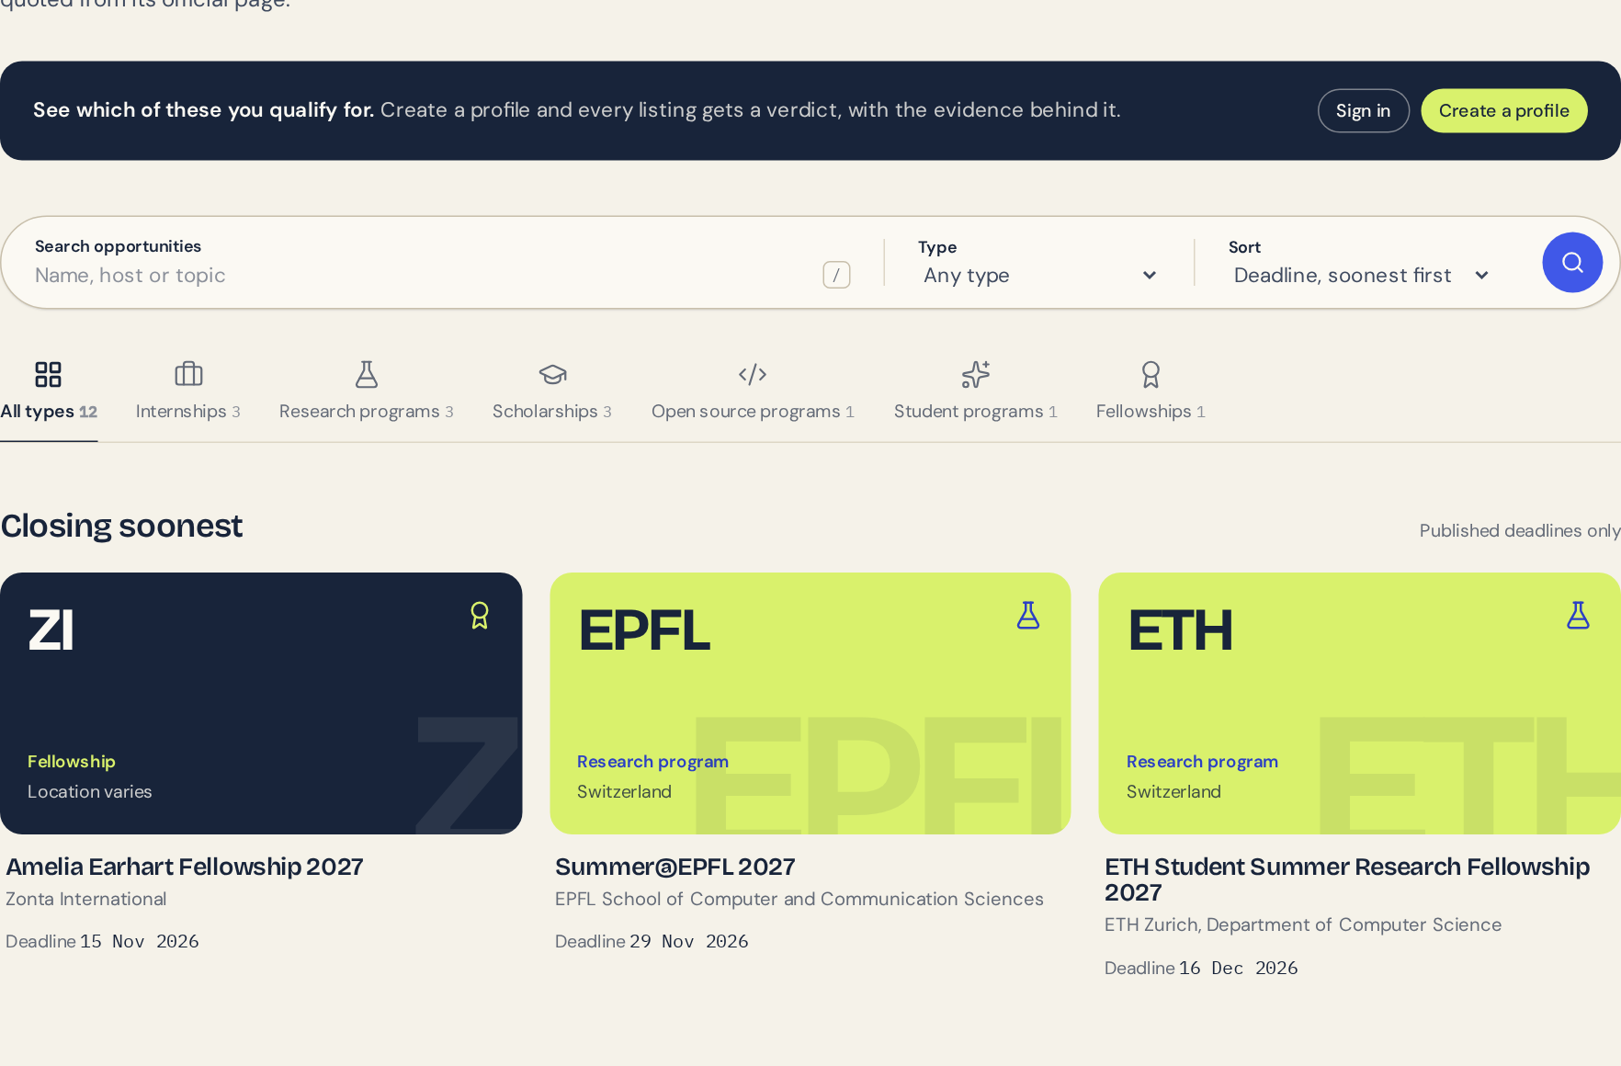
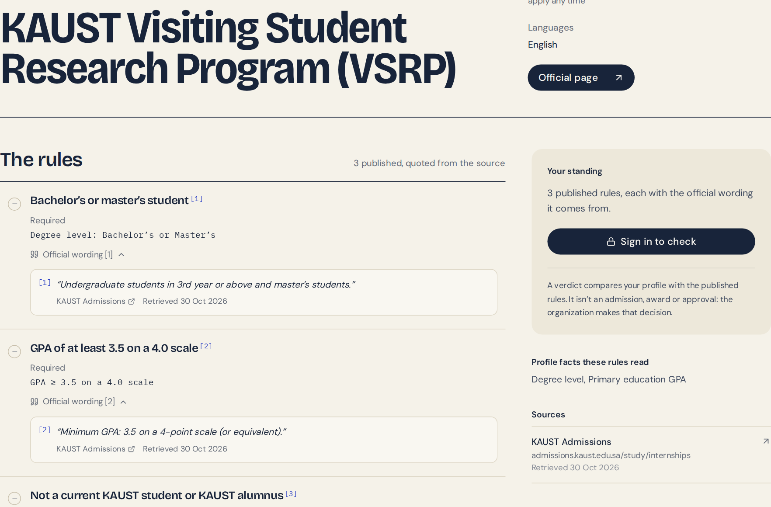
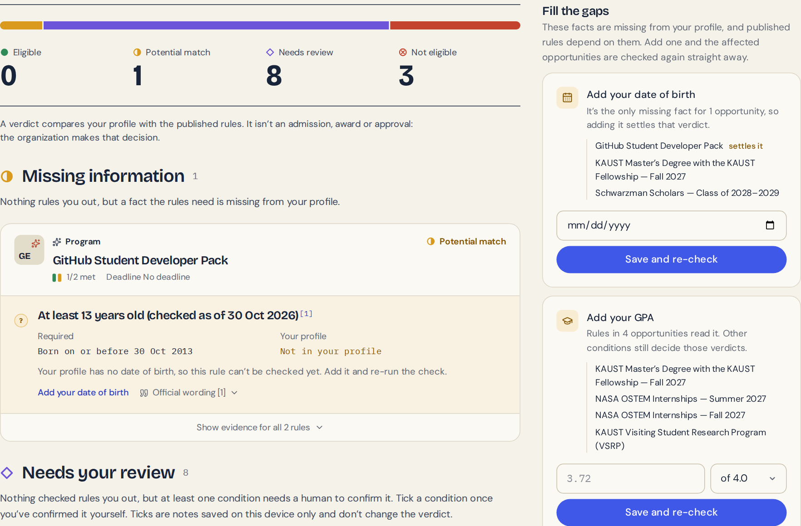
One profile, checked against every published rule
1
Discover
2
Read the rules
3
Check eligibility
4
Fill the gaps
Search and filter real programs
Each rule beside its official wording
A verdict for every program
Add a missing fact, re-check instantly
Discover: 12 real programs, searchable
Rules, each footnoted to its source
Verdicts, plus the exact fact that’s missing
Live site
Live site
Release build, demo account
The value: students see where they stand, and what to add, before they invest time in an application.
Notes:
Here's the product. A student browses real programs: CERN, KAUST, NASA, GitHub, ETH Zurich and more. Each listing shows its rules, and every rule is footnoted to the sentence on the official page it came from.
They create one short profile and run one check. Every program gets a verdict, and where a fact is missing, like a date of birth or a GPA, the app says exactly which fact, which programs depend on it, and lets them add it right there. The first two screens are the live site; the third is the release build with our demo account.

Slide 4
Deterministic, evidence-based eligibility
How one verdict is made
Four verdicts, in a fixed order
Student profile
Each rule
×
Not eligible
Citizenship, degree, enrolment, birth date, GPA and scale, skills
Met
A mandatory rule isn’t met
Rule engine
7 rule types, the same answer every time
Not met
Needs review
Published rule
Missing
A condition only a person can confirm
A structured rule, kept beside its official quote
Needs review
Potential match
A fact the rules need is missing
What it runs on
Eligible
React + TypeScript
FastAPI
PostgreSQL
Every published rule is met
Web app (Vite)
Python API
Profiles, rules, results
Deployed on Render; API types generated from the backend’s OpenAPI schema.
“Eligible” is our verdict, not an approval.
Notes:
Under the hood it's deliberately simple and checkable. A React and TypeScript web app talks to a FastAPI backend with PostgreSQL, deployed on Render.
Each requirement is a structured rule (a GPA threshold on a stated scale, a citizenship list, a degree level, an age on a given date) stored next to its official quote. The engine checks each rule against the profile: met, not met, missing, or needs review. Then the program takes the first verdict that applies, in this order.
There's no AI deciding anyone's future: the same profile and rules always give the same answer. Where it can't be sure, like a GPA on a 10-point scale against a 4-point threshold, it hands the call to the student instead of guessing. And Eligible means every published rule is met. It is never an admission: the organization decides.

Slide 5
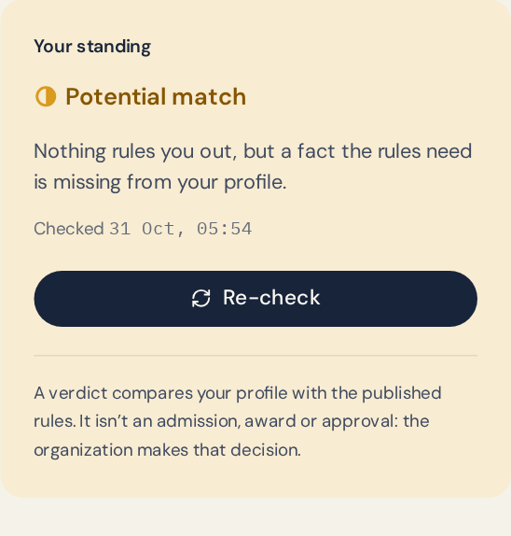
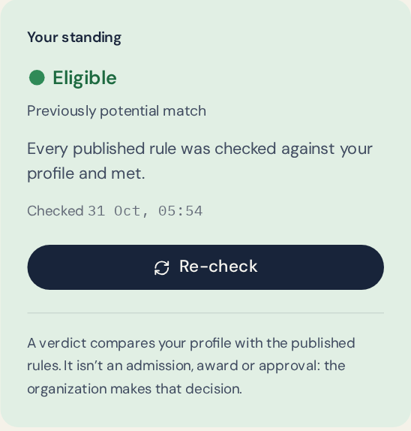
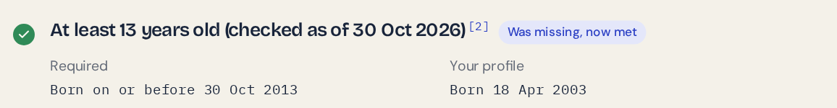
It works: one missing fact, one real change
Before: no date of birth in the profile
After: 18 Apr 2003 added, re-checked
Verified at release
572
21
12
backend tests passing
browser tests on the real stack
live programs, rules quoted
Next
Curator tools: turn an eligibility page into verified rules faster
More profile facts: field and year of study, so fewer answers need review
Deadline alerts: for programs a student qualifies for
Every student should spend their time on applications they can actually win.
GitHub Student Developer Pack, demo account: real engine output.
opportunities.sahelyon.com
Notes:
This is the moment we demo live. Our fictional student Mekdes runs a check. The GitHub Student Developer Pack comes back as a Potential match: nothing rules her out, but one rule, at least 13 years old, can't be checked because her profile has no date of birth. It's marked missing, not failed.
She adds her date of birth and re-checks. The real engine re-evaluates only the affected programs, and the verdict becomes Eligible, with the rule marked 'was missing, now met'.
It's tested: 572 backend tests and 21 browser tests on the real stack passed at release. Today it covers 12 hand-checked programs. Next come curator tools to grow coverage without losing accuracy, more profile facts so fewer answers stop at needs review, and deadline alerts.
Every student should spend their time on applications they can actually win. Try it at opportunities.sahelyon.com.

