Slide 1
Gender Differences in Responses to
LLM-Generated vs Human-Written
Donation Appeals
A Multi-factorial Analysis of Digital Charitable Giving
Salah-din Mrait
Bachelor End Project • Data Science Joint Degree
Tilburg University — Eindhoven University of Technology
Supervisor: John Caffier
January 2026

Slide 2
The Research Problem
1
Charitable organizations increasingly use Large Language Models (LLMs) to create donation appeals
Main Research Question
2
Women donate more frequently and give higher amounts than men across cultures
"Do women and men respond differently to LLM-generated versus human-written emotional donation appeals for cancer charities?"
3
LLMs produce emotionally polished language but lack genuine emotional experience
4
Will women — who value emotional authenticity — respond differently to LLM content?

Slide 3
Theoretical Background
Empathic Concern
🧠
Women report higher empathy. Perceived sincerity matters when emotional engagement drives persuasion.
Algorithm Aversion
⚠️
People trust algorithms less in emotional domains. Women may react more negatively to disclosed LLM content.
Care vs. Justice
❤️
Women adopt care-focused moral reasoning; LLM appeals may fail if caring relationship perception weakens.

Slide 4
Research Hypotheses
H1
Women will report significantly lower persuasiveness scores (1-7 Likert) for LLM appeals, while men show no difference.
H2a
Women will allocate higher monetary amounts (USD 0.00-0.10) regardless of appeal source.
H2b
The donation gap between genders will be larger for human-written appeals.
H3
Women's likelihood of selecting 'Like' will be higher for human-written appeals.

Slide 5
Research Methods
725
4,350
6
U.S. Participants
Total Observations
Appeals per Participant
📊 Design: Within-subjects experiment • Human vs LLM-generated appeals • Cancer charities
📏 Outcomes: Engagement (Dislike/Neutral/Like) • Persuasiveness (1-7 scale) • Donation ($0.00-$0.10)

Slide 6
Analytical Approach
1
Engagement: Ordinal logistic mixed-effects regression (cumulative link model)
All models include:
2
Persuasiveness: Linear mixed-effects model (continuous outcome)
✓ Random intercepts for participants
✓ Random intercepts for posts
✓ Gender × Content Source interaction
3
Donation: Hurdle model (35.3% zero-inflation required two-part approach)

Slide 7
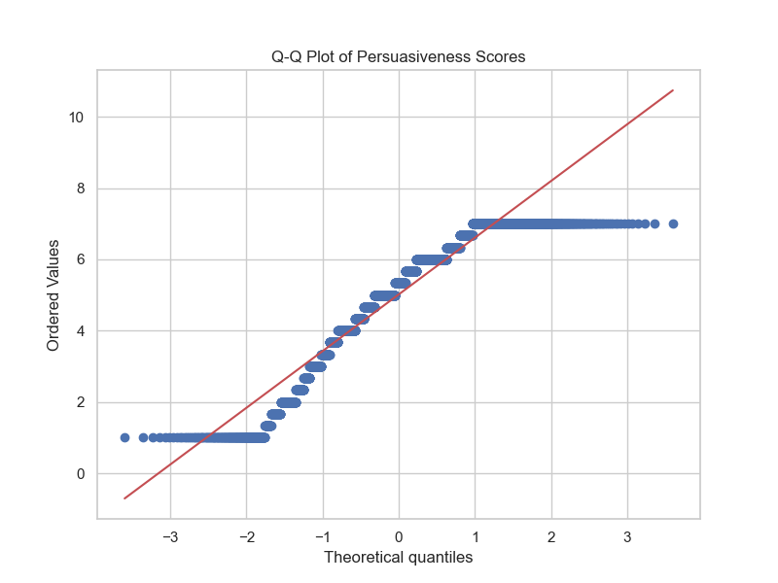
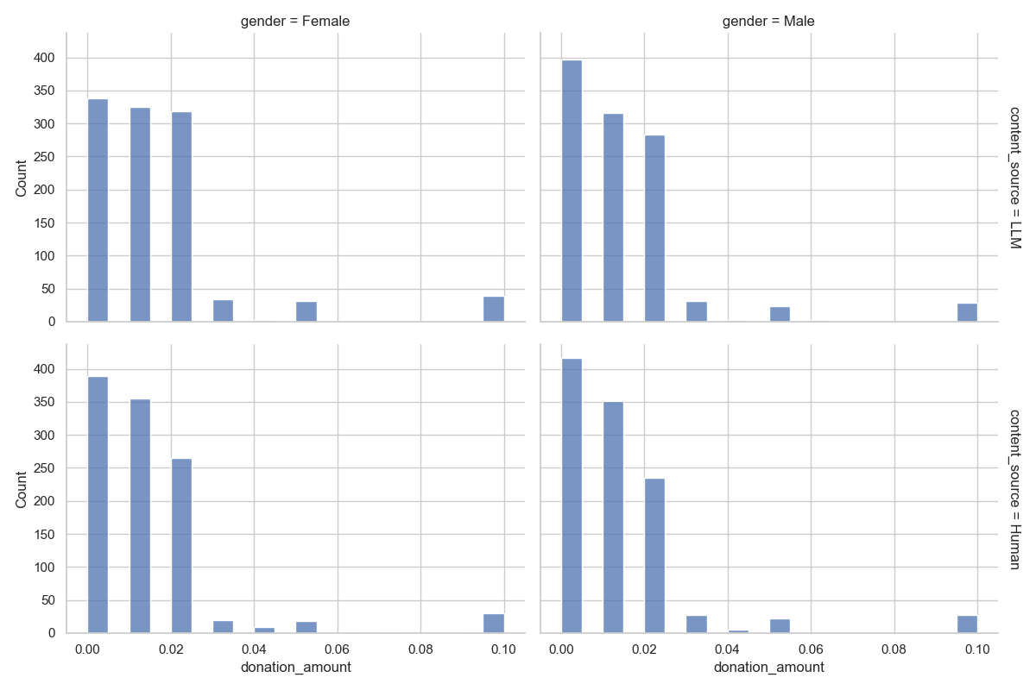
Model Selection Justification
Persuasiveness: Q-Q plot confirms normality → Linear mixed-effects model
Donation: 35.3% zeros → Hurdle model required

Slide 8
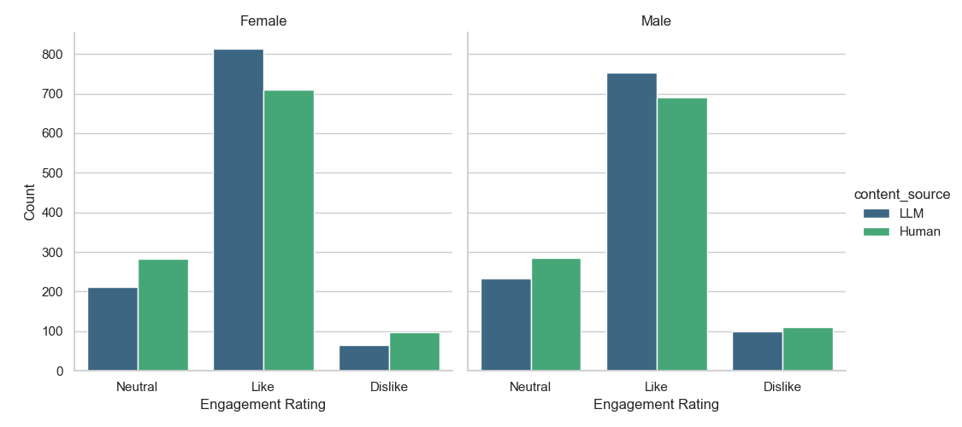
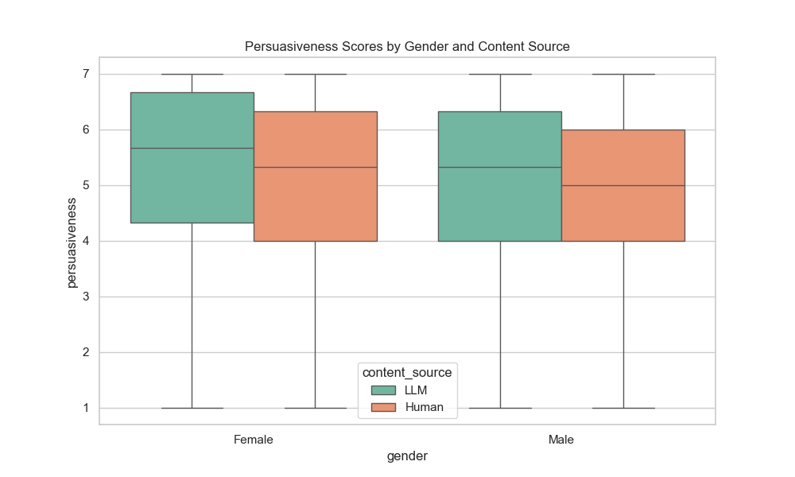
Descriptive Statistics

Slide 9
Main Effects: The LLM Advantage
Outcome
LLM Effect
p-value
Interpretation
Engagement
OR = 1.58
< .001
58% higher odds of favorable rating
Persuasiveness
b = 0.20
< .001
+0.20 points on 7-point scale
Donation Amount
b = 0.0018
.011
Higher amounts for LLM appeals
LLM-generated appeals outperformed human-written appeals on ALL outcomes

Slide 10
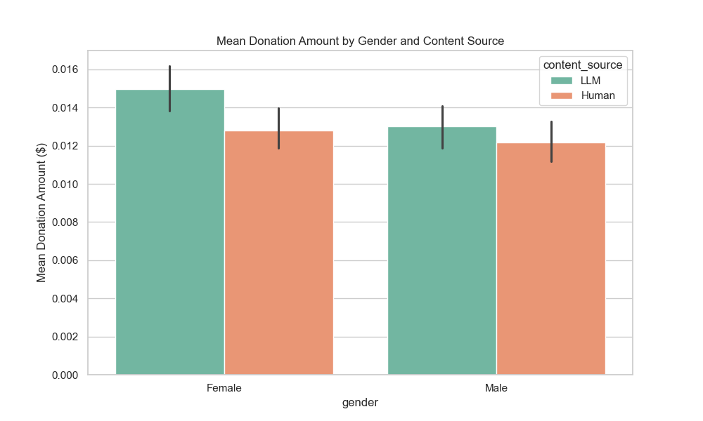
Gender Effects on Donation
$0.0013
Women donate more (p = .026)
✓ H2a Supported: Women allocate higher amounts than men
✗ Gender did NOT predict whether someone donated at all (p = .412)

Slide 11
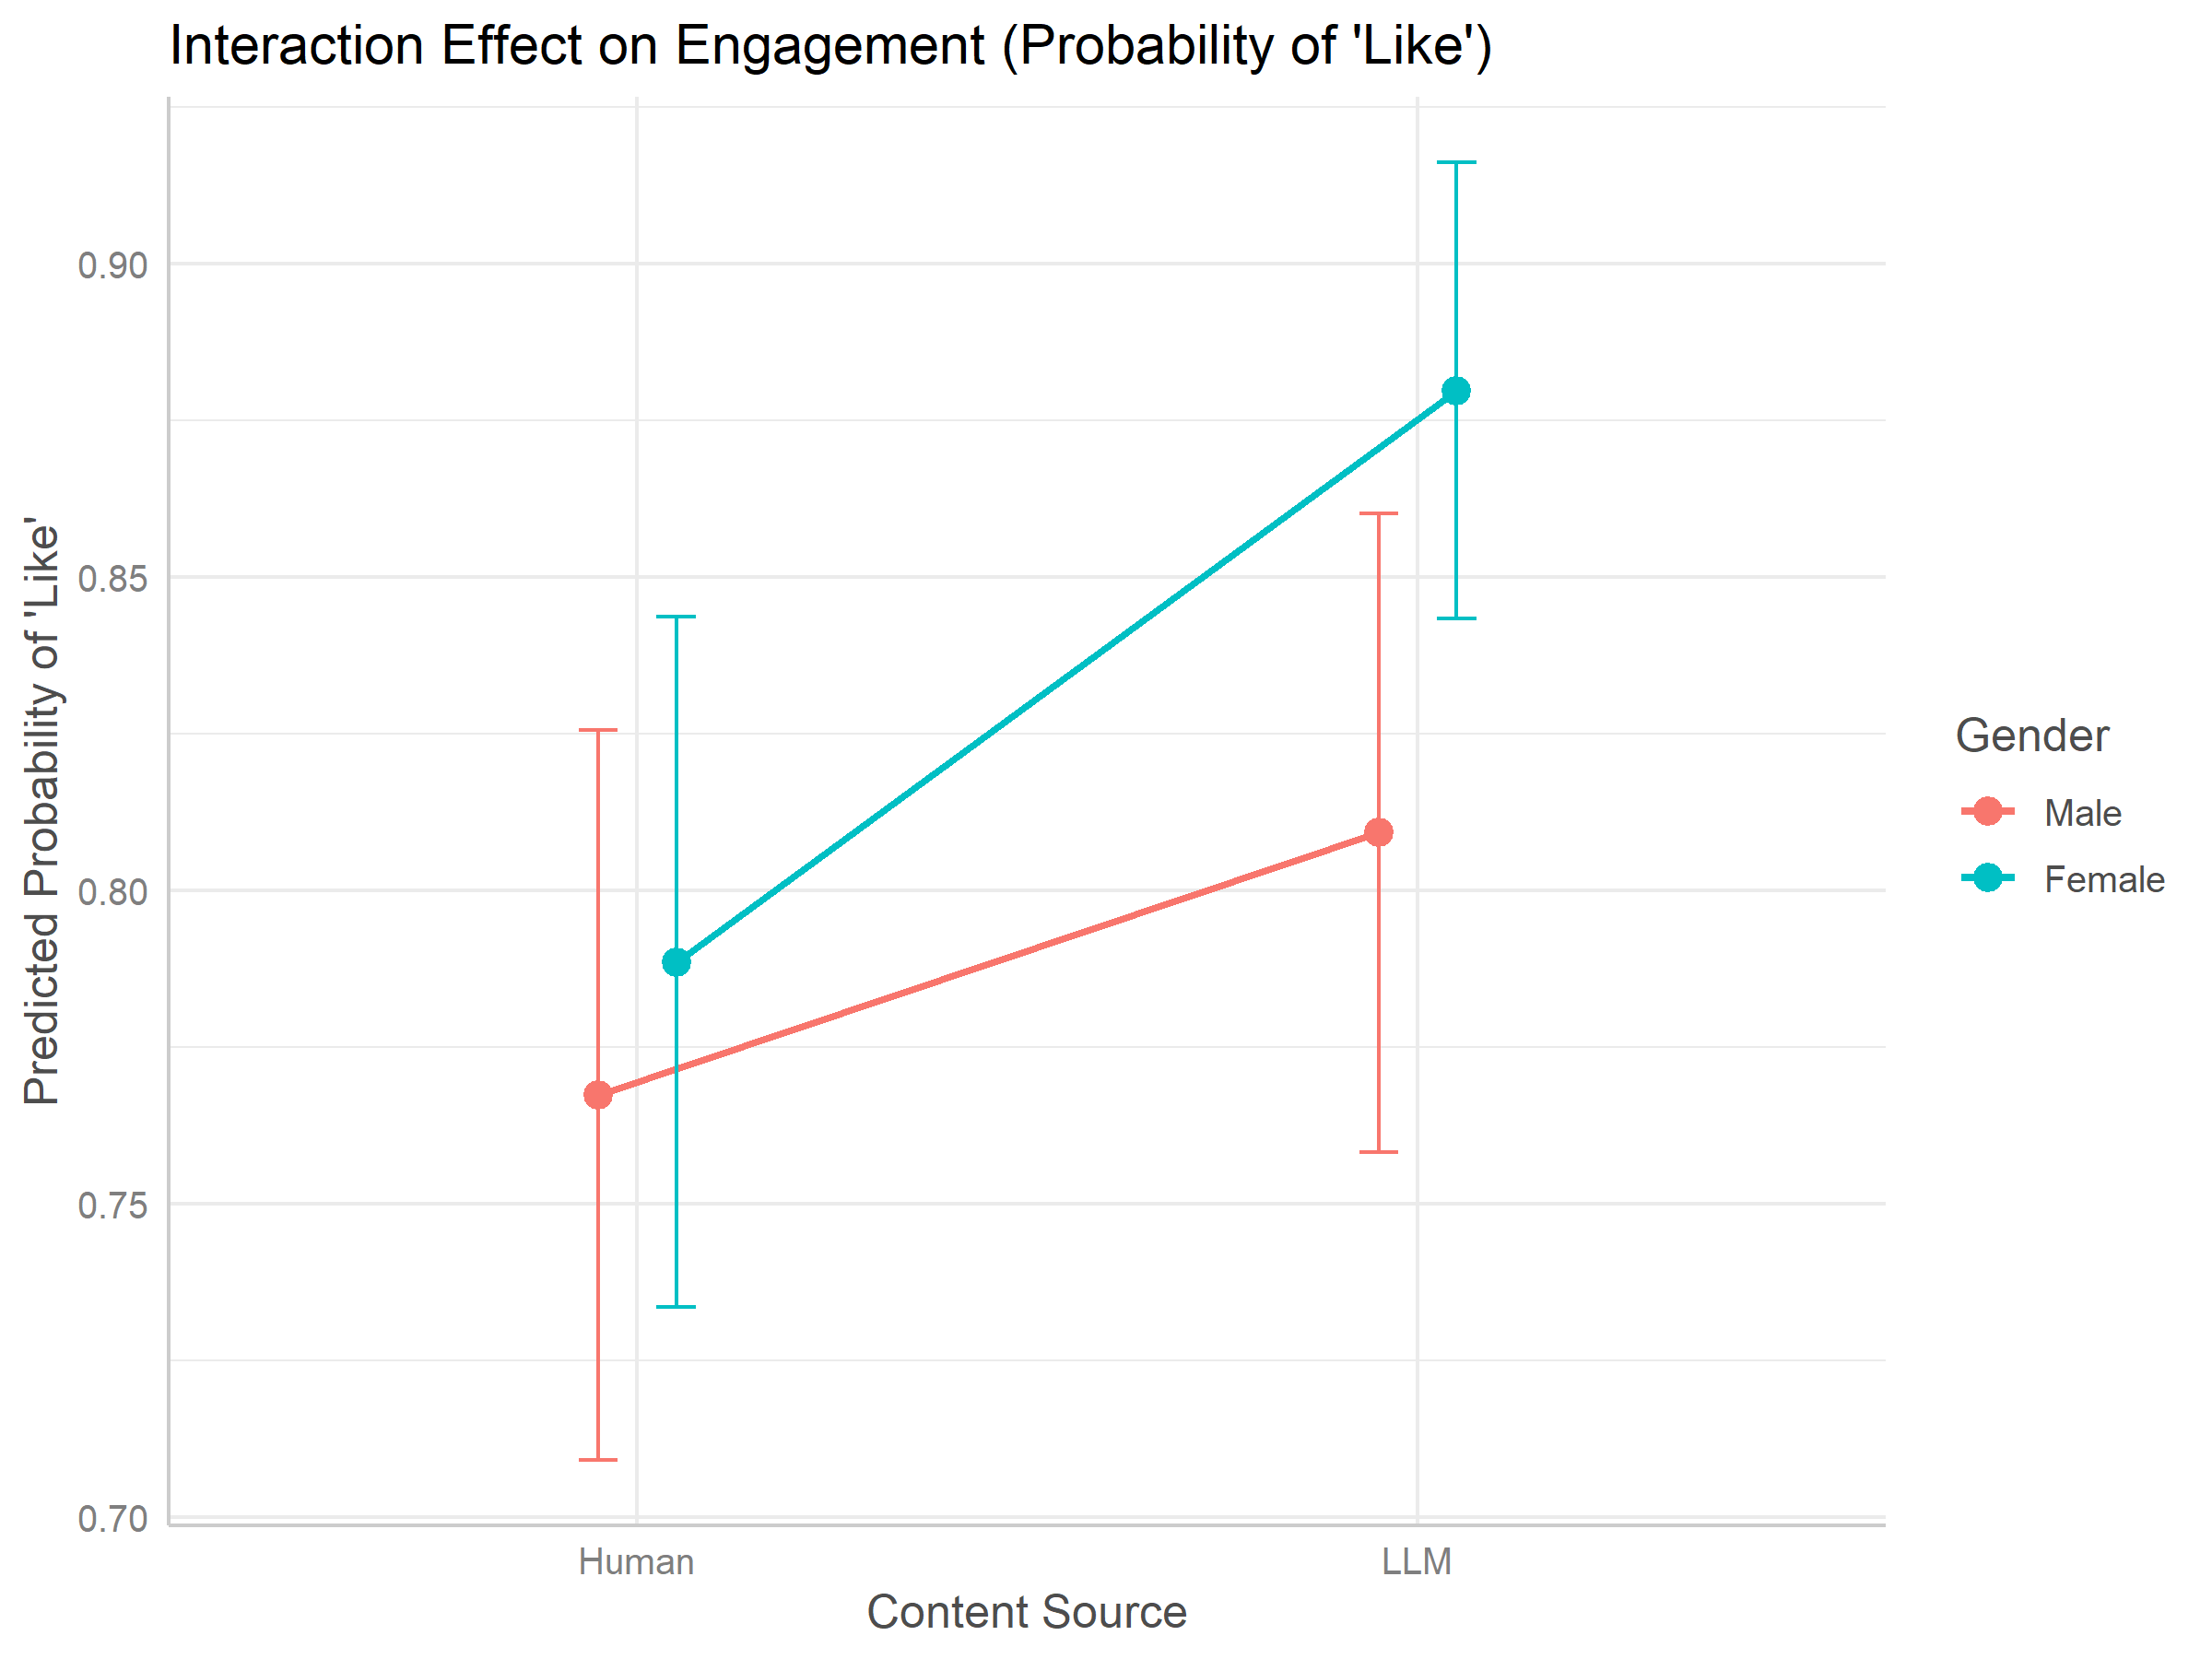
Interaction: Engagement
Gender × Content Source (OR = 1.53, p = .011) — SIGNIFICANT
→ Both genders prefer LLM content
→ Women show stronger preference for LLM appeals
→ Steeper slope for women = significant interaction
H3 NOT Supported: Women preferred LLM content more, not less

Slide 12
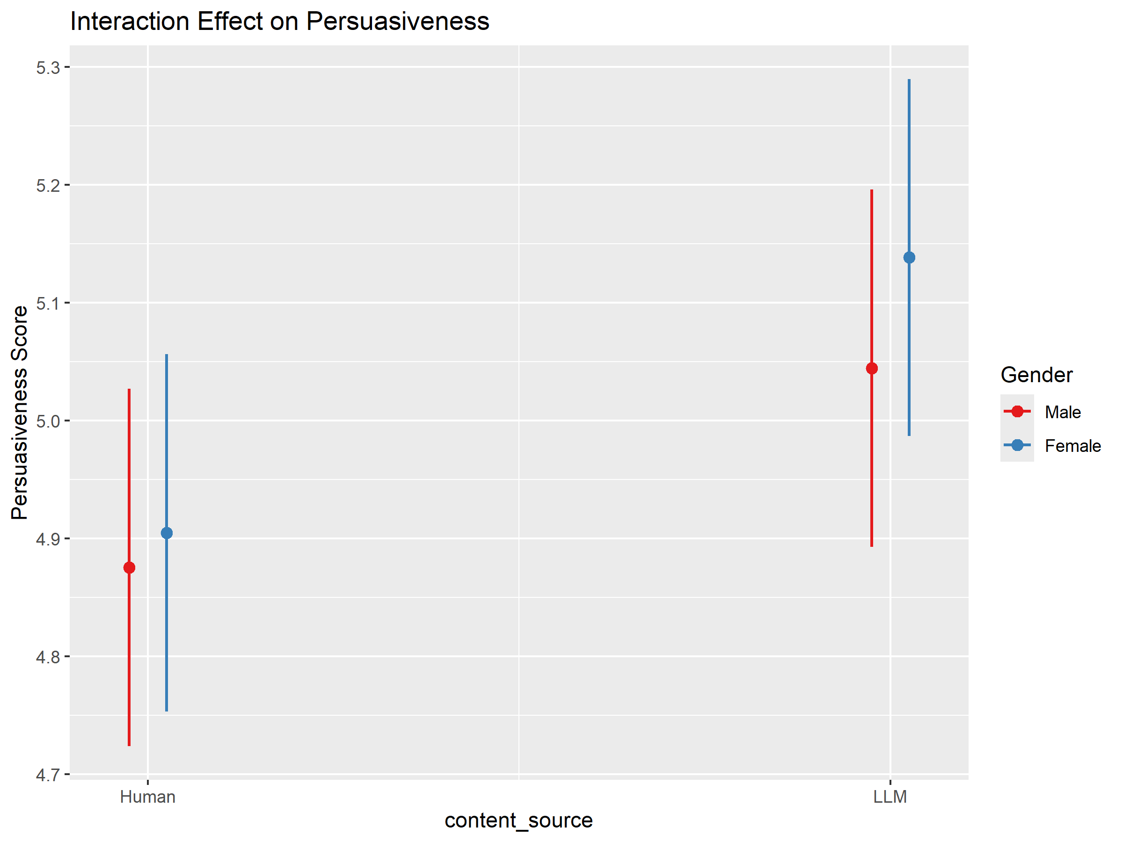
Interaction: Persuasiveness
Gender × Content Source (b = 0.06, p = .428) — NOT SIGNIFICANT
→ Both rated LLM content as more persuasive
→ Visible gap is not statistically significant
H1 NOT Supported: No interaction on persuasiveness

Slide 13
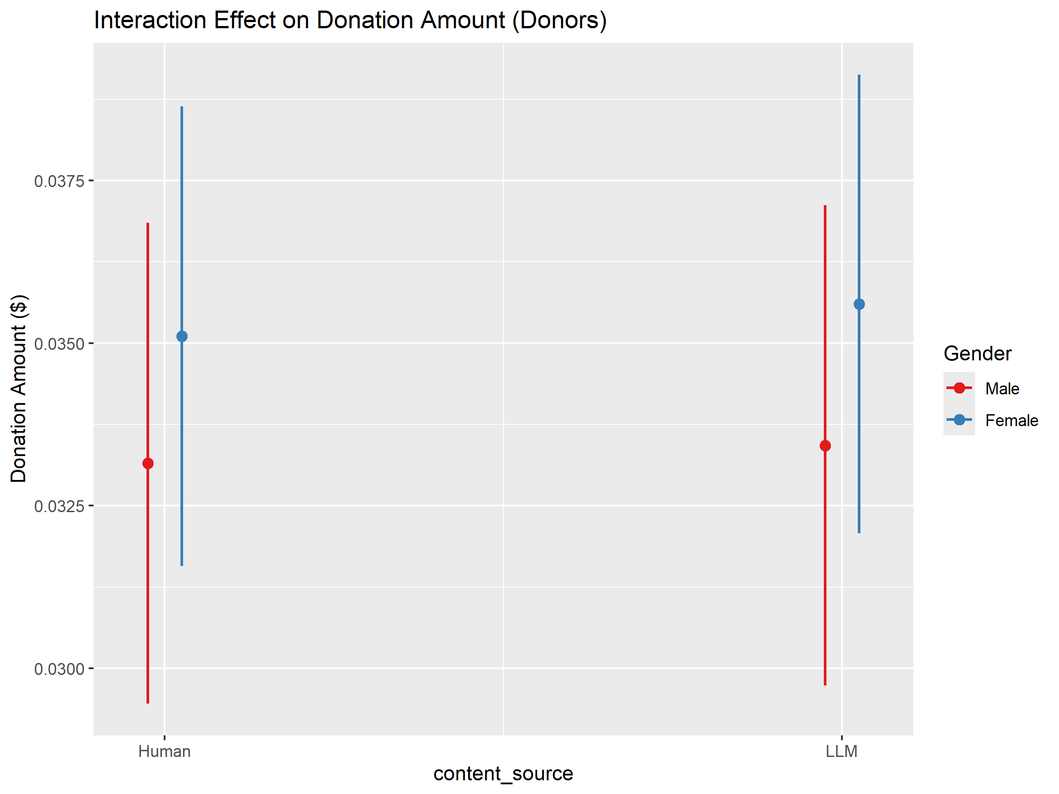
Interaction: Donation Amount
Gender × Content Source (b = 0.0002, p = .735) — NOT SIGNIFICANT
→ Women donate more across both conditions
→ Parallel lines = no interaction
H2b NOT Supported: Gender gap consistent across sources

Slide 14
Hypothesis Testing Summary
Hypothesis
Prediction
Result
H1
Women rate LLM as less persuasive
Not Supported
H2a
Women donate more than men
Supported
H2b
Larger gender gap for human appeals
Not Supported
H3
Women prefer human content for engagement
Not Supported (Opposite)

Slide 15
Discussion
1
"Sincerity Gap": Gender differences appeared only for quick, automatic engagement — not for deeper judgments or actual behavior.
2
Algorithm Aversion Not Activated: Participants weren't told about LLM authorship, so skepticism wasn't triggered.
3
Care Orientation Persists: Women's higher donations are triggered by distress signals — regardless of human or machine authorship.

Slide 16
Practical Implications
✓ LLMs can generate appeals that perform at least as well as human-written content
Key Takeaway:
✓ Especially useful for nonprofits with limited resources
Gender does not limit the value of LLMs in fundraising. Donors respond to content quality, not author identity.
⚠️ Disclosure policies require caution — labeling may reduce impact
→ Organizations face a trade-off between transparency and effectiveness

Slide 17
Limitations & Future Research
🔒 Participants not disclosed about LLM authorship
Future Directions
1. Test effects when LLM authorship is disclosed
2. Explore other charitable domains
3. Examine long-term donor relationships
🎯 Single domain (cancer charities)
💰 Small donation amounts ($0.00-$0.10)
🇺🇸 U.S. sample only

Slide 18
Conclusion
LLM-generated donation appeals outperform human-written appeals across all outcomes.
Gender differences do not limit the effectiveness of LLM-generated charitable appeals.
Women's higher generosity persists regardless of whether a human or machine wrote the appeal.

Slide 19
Thank You
Questions?
Salah-din Mrait
s.mrait@tilburguniversity.edu
Supervisor: John Caffier

