Slide 1
VitaMap AI
Transforming supplement labels into 3D body insights

Slide 2
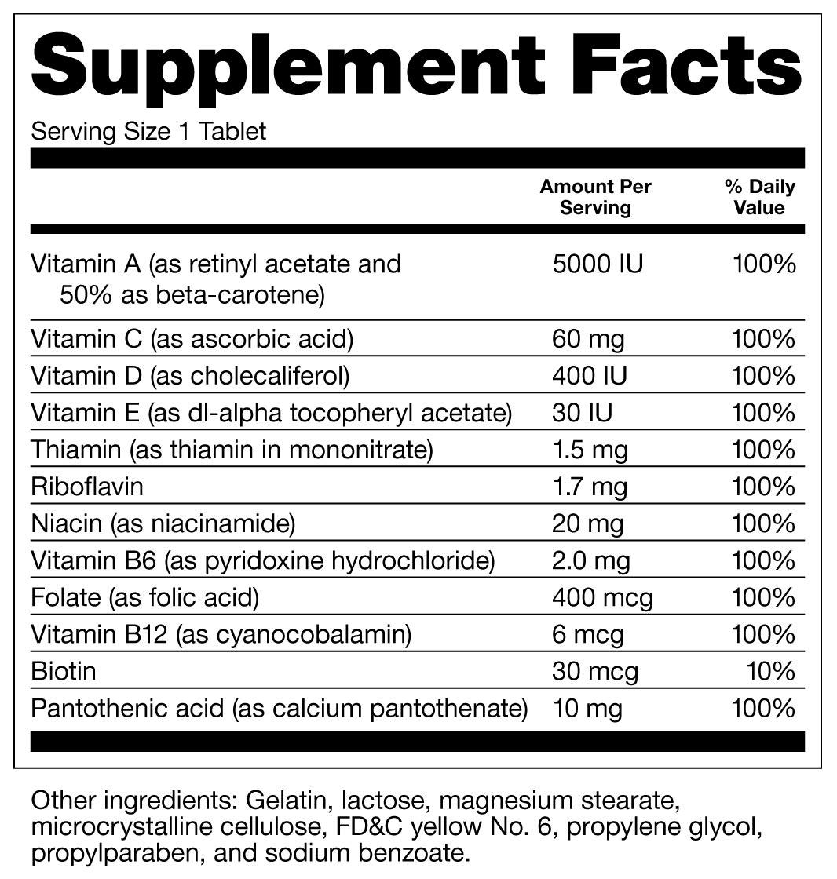
Problem
Users struggle to understand supplement facts labels

Slide 3
Input
User uploads supplement label image

Slide 4
AI Process
OCR → Vitamin Detection → RAG → AI Interpretation

Slide 5
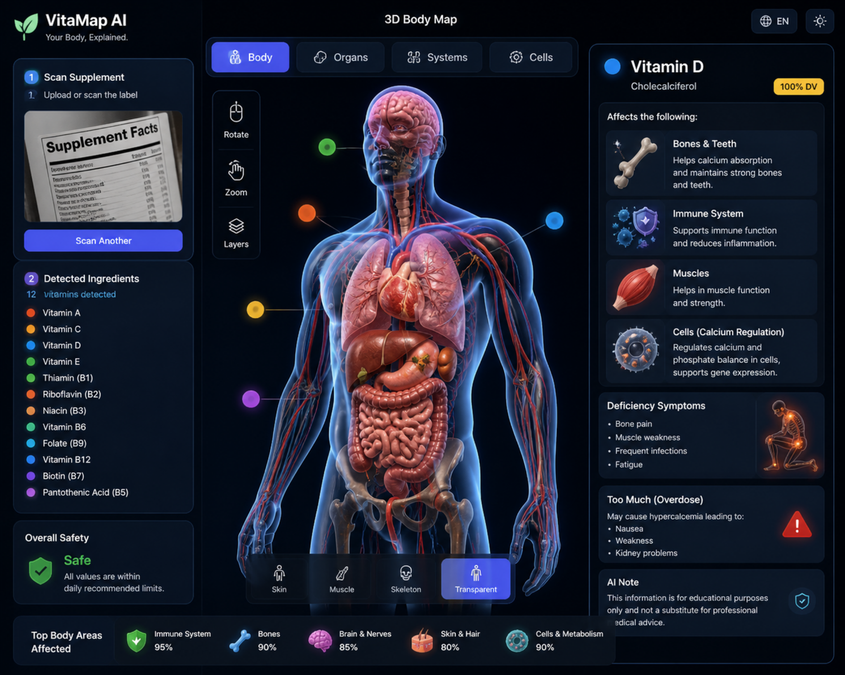
Output
3D human body visualization showing vitamin effects

Slide 6
Impact
Improves understanding and safer supplement use

