Slide 1
TDD

Slide 2

Who am I?
Programmer since 2002
Developer since 2013
Problem Solver
JAVA / JAVASCRIPT /PHP
Communication Engineer

Slide 3
What is TDD?
Test Driven Development
Is a process that relies on the repetition of a very short development cycle
Kent Beck is credited with having developed the technique,stated in 2003
Related to the test-first programming concepts
TDD encourages simple designs and inspires confidence

Slide 4
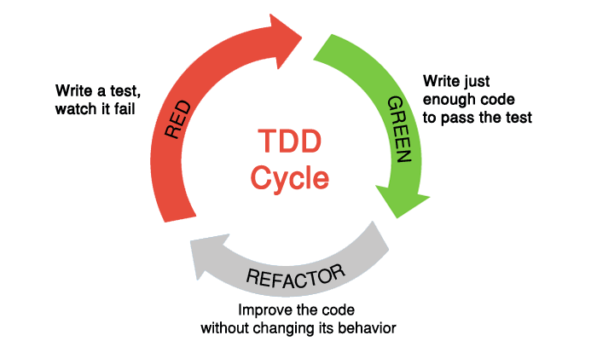
Simple TDD Process

Slide 5
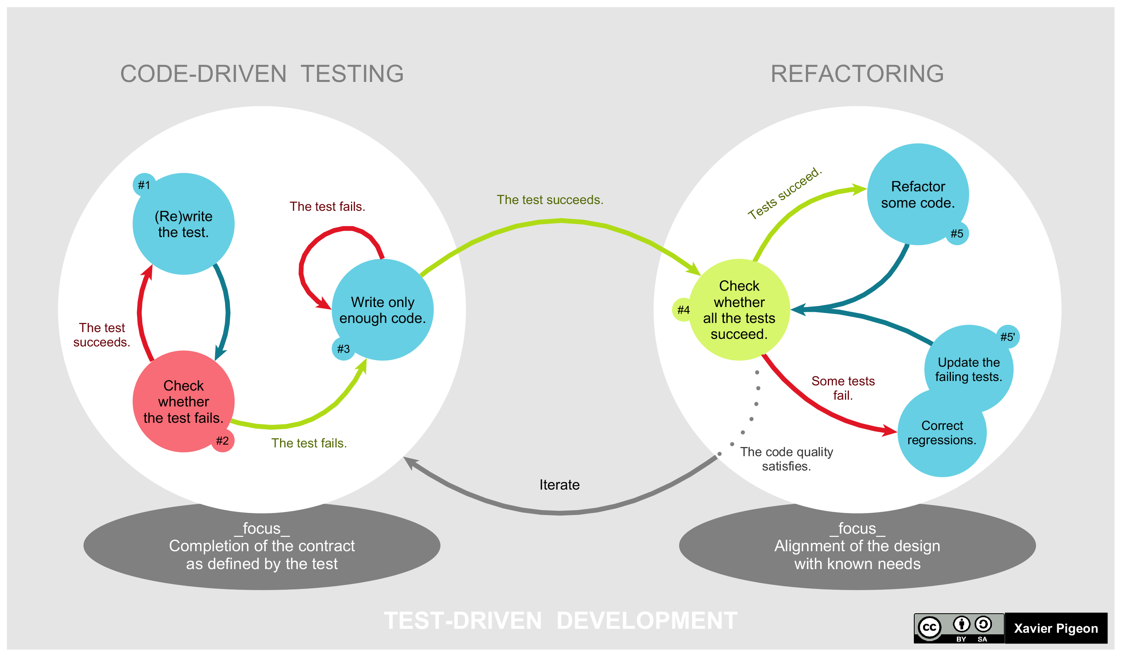
Details TDD Process

Slide 6
TDD vs Unit Test
TDD
Unit Test
Refers to a method for design and development
Always automated are written first
Before the code is written
Technique for testing code modules (units) on a standalone basis
Can be manual or automated
Before or after the code is written

Slide 7
Let's get hands dirty

Slide 8
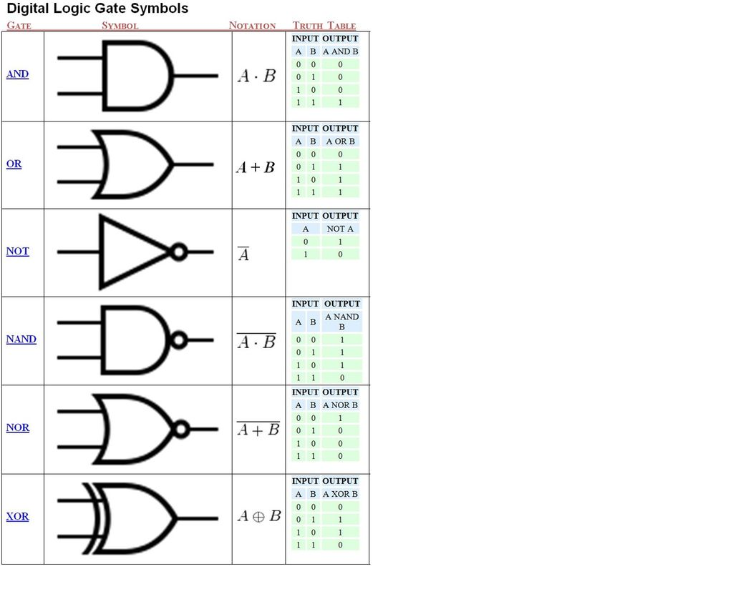
Implement NOT Gate

Slide 9
Implement OR Gate

Slide 10
Implement AND Gate

Slide 11
Implement XOR Gate

