Slide 1
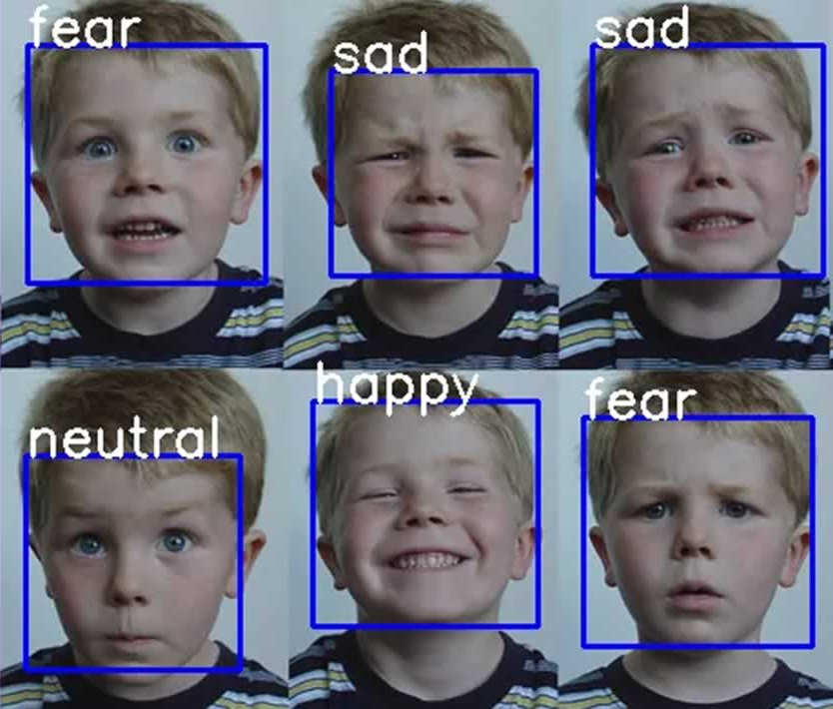
EMOTION DETECTION USING DEEP LEARNING

Slide 2
ABSTRACT
human emotion recognition plays an important role in the interpersonal relationship. emotions are reflected from speech, hand and gestures of the body And through facial expressions.
Hence extracting and understanding of emotion has a high importance of interaction between human and machine communication.
In this project we deal with emotion recognition using face reaction, this project describes the advances made in this field and the various approaches used for recognition of emotions.

Slide 3
OBJECTIVE
The main objective of the project is to propose real time implementation of emotion recognition system.
Emotion detection using deep learning, we have to train the code with collection of photos/image using cnn or convnet(convolutional neural network)
To train image classifier deep learning model using CNN.

Slide 4

Software Requirement
Software:
OS: windows 10
language: python
Library : keras,Numpy
Hardware:
Accessories : web cam (external camera)
RAM : 4 GB

Slide 5
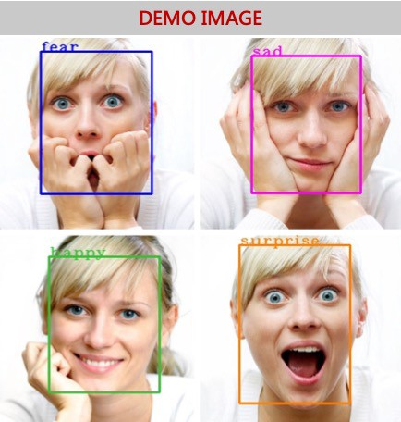
Proposed system: our motto is to detect the emotion of a person whether they are happy, sad, fear, surprise , shock…
Proposed system

Slide 6
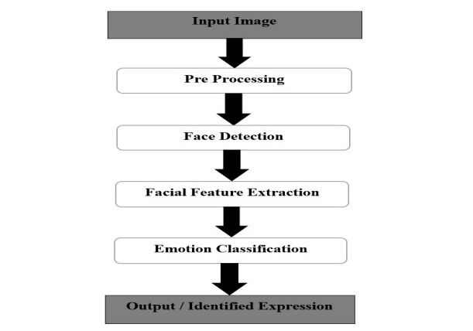
FLOWCHART

Slide 7
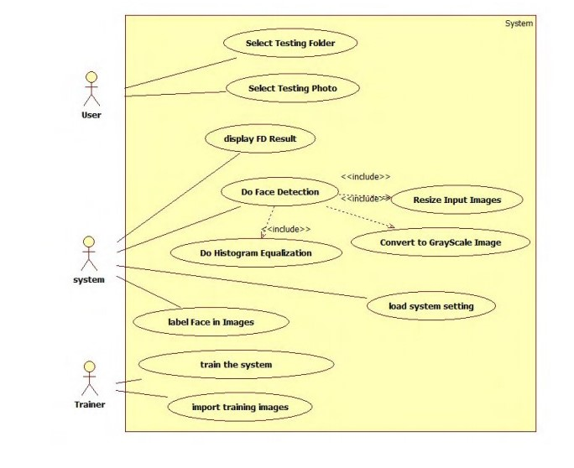
USECASE DIAGRAM

Slide 8
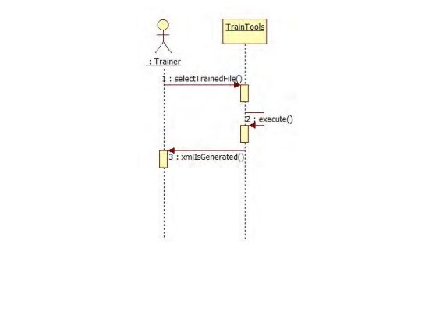
SEQUENCE DIAGRAM

Slide 9
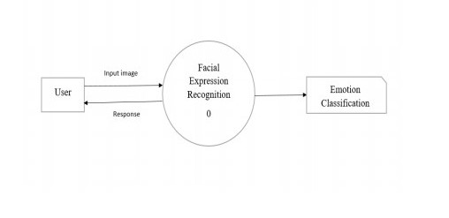
DFD(DATA FLOW DIAGRAM)

Slide 10
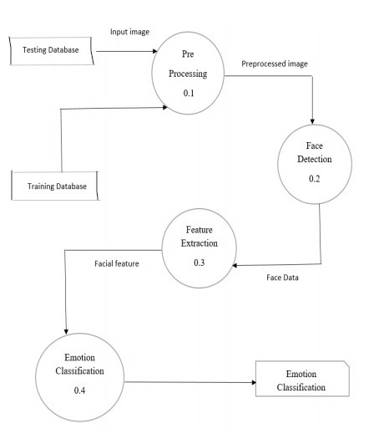

Slide 11
Step 1:Collection of a dataset of images.(In this case we are using downloaded dataset of pre-copped,48 by 48 pixel grayscale images of faces each labeled with one of the 5 emotion :happy,sad,surprice Step 2:pre-processing of images. Step 3:Detection of a face from each image. Step 4:The cropped face is converted into grayscale images Step 5:The numpy(np) array gets passed into the convolution2D layer. Step 6: Convolution generates feature maps. Step 7:pooling method called Maxpolling2D that uses (2,2) windows across the features map only keeping the maximum pixel value. Step 8: During training, Neural network Forward propagation and backward propagation performed on the pixel values. Step 9: The softmax function presents itself as a probability for emotion class.
ALGORITHM

Slide 12
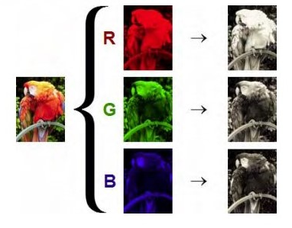
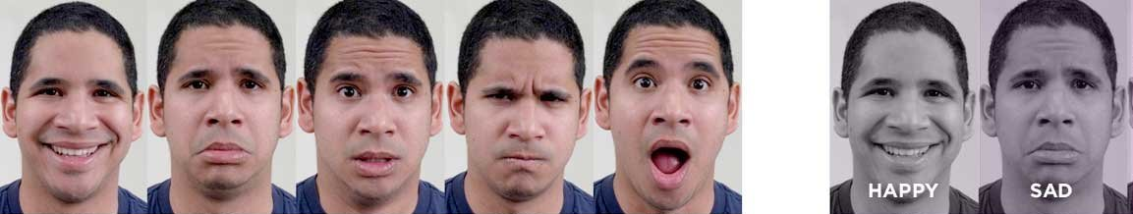
Color image -> Gray scale image

Slide 13
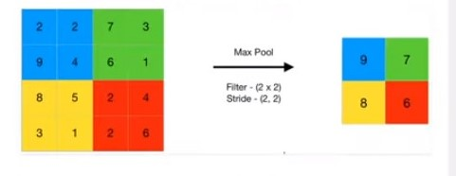
MAX pooling
Max pooling is a pooling operation that selects the maximum element from the region of the feature map covered by the filter. Thus, the output after max-pooling layer would be a feature map containing the most prominent features of the previous feature map.

Slide 14
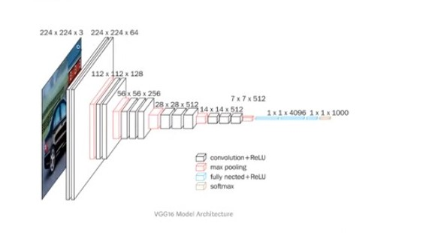
IMAGE LAYER WISE EXTRACTION(PROCESS)

Slide 15
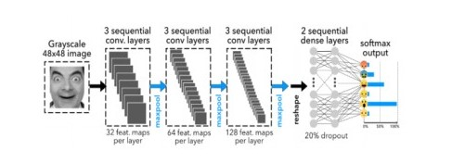
process

Slide 16
from __future__ import print_function import keras from keras.preprocessing.image import ImageDataGenerator from keras.models import Sequential from keras.layers import Dense,Dropout,Activation,Flatten,BatchNormalization # from keras.layers import Conv2D,MaxPooling2D #convert2d and maxpooling import os num_classes = 5 #5 emotion img_rows,img_cols = 48,48 batch_size = 8 # how many models train at a time since my RAM is low i go with 8 no train_data_dir = r'H:\6th sem\project\images\train' #r for forward slash python not accept / validation_data_dir = r'H:\6th sem\project\images\validation' train_datagen = ImageDataGenerator( rescale=1./255, rotation_range=30, shear_range=0.3, zoom_range=0.3, width_shift_range=0.4, height_shift_range=0.4, horizontal_flip=True, fill_mode='nearest') #5 to 6 image will create from 1 image,hor_flip=mirror photo validation_datagen = ImageDataGenerator(rescale=1./255) #it is used for crosscheck the image
Classification_little_vgg.py

Slide 17
train_generator = train_datagen.flow_from_directory( train_data_dir, color_mode='grayscale', target_size=(img_rows,img_cols), batch_size=batch_size, class_mode='categorical', shuffle=True) #cate=happy,sad,... validation_datagen = ImageDataGenerator(rescale=1./255) #it is used for crosscheck the image train_generator = train_datagen.flow_from_directory( train_data_dir, color_mode='grayscale', target_size=(img_rows,img_cols), batch_size=batch_size, class_mode='categorical', shuffle=True) #cate=happy,sad,... validation_generator = validation_datagen.flow_from_directory( validation_data_dir, color_mode='grayscale', target_size=(img_rows,img_cols), batch_size=batch_size, class_mode='categorical', shuffle=True) #target color mode=greyscale image model = Sequential() #simple model

Slide 18
# Block-1 ( 3,3 size taken and stread = 2,2 padding means = how many pixels taking model.add(Conv2D(32,(3,3),padding='same',kernel_initializer='he_normal',input_shape=(img_rows,img_cols,1)))#1 for grey scale ,padding amount of pixel added to an image when (32 neurons) model.add(Activation('elu'))# x x>e0 and alpha(e^x-1) x<0 model.add(BatchNormalization()) #nerual network model.add(Conv2D(32,(3,3),padding='same',kernel_initializer='he_normal',input_shape=(img_rows,img_cols,1))) model.add(Activation('elu'))#cross the thersold value o/p then only it go for output model.add(BatchNormalization())#it is used to speed up the training neral network(performance and stubilty) model.add(MaxPooling2D(pool_size=(2,2)))#2x2 model.add(Dropout(0.2)) # Block-2 model.add(Conv2D(64,(3,3),padding='same',kernel_initializer='he_normal'))#64 neurons model.add(Activation('elu')) model.add(BatchNormalization()) model.add(Conv2D(64,(3,3),padding='same',kernel_initializer='he_normal')) model.add(Activation('elu')) model.add(BatchNormalization()) model.add(MaxPooling2D(pool_size=(2,2))) model.add(Dropout(0.2)) # Block-3 model.add(Conv2D(128,(3,3),padding='same',kernel_initializer='he_normal')) model.add(Activation('elu')) model.add(BatchNormalization()) model.add(Conv2D(128,(3,3),padding='same',kernel_initializer='he_normal')) model.add(Activation('elu')) model.add(BatchNormalization()) model.add(MaxPooling2D(pool_size=(2,2))) model.add(Dropout(0.2))

Slide 19
# Block-4 model.add(Conv2D(256,(3,3),padding='same',kernel_initializer='he_normal')) model.add(Activation('elu')) model.add(BatchNormalization()) model.add(Conv2D(256,(3,3),padding='same',kernel_initializer='he_normal')) model.add(Activation('elu')) model.add(BatchNormalization()) model.add(MaxPooling2D(pool_size=(2,2))) model.add(Dropout(0.2)) # Block-5 model.add(Flatten()) model.add(Dense(64,kernel_initializer='he_normal')) model.add(Activation('elu')) model.add(BatchNormalization()) model.add(Dropout(0.5)) # Block-6 model.add(Dense(64,kernel_initializer='he_normal')) model.add(Activation('elu')) #elu for setting the threshold value model.add(BatchNormalization()) model.add(Dropout(0.5))

Slide 20
# Block-7 model.add(Dense(num_classes,kernel_initializer='he_normal')) model.add(Activation('softmax')) #used to get the output from 5 sample/cat print(model.summary()) from keras.optimizers import RMSprop,SGD,Adam from keras.callbacks import ModelCheckpoint, EarlyStopping, ReduceLROnPlateau #checkpoint is pick the model in best accuracy checkpoint = ModelCheckpoint('Emotion_little_vgg.h5', monitor='val_loss', mode='min', save_best_only=True, verbose=1)#if model accuracy is not improving , vgg.h5 is generated one earlystop = EarlyStopping(monitor='val_loss', min_delta=0, patience=3, verbose=1, restore_best_weights=True ) #used to stop the traning if accuracy is not best one reduce_lr = ReduceLROnPlateau(monitor='val_loss', factor=0.2, patience=3, verbose=1, min_delta=0.0001) #reduce learning rate slow down the learning .

Slide 21
callbacks = [earlystop,checkpoint,reduce_lr] #callback lst model.compile(loss='categorical_crossentropy', optimizer = Adam(lr=0.001), metrics=['accuracy']) #compiler part , adam is optimizer nb_train_samples = 24176 #no of training samples 7000*5 nb_validation_samples = 3006 #no of validation samples epochs=25 # 25 times it train the program #fit for traning purpose history=model.fit_generator( train_generator, steps_per_epoch=nb_train_samples//batch_size, epochs=epochs, callbacks=callbacks, validation_data=validation_generator, validation_steps=nb_validation_samples//batch_size) #fitgen is start to generate the training part

Slide 22
from keras.models import load_model #used to load the .h5 file from time import sleep from keras.preprocessing.image import img_to_array #converting image to array from keras.preprocessing import image import cv2 import numpy as np face_classifier = cv2.CascadeClassifier(r'H:\6th sem\project\haarcascade_frontalface_default.xml') #used to detect the face classifier =load_model(r'H:\6th sem\project\Emotion_little_vgg.h5')#calling the trained file class_labels = ['Angry','Happy','Neutral','Sad','Surprise'] cap = cv2.VideoCapture(0) #web camera while True: # Grab a single frame of video ret, frame = cap.read() #reading the camera labels = [] gray = cv2.cvtColor(frame,cv2.COLOR_BGR2GRAY)#convert colour input to gray color faces = face_classifier.detectMultiScale(gray,1.3,5)#scale down our i/p image (pixel down) for (x,y,w,h) in faces: cv2.rectangle(frame,(x,y),(x+w,y+h),(255,0,0),2)#2 is tickness of the rectangle BGR colour rectagle roi_gray = gray[y:y+h,x:x+w] #roi=reasong of interest is our face in this program roi_gray = cv2.resize(roi_gray,(48,48),interpolation=cv2.INTER_AREA) #resize our input # rect,face,image = face_detector(frame)
Facial_exp.py

Slide 23
#60% happy 40%-angry = happy if np.sum([roi_gray])!=0: #numpy sum not equal to 0 do this used to through the error face is not detected roi = roi_gray.astype('float')/255.0 #to reduce the pixel size max 255 min 0/1 roi = img_to_array(roi) #roi=reason of interest is face. roi = np.expand_dims(roi,axis=0) # make a prediction on the ROI, then lookup the class roi=reason of interest preds = classifier.predict(roi)[0] #random value predit roi 0-random values first index label=class_labels[preds.argmax()] label_position = (x,y) cv2.putText(frame,label,label_position,cv2.FONT_HERSHEY_SIMPLEX,2,(0,255,0),3) #BGR= green colour 255 else: cv2.putText(frame,'No Face Found',(20,60),cv2.FONT_HERSHEY_SIMPLEX,2,(0,255,0),3) #20,60 are position cv2.imshow('Emotion Detector',frame) #show the frame as Emo Det if cv2.waitKey(1) & 0xFF == ord('q'): #q = quit.by pressing q we quit the program/frame break cap.release() cv2.destroyAllWindows()

Slide 24
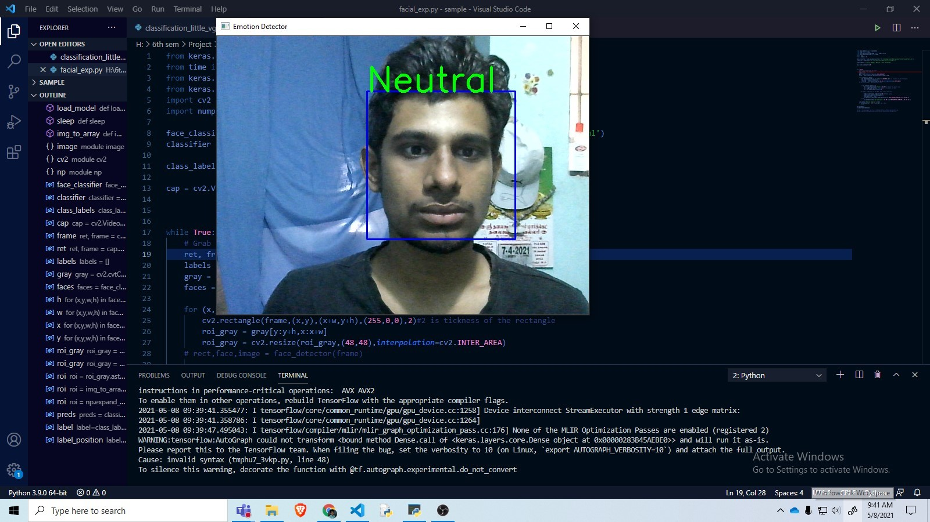

Slide 25
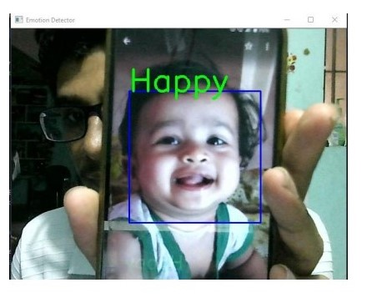
Ouput - 2

Slide 26
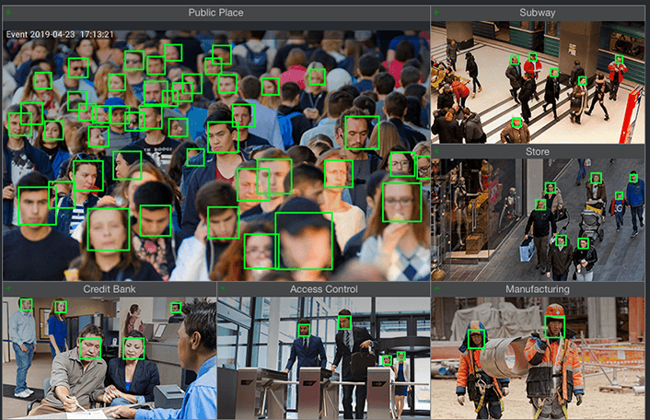
FEATURES ENHANCEMENTS
Emotion detection can be implemented in real life problems
some example:
1.Making cars safer and personalized.
2.Implemented in CCTV camera
3.Market research.

Slide 27
Conclusion
Combination of different genre datasets can improve and generalize emotion detection. We showed multi-task deep neural net models are able to successfully classify emotion. Further, we aim to add genre specific layer to improve results across different genres.

Slide 28
climax...............................

